Slide 1
Spiritual Impressions
Kenneth R. Turner

Slide 2
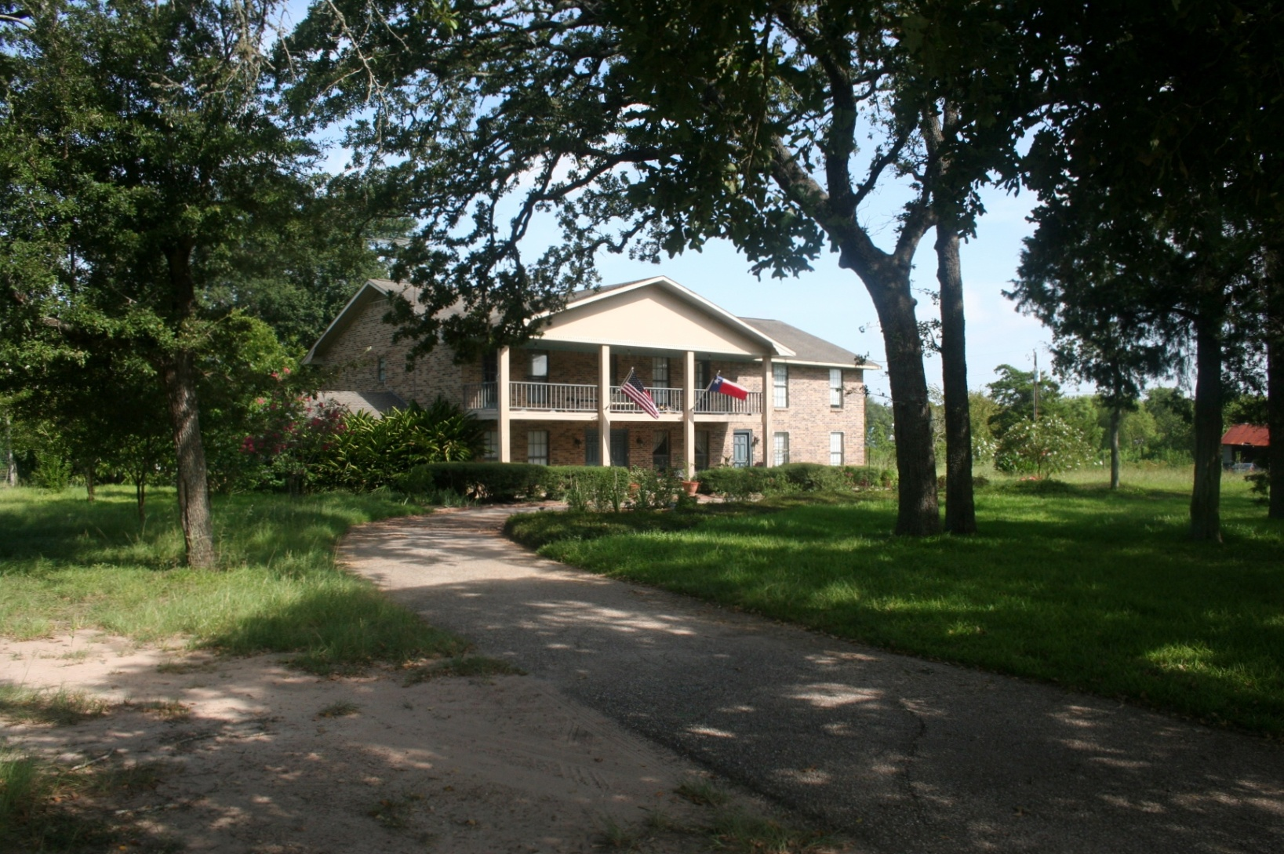
Turner Home and Studio

Slide 3
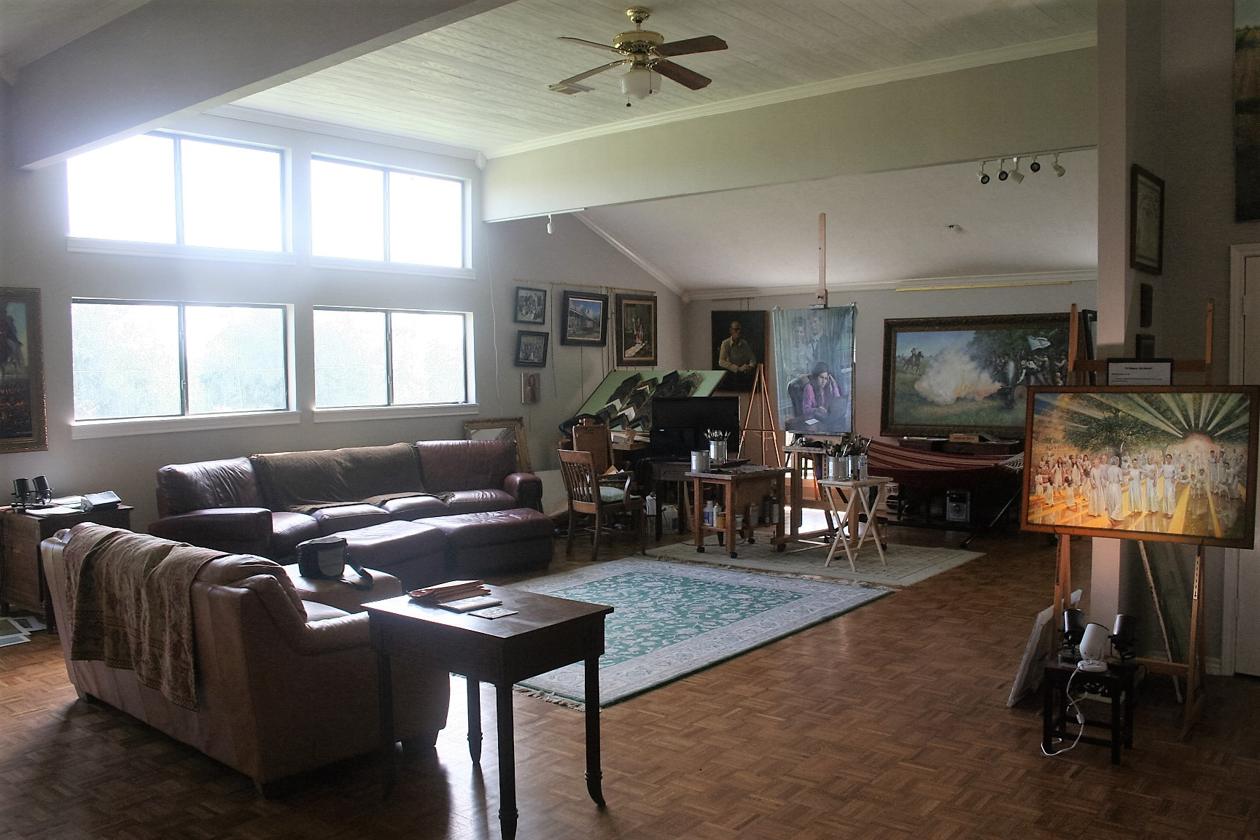
Studio Interior

Slide 4
1.0 USA
1.1 Light of Freedom (Signing US Const.)
1.2` Out of the Ashes (911)
1.3 We The People (Flag)
1,4 Washington HQ
1.5 Liberty Hall
1.6 Viet Nam
1.7 Union de dos Culturas

Slide 5
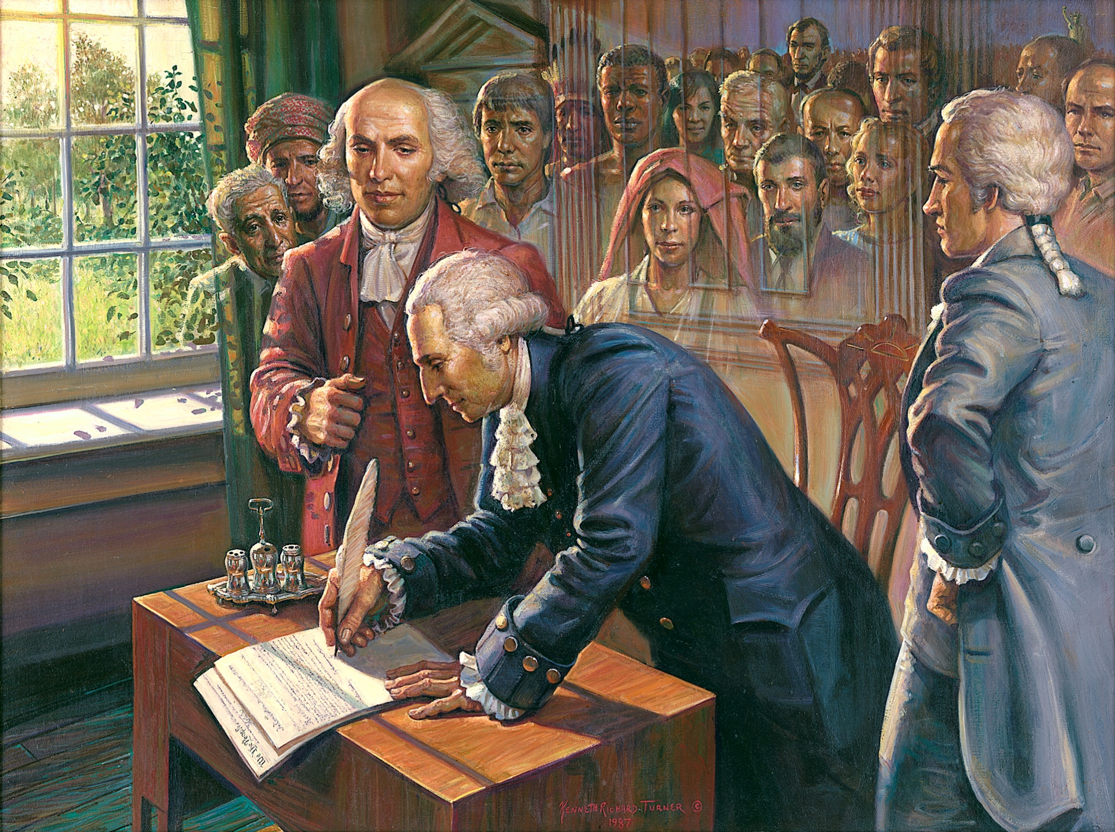

Slide 6
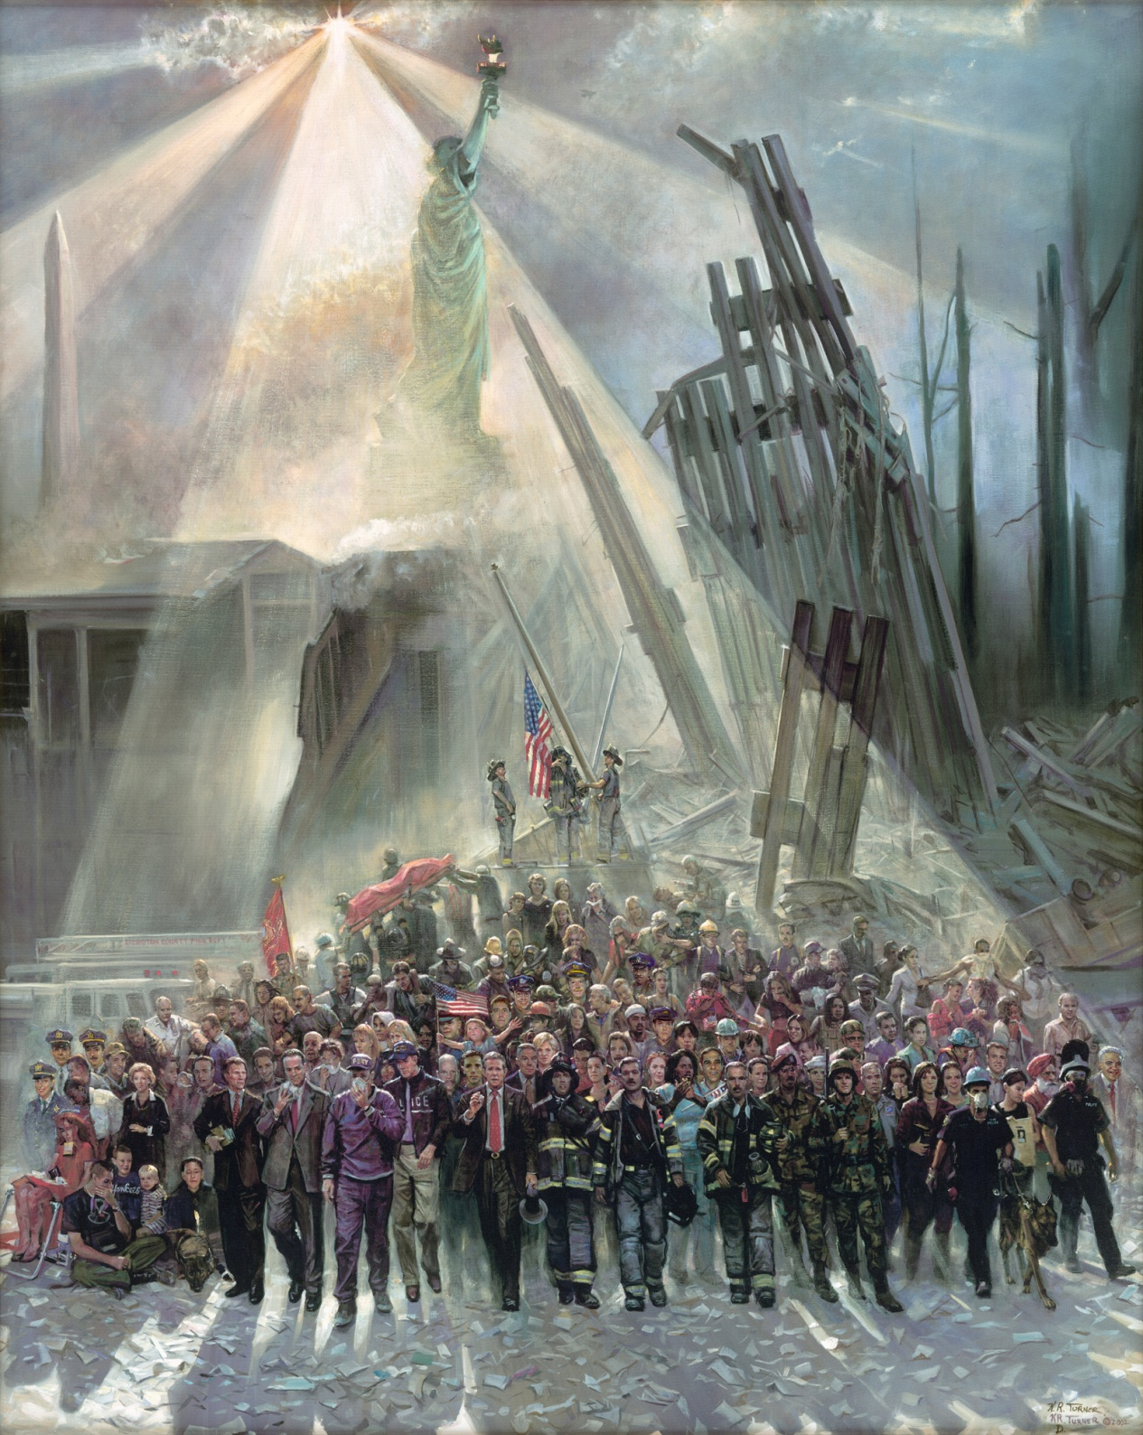

Slide 7
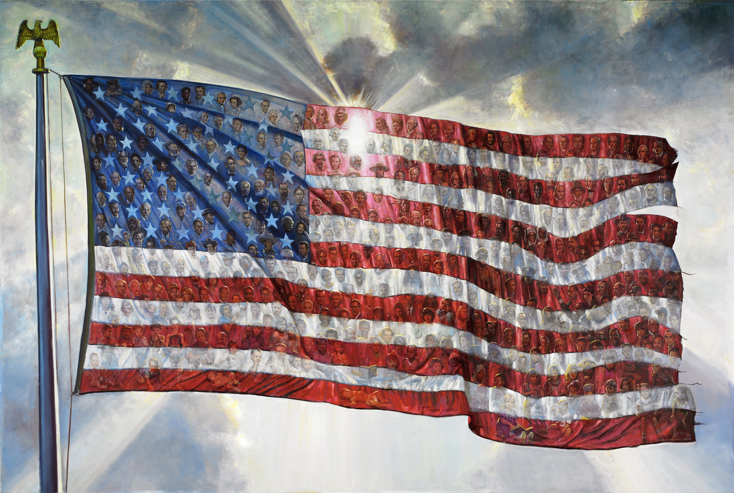

Slide 8
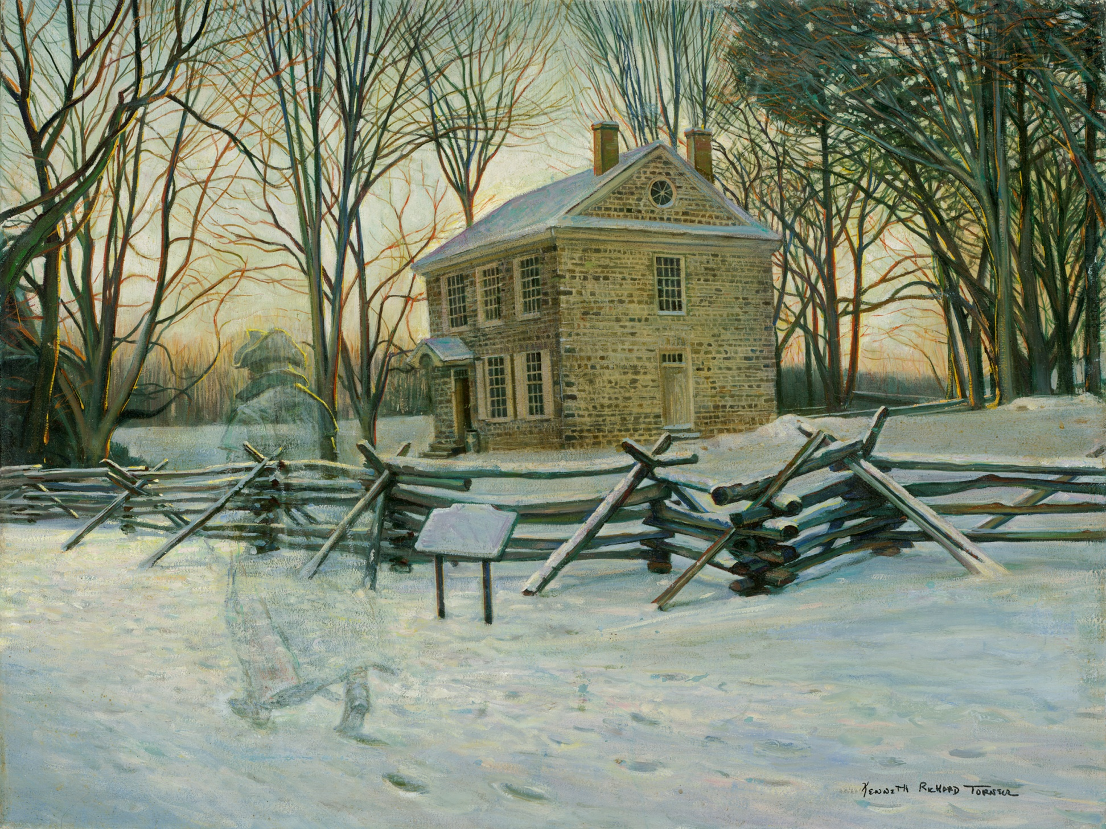

Slide 9
Liberty Hall

Slide 10
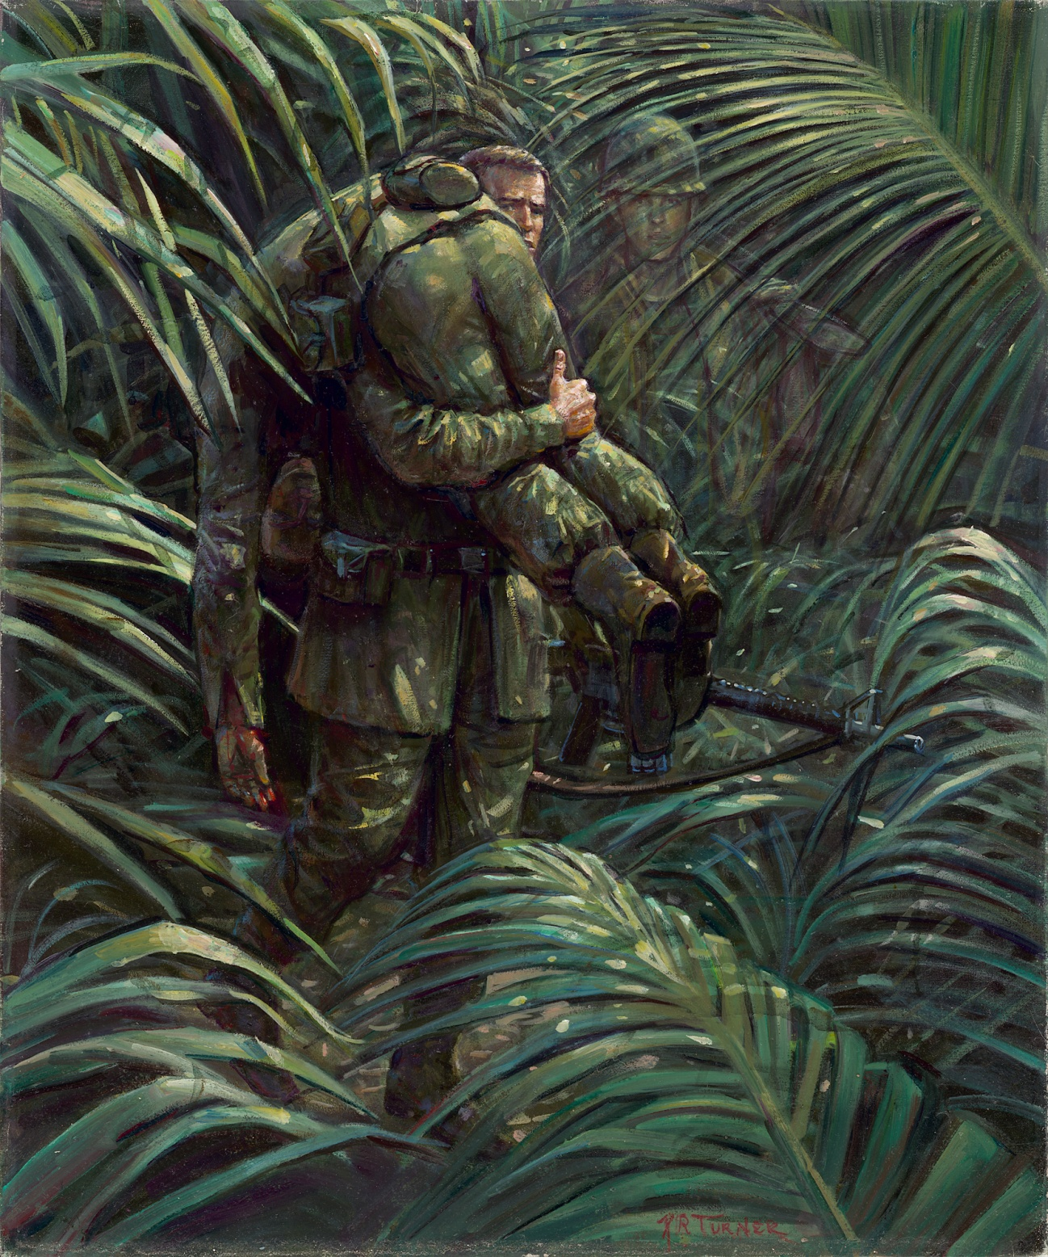
Viet Nam

Slide 11
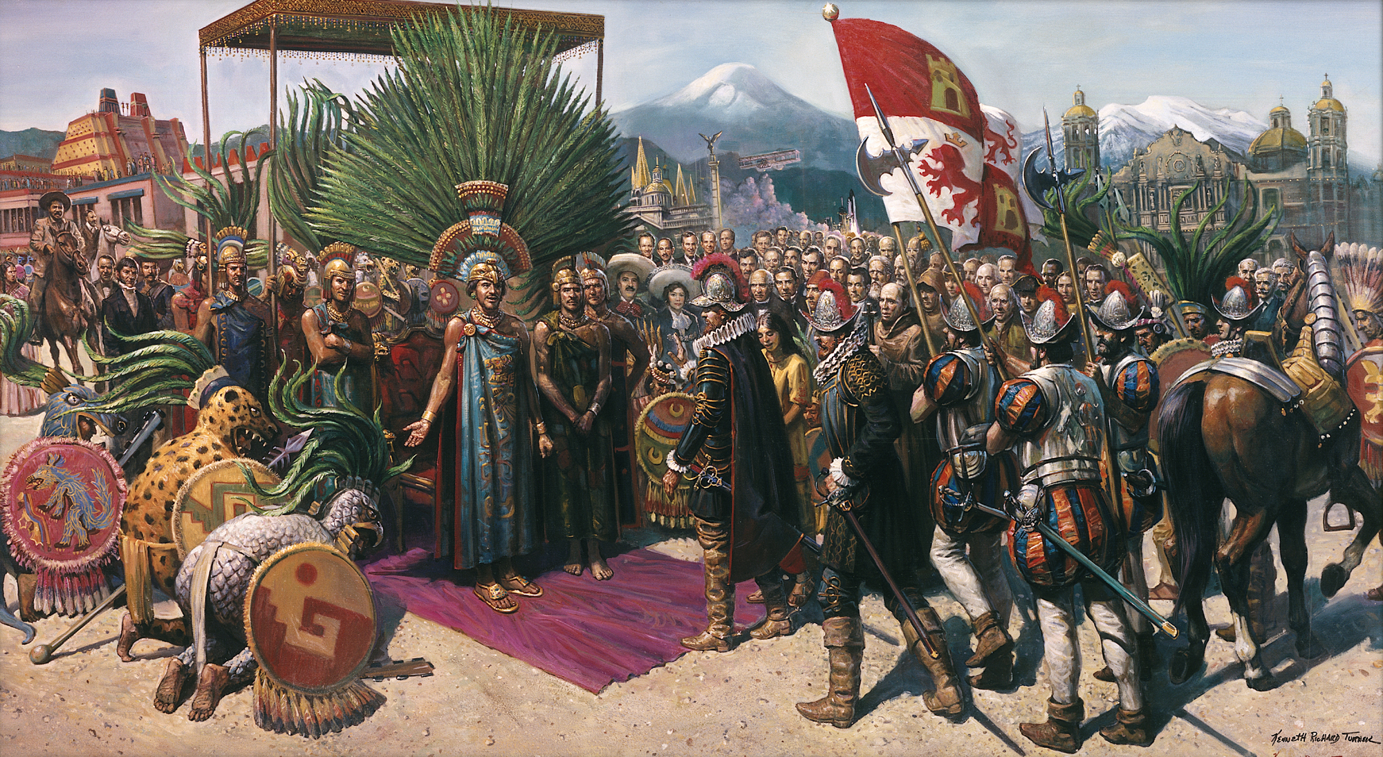
Union de dos Culturas

Slide 12
2.0 Texas
2,1 Come and Take It
2.2 Alamo
2.3 Messenger from the Alamo (Deaf Smith)
2.4 Sam Houston at San Jacinto
2.5 Parade of Texas Legends
2.6 Reflections 1
2.7 The Everett Oak

Slide 13
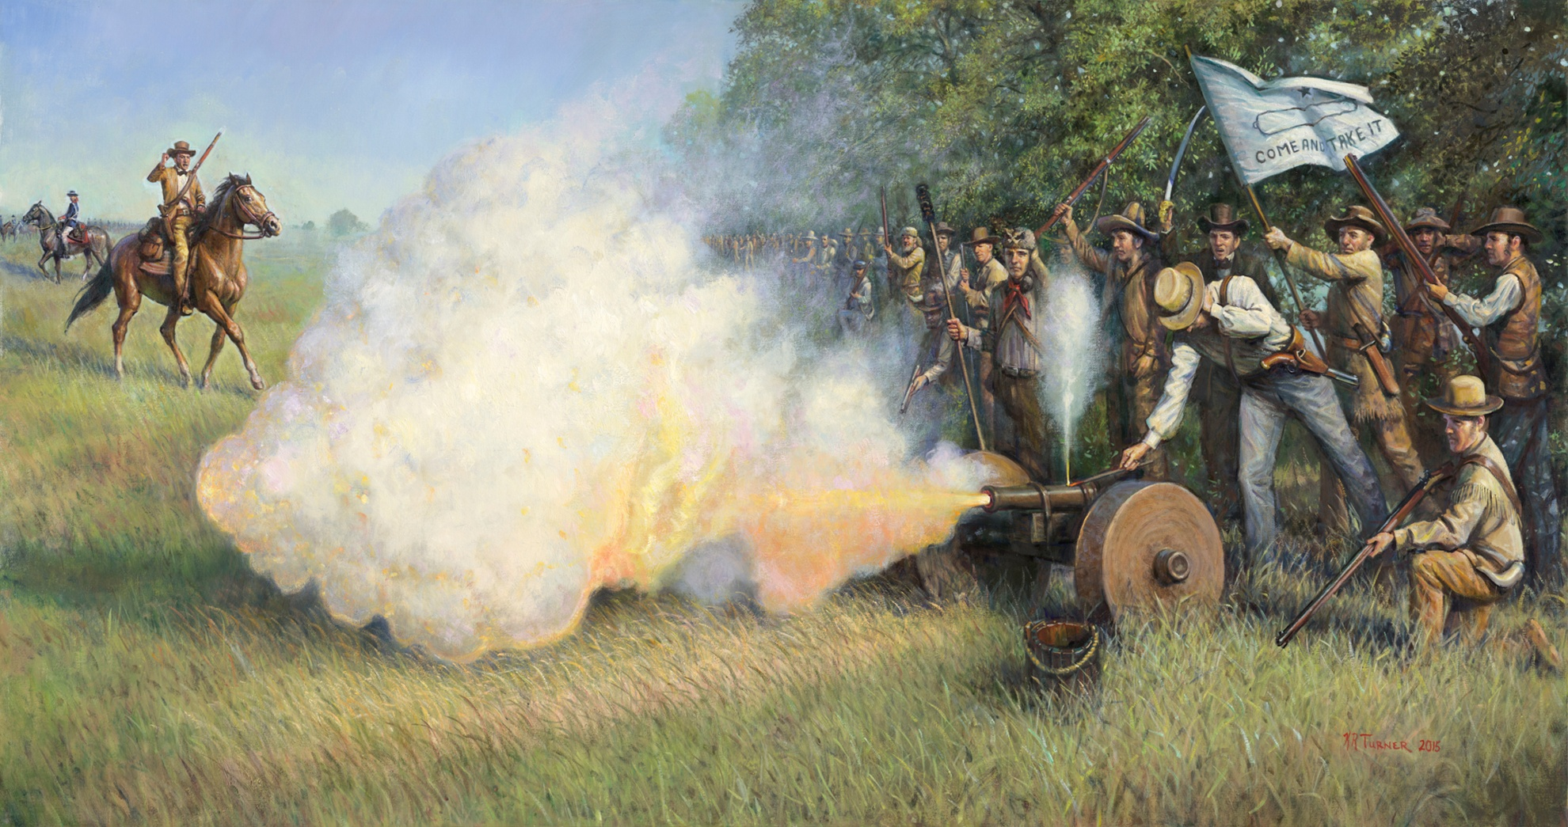
Come and Take It

Slide 14
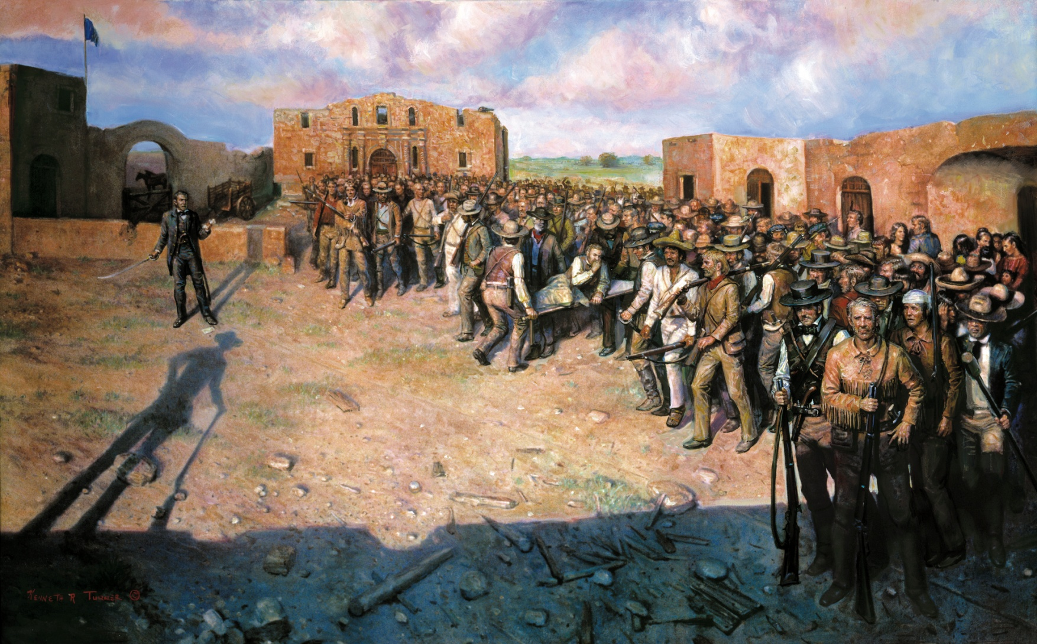
Decision at the Alamo

Slide 15
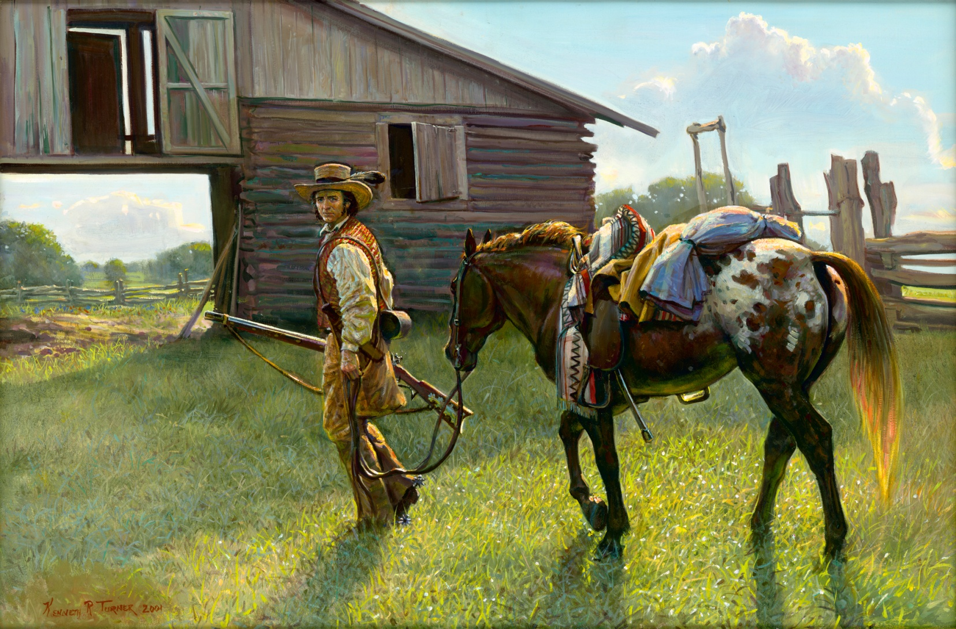
Messenger from the Alamo

Slide 16
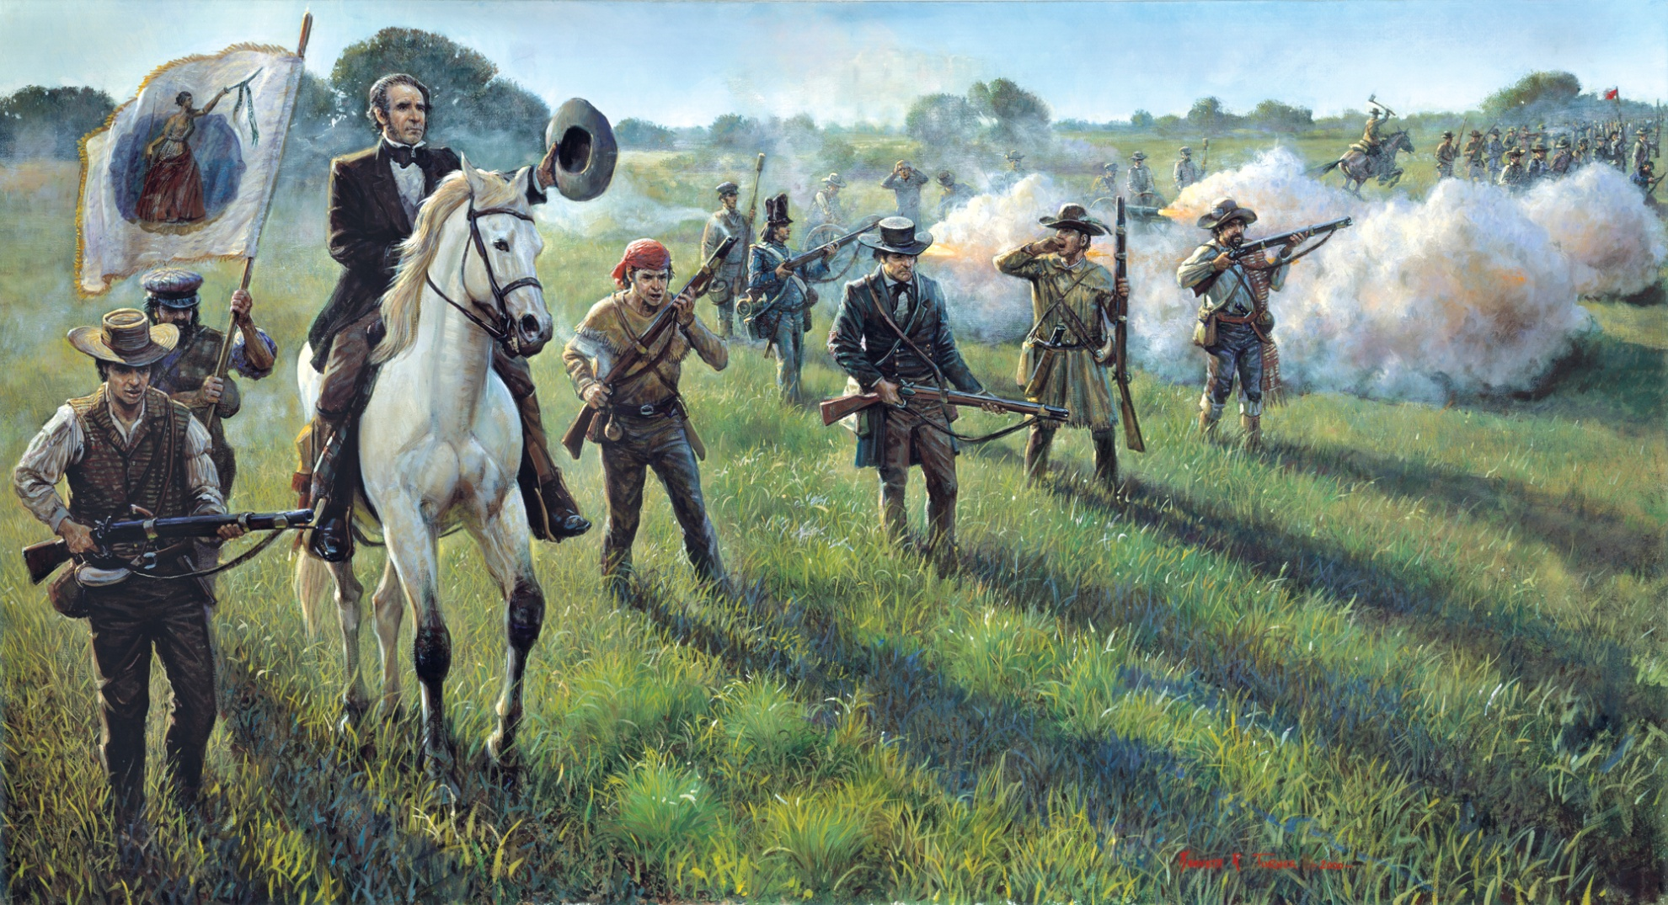
Sam Houston at San Jacinto

Slide 17
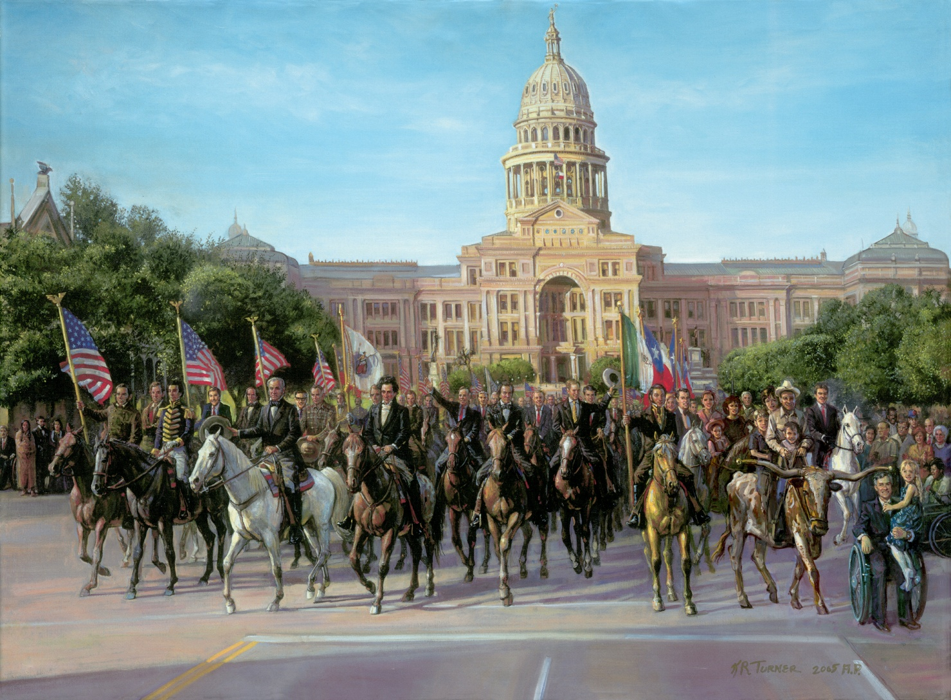
Parade of Texas Legends

Slide 18
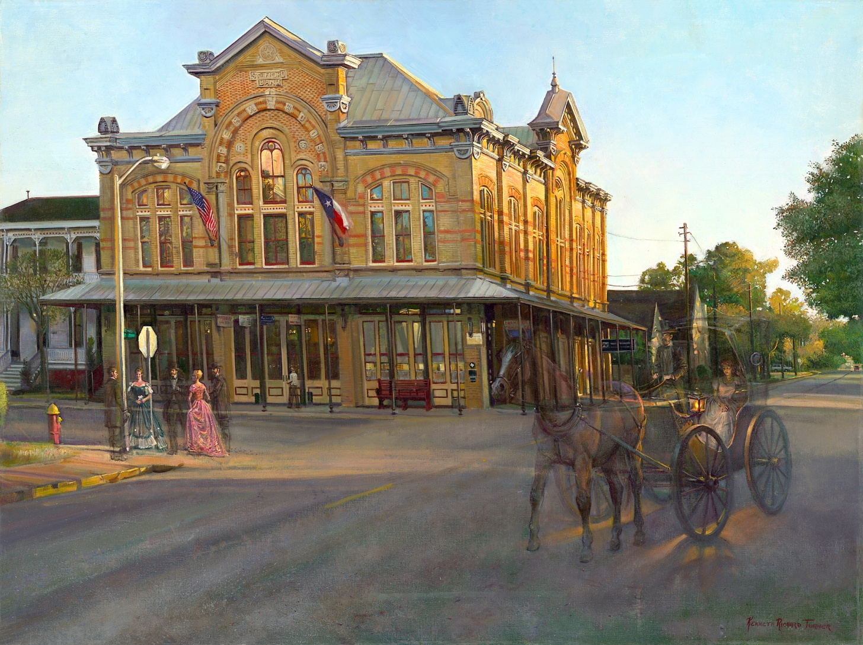
Reflections I

Slide 19
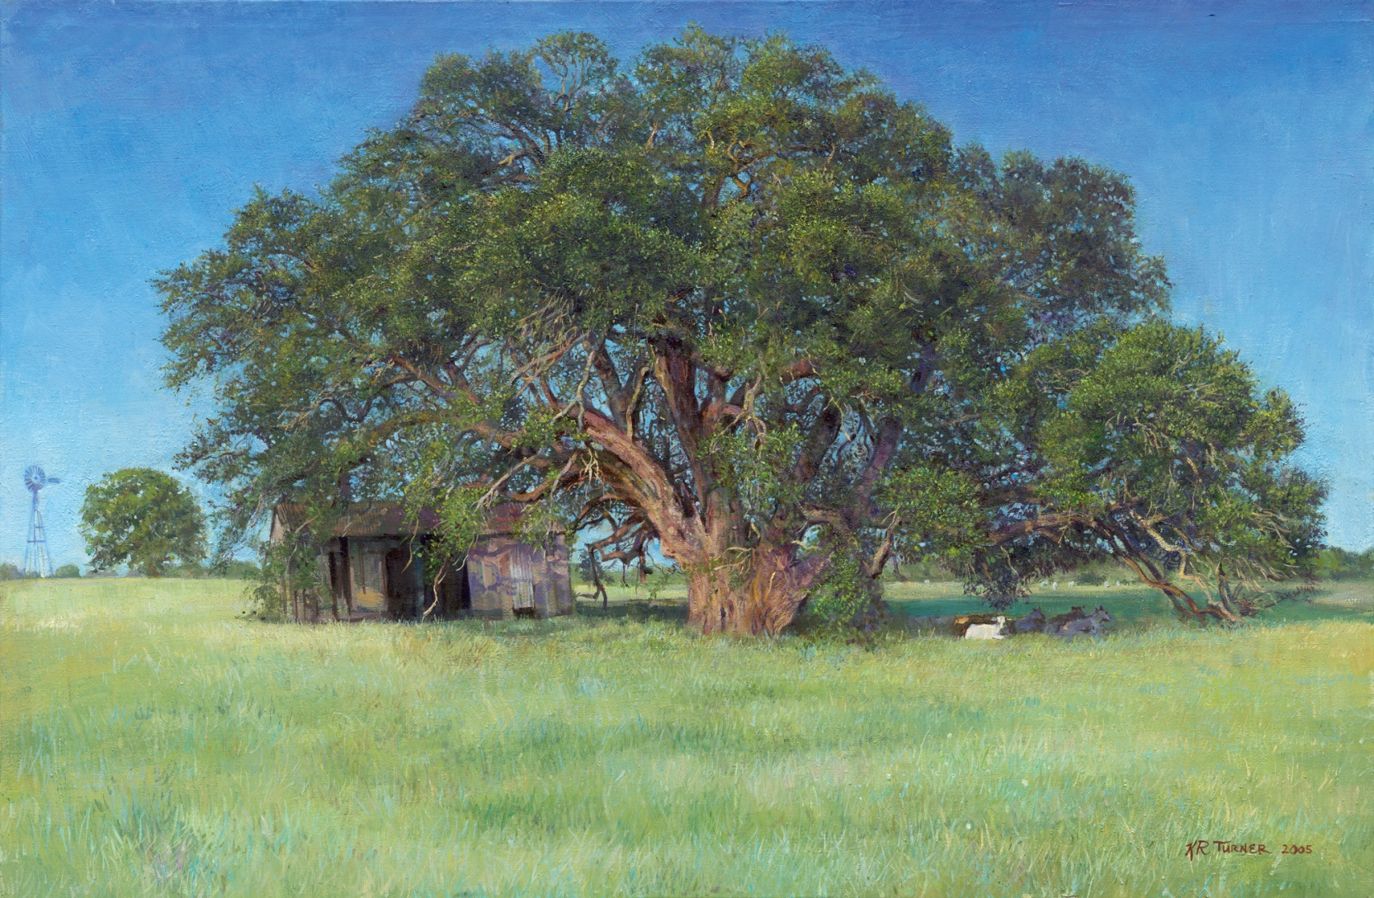
The Everett Oak

Slide 20
3.0 Images of Christ
3.1 Yeshua (Galilee)
3.2 Walking on Water
3.3 The Annointing
3.4 He That is Without Sin
3.5 Christ Washing the Feet of the Apostles
3.6 Garden of Gethsemane
3.7 Surely He Hath Born Our Griefs
3.7` Resurection (the empty tomb)
3.8 Eternal Reunion

Slide 21
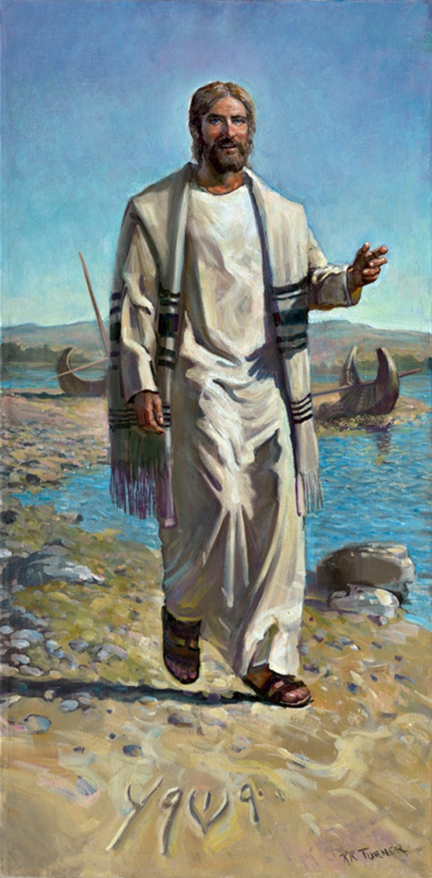
Yeshua on Sea of Galilee

Slide 22
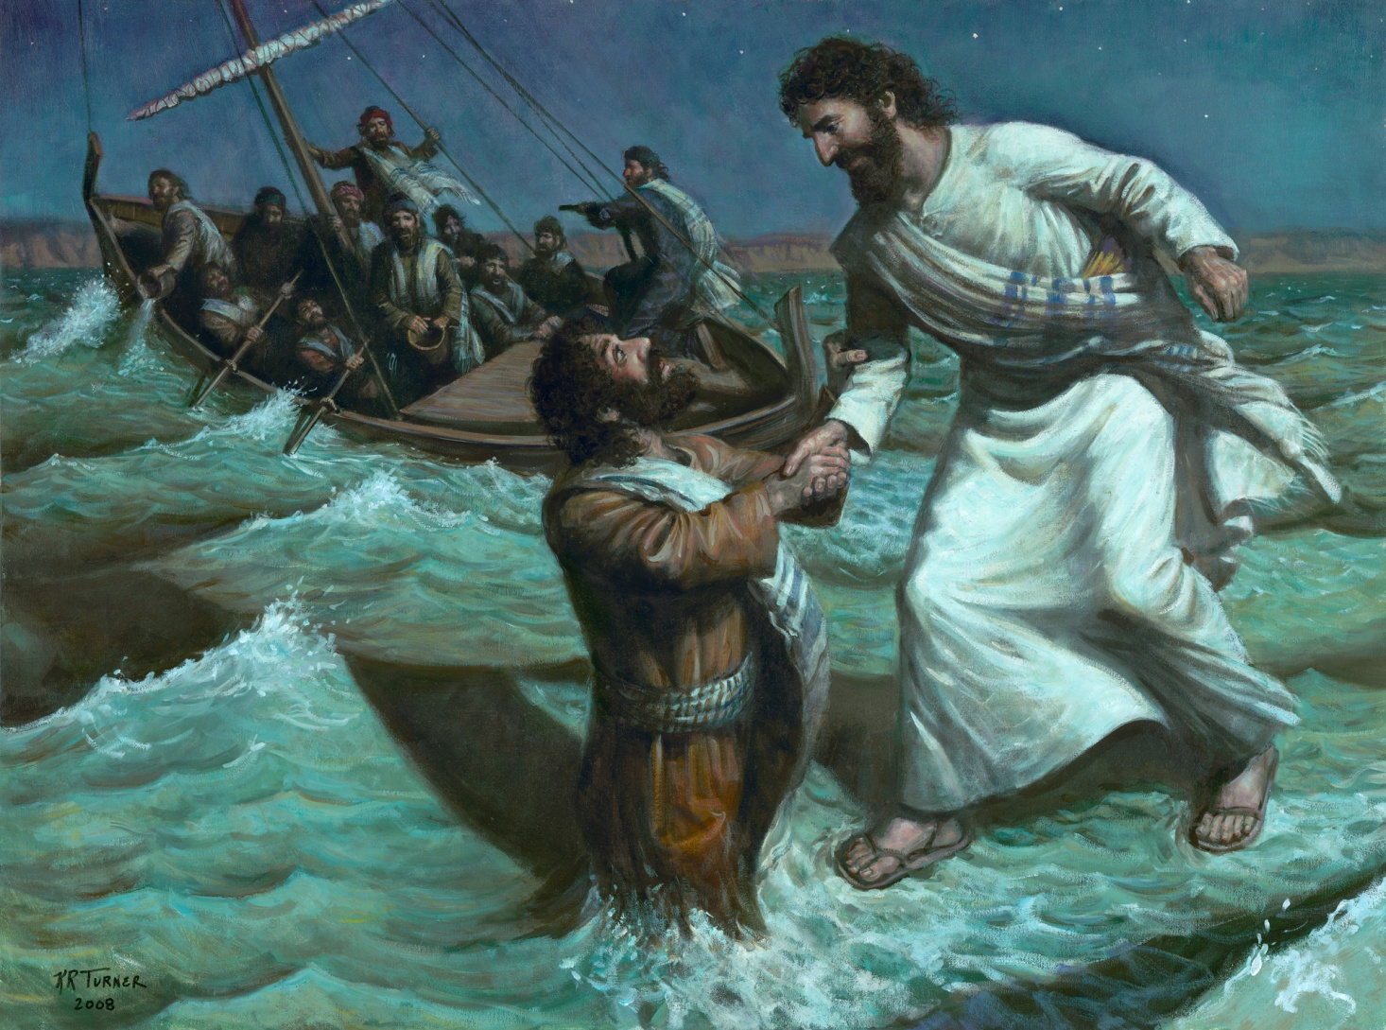
Walking on Water

Slide 23
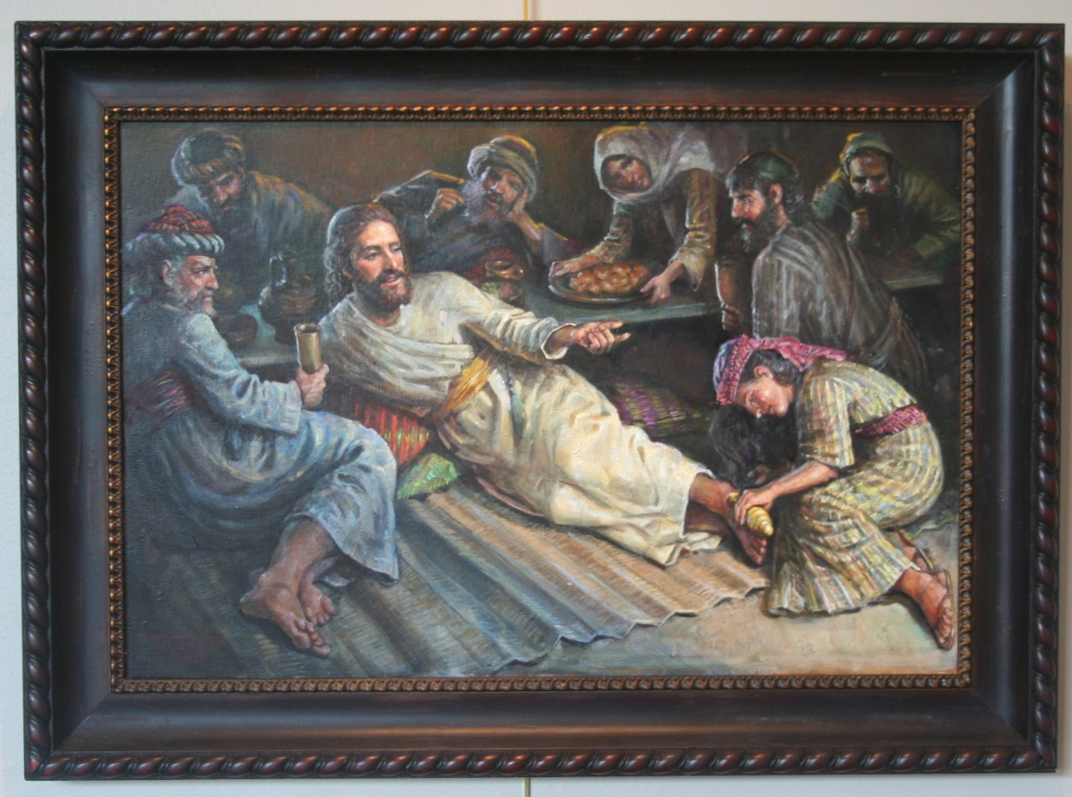
The Annointing

Slide 24
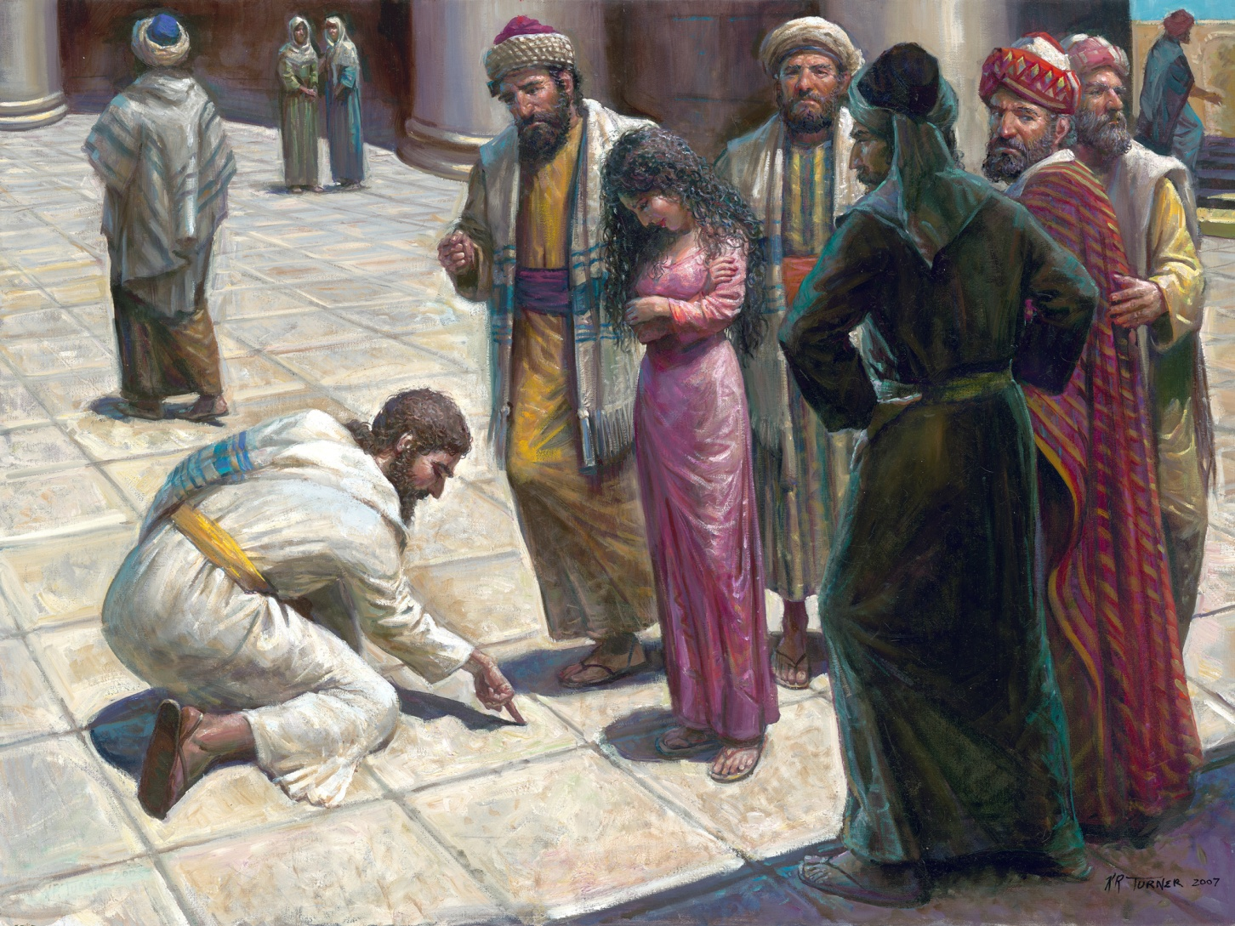
He That is Without Sin

Slide 25
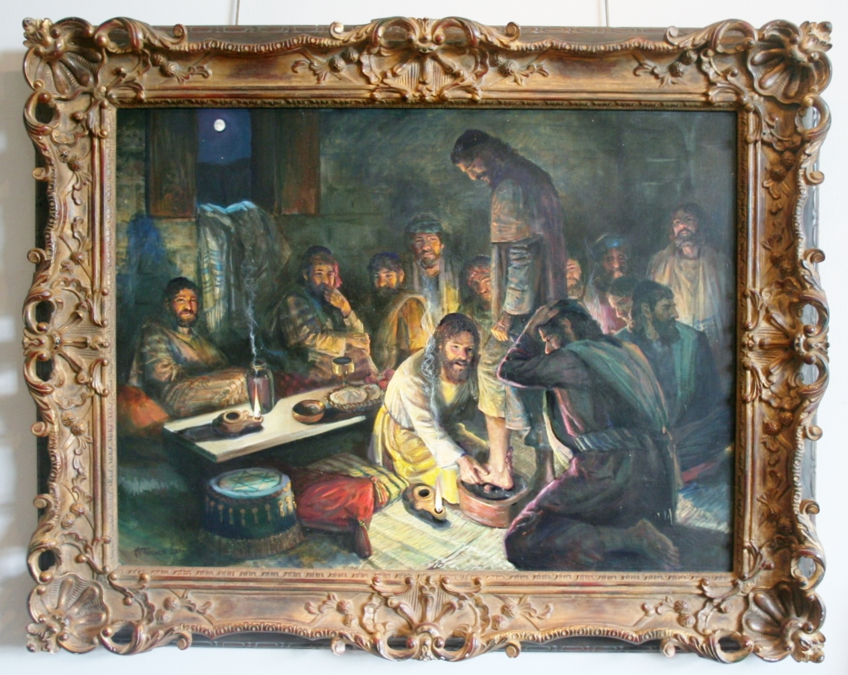
Washing of the Feet

Slide 26
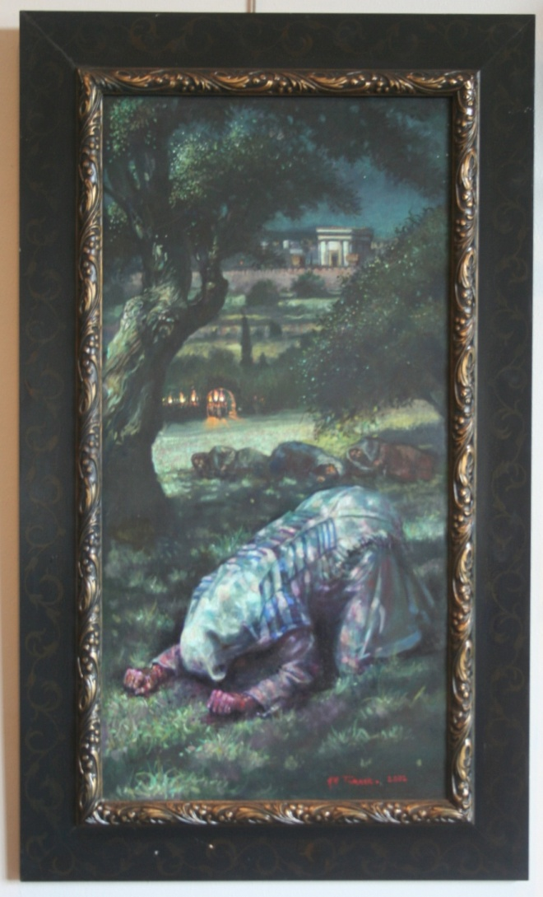
Garden of Gethsemane

Slide 27
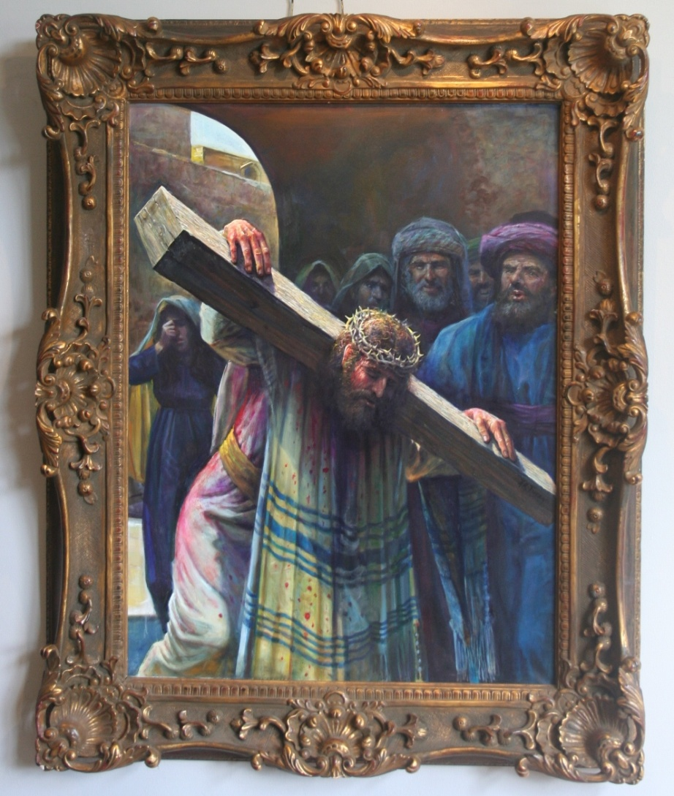
Truly He Hath Born Our Griefs

Slide 28
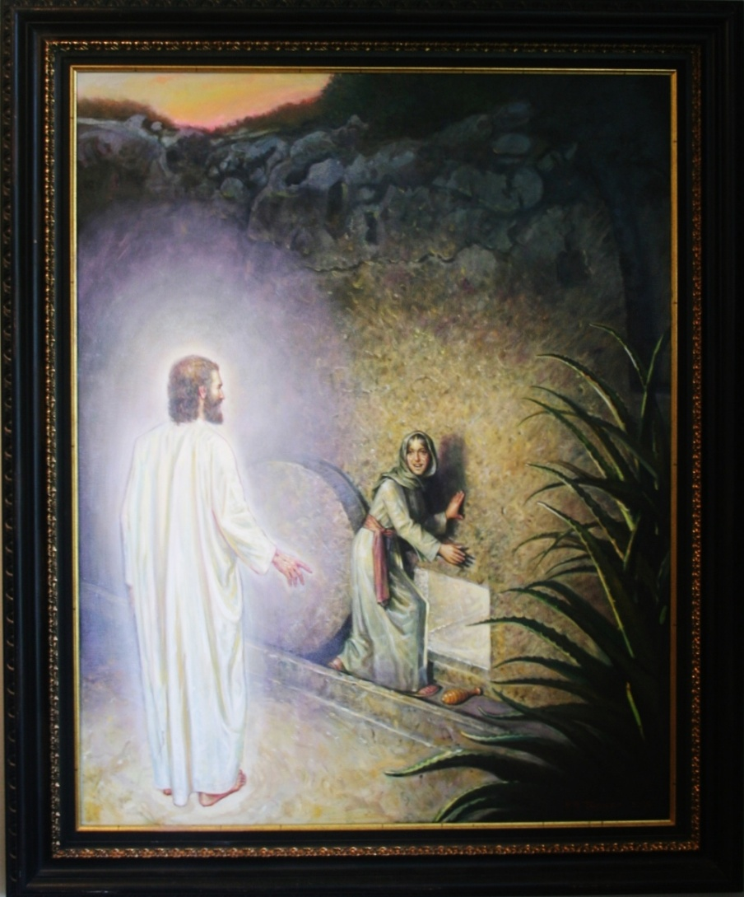
The Empty Tomb

Slide 29
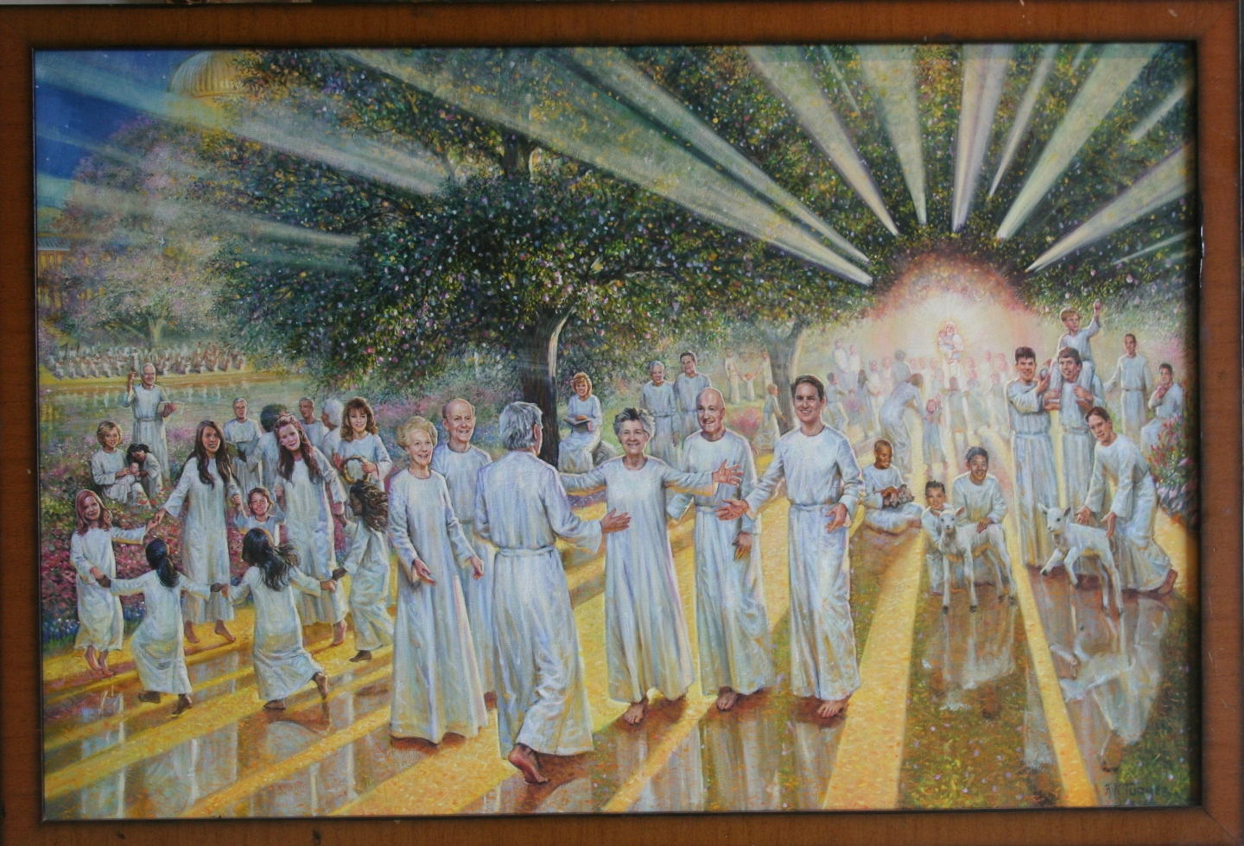
Eternal Reunion

Slide 30
4.0 LDS
4.1 I Will go Before Your Face (duo)
4,2 Mosiah 24
4,3 The Brother of Jared
4.4 Houston Temple
4.5 The Spirit of Elijah

Slide 31
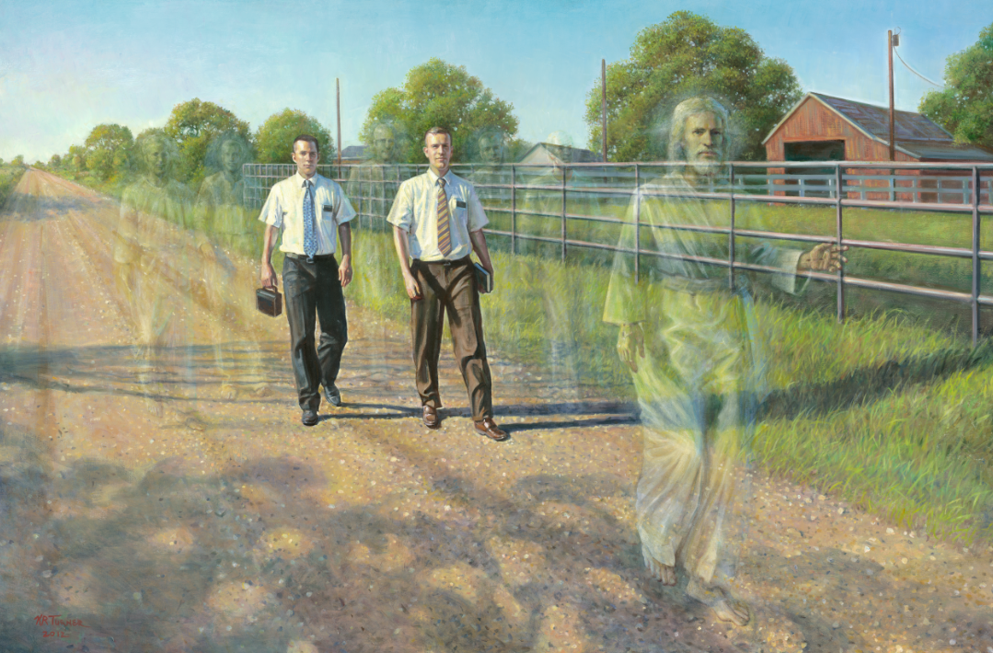
I Will Go Before Your Face

Slide 32
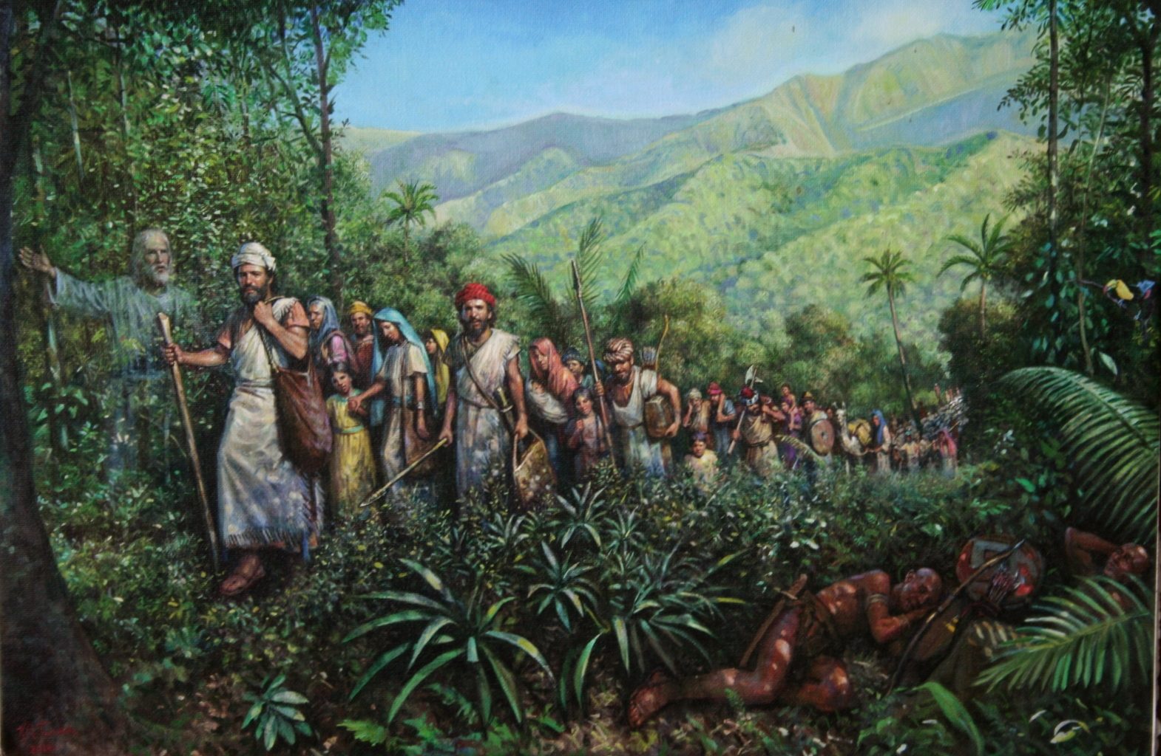
Mosiah 24

Slide 33
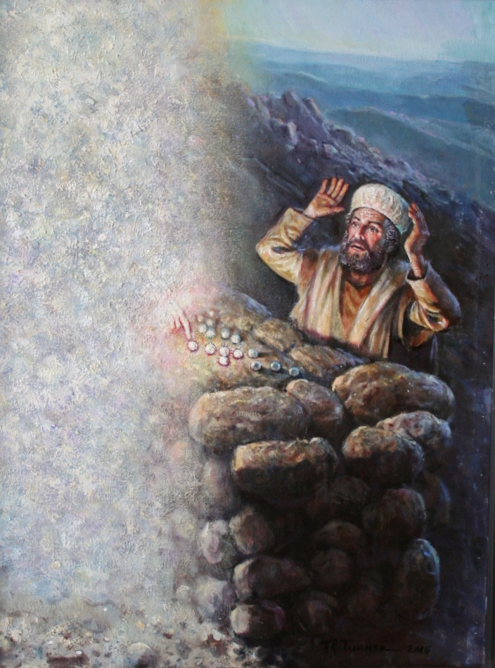
The Brother of Jared

Slide 34
The Houston Temple

Slide 35
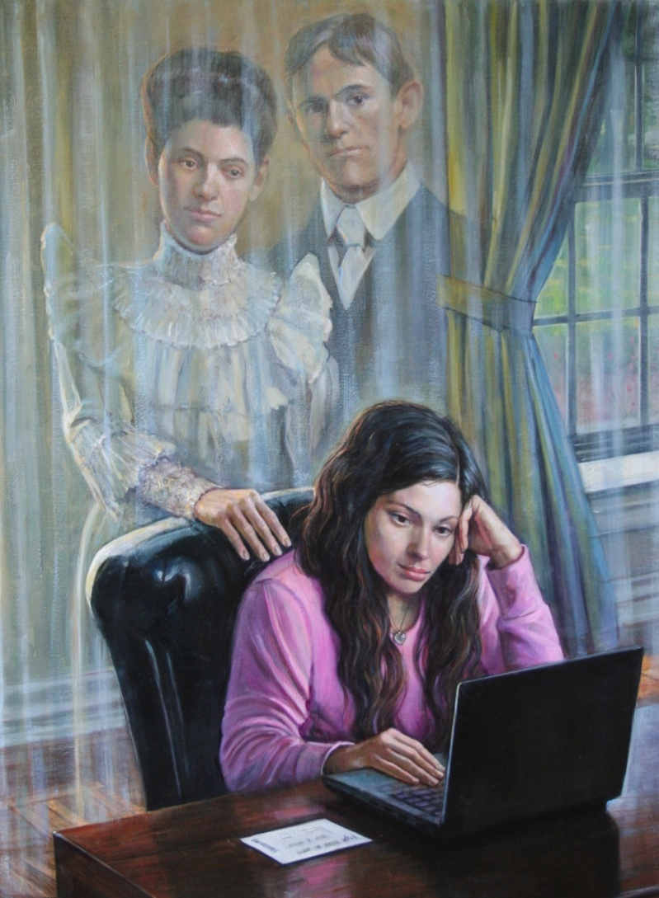
The Spirit of Elijah

Slide 36
5.0 Portraits
5.1 Hilton College Portraits
5.1.1 Chris Nassetta
5,1.2 Dean
5,1,3 Coach
5.2 Y. A. Tittle
5.3 Family Reunioin
5.4 Christ with Children

Slide 37
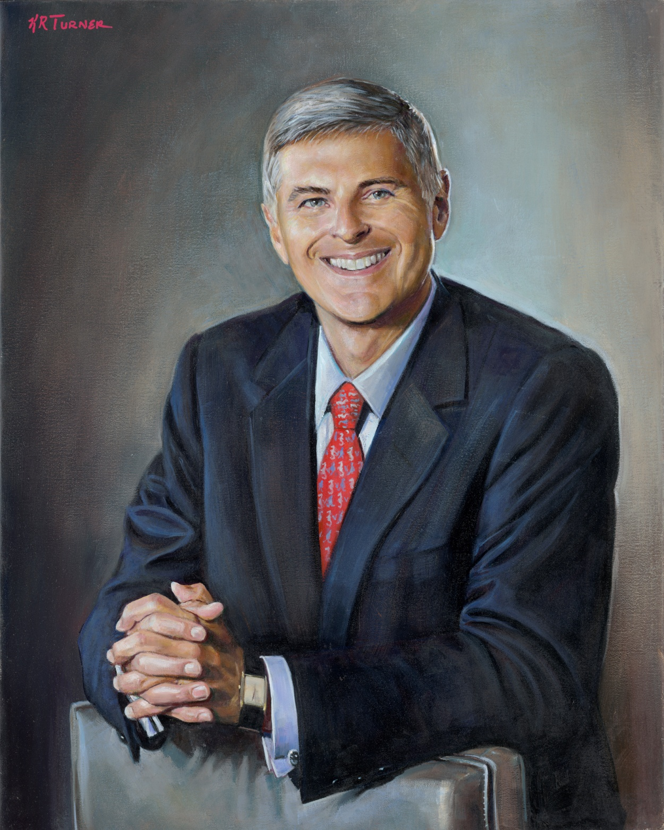
Chris Nassetta
CEO Hilton Worldwide

Slide 38
Dr. Clinton Rappole

Slide 39
Coach

Slide 40
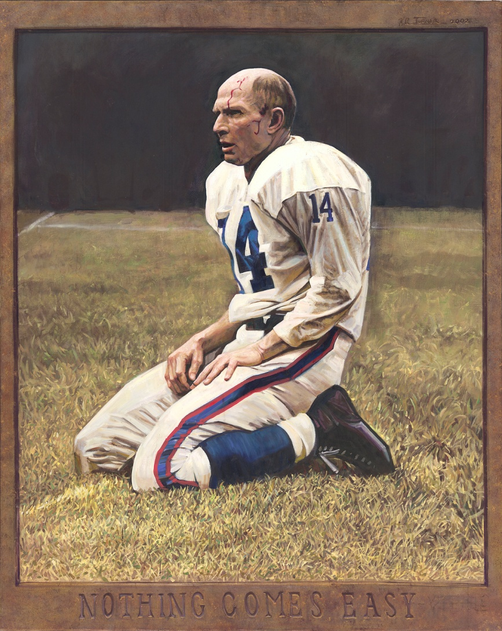
Y. A. Tittle

Slide 41
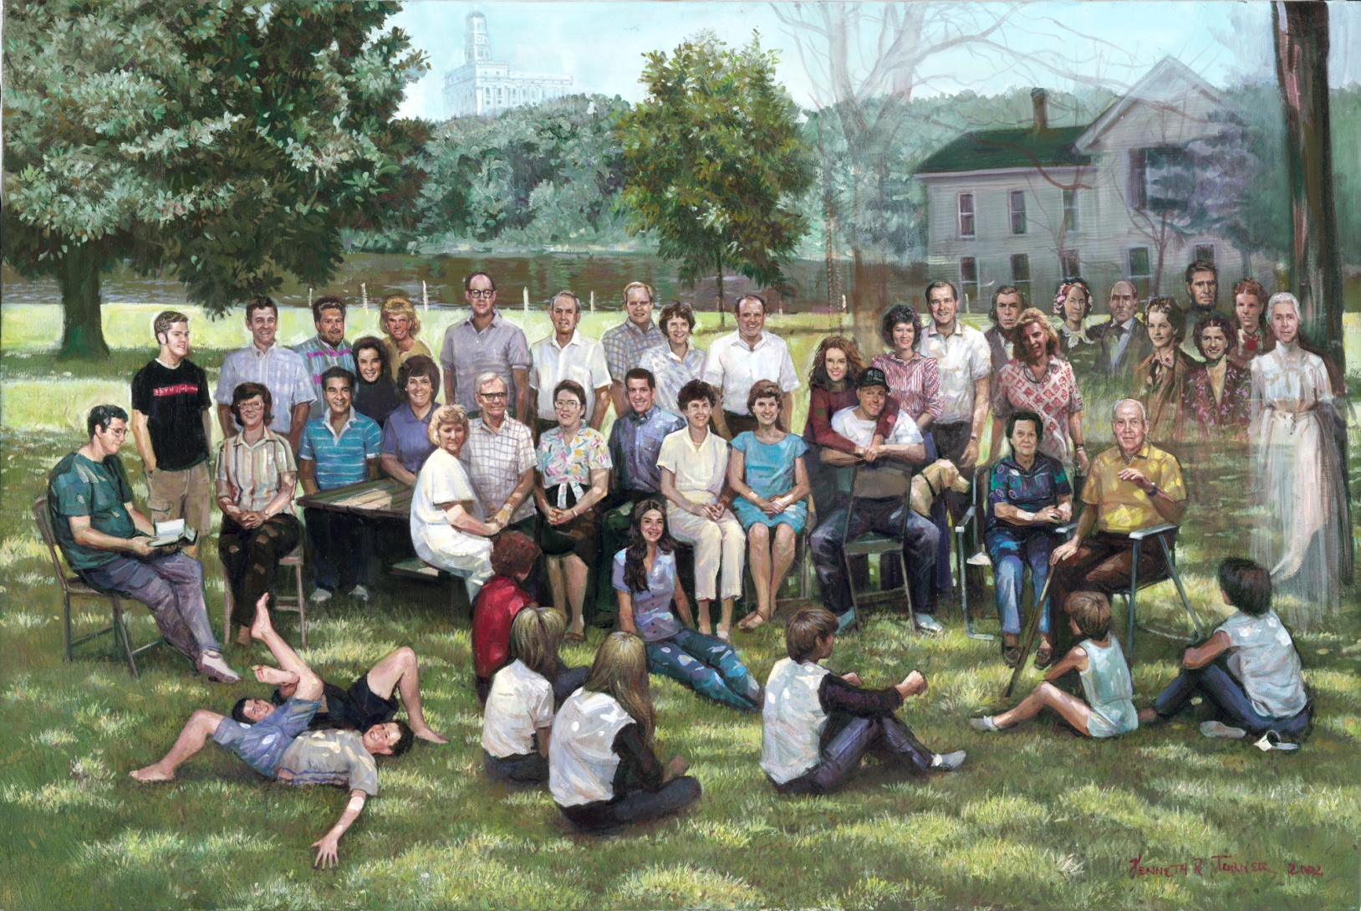
The Family Reunion

Slide 42
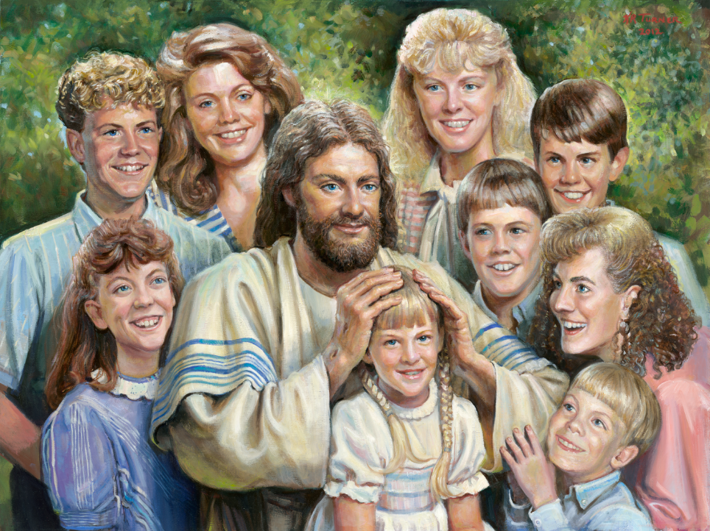
Christ with The Children

Slide 43
Spiritual Impressions
Thank You for Participating
Kenneth R. Turner
Copyright 2016 by Artist
Producer: Austins Productions

