Slide 1
Science Camp #160706.7
06-08 July 2016 @ the Condo, the Nelson Cabin, and surrounding area
Advisors
H. Roice Nelson, Jr., Andrea S. Nelson, Paul F. Nelson,
Benjamin B. Nelson, & Jared Wright
Attendees
Ethan E. Nelson, Grant M. Nelson, Colby C. Wright,
Taylor R. Wright, Ella D. Nelson, Halle N. Wright,
Bobbie Sophia Waldron (pre-visit & via video),
Dallin Spencer Nelson, Rachel Lee, & Ian Lee

Slide 2
Past Science Camp Themes & Sites Visited
Nelson Cabin, Fishing, Condensation, Water Coloring, and Music
Nelson Cabin
Panquitch Lake
Swimming at Cedar City Aquatics Center
Mining Range, Frisco, Silver Reef, Iron Town, Astronomy at Frisco Peak, Archery
Nelson Cabin, Kolob Reservoir, Silver Reef, Snow Canyon, Volcano
Parowan Gap, Rack Range Mines, Frisco, Frisco UU Telescope
Iron Mine, Iron Town
Geocaching, Mammoth Cave, Cascade Falls, and Cedar City Cemetery
Nelson Farm, Fiddler’s Canyon,
Boys to Mammoth Cave, Cascade Falls and Girls to St. George and Pottery Making
Cedar City Cemetery
Volcanoes, Classy Closets, Maps, Surveying, Sand Painting, and Genealogy
Condo, Snow Canyon Volcanoes, Classy Closets, Fiddler’s Canyon
Nelson Farm to survey, Nelson Cabin
Cedar City 24th of July Parade
Patterns, Horse Riding, Internet, Be-a-man-campout
Dust Devil Ranch, InfoWest, Fiddler’s Canyon
Nelson Cabin
Cedar City July 4th Parade
Music & Spoken Word, SilencerCo, Indian Tribes & Archaeology, Solar Astronomy
Family Discovery Center, Sophie & Dallin’s Baptism, SilencerCo, Music & Spoken Word, UU Science Museum
Freemont Indian Museum, Boulder Anasazi Ruins, Escalante Petrified Forest, Bryce Canyon
Parowan Gap, Solar Astronomy, Nelson Cabin, Uncle Des’ & Aunt Sara’s, Swimming
Rock Cutting, SUU Museum, Computer Hardware and Software, Cabin

Slide 3
Safety
Never go anyplace alone.
Exception is if one of you is hurt, then:
One of you stay and help the person hurt.
The other one run and get help.
If you get lost stay put, we will find you.
If you hear a rattlesnake do not move quickly, just slowly move away from the sound.
Do not run with a knife open. Use knife safety.
If you cut yourself, apply pressure to the wound to stop bleeding, and send for help.
Never point an arrow in a cocked bow or a gun at any person.
Drink lots and lots and lots of water.
Do not go swimming unless an adult is with you.
Do not start branches on fire and swing them around where others can be hurt.
Have fun, use common sense, and think before you act.

Slide 4
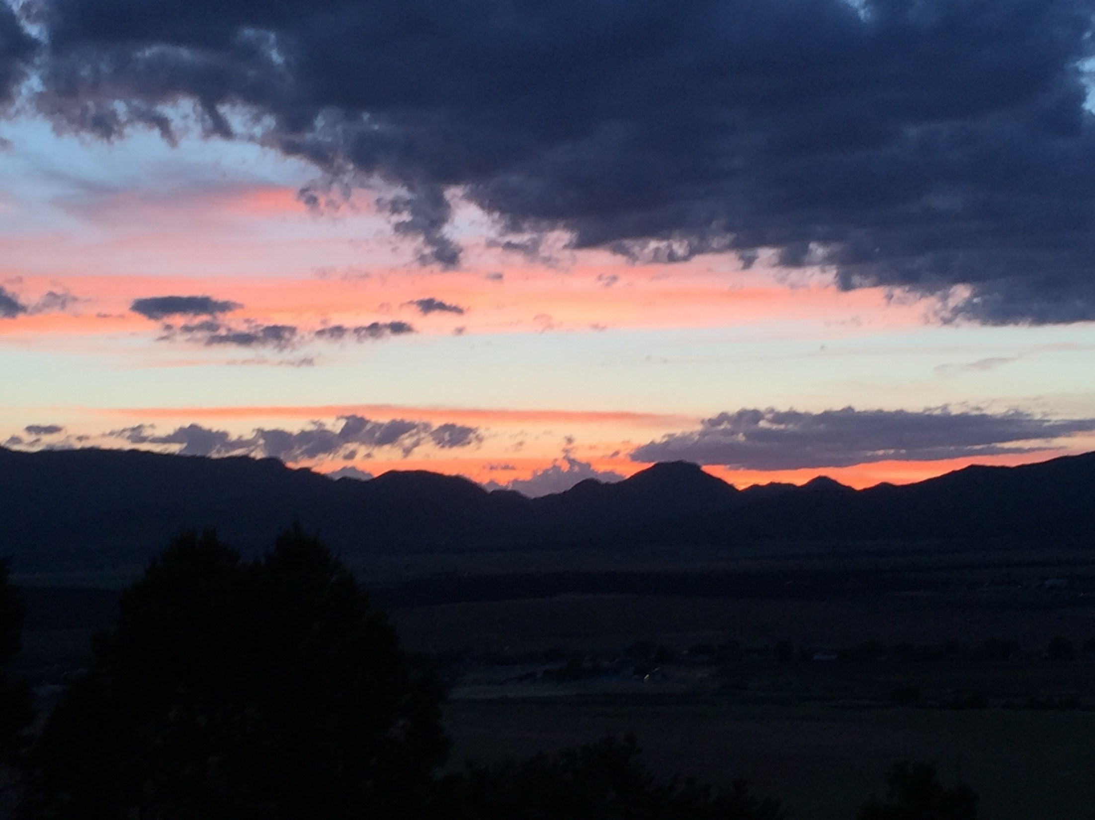
Hardware and Software

Slide 5
Schedule Friday - Saturday
Friday, 01 July 2016:
Nelson Reunion at Frontier Homestead Museum.
Grandpa and cousins singing “My Farm” with words written by his Grandma Nelson.
Saturday, 02 July 2016:
Nelson Reunion breakfast through lunch with lamb-burgers.
Paul, Grant ,Ella, and Dallin Nelson and Sophie Waldron arrive. Possible astronomy activity.
Sunday, 03 July 2016:
Church, Inter-Faith Fourth of July Concert.
Monday, 04 July 2016:
Fourth of July breakfast and parade, Sophie to London via Salt Lake. Paul’s Family in Cedar
Tuesday, 05 July 2016
Hikes
Grandpa and Grandma Family History Center.
Jared, Melanie, Colby, Taylor, Halle, Avalyn, & Kendall Wright and Ben & Ethan Nelson arrive.
Wednesday, 06 July 2016:
Fun Run/Walk, Rock Hunting at Bloody Ridge, SUU, Rock Cutting, Presentations, Cabin.
Thursday, 07 July 2016:
Hardware, Software, Firmware, Media, Lego Robots, Races, Campfire Singing, Astronomy
Friday, 08 July 2016:
Programming, Revisit Favorite Site, Marshmallow Guns, Water Rockets, Swimming.
Saturday, 09 July 2016:
Carriage Rides and breakfast at Iron Springs, everyone but Grandpa & Grandma leaves.

Slide 6
Notes

Slide 7
Job Chart
 | Tuesday | Wednesday | Thursday | Friday | Saturday
Ethan Nelson | Arrive | Presentation Breakfast Setup | Lunch Setup | Clean Cabin Dinner Setup | Leave
Grant Nelson | Fishing | Presentation Dinner Setup | Lunch Cleanup | Breakfast Setup Clean Cabin | Fishing
Colby Wright | Arrive Dinner Setup | Presentation Breakfast Cleanup | Dinner Setup | Lunch Cleanup Clean Cabin | Breakfast Setup
Taylor Wright | Arrive Dinner Cleanup | Presentation Breakfast Cleanup | Dinner Cleanup | Lunch Cleanup Clean Cabin | Breakfast Cleanup
Ella Nelson | Last Minute Shopping | Presentation Dinner Cleanup | Breakfast Cleanup | Lunch Cleanup Clean Cabin | Breakfast Setup
Halle Wright | Arrive Dinner Cleanup | Presentation Lunch Setup | Dinner Cleanup | Breakfast Setup Clean Cabin | Breakfast Cleanup
Dallin Nelson | Review Grandpa’s Rocks | Presentation Dinner Cleanup | Lunch Cleanup | Breakfast Setup Clean Cabin | Breakfast Setup
Rachel Lee | Arrive | Presentation Lunch Cleanup | Breakfast Setup | Clean Cabin Dinner Cleanup | Breakfast Cleanup
Ian Lee | Arrive | Presentation Lunch Cleanup | Breakfast Cleanup | Clean Cabin Dinner Cleanup | Breakfast Cleanup

Slide 8
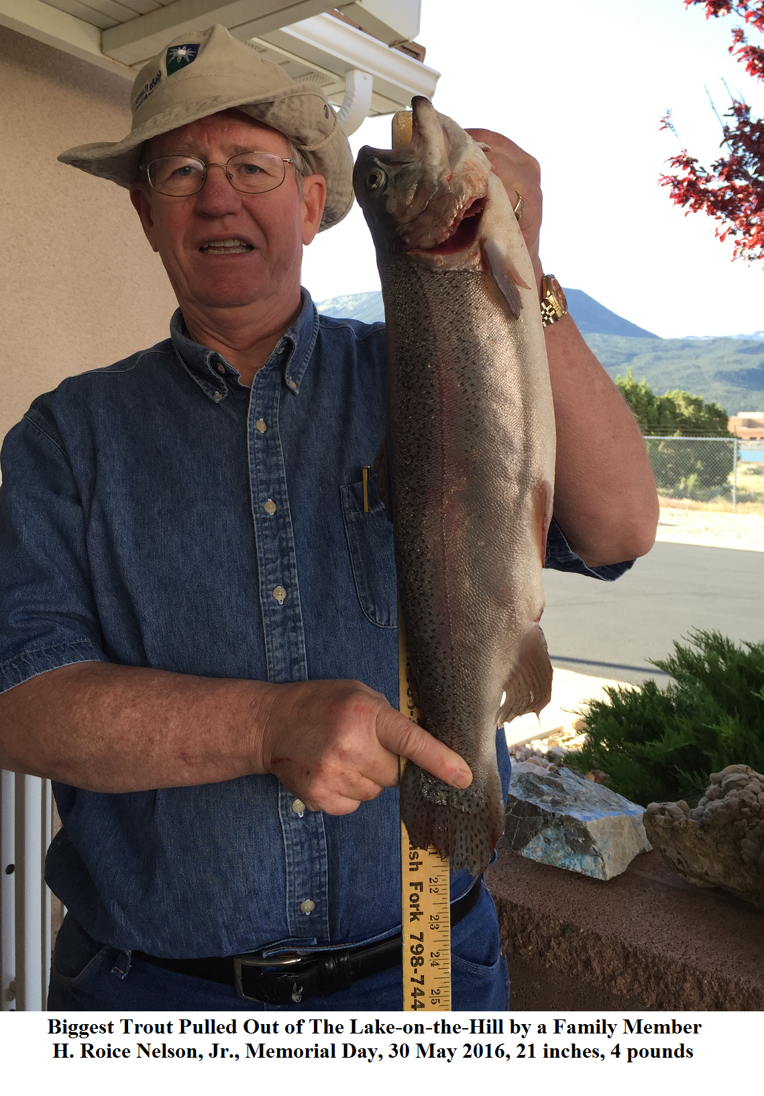
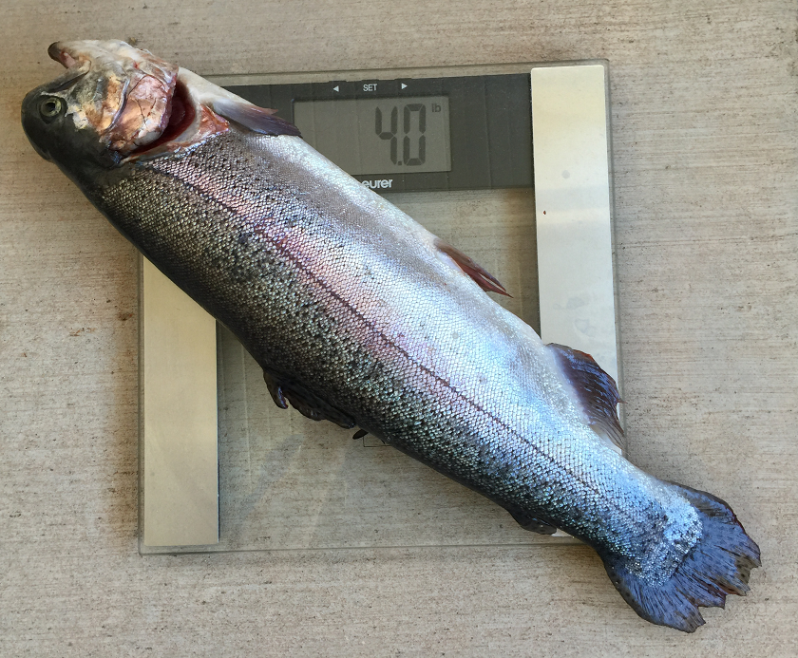
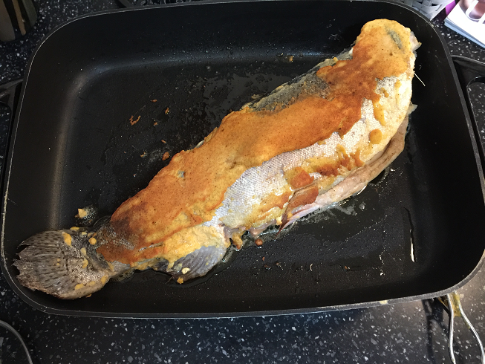
Championship Fish

Slide 9
Day 1: Wednesday, 06 July 2016
Fun Run/Walk
Rock Hunting at Bloody Ridge
Southern Utah University
Lunch with Aunt Sara & Uncle Des
Rock Cutting
Presentations
Cabin

Slide 10
Fun Run / Walk Certificate

Slide 11
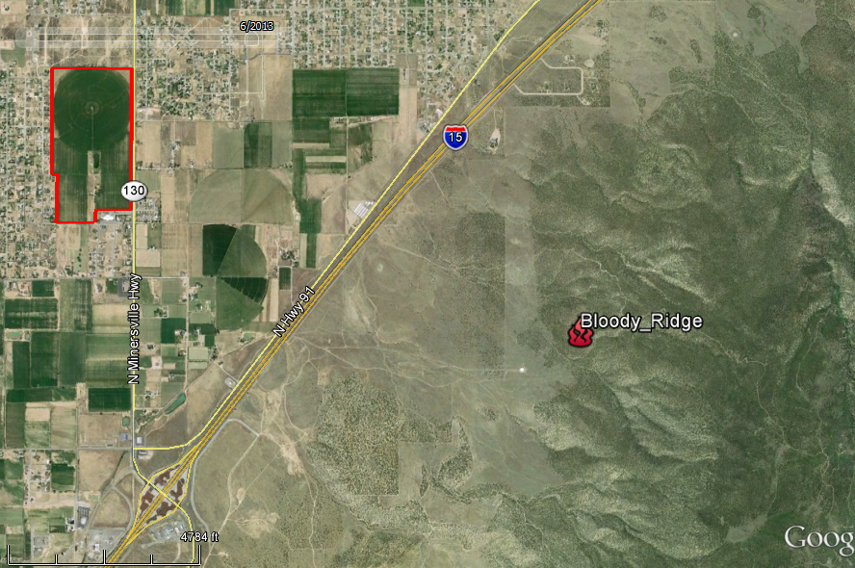
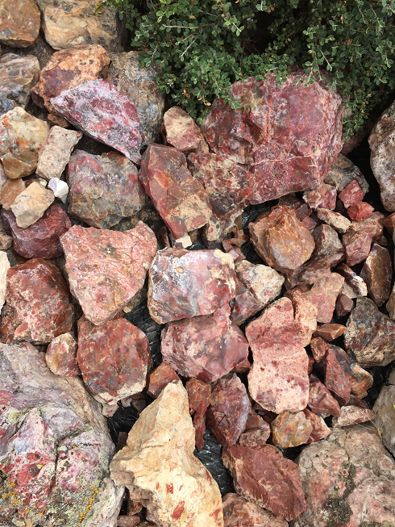
2. Bloody Ridge Agate Hunting
Nelson
Farm

Slide 12
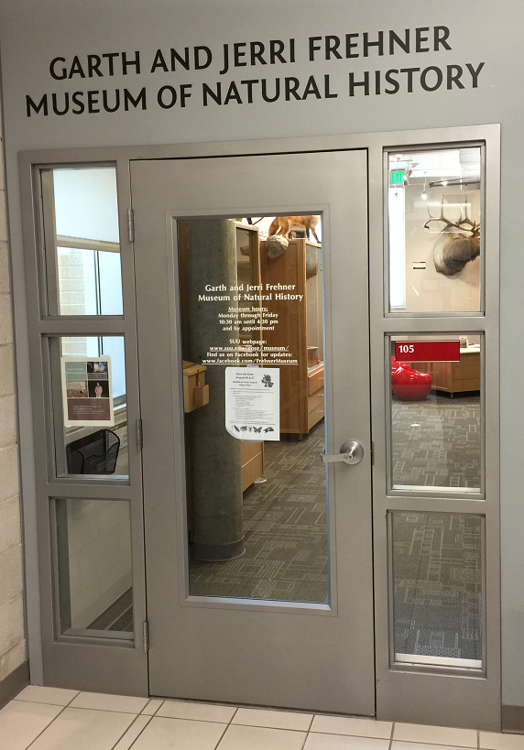
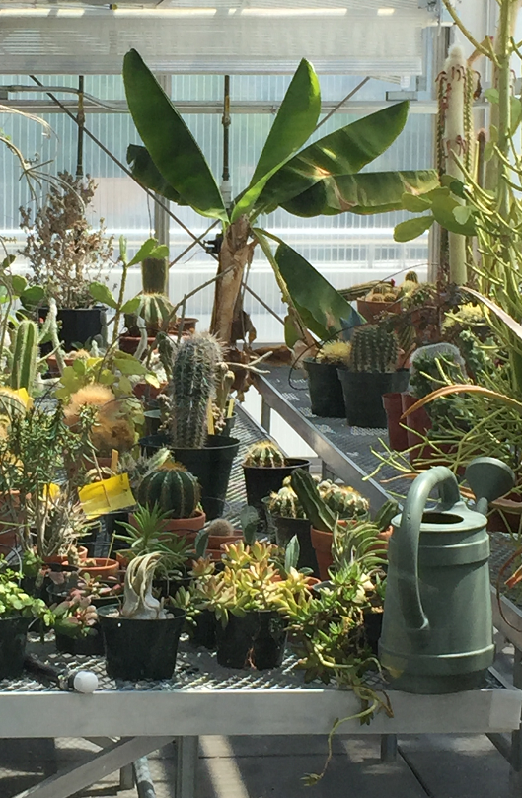
3b. SUU Greenhouses
3a. SUU
Museum

Slide 13
Notes

Slide 14
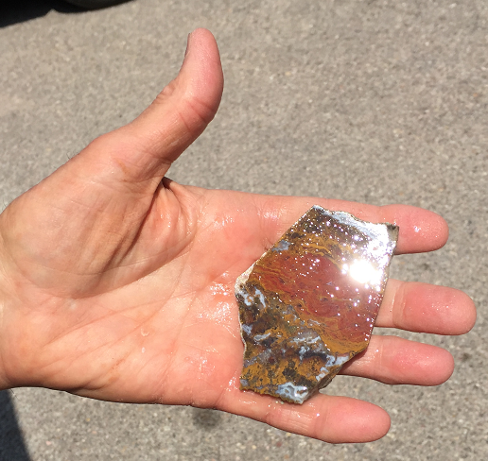
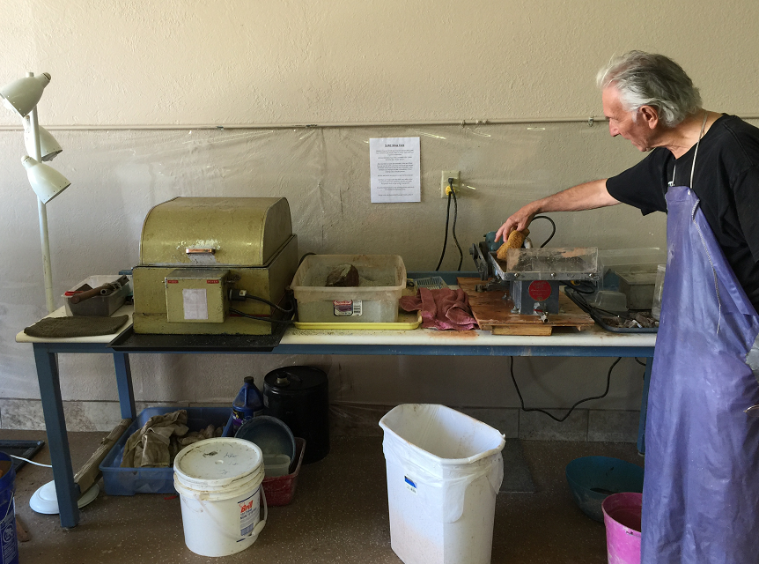
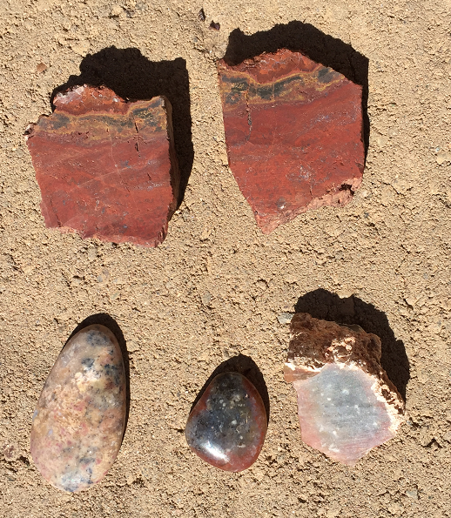
5. Southern Utah Rock Club Rock Cutting Shop
2. Grind
1. Cut
Grandpa’s First Pendant
4. Polish
3. Sand
Grandma’s First Pendant

Slide 15
Notes

Slide 16
6. Presentations
Ethan ____________________________________.
Grant ____________________________________.
Colby ____________________________________.
Taylor ____________________________________.
Ella ____________________________________.
Halle ____________________________________.
Sophie ____________________________________.
Dallin ____________________________________.
Rachel ____________________________________.
Ian ____________________________________.

Slide 17
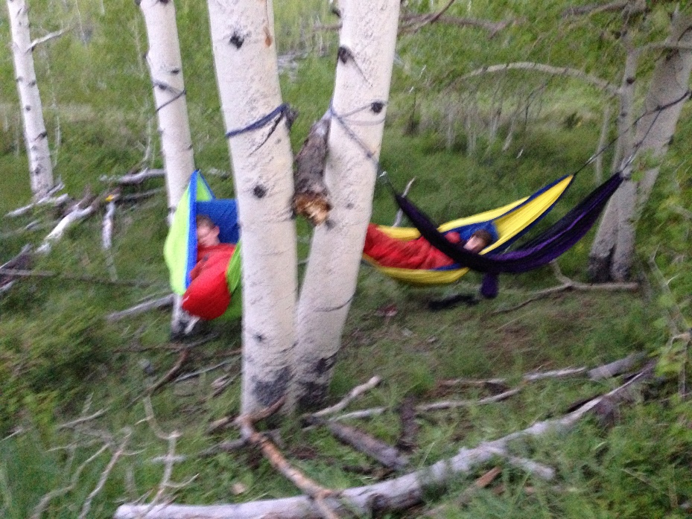
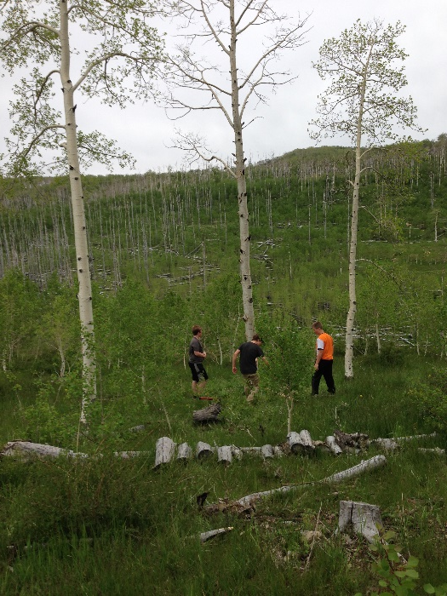
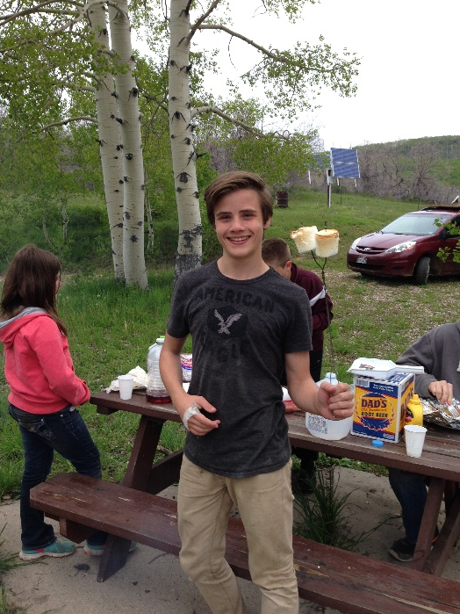
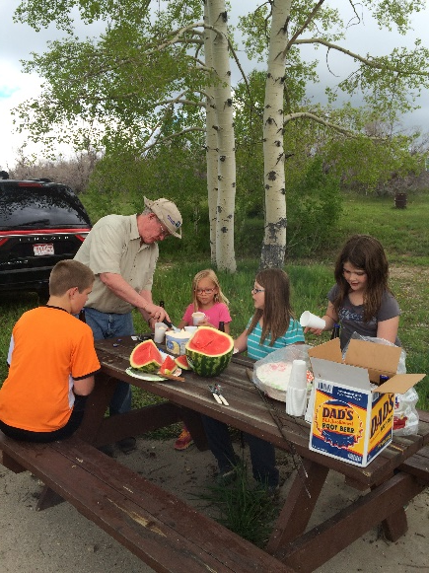
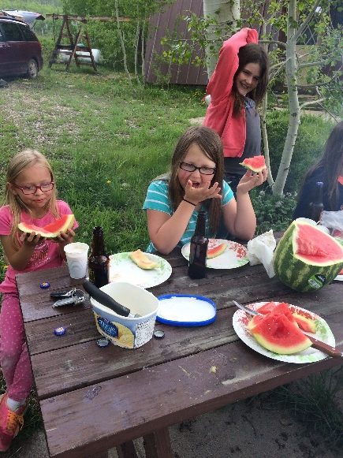
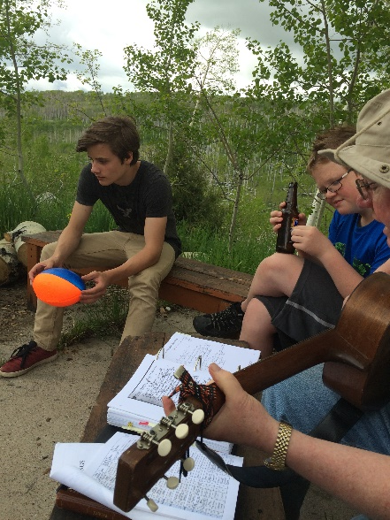
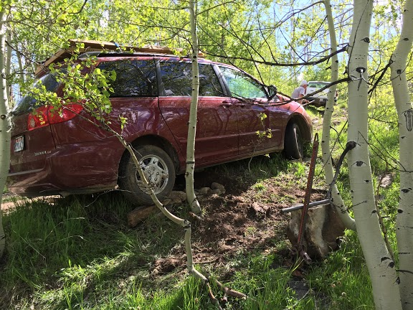
7. Nelson Cabin

Slide 18
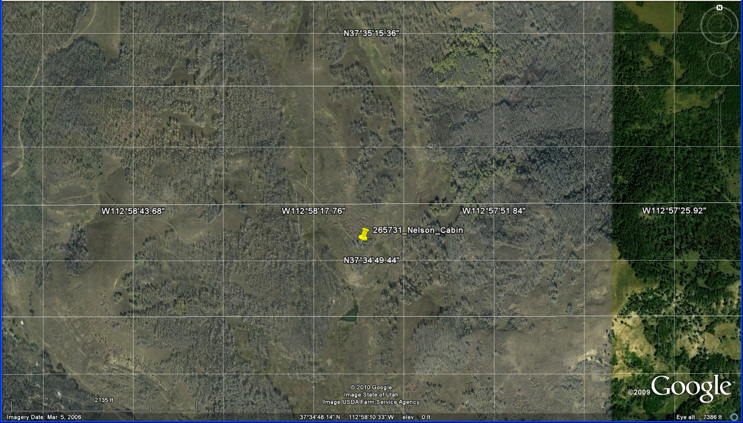
Nelson Cabin Map

Slide 19
Reference Grid
26 36 46 56 66 76
25 35 45 55 65 75
24 34 44 54 64 74
23 33 43 53 63 73
22 32 42 52 62 72
11 21 31 41 51 61 71

Slide 20
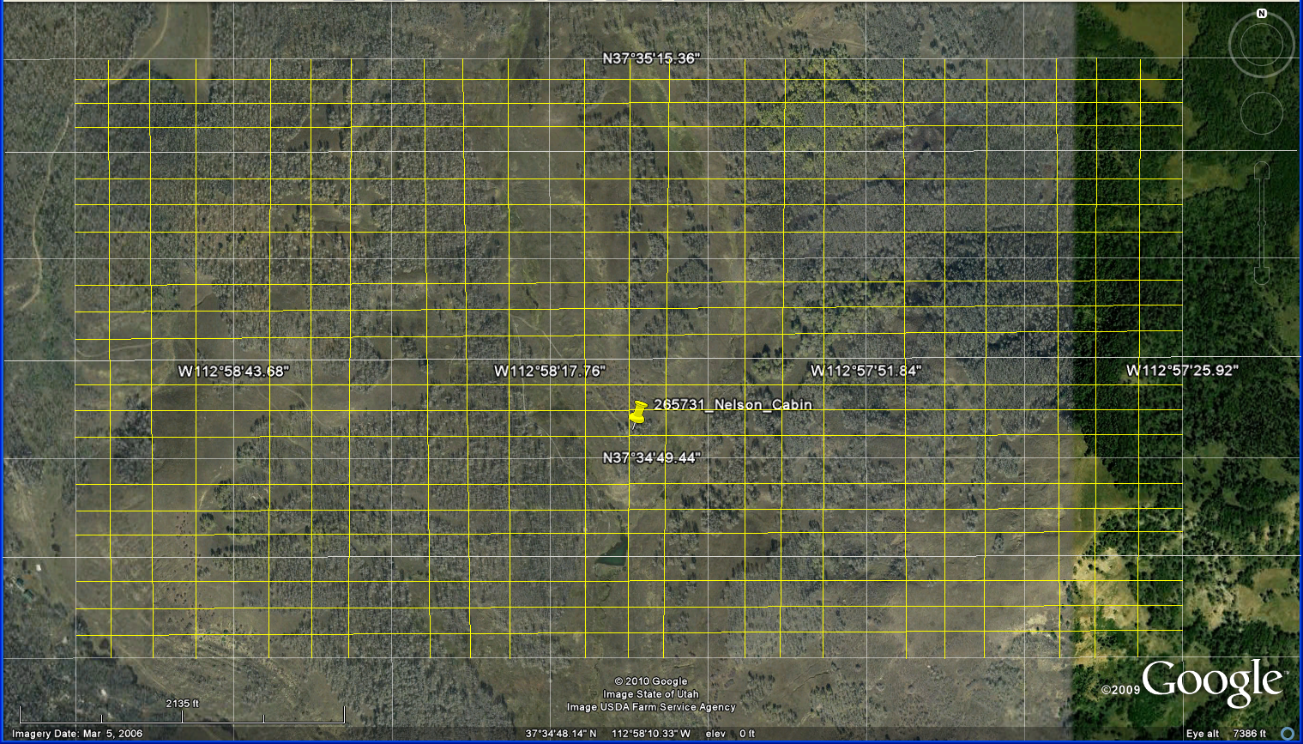
More Detail Reference Grid
66.41 76.11 76.21 76.31 76.41
16.14
16.13
16.12
16.11
15.14
11.11 11.21 11.31 11.41 21.11

Slide 21
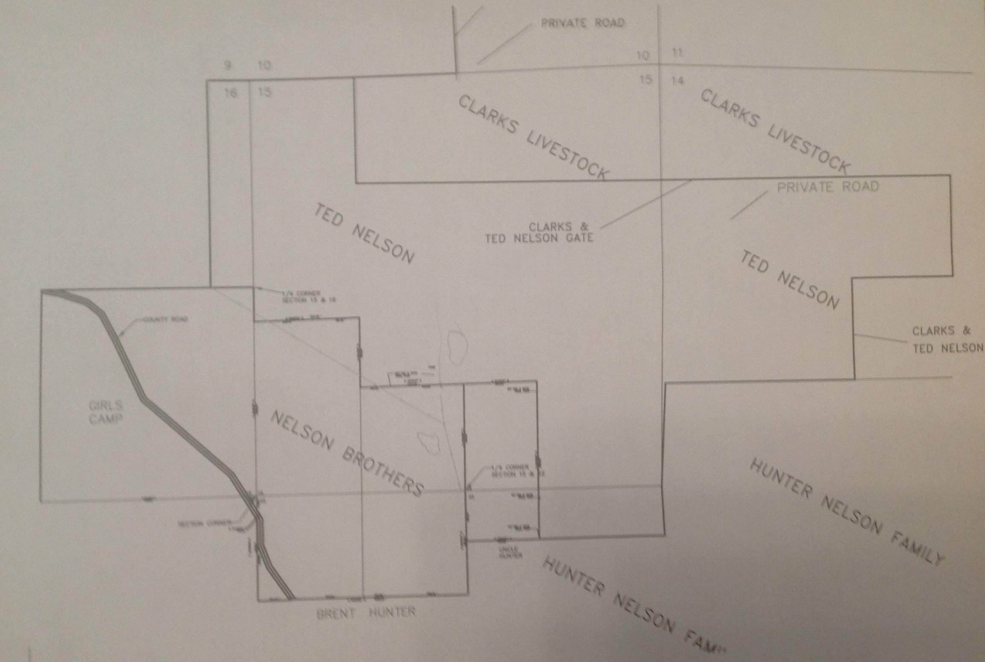
Find Quarter Section Corners at Cabin

Slide 22
Notes

Slide 23
Day 2: Thursday, 07 July 2016
Hardware
Media
Software
Languages
Lego Robots
Programming
Campfire Singing
Astronomy

Slide 24
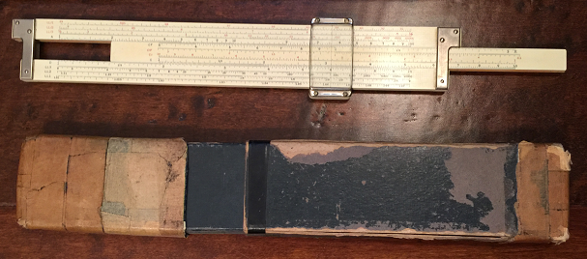
1.a. Slide Rule – An early computer
What is being calculated here?

Slide 25
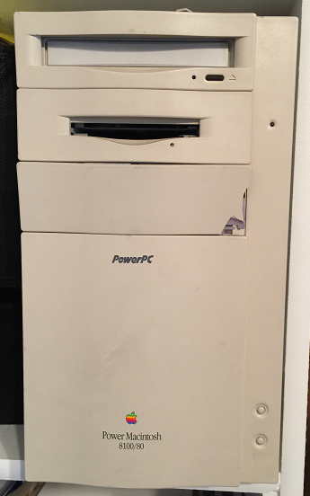
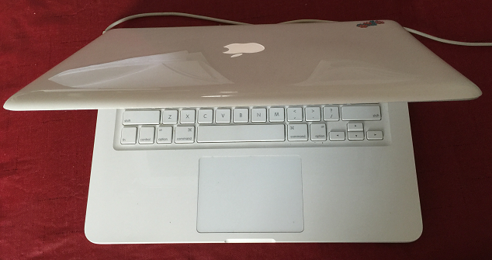
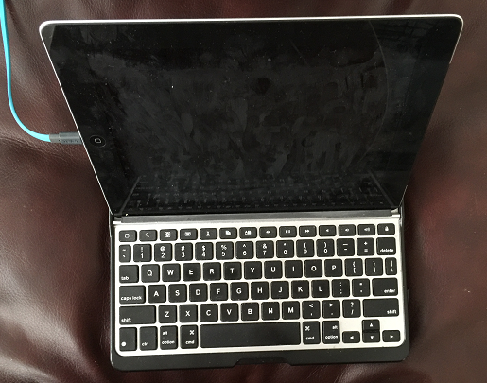
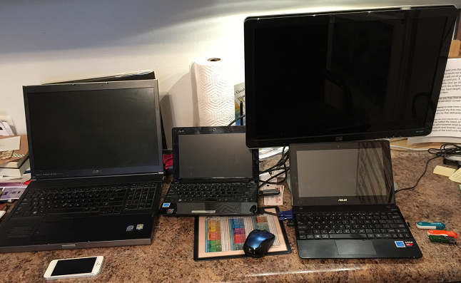
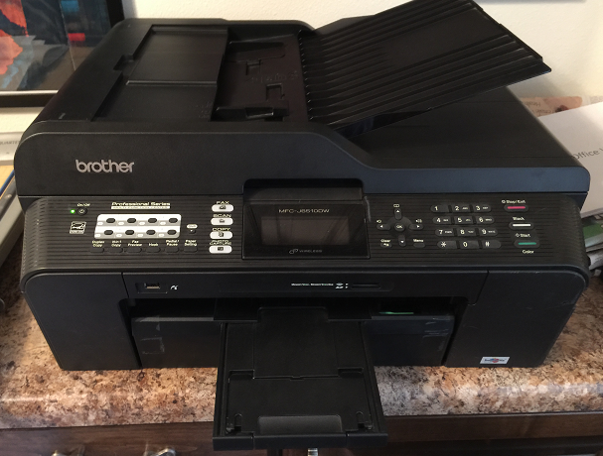
1.b. Hardware: Equipment, especially computer machine equipment
MacBook
PowerMac
Tablet
Computers at Grandpa
and Grandma’s place
Expanded
Screen
Linux
Server
Linux
PC
PC
Printer / Scanner

Slide 26
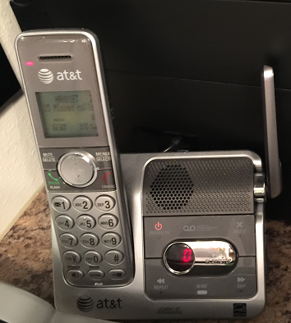
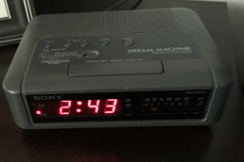
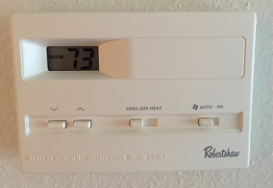
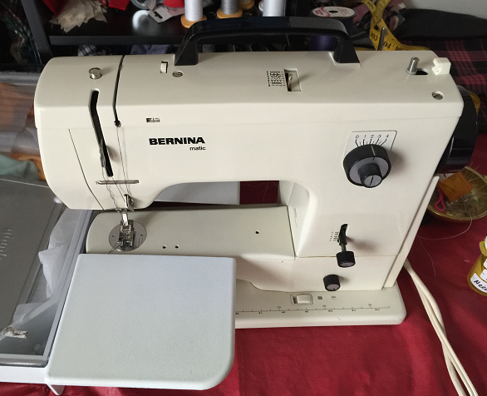
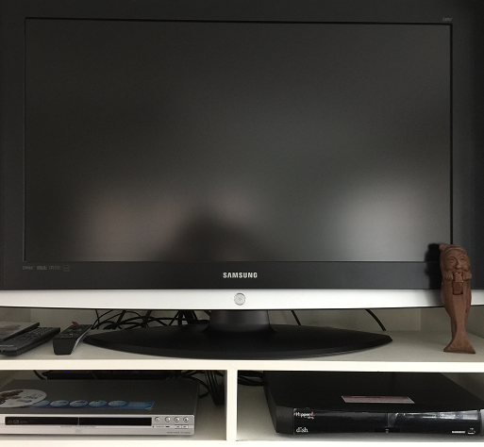
1.c. Other Hardware with Compute Power
Phone
Alarm Clock
Thermostat
Televison
Sewing Machine
DVD
Cable

Slide 27
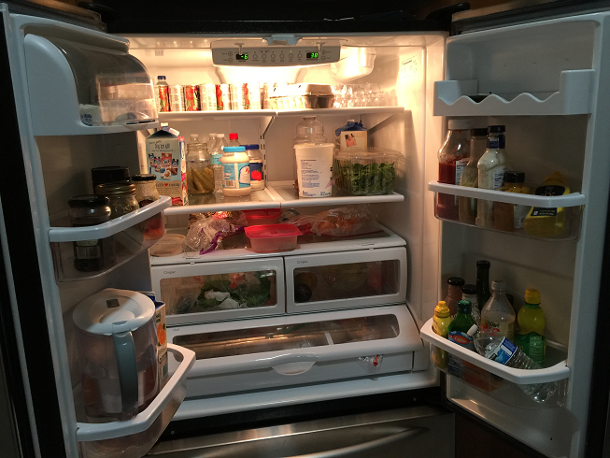
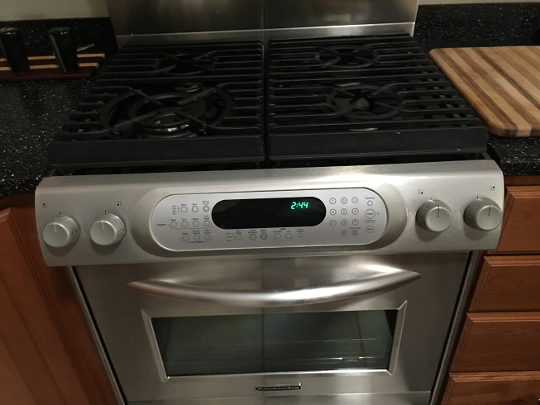
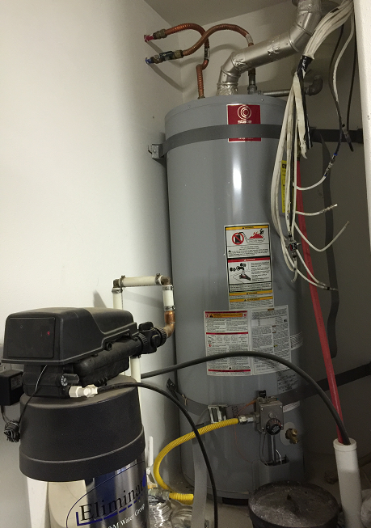
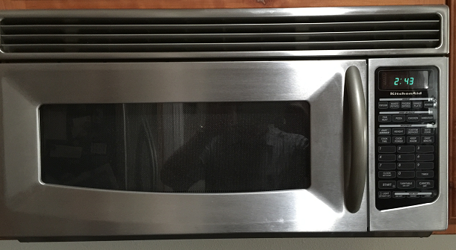
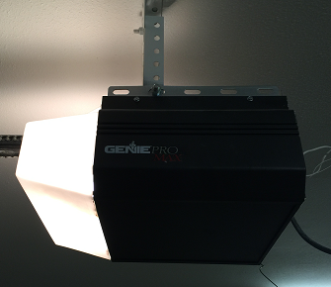
1.d. Hardware Becoming More Computerized
Stove
Refrigerator
Garage
Door
Opener
Water
Heater
&
Softerner
Microwave

Slide 28
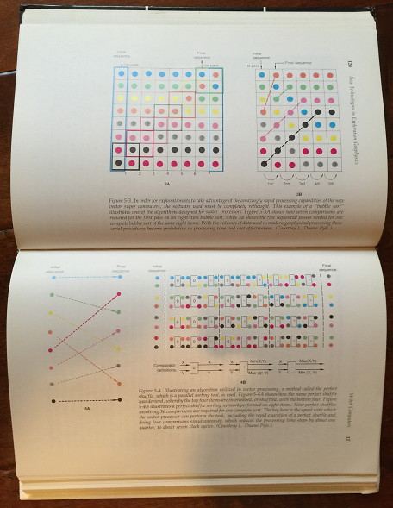
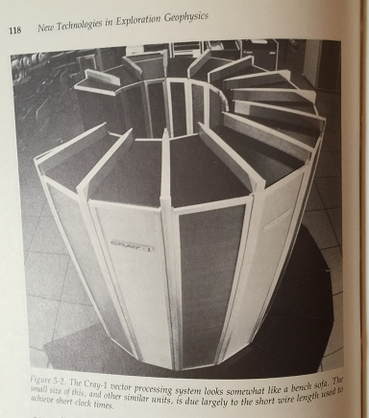
1.e. Clusters & Parallel Computers
Parallel Computer Programming
Cray Computer

Slide 29
Notes

Slide 30
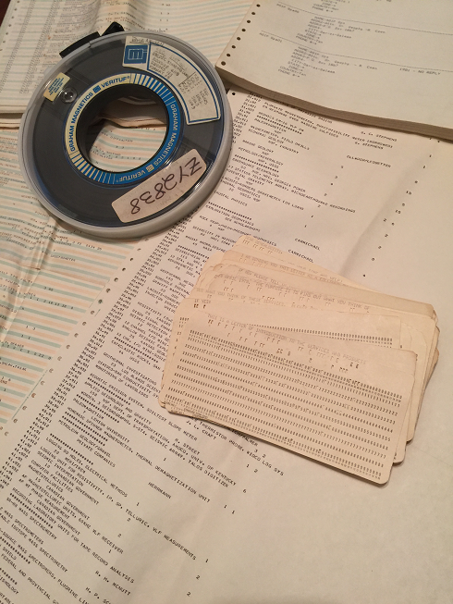
2.a. Media Input and Output
Punch Cards
9-Track Tapes
Printouts
Never, never, never point a gun or a bow at another person.

Slide 31
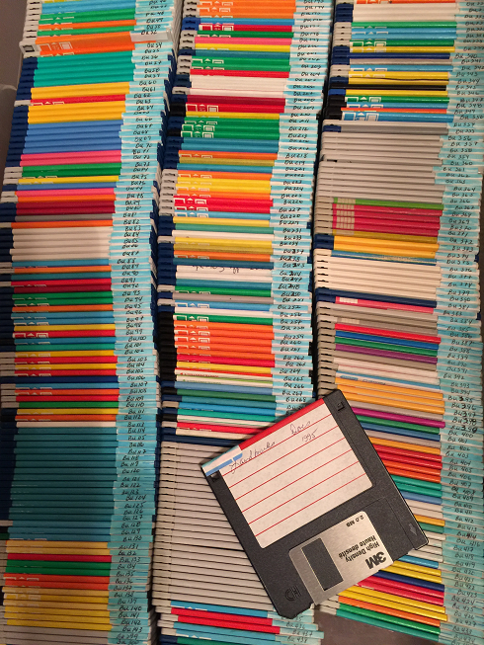
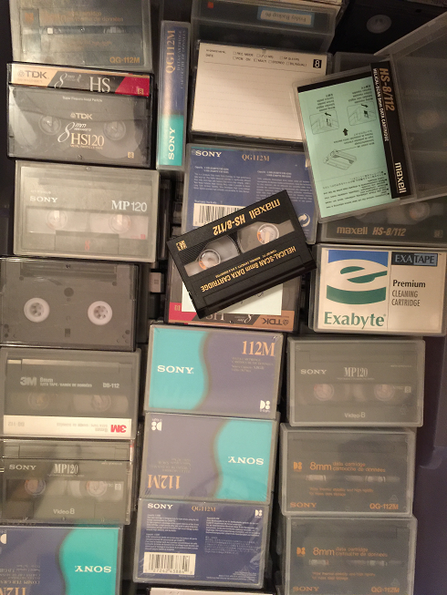
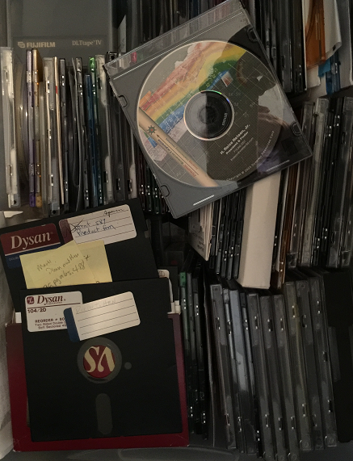
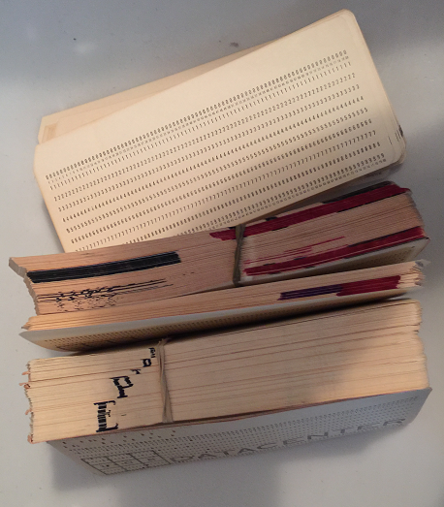
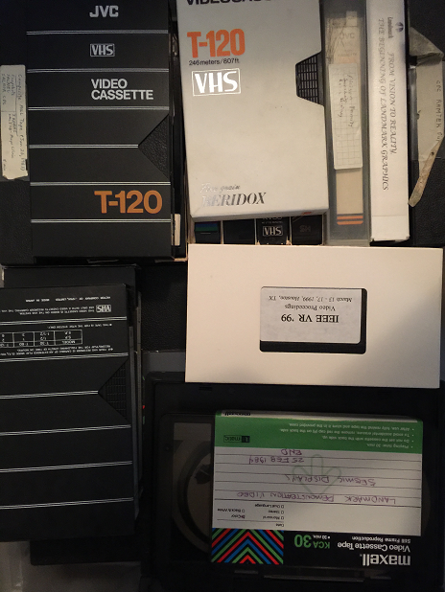
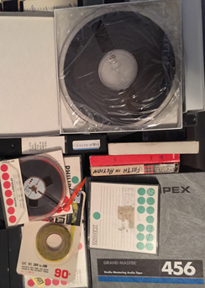
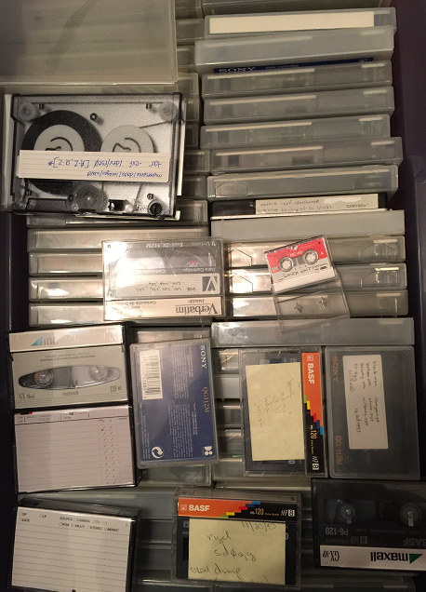
2.b. Media
Diskettes
Exabyte Tapes
CD’s
IBM Disk Storage
Punch Cards
Video Tapes
Audio Tapes

Slide 32
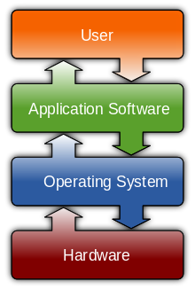
3. Software
Computer software, or simply software, is that part of a computer system that consists of encoded information or computer instructions, in contrast to the physical hardware from which the system is built. The term is roughly synonymous with computer program.
The term "software" was first proposed by Alan Turing and used in this sense by John W. Tukey in 1957. In computer science and software engineering, computer software is all information processed by computer systems, programs and data. Computer software includes computer programs, libraries and related non-executable data, such as online documentation or digital media. Computer hardware and software require each other and neither can be realistically used on its own.
At the lowest level, executable code consists of machine language instructions specific to an individual processor—typically a central processing unit (CPU). A machine language consists of groups of binary values signifying processor instructions that change the state of the computer from its preceding state. For example, an instruction may change the value stored in a particular storage location in the computer—an effect that is not directly observable to the user. An instruction may also (indirectly) cause something to appear on a display of the computer system—a state change which should be visible to the user. The processor carries out the instructions in the order they are provided, unless it is instructed to "jump" to a different instruction, or interrupted.
The majority of software is written in high-level programming languages that are easier and more efficient for programmers, meaning closer to a natural language.[1] High-level languages are translated into machine language using a compiler or an interpreter or a combination of the two. Software may also be written in a low-level assembly language, essentially, a vaguely mnemonic representation of a machine language using a natural language alphabet, which is translated into machine language using an assembler.
https://en.wikipedia.org/wiki/Software
A diagram showing how the userinteracts with application software on a typical desktop computer. The application software layer interfaces with the operating system, which in turn communicates with the hardware. The arrows indicate information flow.

Slide 33
Notes

Slide 34
4.a. Languages
Java: a class-based, object-oriented programming language developed by Sun Microsystems in the 1990s. Java is designed to work across multiple software platforms, meaning a program written on Mac OS X, for example, could also run on Windows.
C: A general-purpose, imperative programming language developed in the early '70s, C is the oldest and most widely used language, providing the building blocks for other popular languages, such as C#, Java, JavaScript and Python.
C++: an intermediate-level language with object-oriented programming features, originally designed to enhance the C language. It's used to develop systems software, application software, high-performance server and client applications and video games.
C#: Pronounced "C-sharp," C# is a multi-paradigm language developed by Microsoft as part of its .NET initiative. Combining principles from C and C++, C# is a general-purpose language used to develop software for Microsoft and Windows platforms.
Objective-C: Objective-C is a general-purpose, object-oriented programming language used by the Apple operating system. It powers Apple's OS X and iOS, as well as its APIs, and can be used to create iPhone apps, which has generated a huge demand for this once-outmoded programming language.
PHP: (Hypertext Processor) is a free, server-side scripting language designed for dynamic websites and app development. It can be directly embedded into an HTML source document rather than an external file, which has made it a popular programming language for web developers.

Slide 35
4.b. Languages
Python: a high-level, server-side scripting language for websites and mobile apps. It's considered a fairly easy language for beginners due to its readability and compact syntax, meaning developers can use fewer lines of code to express a concept than they would in other languages.
Ruby: A dynamic, object-oriented scripting language for developing websites and mobile apps, Ruby was designed to be simple and easy to write.
JavaScript: a client and server-side scripting language developed by Netscape that derives much of its syntax from C. It can be used across multiple web browsers and is considered essential for developing interactive or animated web functions. It is also used in game development and writing desktop applications.
SQL: Structured Query Language (SQL) is a special-purpose language for managing data in relational database management systems. It is most commonly used for its "Query" function, which searches informational databases. SQL was standardized by the American National Standards Institute (ANSI) and the International Organization for Standardization (ISO) in the 1980s.
HTML and XML: HyperText Mark-Up and Extended Markup Languages used to write web pages and database interfaces.
Perl, sed, & awk: scripting languages used to replace Fortran, or Binary Code.

Slide 36
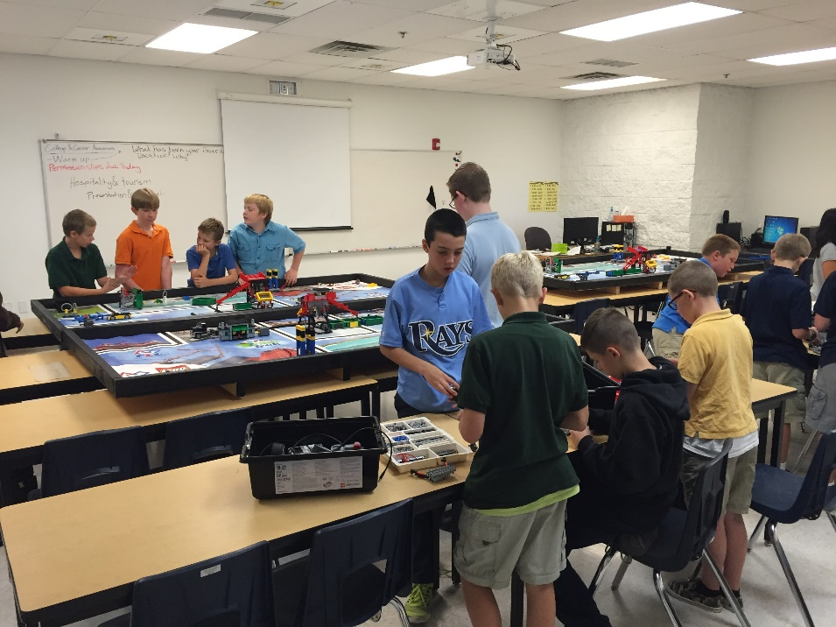
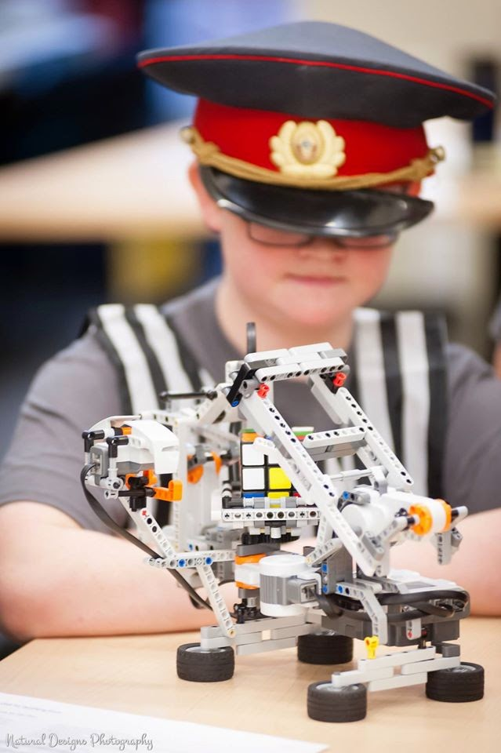
4. Lego Robots

Slide 37
6. Programming
We will have several computers.
Your assignment is to
Determine something you want software to do.
Build a work flow describing:
Input;
Process; and
Output
Select a language to write your program in.
Write the software.
Demonstrate the results to Science Camp attendees.
This is something you can expand on between now and Science Camp in 2017, and bring the results and show them to everyone next year.

Slide 38
Notes

Slide 39
6. Campfire Singing
374 To Me, My Farm Is
Words by Emma Lambson Nelson,
music by Leonard Cohen, arranged by HRN
18 May 2015 written on my i-Pad
0 Fret Strum
Bb Gm Bb Gm Bb Gm
1. My farm to me is not just land
Bb Gm
Where bare, unpainted buildings stand
Eb F Bb
To me my farm is nothing less
Eb F Bb Gm Bb Gm
Than all created loveliness
Bb Gm
2. My farm is not where I must soil
Bb Gm
My hands in endless, dreary toil,
Eb F Bb
But where, through seed and swelling pod
Eb F Bb Gm Bb Gm
I've learned to walk and talk with God
Bb Gm
3. My farm to me is not a place
Bb Gm
Outmoded by a modern race,
Eb F Bb
I like to think I just see less
Eb F Bb
Of evil, greed, and selfishness.
Bb Eb Gm
C: Hallelujah, Hallelujah
Eb Bb F Bb Gm Bb Gm
Hallelujah, Hallelu jah
Bb Gm
4. My farm's not lonely, for all day
Bb Gm
I hear my children shout and play,
Eb F Bb
And here, when age comes, free from fears
Eb F Bb Gm Bb Gm
I'll live again, long joyous years.
Bb Gm
5. My farm's a heaven - here dwells rest,
Bb Gm
Security and happiness,
Eb F Bb
Whate'er befalls the world outside
Eb F Bb Gm Bb Gm
Here faith and hope and love abide.
Bb Gm
6. And so my farm is not just land
Bb Gm
Where bare, unpainted buildings stand,
Eb F Bb
To me my farm is nothing less
Eb F Bb
Than all God's hoarded loveliness.
Bb Eb Gm
C: Hallelujah, Hallelujah
Eb Bb F Bb
Hallelujah, Hallelu jah

Slide 40
8. Reflector Telescope (Ray Gardner) and Refractor Telescope (Hilton Long)
Photo of Saturn taken with Grandpa’s cell phone

Slide 41
8.a. Reflection and Refraction Lens

Slide 42
8.b. Microscope Reflection & Refraction

Slide 43
8.c. Night Astronomy with Hilton Long & Ray Gardner

Slide 44
Day 3: Friday, 08 July 2016
Programming
Marshmallow Guns
Races
Water Rockets
Revisit Favorite Site:
Cascade Falls
Mammoth Cave
Cedar Breaks
Snow Canyon
Volcano
Go to New Site
Kanaraville Falls
Spring Hill Canyon
Taylor Creek
Calf Springs Ranch
Swimming

Slide 45
Water Bottle Rockets

Slide 46
Water Bottle Rockets continued

Slide 47
Status Report on Grandpa’s work with Lightning Data

Slide 48
Notes

Slide 49
Swimming in Cedar City

Slide 50
Day 4: Saturday, 09 July 2016
Breakfast at Iron Springs
Carriage Rides

Slide 51
Notes

Slide 52
Grandma and Grandpa’s Garden @ Grandma Nelson’s Place

Slide 53
Cedar City Temple Construction Progress 28 June 2016

Slide 54
Howard Roice Nelson, Jr.’s Pedigree Chart
“I am very proud of my heritage and the sacrifices my ancestors made so I could have the life I have. I will always strive to live my life so I am worthy to be part of this eternal family after I die.”
H. Roice Nelson, Jr.

Slide 55
Bengt Nelson, Sr. & Ellen Johnson

Slide 56
Bengt Nelson, Jr. & Sarah Catherine Hunter

Slide 57
Roice Bengt Nelson & Emma Lambson

Slide 58
Howard Roice Nelson, Sr. & Pauline Hafen

Slide 59
Morris Alpine Shirts

Slide 60
Notes

Slide 61
2016 Science Camp
What was best about 2016 Science Camp?
__________________________________
__________________________________
__________________________________
What would be your ideal 2017 Science Camp Theme?
__________________________________
__________________________________
__________________________________

