Slide 1
Utah State University
Engineering Week 2013
A Snapshot of Engineering at ATK
What do engineers do
Presented by:
Charlie Precourt
ATK Aerospace Group

Slide 2


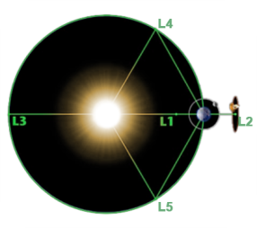


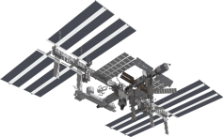







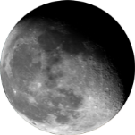


The Future of Exploration
Mars
34,600,000 mi /
55,700,000 km
International
Space Station
286 mi / 460 km
Lagrangian Point L2
274,000 mi /
440,960 km
Earth
Moon
238,855 mi / 384,400 km
Near-Earth Asteroid
3,106,866 mi /
5,000,000 km
Human Spaceflight Capabilities
Mobile Extravehicular Activity and
Robotic Platform
Deep Space
Habitation
Advanced Spacesuits
Advanced Space Communications
Advanced In-Space Propulsion
In Situ Resource
Utilization
Human-Robotic Systems
Notes:
NOTES:
SLS complements NASA’s Commercial Crew and Cargo initiatives, which are creating a supply line to and from the International Space Station and low-Earth orbit.
In contrast, the SLS super heavy-lift rocket is designed for missions beyond Earth’s orbit.
It will expand human presence and enable new missions of exploration across the solar system.
The SLS rocket will carry the Orion spacecraft, its crew, cargo, equipment, and science experiments to deep-space destinations.
It will be a platform for continuing America’s tradition of human space flight, as well as providing the capability to launch entirely new science missions and other missions of national and international importance.

Slide 3
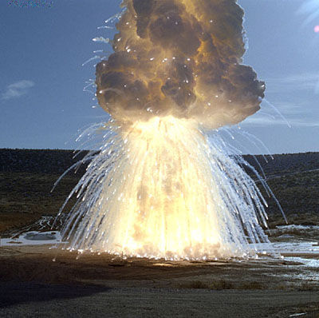
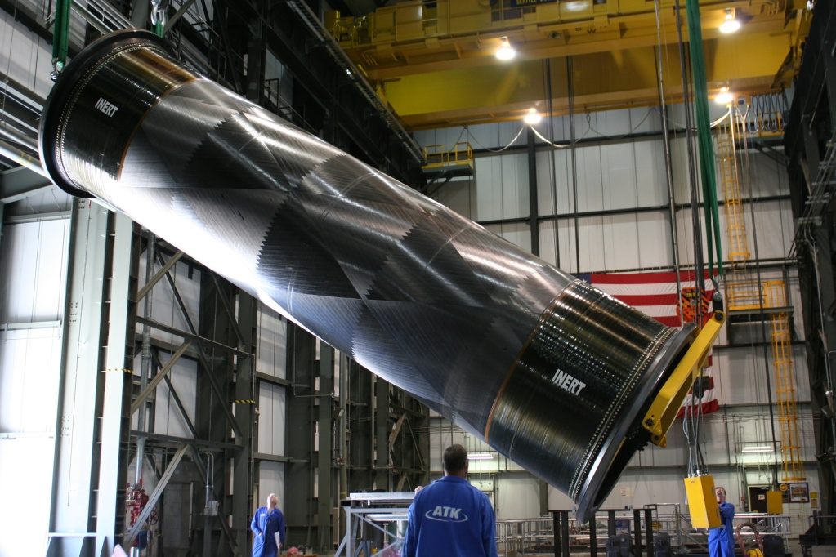
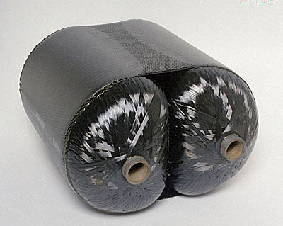
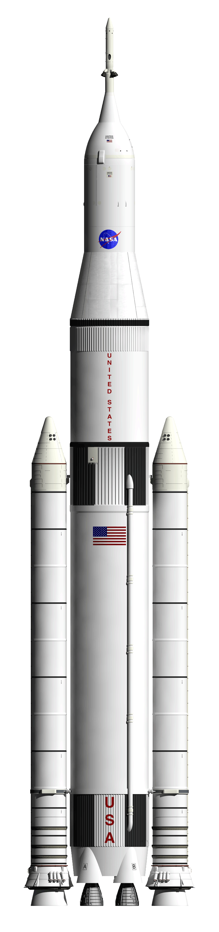
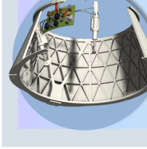
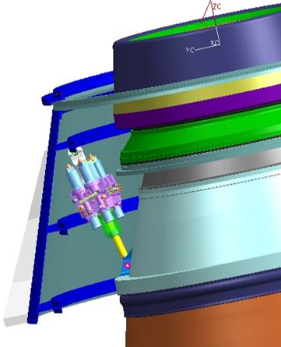
It is Rocket Science
Propellant
Pyrotechnics
Composite Case
Composite Pressure Vessels
Metal Skirt
Nozzle and Thrust Vector Control

Slide 4
Breakdown of Engineer Disciplines at ATK
Engineer Type | # of Empls
Associate Eng | 22
Designer | 19
Analysis | 62
Design | 131
Environment Health & Safety | 33
Facilities | 24
Manufacturing | 87
Materials | 3
Mission Assurance (Quality) | 62
Software | 7
Systems | 17
Test | 35
Project Engineer | 52
Chief Engineer | 80
Scientist | 60
Tech Project Mgr | 7
Engineers as Managers | # of Empls
Analysis Eng | 6
Design Eng | 25
EHS Eng | 5
Facilities Eng | 3
Manufacturing Eng | 13
Materials Eng | 1
Mission Assur Eng | 15
Sciences | 3
Tech Projects | 1
Test Eng | 6
Engineering | 15
Systems | 2
Grand Total | 796

Slide 5
Engineer Area of Responsibility
Test
Instrumentation
Test plans
Work instructions
Test equipment
Data acquisition
Mission Assurance
Quality
Procurement QA
System Safety
Reliability
NDT
Metrology
Facilities
Buildings
Equipment
HVAC
Electrical
Boilers
Project Engineering
Technical planning
Schedule and budgets
Chief Product Engineer
Manufacturing
Processes
Equipment
Shop Instructions
Machining
Bonding, curing, painting, mixing, casting, cleaning
R&D
PhD Chemists
PhD Physicists
Material synthesis
Metallurgy
Polymers
Tooling
Electrical
Mechanical
Robotics
Automation
Design
Case
Nozzle
Propellant
Electrical
Avionics/controls
Software
Instrumentation
Pyrotechnics
Motor Integration
Vehicle Integration
Industrial Safety
Industrial Hygiene
Hazards Analysis
Ergonomics
Environmental
Air
Ground water
Waste disposal
Analysts
Structures
Viscoelastic
Nonlinear
Temp Dependent
Orthotropic
Heat transfer
Gas dynamics
Ballistics
Dynamics
Fracture
Orbital mechanics
Systems Engineering
Requirements definition and allocation
Systems integration
Loads and environments
Maintainability
Materials & Process
Metals
Polymers
Composites
Adhesives

Slide 6
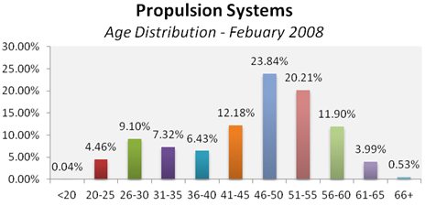
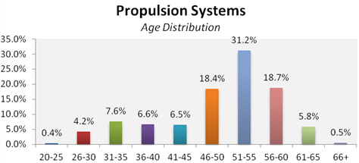
Industry Talent Needs – We need you!
Workforce is aging
Downsizing exacerbates proportion of older workforce
Young workforce presently under-represented (< 30 age group reduced from 14% to 4.6%)
Recognize necessity of ensuring skills, knowledge and experience transfer to a younger workforce
- February 2012

Slide 7
Backup Fodder

Slide 8
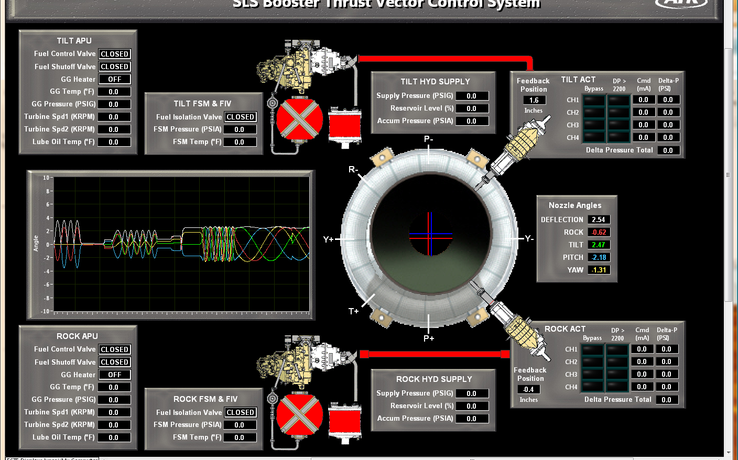
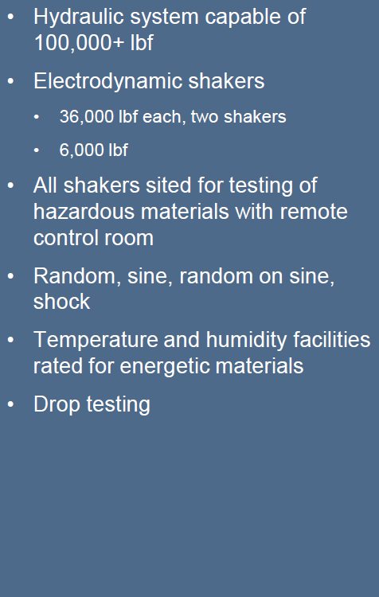
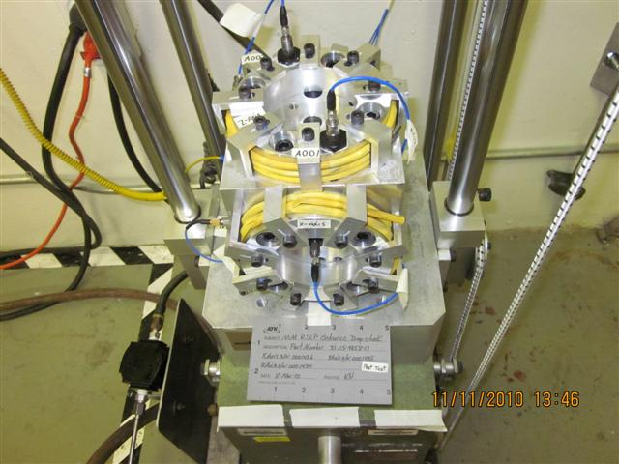
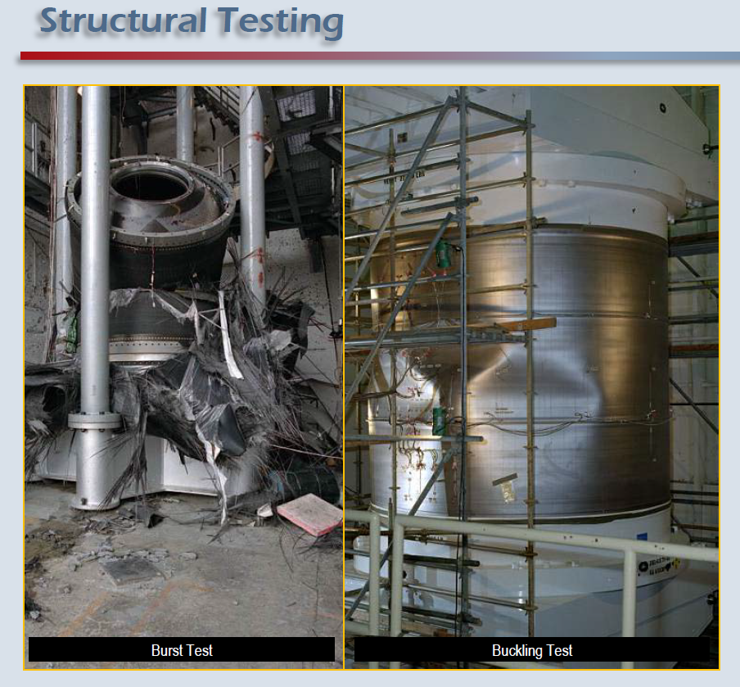
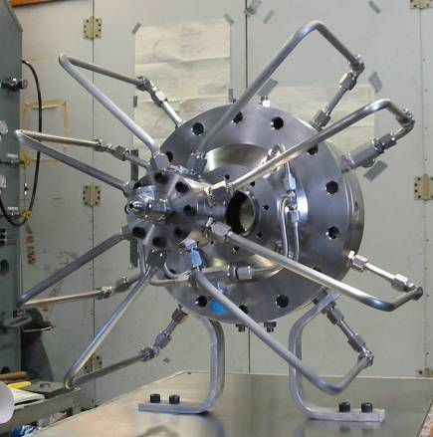
Test Engineering and Control Systems
Structural Testing
Test Control and Acquisition Software
Feedback Control/Data Acquisition
Ground Support
Countdown Sequencing
HCI/MMI design
Materials Testing
Adhesives
Liners
Elastomeric Materials
Insulators
Composites
Thermal Protection Systems
Nozzles
Specialty coatings

Slide 9
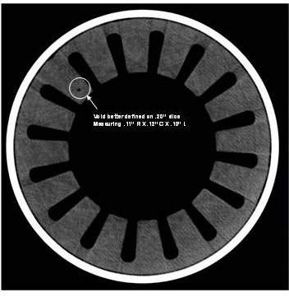
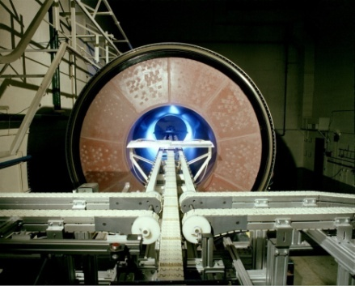
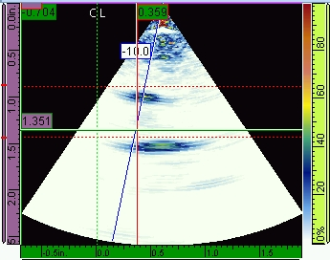
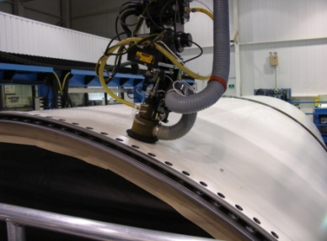
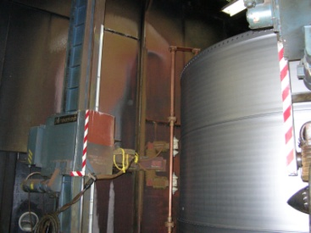
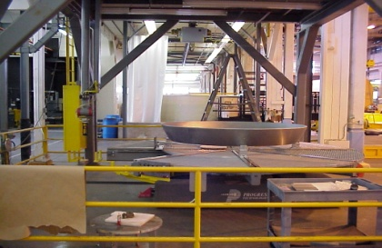
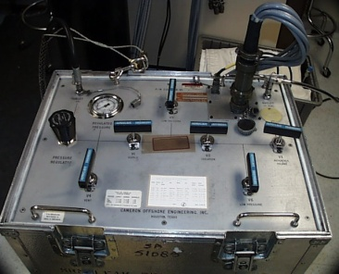
Quality Engineering
NDT Capabilities
X-ray
  Extensive equipment and facilities with 160 KeV to 16 MeV sources; digital technologies
  Inspections from material samples at micron level to large solid rocket motors
Ultrasonic
  Standard pulse – echo to sophisticated tone burst and phased array systems
  Field inspections with portable equipment to automated gantry for large solid rocket motors
SRM X-Ray
CT Image
Phased
Array
Scan
UT Gantry
Eddy current, mag particle, penetrant
  Wide array of sensors and equipment; all standard methods
  Field inspections with portable equipment to automated gantry and inspection bays for large metal components
  Leak test
  Equipment to perform pressure decay and mass flow inspections
Mag Particle
Bay
Automated
Eddy Current
Leak Test Equipment

Slide 10
Design Modeling/Optimization
Preliminary Design
Development & Design
Capabilities: Modeling – Drawings – Fabrication
Product Optimization
Evaluation of technologies applied to improve current & future programs
Design to maximize performance, minimize cost, increase robustness
Conduct trade studies
Optimize design to meet customer requirements
Accurate synthesis of all components
Identify system level variables and overall constraints
Maximize customer value function to exceed expectations
Predict system performance
Trajectory simulation
Operating Parameters
Interface geometry
Mass Properties
Composite processing:
Numerous tools for composite processing
Armalon and FEP film tensioners
Testing and bonding fixtures
Uni-tape impregnation equipment
Tape & film slitting equipment
Nozzle components:
Segmented Metal wrap mandrels
Aero shells
Test nozzles
Other:
Propellant core cutting models
Product development
Process illustrations
Modeling & simulation tools:
  NX
  MATLAB
  iSIGHT
SPP
ADP
TetRUSS

Slide 11
Systems Engineering and Integration
FEM Builder is an interactive PC based Windows® program
Integration Hardware Design
Engineering design and analysis
System Loads & Dynamics
Assessment of vibration, acoustic, and shock environments
FEM Builder
Developed by the Scientific and Engineering Programming Team for internal use
Jointly funded and used by AFRL and NASA; in use at several ATK sites
FEM Builder provides tools for:
Pre-processing – Finite Element Model creation
Post-processing – Result evaluation and visualization
Solver interfacing – Reading/writing input/output files for many solvers
Solution coupling – Automated iterative coupled solutions using multiple solvers
Vehicle hardware
Component packaging
Assemblies and installations
Material evaluation/compatibility
Engineering interface and interface integration
Engineering layouts
Electronics and physical mockups
Indentured document lists
ESD/ESE attention
Lightning protection
Electrical harnesses
Ordnance trains
Interface control documents
Arrangements drawings
Developmental / confirmation fit-checks
Preliminary and detailed system/component level loads
Static, modal, frequency response, random/sinusoidal vibration, shock/impact response, acoustic, modal/direct transient analysis
Large, system level FEM development/analysis
Dynamic environment test design and support

Slide 12
Structural Design and Analysis
I-DEAS Master Series, ABAQUS,
ANSYS, NASTRAN, TEX codes, etc.
Propellant / Liner / Insulation
Extensive experience in viscoelastic structural analysis, material characterization, service life analysis, cumulative damage assessment, and fracture mechanics for propellants, liners, insulators, and their bondlines (4 PhD, 7 MS, 9 BS)
Propellants
Design and analysis
Structures
Closed form, 2-D FEA, and 3-D
FEA static and dynamic
Linear, nonlinear, elastic-plastic,
viscoelastic, and hyperelastic
Isotropic, othotropic, and anisotropic materials
Fracture and fatigue analysis
Integrated structural and
thermal analysis
Manufacturing and material
problem resolution
Design, analysis, and post-test evaluation
Cases, pressure vessels, and tanks
Bonded and bolted joints
Fixed and movable nozzles
Wide range of propellant grains
Stage hardware and other structures
Primary analytical tools are finite element structural analysis codes to compute deformations, strains, stresses, and strain energy in a propellant grain, pre-processors to prepare finite element models, and post-processors to evaluate results.
Codes: structural, thermodynamic, flight, plume
Gas generators
Rocket-assisted projectiles
Motor performance
Chamber pressure
Thrust
Ignition delay
Bore heat flux
Gun propellants
Impetus
Burn rate (closed bomb)
Ignition (flamed spread)
Flame temperature

Slide 13
Thermal and Fluids Analysis
Complex 2D and 3D geometries in FLUENT
Gas Dynamics & Heat Transfer
Internal and external flow modeling
TVA / TVC
Codes: X-Math, TASS, ABAQUS,
WAVE, NASTRAN
Fluid Dynamics
Turbulent, chemically reactive, transient or steady-state (ignition, combustion)
Single or multi-phase flow with entrained particles, 2 different fluids, or fluids with free surfaces (droplet combustion, mixing)
Moving surface boundaries (fluid-structure interaction, staging, confined launch of projectiles)
Fully-coupled flow field and solid region heat transfer with conduction, convection, radiation
2-D and 3-D finite volume
2-D and 3-D thermal analysis
Spatial radiation, convection, and conduction
Chemical ablation and decomposition
Thermal structural analysis
Material selection
Insulation requirements
Erosion prediction
Coupled and uncoupled two-phase flow
Turbulent and reactive flow
Specific impulse prediction and
nozzle contouring
External aerodynamic prediction
Heat transfer analysis
Full control system math simulation
System response predictions
Design of flex bearing core
Hyperelastic nonlinear bearing analysis
System-response data analysis
Dynamic response analysis and static equivalent loads
Movable nozzles
Flex bearing
Ball and socket
Gimballed/hinged
Fixed nozzles
Liquid injection
Deflectors (jet vanes)
TVA systems
Turbohydraulic
Electrohydraulic
Gas blowdown hydraulics
Electromechanical

Slide 14
Ordnance, Controls, Electronics, Service Prediction
Facilities, Equipment
Control System Design
Broad experience with multiple types of control systems and ‘hardware-in-the-loop’ simulations
Aging & Service Life Prediction
Metal structures corrosion evaluation
Electronics Laboratory
Full electronic prototype development; integration with NDE and Sensor development
Electronic and Electromechanical Prototyping
Circuit and Mechanical Package design, piece part selection, Board Design, PWA assembly, Assembly and box performance
and environmental testing, System Integration V&V and Qualification and Production Oversight
High Resolution Visual, Thermal, Eddy Current, Ultrasonic, and Laser Inspection Systems
Electrical Power Supplies. Meters, Scopes, Impedance and Network Analyzers
Full Fault Isolation Capability to component level and below if needed to include coordinated DPA with internal labs or OEM
Access to full Chemical, Mechanical, Environmental,
and Metallurgical Expertise and Equipment
Turbohydraulic – Peacekeeper, Small ICBM
Electrohydraulic – Minuteman
Cold gas blow down – Castor IVB, Castor 120, Solar Thermal Propulsion
Electromechanical – IHPRPT, IPSM, Hybrid, Star
Liquid Injection – Minuteman
Jet vanes – Tactical applications
MSC.ADAMS
MATLAB
MathCAD
OrCAD, pSPICE
Modeling & simulation tools:
Composite structures response to the environment
O-ring sealing effectiveness
Bondline integrity
Numerous ordnance
devices
Safe and arm
Flight initiation and termination
Tactical- to booster-size igniter
Tactical motors
ICBM and booster motors
Igniter/ordnance
Performance data evaluation
Reliability from binomial
probability analysis
Propellant grain
Probabilistic service life prediction
Advanced methods for failure prediction

Slide 15

As an Industry we need to:
Execute
Focus on Affordability
Leverage Lessons Learned
Support STEM Outreach
Involve International Partners
Execution, Affordability and Safety are Keys to Success
14

