Slide 1
Science Camp #130722.4
22-24 July 2013 @ the Nelson Condo, the Nelson Cabin
on Cedar Mountain, and the surrounding area
Advisors
H. Roice Nelson, Jr., Andrea S. Nelson,
Benjamin B. Nelson, Paul F. Nelson, & Brian H. Shirts
Attendees
Ethan E. Nelson, Grant M. Nelson, Colby C. Wright,
Taylor R. Wright, Ella D. Nelson, Rachel Gabrielle Lee,
Jeffrey Randall Shirts, & Eleanor Danielle Shirts

Slide 2
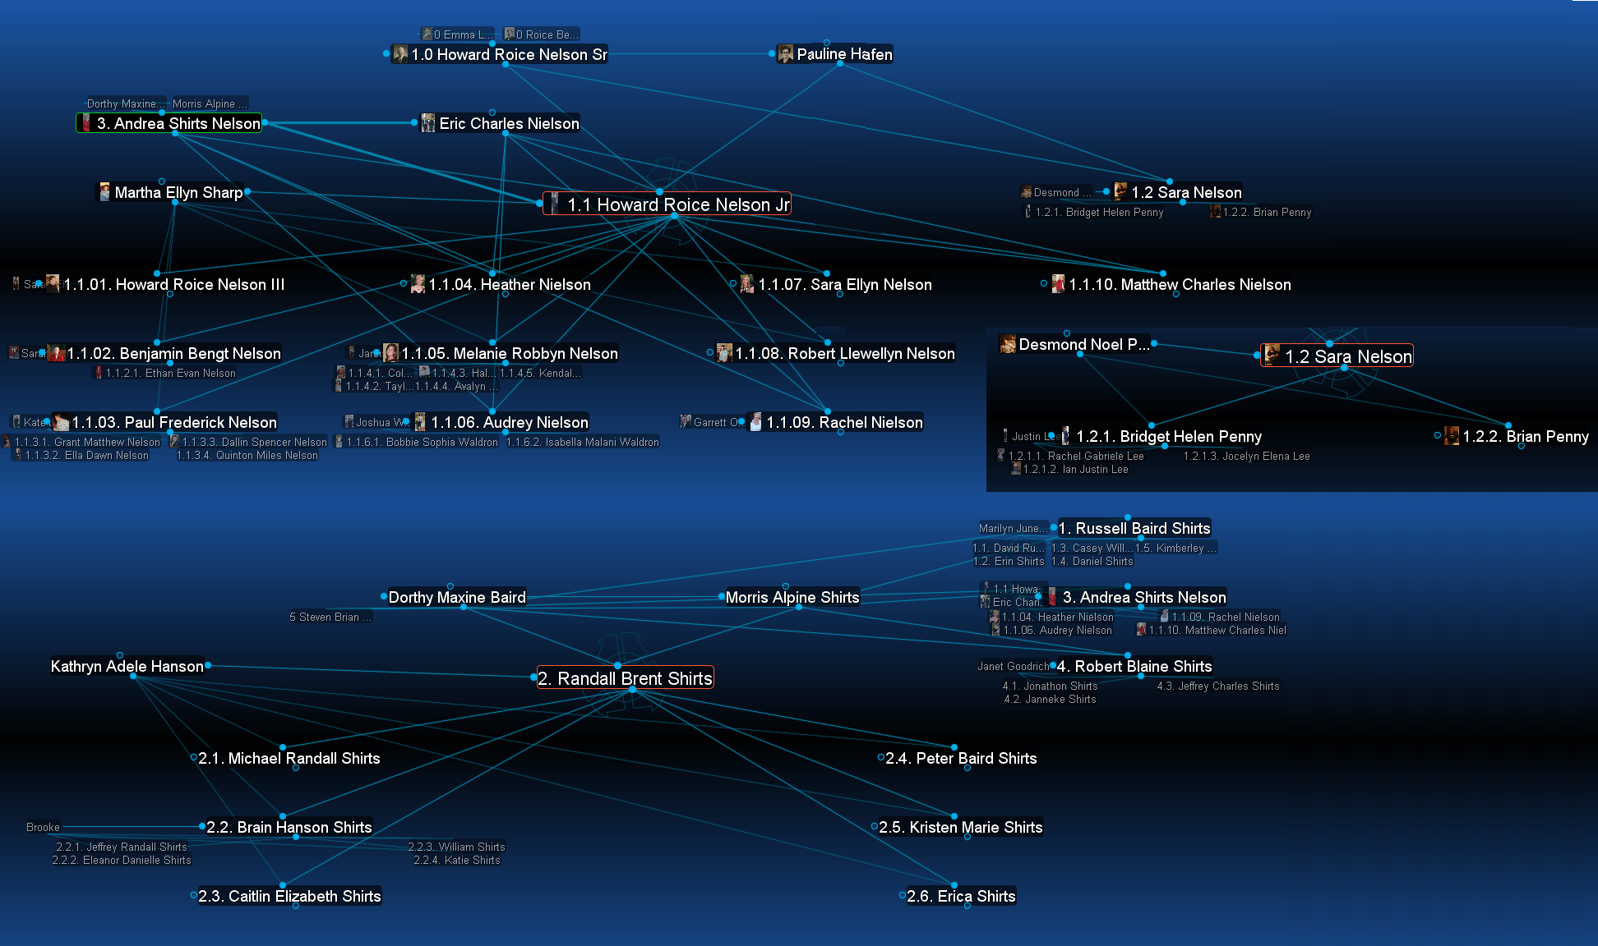
Family Relationships of 2013 Science Camp Attendees

Slide 3
Safety
Never go anyplace alone!
Exception is if one of you is hurt, then:
One of you stay and help the person hurt.
The other one run and get help.
If you get lost stay put, we will find you.
If you hear a rattlesnake do not move quickly, just slowly move away from the sound.
Do not run with a knife open. Use knife safety.
If you cut yourself, apply pressure to the wound to stop bleeding, and send for help.
Never point an arrow in a cocked bow at any person.
Drink lots and lots and lots of water.
Do not go swimming unless an adult is with you.
Do not start branches on fire and swing them around where others can be hurt.
Use common sense, and think before you act.

Slide 4
Schedule
Sunday Night:
Arrive at Grandpa & Grandma’s Condo
Hand out books, review Schedule and Plans
Monday:
Breakfast @ the Condo
Climb 2 Volcanoes and EDM (Electronic Distance Measure) between volcanoes
Visit Classy Closets, who are building cabinets for the Condo
Lunch
Visit last year’s Geocache up Fiddler’s Canyon
Training in surveying – Grandpa’s Cousin Lynn Nelson (Grandpa’s Dad’s brother, Uncle Bud’s 3rd son)
Nelson Cabin – Campfire and Dinner
Tuesday
Practice Surveying at the Nelson Cabin
Sand Paintings and Sand Jars
Fishing, Hiking, & looking for arrowheads
Theater Preview, Greenshow, The Tempest or Peter and the Star Catcher
Wednesday
Run / Walk / Breakfast
24th of July Parade
Lunch in the Park

Slide 5
Job Chart
 | Sunday | Monday | Tuesday | Tuesday Afternoon | Wednesday
Ethan | Review Notes | Prepare Breakfast | Breakfast Dishes | Clean Cabin | Return Colorado
Grant | Arrive Late Review Notes | Breakfast Dishes | Prepare Breakfast | Clean Cabin | Breakfast Dishes
Colby | Arrive Late Review Notes | Prepare Dinner | Breakfast Dishes | Clean Cabin | Breakfast Dishes
Jeffrey | Arrive Late Review Notes | Lunch Clean-Up | Prepare Breakfast | Clean Cabin | Breakfast Dishes
Taylor | Arrive Late Review Notes | Prepare Breakfast | Snack Helper | Clean Cabin | Breakfast Dishes
Ella | Arrive Late Review Notes | Prepare Dinner | Snack Helper | Clean Cabin | Breakfast Dishes
Rachel | Arrive Late Review Notes | Dinner Dishes | Breakfast Dishes | Clean Cabin | Breakfast Dishes
Eleanor | Arrive Late Review Notes | Breakfast Dishes | Snack Helper | Clean Cabin | Breakfast Dishes

Slide 6
Notes

Slide 7
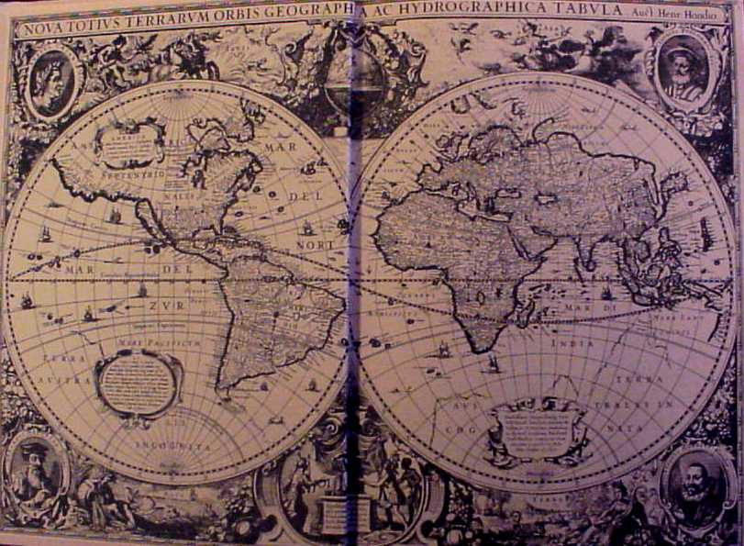
Why are maps important?
To show us where we are.
To show us where we want to go.
To provide spatial context.
In Western Society, to show the extent of property and mineral ownership.

Slide 8
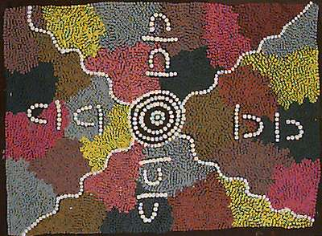
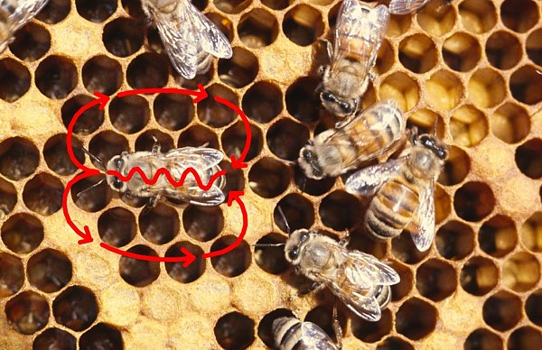
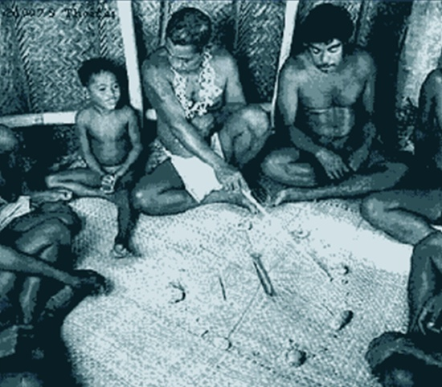
Different Cultures Use Different Kinds of Maps
Bee Tidings Newsletter,
March, 2003
entomology.unl.edu
Topsy Nabanardi Australian Aboriginal Song Line Painting
Honeybee’s keep track of the location of a flower relative to their hive with a dance.
Australian Aborigines kept track of tribal ownership with 1-D linear maps, or Song Lines.
Western Pacific Islander’s kept track of the relationships between islands by learning star locations.
These approaches are not based on Western Society land ownership concepts.
1D – Linear Maps
Learning the Western Pacific Navigation Star Structure

Slide 9
American Indian & Land Ownership
Land, a part of the universe, belonged to all, particularly the tribe.
Individual land ownership did not exist, since all were entitled to the fruits of nature.
Users' rights were protected and specified in various traditions, but there was no such things as land "ownership".
Generally, individuals could clear as much land as needed for farming; this land would remain in a family's possession as long as they continued to use it.
Once it was abandoned, anyone else could cultivate it.
Indians readily understood and entered into treaties concerning rights to land use, but the idea of land sales was alien to them—and it is likely that, because of difficulties in translation of each others' languages, neither the natives nor the settlers understood this vital difference, at first.
http://www.landandfreedom.org/ushistory/us1.htm

Slide 10
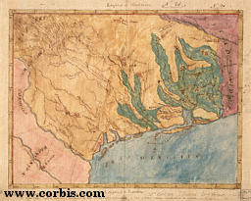
Western Land and Mineral Ownership
2D – Planar Maps
Dates back at least to Abraham’s inheritance.
Specifically to retaking the Israelite homeland.
Greeks and Romans defined land ownership.
The British and Spanish Civilizations were built on claiming discovered lands for the Crown.
Joint stock companies received charters from the Crown to parceled lands out to others.
Stephen F. Austin’s Map of Texas

Slide 11
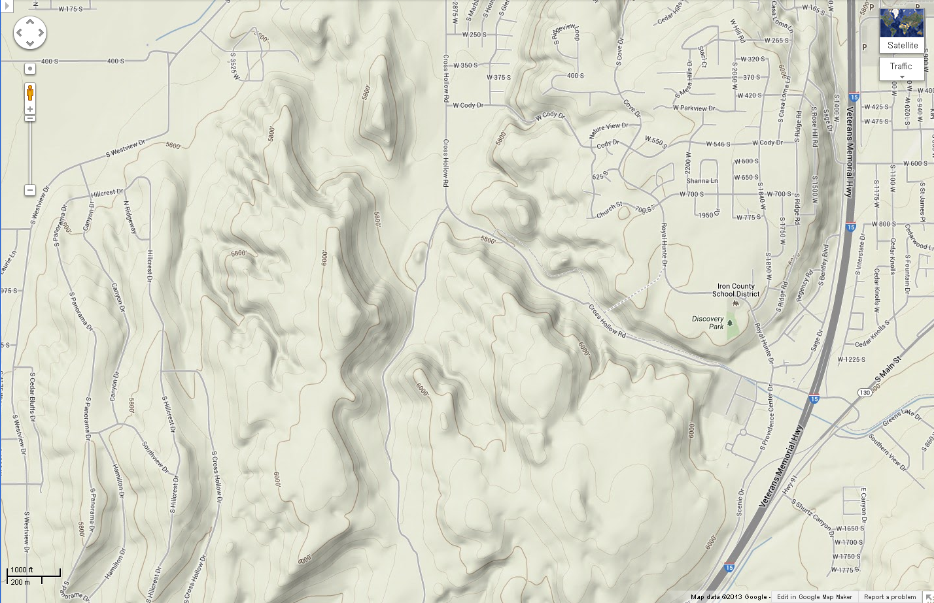
Every Road and Every Elevation on this map was surveyed by a surveyor

Slide 12
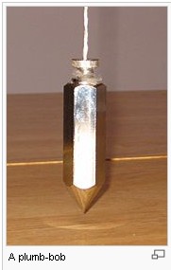
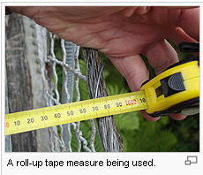
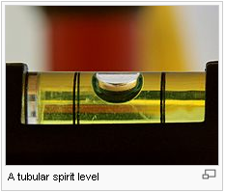
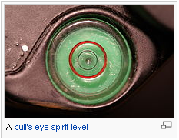
Surveying: the measurements making maps
The technique, profession, and science of accurately determining the terrestrial or three-dimensional position of points and the distances and angles between them. These points are usually on the surface of the Earth, and they are often used to establish land maps and boundaries for ownership or governmental purposes.
To accomplish their objective, surveyors use elements of mathematics (geometry and trigonometry), physics, engineering and law.
http://en.wikipedia.org/wiki/Surveying

Slide 13
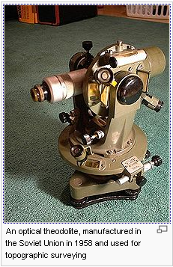
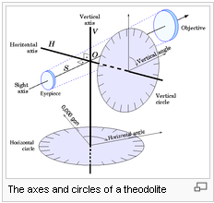
Surveying Equipment
As late as the 1990s, the basic tools used in planar surveying were a tape measure for determining shorter distances, a level to determine height or elevation differences, and a theodolite, set on a tripod, to measure angles (horizontal and vertical), combined with the process of triangulation. Starting from a position with known location and elevation, the distance and angles to the unknown point are measured.
A more modern instrument is a total station, which is a theodolite with an electronic distance measurement device (EDM). A total station can also be used for leveling when set to the horizontal plane. Since their introduction, total stations have made the technological shift from being optical-mechanical devices to being fully electronic.
http://en.wikipedia.org/wiki/Surveying

Slide 14
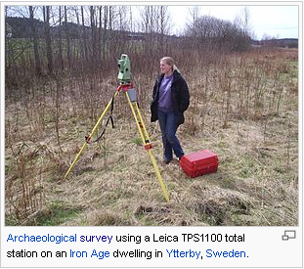
Surveying impacts more than property lines
A total station is an electronic/optical instrument used in modern surveying. The total station is an electronic theodolite (transit) integrated with an electronic distance meter (EDM) to read slope distances from the instrument to a particular point.
Surveying has been an essential element in the development of the human environment since the beginning of recorded history (about 6,000 years ago). It is required in the planning and execution of nearly every form of construction. Its most familiar modern uses are in the fields of transport, building and construction, communications, mapping, and the definition of legal boundaries for land ownership.
http://en.wikipedia.org/wiki/Surveying
Total Stations are used by:
Land Surveyors;
Civil Engineers;
Archaeologists;
Police;
Crime Scene Investigators;
Private Accident Reconstructionists;
Insurance Companies;
Mining Companies:
Tunnel Walls;
Ceilings;
Floors;
Etc.

Slide 15
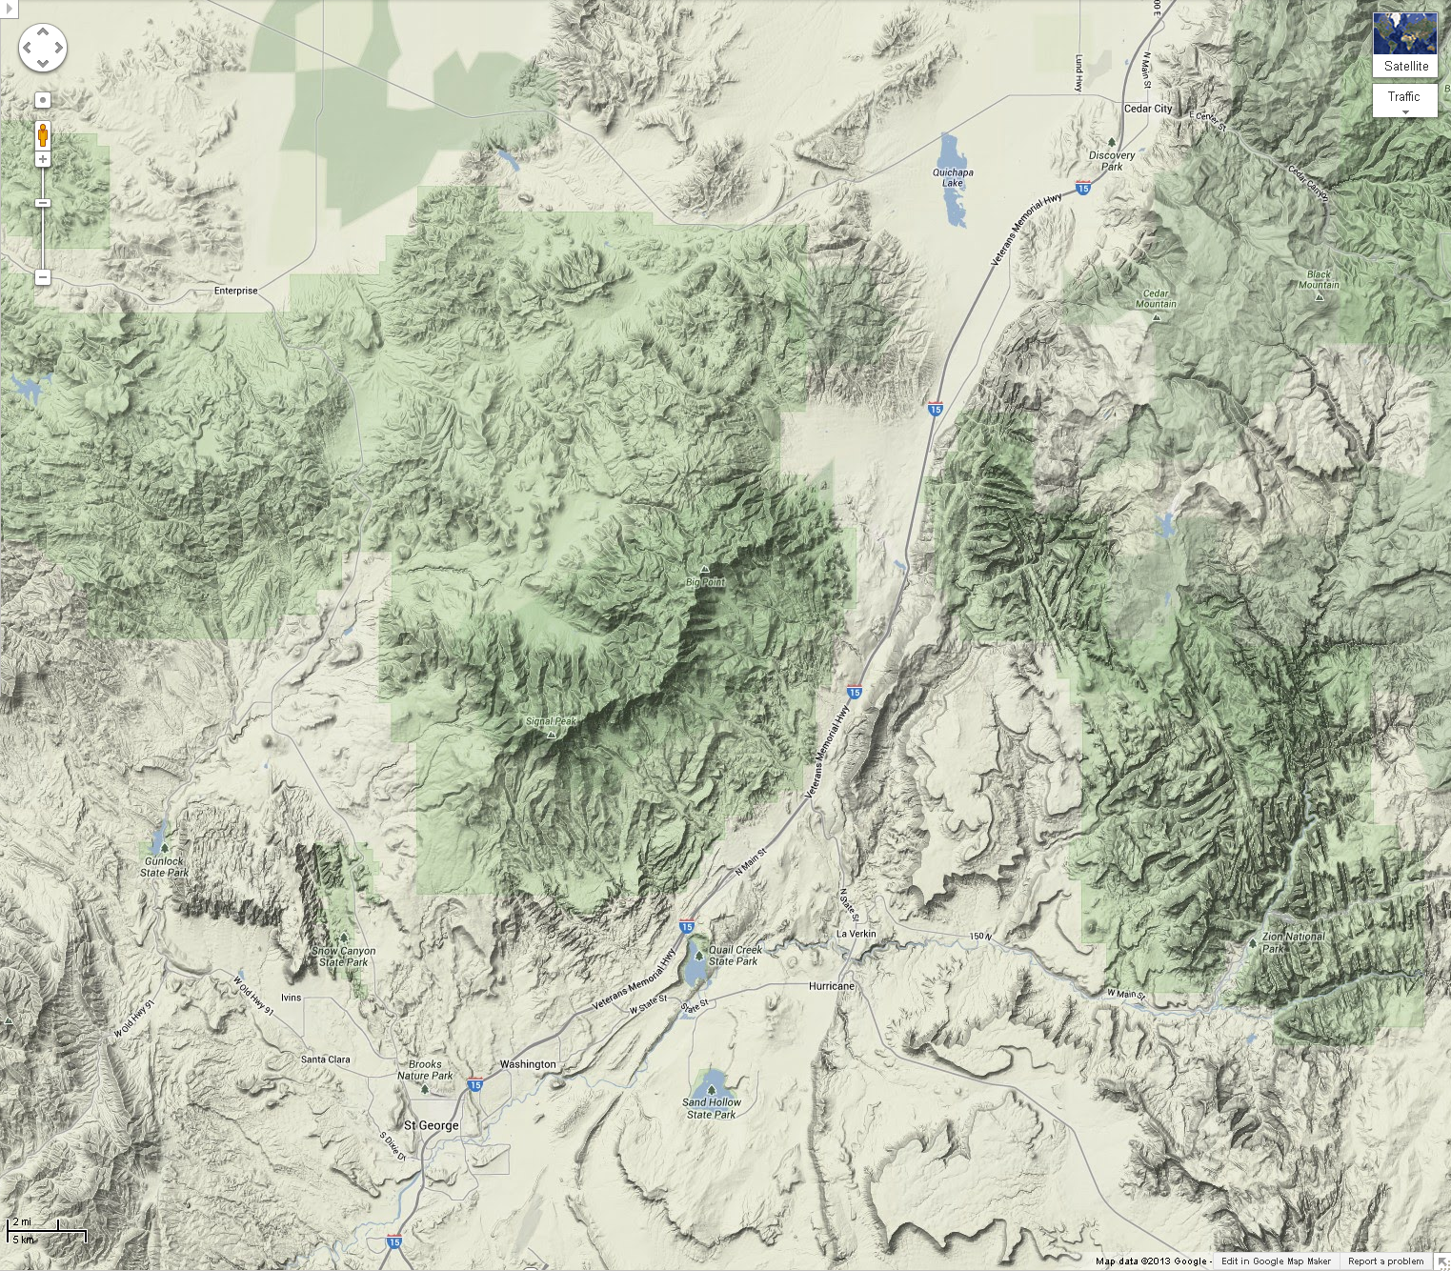
Roads to the Santa Clara Volcanoes
Where we are
.
Nelson Cabin
Pinto
.
Where we want to go

Slide 16
GPS (Geographical Positioning System)
What is a GPS device?
A GPS device is an electronic unit that can determine your approximate location (within around 6 - 30 feet) on the planet. Coordinates are normally given in latitude and longitude. You can use the device to navigate from your current location to another location. Some devices have their own maps, built-in electronic compasses, and voice navigation, depending on the complexity of the device.
How does GPS work?
Each GPS device is a computer that receives signals broadcast from GPS satellites. A device needs to read signals from at least three satellites at a time to calculate its general location by a process called trilateration.
With signals from four satellites, a GPS receiver can get a more accurate fix that includes altitude and the exact time, as well as latitude and longitude. The more satellite signals the receiver reads, the more accurate the position it reports to you.

Slide 17
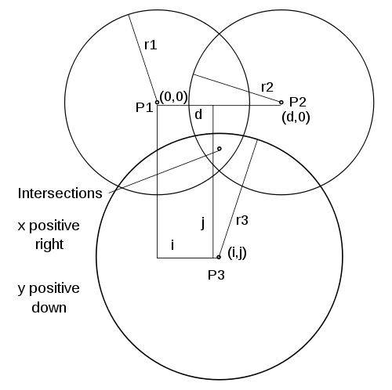
Trilateration
In geometry, trilateration is the process of determing absolute or relative locations of points by measurement of distances, using the geometry of circles, spheres , or triangles.In addition to its interest as a geometric problem, trilateration does have practical applications in surveying and navigation, including global positioning systems (GPS). In contrast to triangulation it does not involve the measurement of angles.
Figure 1. The plane, z=0, showing the 3 sphere centers, P1, P2, and P3; their x,y coordinates; and the 3 sphere radii, r1, r2, and r3. The two intersections of the three sphere surfaces are directly in front and directly behind the point designated intersections in the z=0 plane.

Slide 18
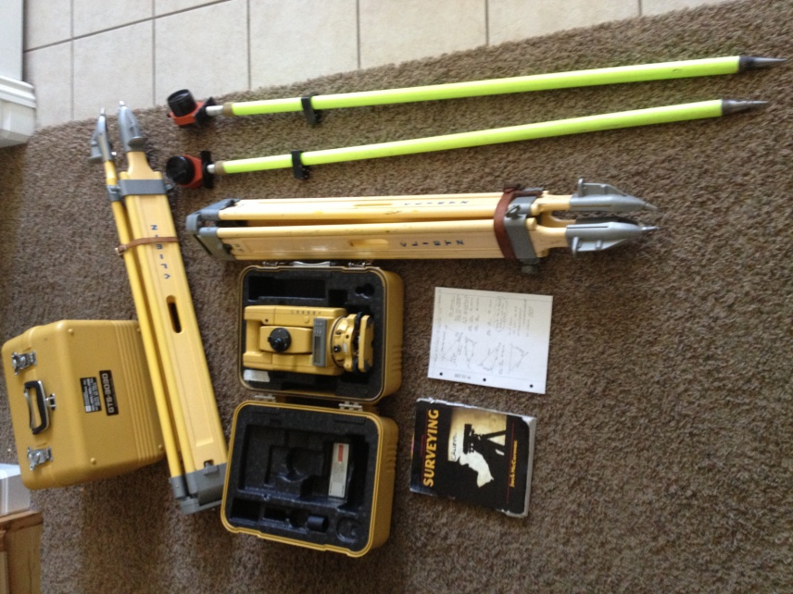
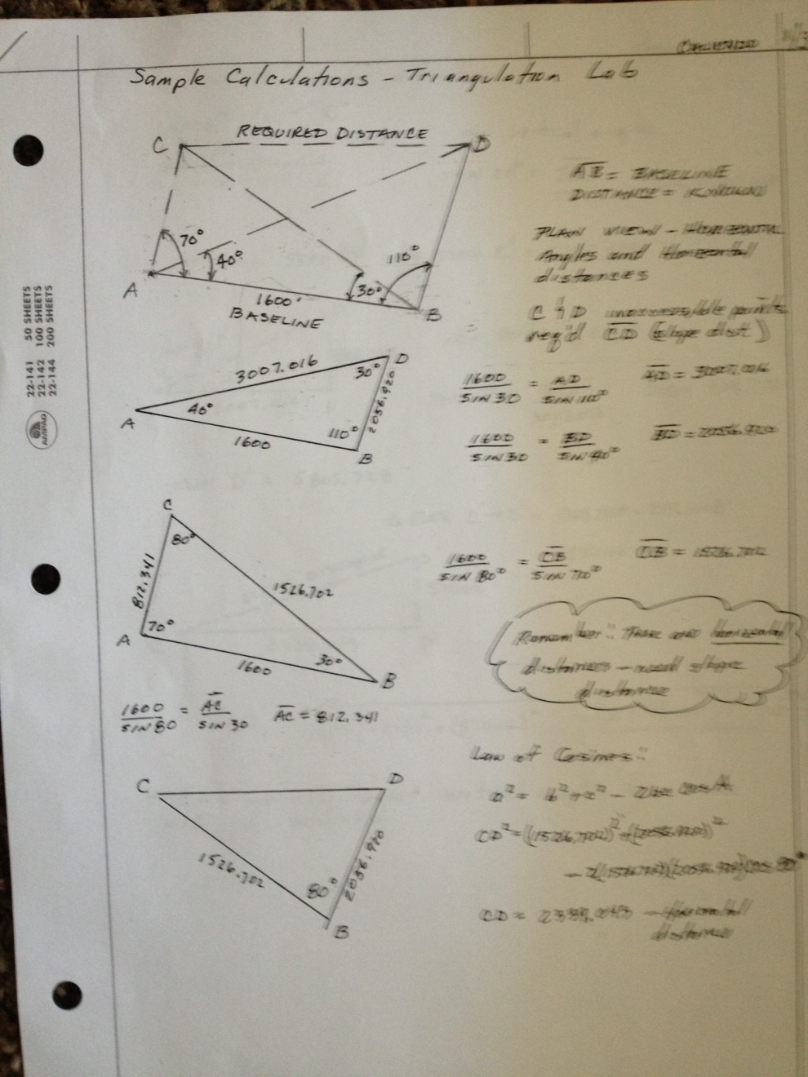
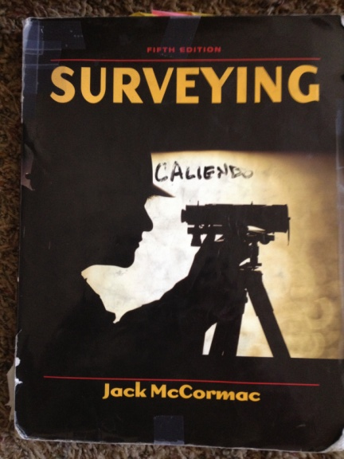
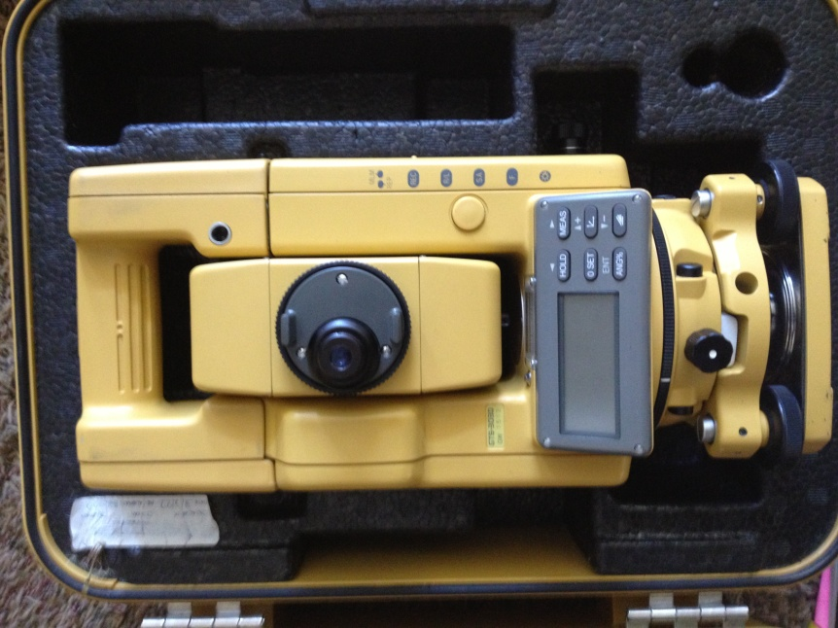
Our Surveying Equipment and Training

Slide 19
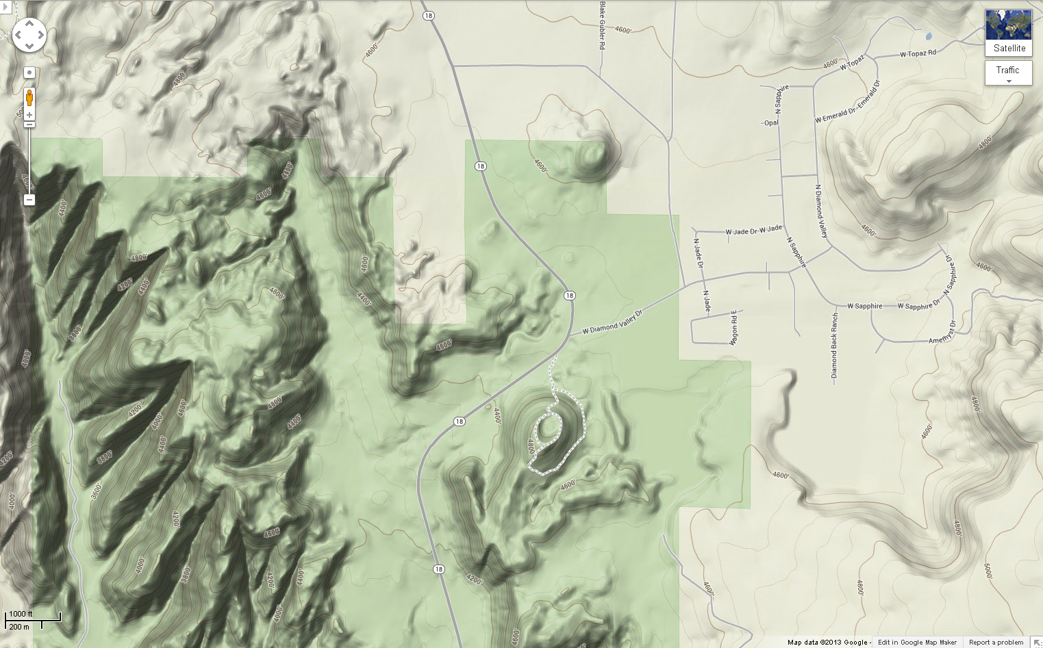
Objective: Survey Distance Between “X’s” with cell phone GPS, measuring on map, and EDM
X
X

Slide 20
Notes

Slide 21
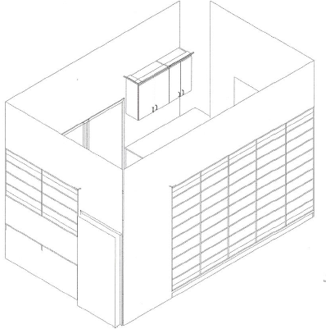
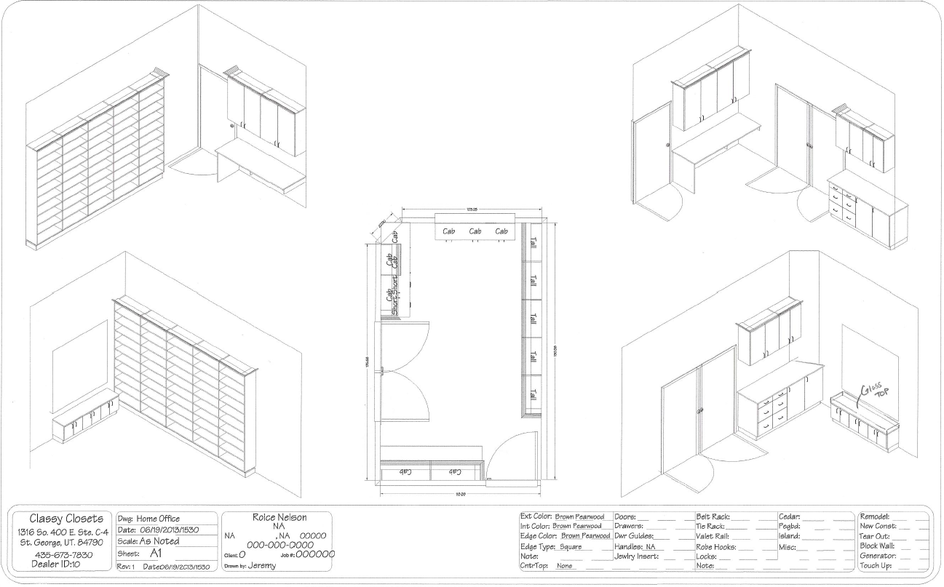
Carpenters Building Grandpa’s Office Bookshelves Do Smaller Scale Surveying

Slide 22
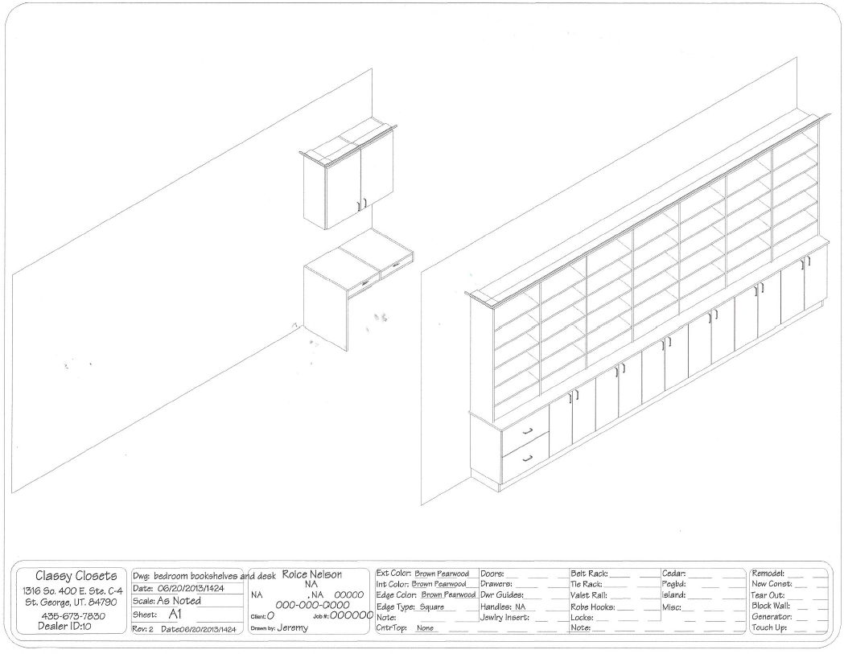
Same for Grandma’s Bookshelves and Desk

Slide 23
Notes

Slide 24
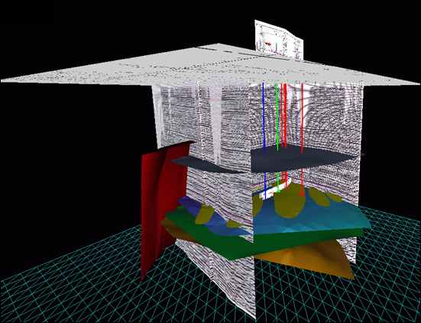
Surveying is Key in Exploration
Locations of seismic shot and receiver locations must be surveyed.
All seismic processing and interpretation depends on the accuracy of these locations.
Well locations must be surveyed accurately.
Other geophysical data must be located accurately: magnetics; gravity; lightning; etc.
Oil Exploration Prospect, South Texas
3D – Spatial Maps

Slide 25
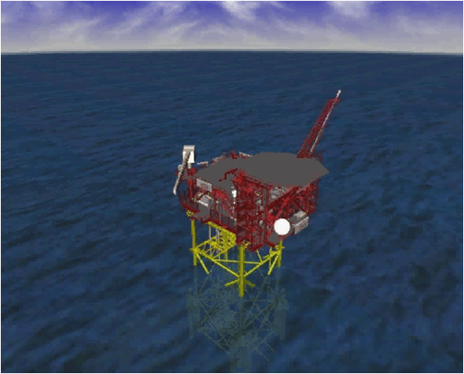
Surveying is Key in Construction
When Grandpa collected seismic data offshore Nigeria he was responsible for the satellite location of the ship.
Later, Grandpa interpreted this seismic data. Some lines were off by 3 miles.
Imagine a platform being miss located by a thousand feet and missing the target.
Imagine the deck of the platform being tilted 1 foot, and trying to keep stuff from rolling off into the sea.
CADCentre Model of Conoco Platform Options, North Sea
3D – Spatial Maps

Slide 26
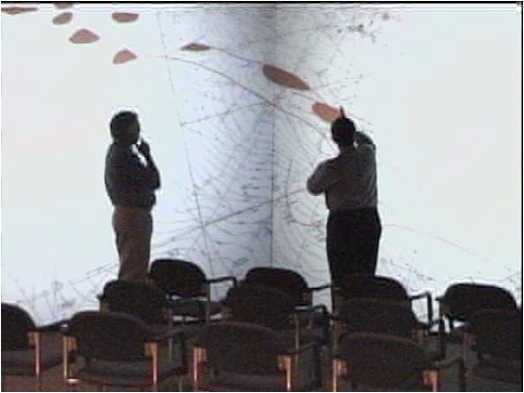
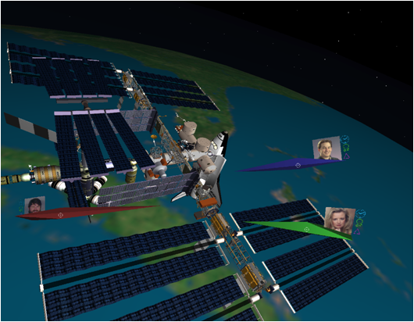
Human Scaled Displays
• People interact naturally with “people sized things”
• Immersion unlocks the power of peripheral vision processing
• Imagination of “microscopic” and “telescopic” is enhanced
• People sized visual representations are augmented with human scale frequencies of:
• movement
• time
• listening
• speaking
• Creativity follows unlocking the imagination with natural interactive interactions with data and displays

Slide 27
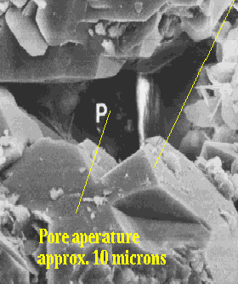
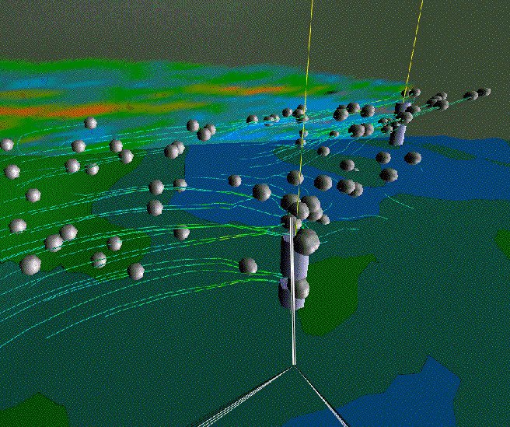
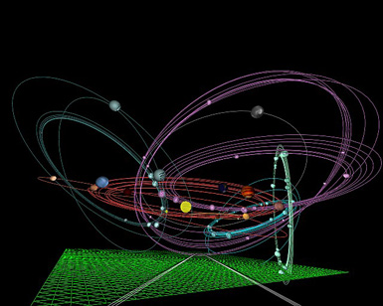
The Microscopic and the Telescopic
Fluid flow pathway
approx. 1,000 feet
Planetary Orbits
approx. 56-9,000 million miles
How do we survey something very small, something which is buried deep in the earth, or something way out in space?
How do we define ownership of something very small, something deep in the earth which moves from place to place, or something way out in space?

Slide 28
Notes

Slide 29
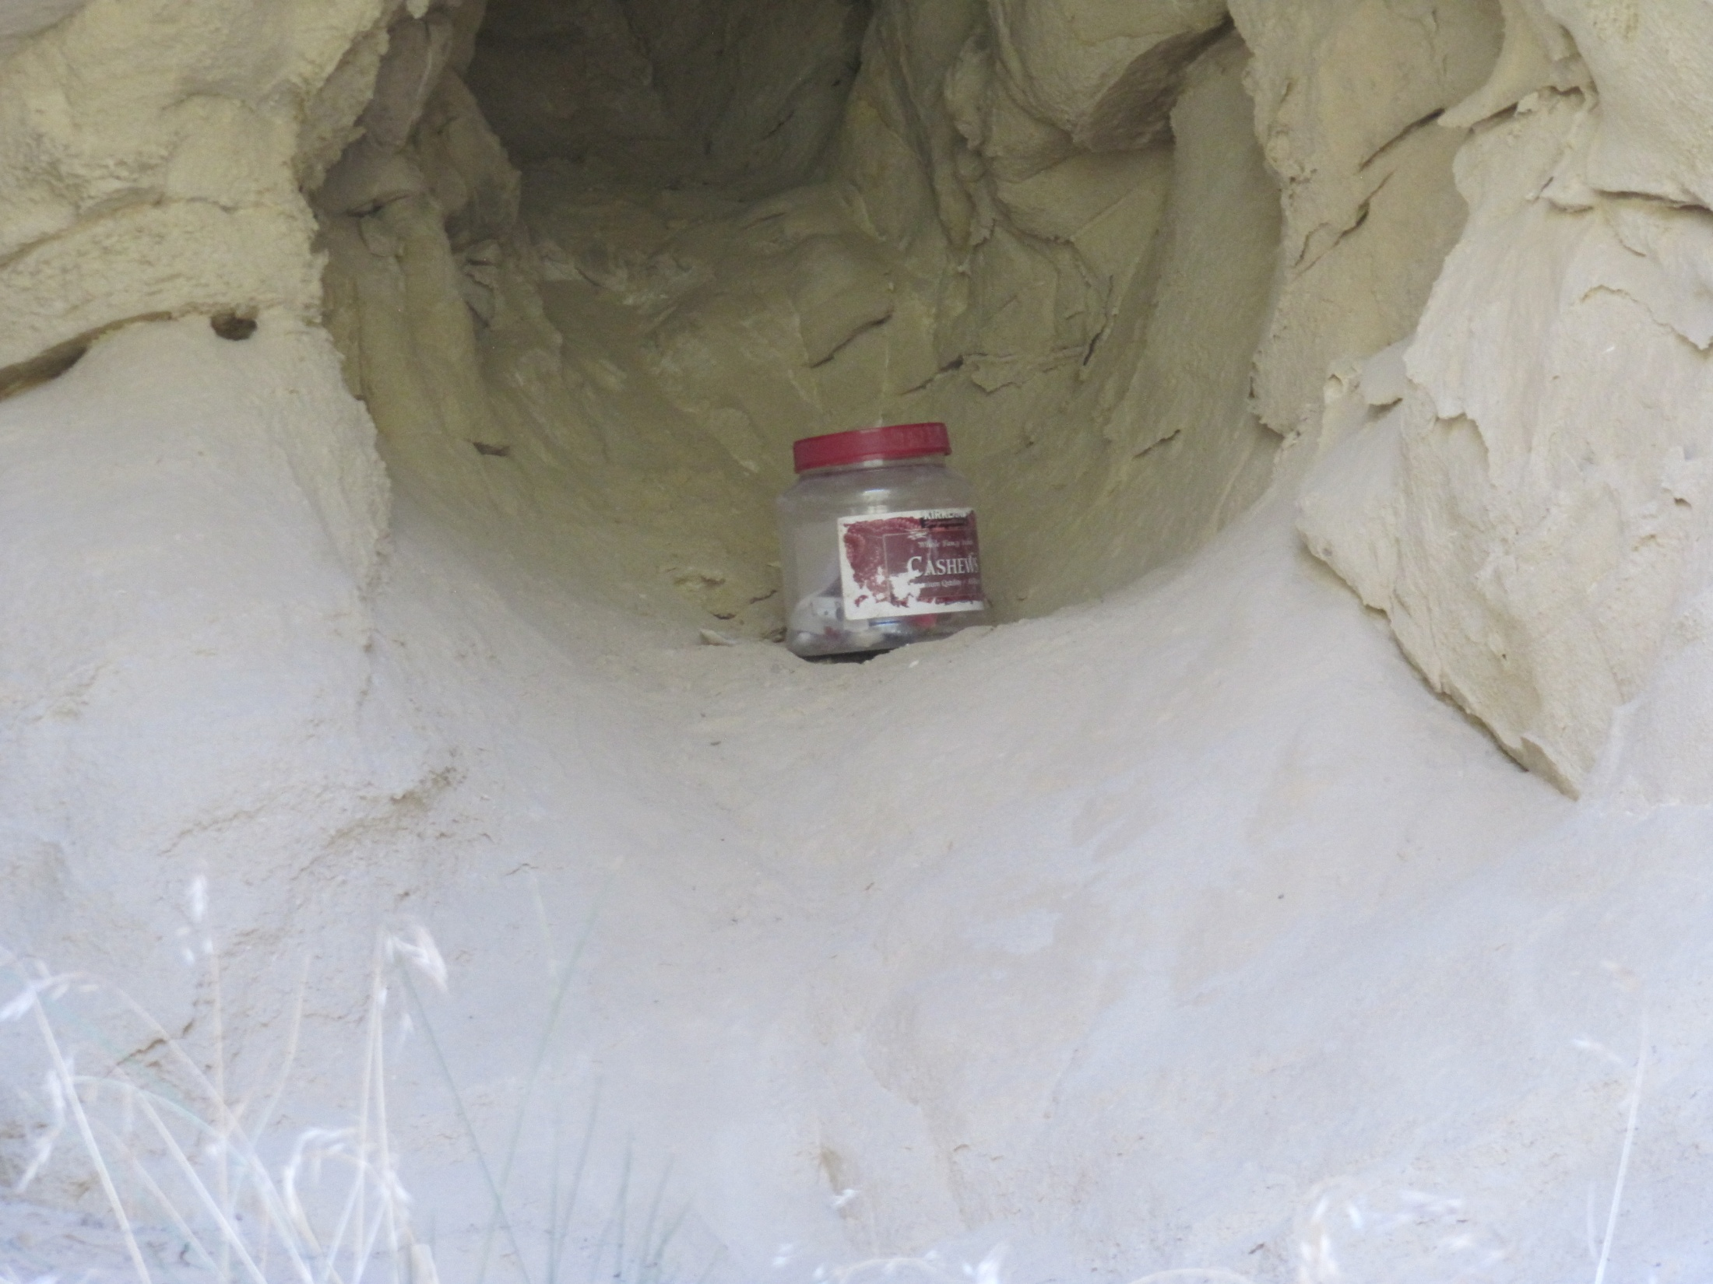
Fiddler’s Canyon Geocache

Slide 30
Notes

Slide 31
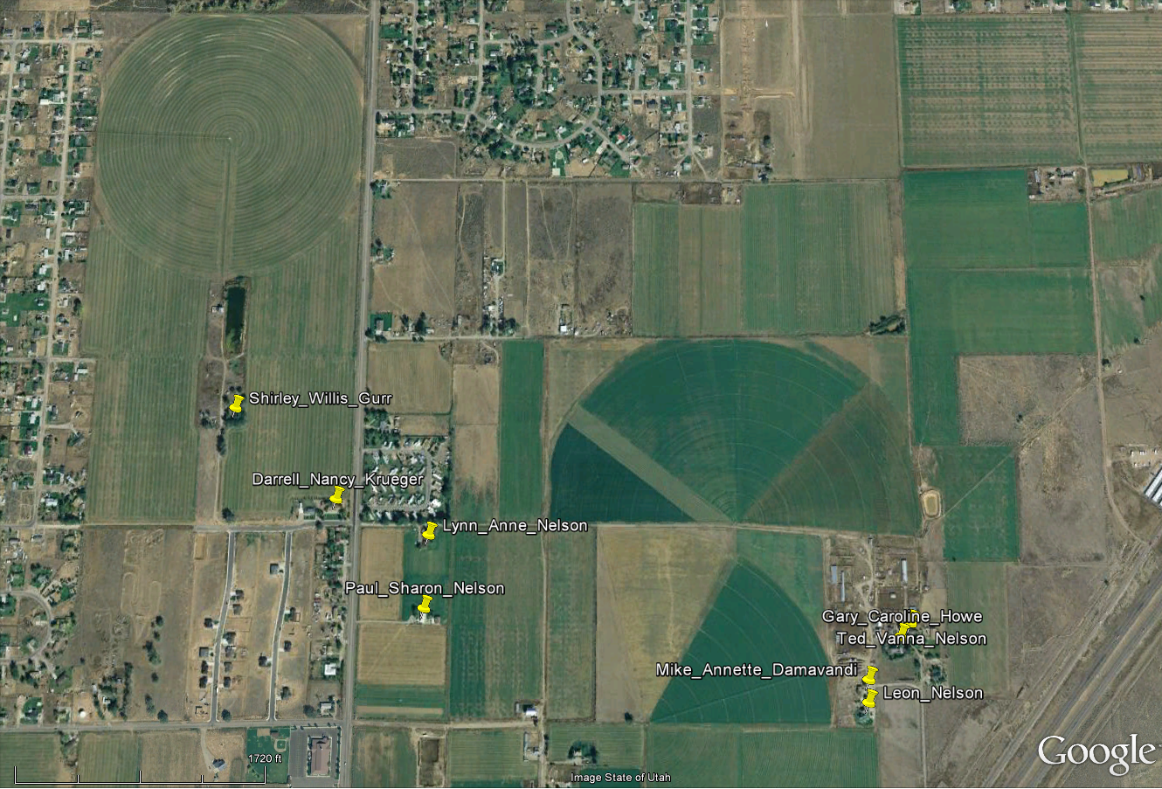
Nelson Farm & Relatives Houses

Slide 32
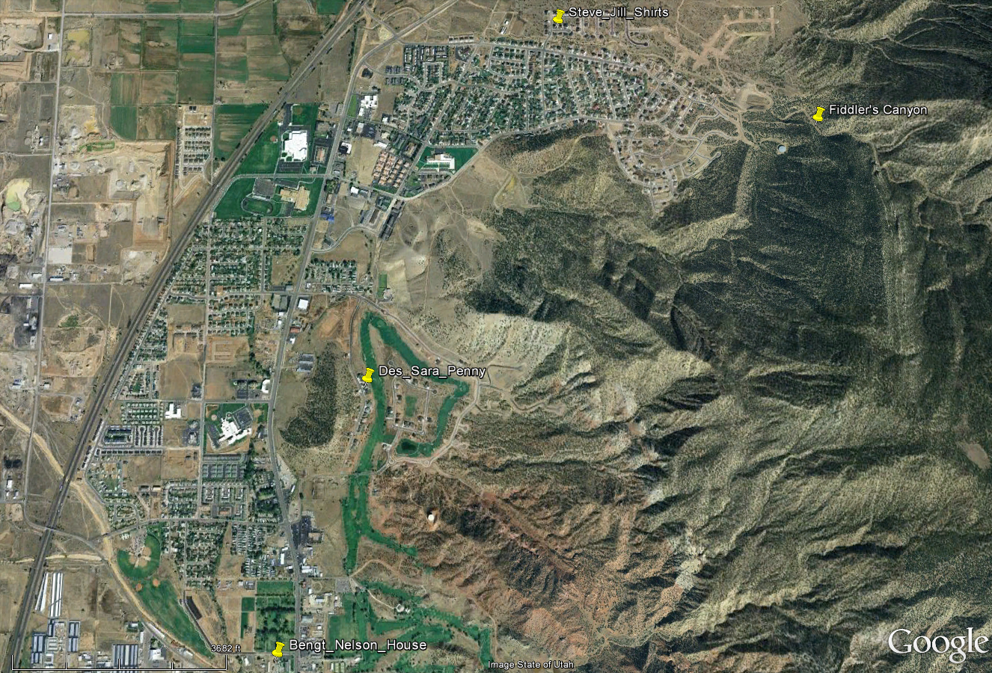
North Cedar & Relatives

Slide 33
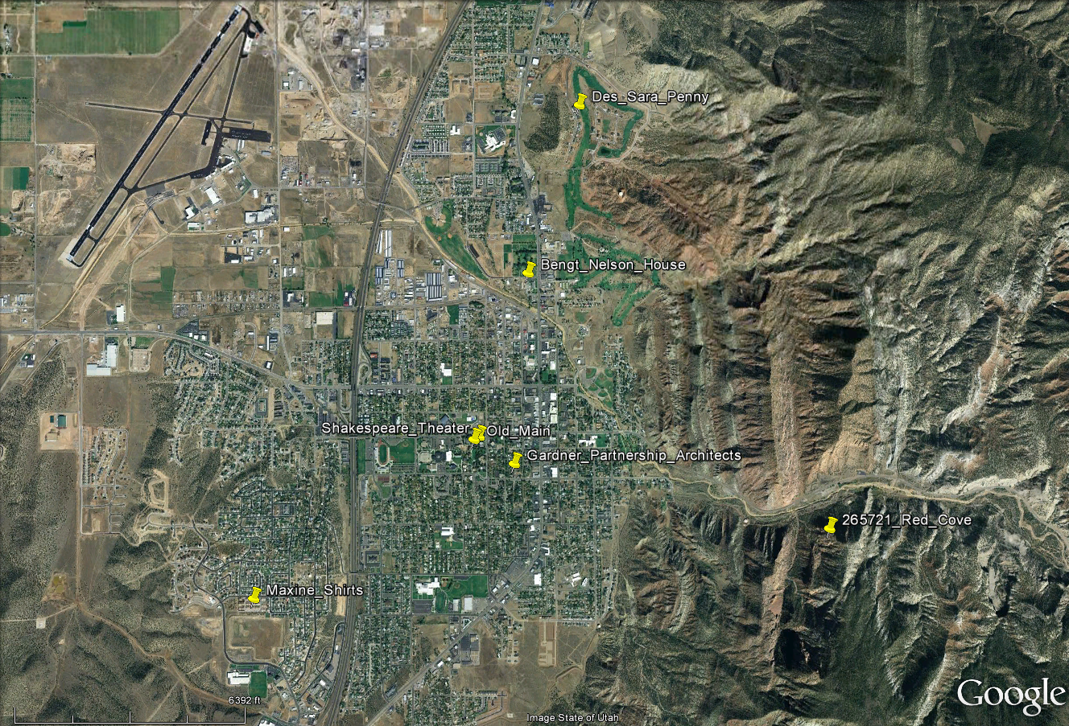
Cedar City & Relatives
Where we are

Slide 34
Notes

Slide 35
10 & 11 Year Old Sheepherders at Eddy Creek, Idaho
Eric was ten and I was eleven when Dad asked us to take care of his sheep. We were still young enough then to deal with life spontaneously; we saw adventure in basic, human struggles: love, fear, hate, hunger, cold, and heat were all strangely exciting. Life was а sensory experience, filled with wonder and awe. We thought little and felt everything. Even now it is hard to distance myself, difficult to look judiciously at what was grand and mysterious. Because the grand and mysterious are best handled by prophets or artists, and because I am neither a prophet nor an artist, my attempt to bind these experiences with words may seem presumptuous. But their authenticity is too great to deny. It would be hazardous, or at least unwise, for me to ignore experiences that continue to shape my values and influence the way I perceive reality.
Dad entrusted Eric and me with his sheep because he had to. We had not anticipated the responsibility; instead ‑‑ as was common for us as boys ‑‑ we spent the day fishing among beaver dams for native cutthroat and hunting rock chucks. We had just finished milking cows that evening, and were on our way to a field where we planned to teach our horses to make sliding‑stops. We did this by galloping across an irrigated pasture and reining our horses to an abrupt halt; horses will usually learn to tuck their hind legs and slide when stopping on wet grass.
But Eric and I did not make it to the pasture that evening. As we were saddling our horses Mom and Dad arrived, worried and in a hurry. They drove our old, dust covered pickup directly to the gas pump. Mom got out first and met us at the barn; she said Smokey Zoofelt ‑‑ one of our sheepherders ‑‑ was very sick and that Dad wanted to talk to us. We ran to the pump where Dad was filling the pick‑up with gas. I looked through the window and saw Smokey; he was half lying and half sitting on the pick‑up seat. His eyes were closed, his mouth open, and his head was resting against the passenger door. Dad told us he and Mom had been checking the sheep camps and had found Smokey, lying on the trail, unconscious. He had had a heart attack and was almost dead.
Smokey was the first almost‑dead person I had ever seen. It was sobering to see him lie pale and unconscious on the pickup seat. His beard was full and grey, and his face above the beard was empty, as if the beard had been greedy and used it up. I thought he looked like a mountain man who had come West to trap beaver and lived too long. Everyone knew he drank heavily, but it was still shocking to see Smokey lie helpless and near death. It made me realize anyone could die ‑‑ even I.
This realization resurfaced throughout my youth and had a significant effect on me, but at the time I did not take much time to think about death. While we were filling the pickup with gas, Dad asked Eric and me if we could find our way to Eddy Creek and look after Smokey’s sheep. We knew where Eddy Creek was, but had never been to this particular camp. Dad told us we would find Smokey’s tepee at the head of Eddy Creek. He said the sheep should be close to the tepee, probably within a mile or two, and probably on the highest peak in the area. He told us to get up early every morning, drive the sheep to a place where they could get fresh water and grass, and give them а half of а bag of salt every night when we bedded them down. Then Dad gave us what Eric and I saw as a great symbol of love and trust: his 6 ММ Remington. He reminded us about coyotes, told us to be careful, and with a very concerned look, began the seventy‑mile trip with Smokey to the hospital in Idaho Falls.

Slide 36
10 & 11 Year Old Sheepherders continued
The thrill of adventure dispersed both reverence and prudence. As soon as we could no longer see the house we yelled like savages, turned our horses from the dirt road, and ran through а hayfield, jumping dikes and ditches. But the trail soon left the valley floor and began to climb into the mountains. It became rocky and steep; we had to stop and rest our horses. As the sun went down we grew anxious, less and less confident in finding the sheep camp. Heavy clouds moved in, covering the moon, and creating а darkness so dense that sparks caused by our horses’ steel shoes on rocks looked like fireworks. We became sober and business‑like as darkness smothered our excitement. The weight of responsibility made us feel gratefully and unabashedly dependent on each other.
Eric, eleven months younger than I, was an important part of almost everything I did as а child. We both had an instinctive passion for exiting, even violent activity. One of the first things I remember is playing “superman” with Eric, and seeing him ‑‑ still in diapers ‑‑ dive head first through a glass door. He cut his thumb. I also remember sitting with him in a bathtub ‑‑ we were living in а Provo apartment at the time while Dad finished his Masters ‑‑ and both of us being afraid that an enraged woman, whose children we had fought with earlier that day, would get past Mom and beat us, while we were naked in the bathtub. Most of the time we were an inseparable pair.
If you had looked through the clouds and seen us that night, you would have been surprised at our confidence in each other. Eric was bare‑headed and had on а pair of pants that were too short for his already short legs. His too‑short pants were augmented by a pair of too‑long chaps, and he wore old work boots; one was bound to his foot with a leather lace that skipped half the holes, and the other by a cotton cord. Mom made sure he had a warm jacket, but the sleeves were too long, the zipper was broken, and of course it was dirty. Telling us apart would have been difficult, except that I wore cowboy boots, a hat, and my nose was running.
Our confidence in each other created some serious illusions about our ability to find the sheep. Since I had been to Eddy Creek more recently than he, Eric was certain I would find the camp. I, on the other hand, was depending on Eric’s sharp eyes to locate the tepee. Rain started falling about the time we arrived at what I thought was Eddy Creek. Willows in the creek bottom slapped us in the dark, soaking us with water they seemed to hoard for no other reason. Our horses’ steel shoes made fewer sparks on the wet, slick ground, and we had to ride carefully so they would not slip.
We were riding slowly, with our heads down, trying to keep warm, when we found ourselves in the center of а herd of cows. They were in а grove of quaking aspen, trying to stay out of the rain. As we passed through this grove the entire herd jumped to their feet, snorting and milling about. It startled us to be so surrounded. The cows were big and strong; they seemed angry and some of their eyes shone brightly in the dark. We felt out of place, like strangers who were interrupting а private party and were not welcome. But as our horses carried us out of the trees and back into the open our confidence returned. We even began to lament the fact that Dad had not sent us to herd cows. We thought it would have been much more fun if we had just found а warm, dry cow camp, and could herd cows instead of sheep.

Slide 37
10 & 11 Year Old Sheepherders continued
But there was no cow camp, and we had to find the sheep, so we rode on. The trail had disappeared long ago, and we were now following the creek ‑‑ as best we could in the dark ‑‑ trying to stay away from those wet, vindictive willows. The rain eased but a north wind started to blow; we were getting cold and tired. Eric began to openly doubt whether we were following the right creek, and I too became skeptical. Tying my reins in a knot, I sat back in the saddle and slid my hands under the saddle blanket to warm them. With warm hands it was easier to think. “Eric,” I said, “Why don’t we pray?” He agreed, so we climbed stiffly from our saddles, knelt in the wet grass, and holding our reins, with the horses’ hot breath spilling down the back of our necks, we prayed. We prayed for Mom, Dad, Smokey, and Grandpa Neilson, but mostly we prayed for help in finding the tepee and getting warm.
At ages ten and eleven we had had little experience with cynicism, and even less with the indignant contempt in which many “thoughtful” people hold prayer and acts of God. Praying had always seemed natural to Eric and me. Our ignorance of social stereotypes ‑‑ particularly those into which boisterous farm boys are supposed to fit ‑‑ prevented us from knowing that by kneeling together in prayer we were ruining ‑‑ for many audiences ‑‑ а story that might otherwise have been acceptable.
The harsh realities of nature humbled us and, combined with praying, gave us hope and a sense of perspective. The clouds thinned and the moon shone through. Feeling united again and determined to find the tepee, we worked our way through the sagebrush, leaving the creek‑bed in favor of high ridges which gave us а better view.
We sighted the tepee about midnight. It stood at the head of a small, nameless stream that flowed into Eddy Creek. For а while we fumbled around in the moonlight, trying to find some oats for our horses but found none. Finally we unsaddled the horses and tied them to aspen trees. Pulling Dad’s 6 MM from the pile of wet saddles, we scrambled, wet and tired, into the tepee. The tepee was not very big; it was made of canvas and was very dark inside. We felt around until we located a sleeping bag; both of us crawled into it, wet clothes, boots, and all. Eric rolled a knot of my hair around his finger, and we fell asleep.
Morning made Eddy Creek look like a different world. Fresh sun on wet sagebrush filled the air with a rich, earthy pungence. Daylight danced among rocky cliffs, played on the tops of fir trees, and glittered across the aspen leaves. It shone on Eric and me, bathing us in warmth and revealing а sack of oats under an old canvas tarp. We picked our saddles off the ground, where we had left them the night before, fed our horses some oats, hobbled them, and let them graze while we breakfasted on Smokey’s canned Vienna Sausages and grape fruit sections.

Slide 38
10 & 11 Year Old Sheepherders continued
After breakfast we tried to find the sheep, but that proved more difficult than we expected. Dad had told us they would probably all be together on top of a hill. [Sheep instinctively seek high ground for protection from predators.] With Dad’s suggestion in mind we spent hours riding up one hill and down another, scanning the peaks, and becoming increasingly skeptical over whether or not we could handle this responsibility.
The thrill and gratitude we felt at finding those sheep is almost embarrassing to remember. All three thousand were perched nervously on a high, rocky knoll, several miles north of the tepee. We were so glad to find them that the area they had trammeled to dust and covered with sheep smells made us yell in spontaneous delight. We drove the herd to а branch of Eddy Creek where they found water and spread out over a green hillside to feed.
Helping so many animals find food and water was gratifying; we felt happy and ‑‑ in a new and meaningful way ‑‑ important. The old ewes would drink their fill of water and then feed in earnest, moving systematical from one patch of grass to another. But the lambs were more entertaining; they nibbled a flower here and a blade of grass there. They climbed rocks and fought mock battles, running races through the sagebrush like so many children in a playground. Occasionally one would leap onto its mother’s back and gaze about, like а proud performer on a stage. That night we bedded the sheep down by pouring twenty five pounds of rocksalt around the top of a hill; they ate the salt and went to sleep in a tight bunch.
А routine soon developed around our care for the sheep. We would get up early and drive them from their bedding ground to water and fresh feed. Then we would eat breakfast ‑‑ which could last until noon ‑‑ cooking pancakes, hash‑browns, and bacon over a fire of dead sagebrush; we enjoyed the smell of burning sagebrush. Often we made more hot‑chocolate than we could drink and ended up giving the last cup or so to our dog. After breakfast we would ride back and check on the sheep, usually stopping to roll rocks from a cliff. Eric and I were rarely able to pass up an opportunity to roll rocks; why we felt such а compulsion for rock‑rolling I do not know, but the noise, dust and violence were hard to resist. We also spent hours stalking deer and antelope. The thrill of seeing how close we could get to them, and their beauty, speed, and grace were enthralling. At dusk our playing stopped. We had to pour salt for the sheep. To do this both of us would get on the same horse; the kid on back would hold the sack and pour salt on the ground while the one in front rode the horse around the top of a hill. Then we would ride back, get the other horse, and together, drive the sheep to the hill‑top where we had poured their salt. They would eat it and bed down for the night.

Slide 39
10 & 11 Year Old Sheepherders continued
Night always brought coyotes: а sheepherder’s biggest challenge. They dominated the night, howling, yapping and occasionally fighting among themselves. Our third night out they killed five sheep, two ewes and three lambs. Both the ewes had their udders eaten away, one of the lambs had been disemboweled and his heart and liver eaten; the others were simply killed. We were mad and disappointed in ourselves for not taking better care of Dad’s sheep.
The night after the killings we took our sleeping bag and slept near the sheep, where we could watch for coyotes, but did not get much sleep. А big, bright moon shone with enough light to cast shadows, and the coyotes made a terrific racket. The ground was rocky, a cold wind blew, and Eric tried to take more than his share of the sleeping bag. We kept Dad’s rifle handy all night but saw no coyotes. Morning arrived calm, clean, and cloudless; the sky turned from а dark, steel gray to a deep blue. As we prepared to move them to water, the sheep on the opposite side of the herd were suddenly frightened; they ran in different directions, bleating feverishly. Racing our horses around the terrified herd we saw one; I pulled the rifle from its scabbard, jumped from my horse and shot at the coyote; it fell and I yelled triumphantly, but prematurely. My yell had just started to echo when the coyote regained his feet and disappeared over a ridge.
The coyote’s escape was very disappointing, especially for Eric. Coyotes, however, were no longer our only serious concern; we had eaten enough long breakfasts to critically deplete our food stores. Dad had told us about a supply camp not far from the Forest Service gate on Erving Creek. We had never seen this camp, but thought we could find it. The following morning we set out for Erving Creek, intent on filling several salt‑sacks with food. No trail led to Erving Creek; we simply wandered from ridge to ridge, avoiding steep, rocky places, and working our way North and West toward the base of Red Mountain.
It took some time to get out of the rocks, but by noon we were riding down а grassy hillside that fell away quickly to the bottom of Erving creek. While descending an especially steep part of this hillside, Eric’s little mare ‑‑ Princess ‑‑ dropped her head for a bite of grass. Eric had put the saddle on as best he could, but like most ten‑year‑olds he was bad at tightening cinches. As long as Princess held her head high, her neck kept the loose saddle in place, but when she dropped her head, going down this sheer slope, both Eric and the saddle slid off her back, over her ears, and landed on the ground in front of her. The saddle caught about her feet, but Eric rolled down hill, crashing against a rock. I was afraid he had been hurt, but he stood up and laughed, claiming it had been great fun. Princess ate her grass as though nothing special had happened.

Slide 40
10 & 11 Year Old Sheepherders continued
Dad’s supply camp at the Forest Service gate was a small metal-clad wagon with a wood-burning-stove, a bunk, and some storage cabinets; we called it a sheep camp, and finding it was like Christmas. Not only did we find all the food we could use, we also found a Marlin 30‑30; now Eric had a gun too. With an extra rifle we thought we could stop the coyotes from killing Dad’s sheep. There was a problem though ‑‑ Eric was afraid the 30‑30 would kick hard enough to hurt him and I was afraid of it as well, but we had to at least try the gun. Eric loaded it and I shot a hole in the Forest Service boundary marker; from then on Eric needed no encouragement to use the Marlin. His confidence grew to exuberance when he made a first‑shot hit on a small pickle jar we had set in an ant‑hill a hundred and fifty yards away. I had already tried the shot and missed. Dad’s supply camp at the Forest Service gate was a small metal-clad wagon with a wood-burning-stove, a bunk, and some storage cabinets; we called it a sheep camp, and finding it was like Christmas. Not only did we find all the food we could use, we also found a Marlin 30‑30; now Eric had a gun too. With an extra rifle we thought we could stop the coyotes from killing Dad’s sheep. There was a problem though ‑‑ Eric was afraid the 30‑30 would kick hard enough to hurt him and I was afraid of it as well, but we had to at least try the gun. Eric loaded it and I shot a hole in the Forest Service boundary marker; from then on Eric needed no encouragement to use the Marlin. His confidence grew to exuberance when he made a first‑shot hit on a small pickle jar we had set in an ant‑hill a hundred and fifty yards away. I had already tried the shot and missed.
Having filled the salt‑sacks with food, we strapped “Eric’s” Marlin onto his saddle and started back to our sheep. Climbing out of Erving Creek took hours longer than it should have. We looked for huckle‑berries, chased squirrels, laughed at each other’s stories, and saw a bobcat. It was hunting rabbits on the same grassy hillside where Eric had fallen over Princess’ head. When the bobcat saw us it ran into a stand of fir trees, disappearing among the dark tree trunks and heavy underbrush. We also surprised a bear. He stood on his hind legs, smelt the air, and lumbered off, his huge muscles rippling beneath a sleek, black coat. That night we thanked God for every animal we could think of; we thanked him for our family, our horses, the water, the trees, and the grass.
We woke up the next morning stiff and sore. My horse, Cody, would not let us saddle him. He was probably tired of walking up and down mountains, and was confident that he could put an end to the inconvenience. Saddling Cody was not easy even when he wanted to cooperate. I had to balance the saddle on my head, stand on a five‑gallon bucket, and throw the saddle with all my strength. This morning Cody bared his teeth, laid his ears back, and knocked me off the bucket. We tried feeding him oats and saddling him while he was eating, but he would stop eating and knock me off the bucket just the same. This went on for over an hour, the morning got old, the sheep began to scatter, and I could not saddle my horse.
4‑Н and text‑book methods were not working; in desperation I told Eric to get the shovel and beat Cody if he tried to bite me again. Eric refused, saying Cody was too expensive a horse to beat with a shovel. He agreed, however, to mount the bucket and let me administer the beating if Cody tried to bite him. When I hit Cody, he almost uprooted the tree to which he was tied. He reared, and fell back, snorting, and rolling his eyes, but further beatings were unnecessary. He stood still, allowing me to climb up on the bucket and saddle him.

Slide 41
10 & 11 Year Old Sheepherders continued
When Dad finally paid us his first visit, we were very glad to see him. He rode in from Erving Creek, leading several packhorses loaded with salt and supplies. My three‑year‑old brother Lad was sitting on the back of a packhorse, hanging on to the Decker pack‑saddle with both hands, smiling, and talking excitedly. As they rode up to our breakfast fire, I felt a love and appreciation for my family I had never known so intensely before. We belonged, we belonged together and we belonged here.
It took Dad three weeks to find а sheepherder. During that time Eric and I broke the bow‑saw trying to cut down a huge fir tree; we found arrowheads among circles of rock where some of Chief Joseph’s Indians had camped, got lost in the fog, and were alternately sun burnt and frozen. We hunted coyotes every day, and raced our horses bareback through Eddy Creek. If we felt dirty, we washed with a pan of water and some dish‑soap; if we were hungry, we ate; if we were tired, we slept. When we felt happy and strong, we wrestled or rolled rocks; and if we were sad we were quiet. At night we prayed. When Dad found another herder to take Smokey’s place, we were almost disappointed. We missed our Mom and the home she kept, but the mountains too seemed like home; we belonged there like the deer, bear, and bobcats.
Just why this sheepherding experience had such а profound affect on me I cannot say. I only know that our faith in God, the realities of nature, the trust of our Mother and Father, our companionship as brothers, and the beauty of the animals imprinted themselves on my mind as good. They are impressions of life, strength, and hope; they are experiences worth sharing.
Nature is а harsh and beautiful friend. She can touch the soul of a boy and give his character a virile, independent dimension institutions tend to suppress. When а young person’s life is dominated by programs, schools, and cities it is easy for him to miss the awe, wonder, and power associated with life, nature, and God. Civilization’s manacles help bind savage passion in some boys ‑‑ like those in William Golding’s Lord of The Flies who worship a pig’s head and try to destroy each other ‑‑ but these manacles can also dull the passion of another kind of boy, who thrills with a love of life, and instinctively, enthusiastically worships the God of life.
On looking back it seems that God took us when we were still tender enough to feel, and said:
“Look at the beauty of these mountains; it is good. Look at the grace and speed of these animals; they are good. Feel the love of your brother; it is good. Observe the trust of your parents; that is also good. Now my little sons, remember and enjoy that which is good. Never forget that there is more to life than you can see; don’t be deceived by а handful of dust.”
Reprinted for The Nelson Grandkid’s Science Summer Camp with permission of:
Renn G. Neilson, now a Texas State Tax Lawyer and Partner at Baker Botts L.L.P.
910 Louisiana Street, Houston, TX 77002-4995 713.229.1671 cell: 281.215.9796

Slide 42
Notes

Slide 43
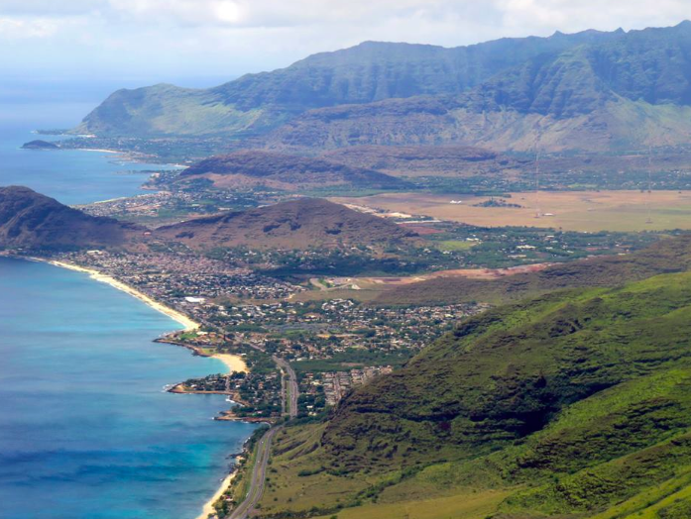
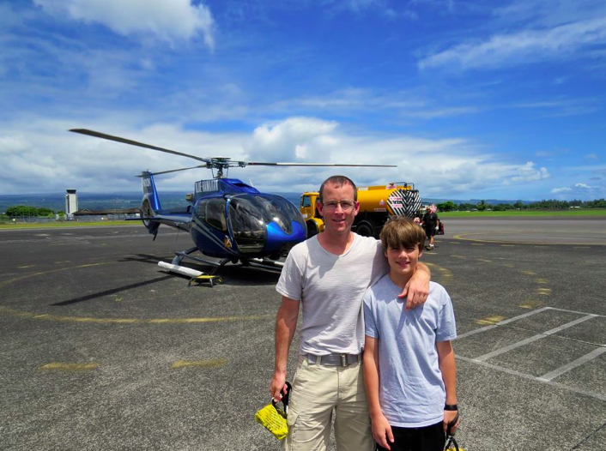
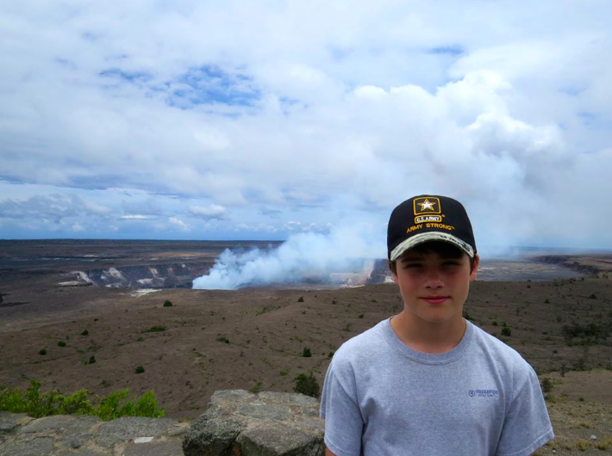
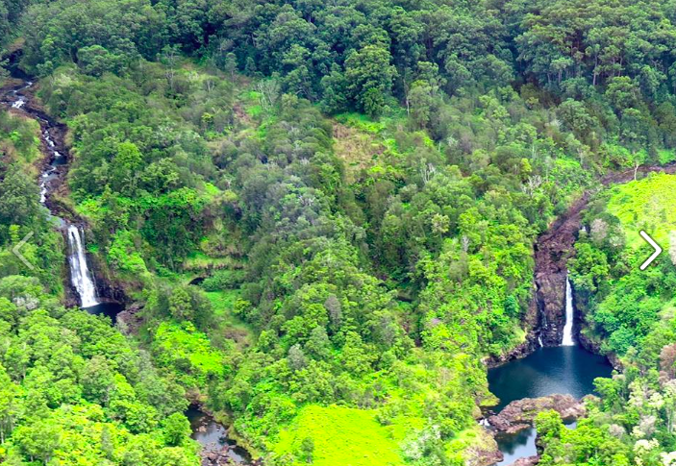
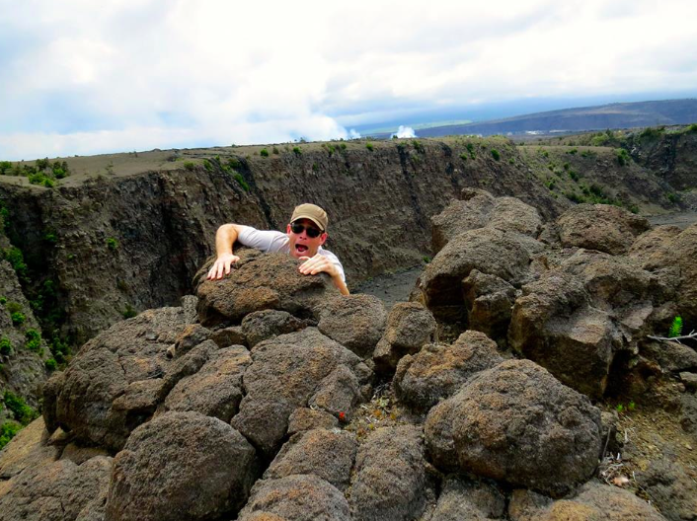
Ethan’s Trip to Hawaii page 1

Slide 44
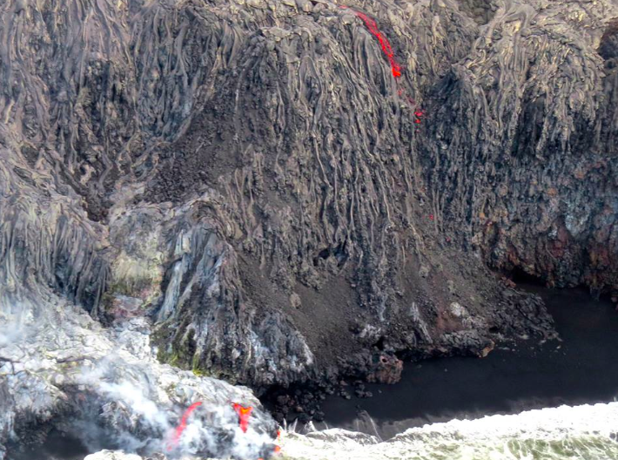
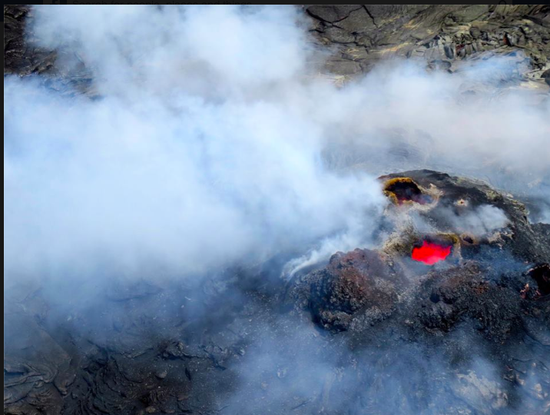
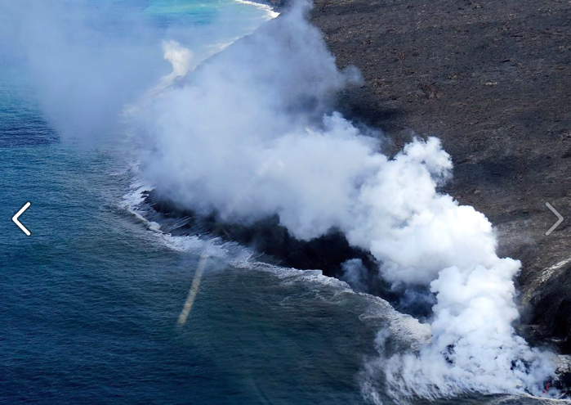
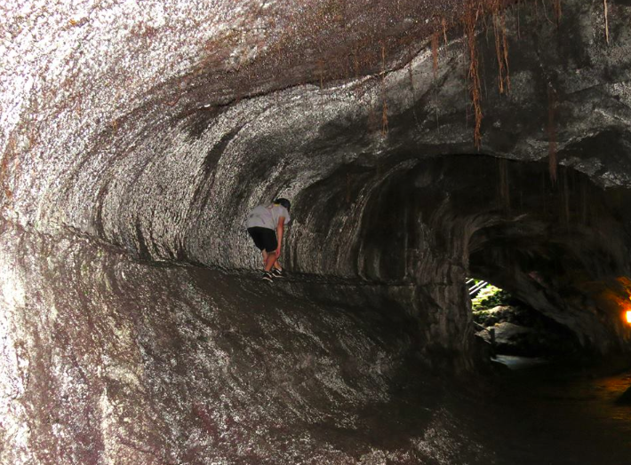
Ethan’s Trip to Hawaii page 2

Slide 45
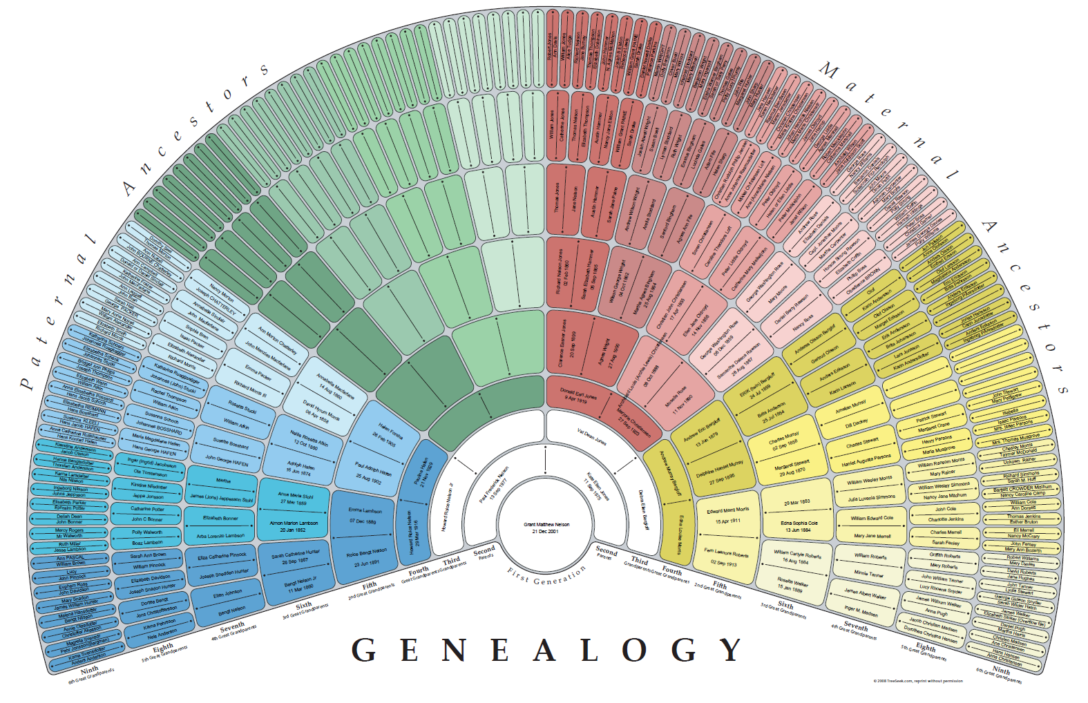
Grant’s Genealogy Starting Point

Slide 46
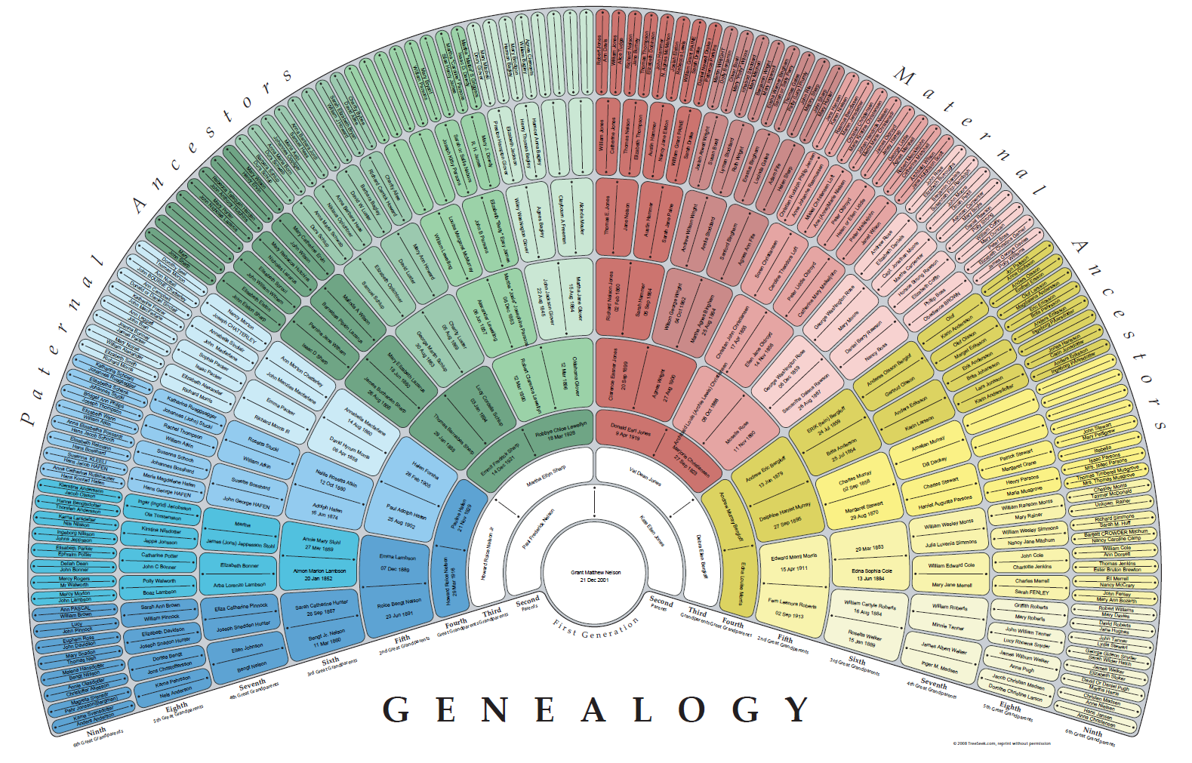
Grant’s Genealogy Work

Slide 47
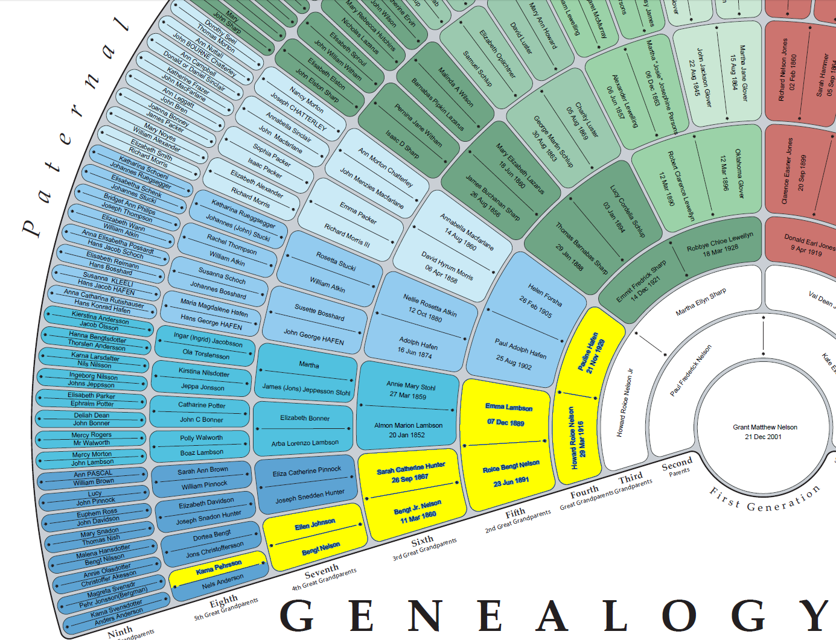
Ancestor’s whose gravestones we visited last year are in yellow

Slide 48
Grant’s Science Fair Project 2013

Slide 49
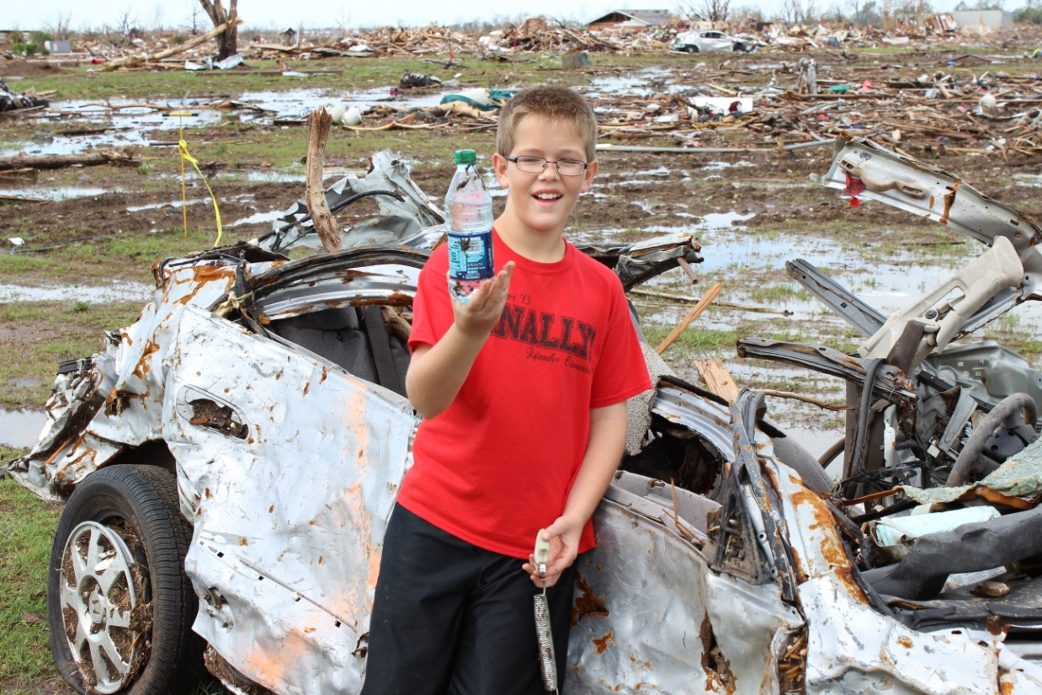
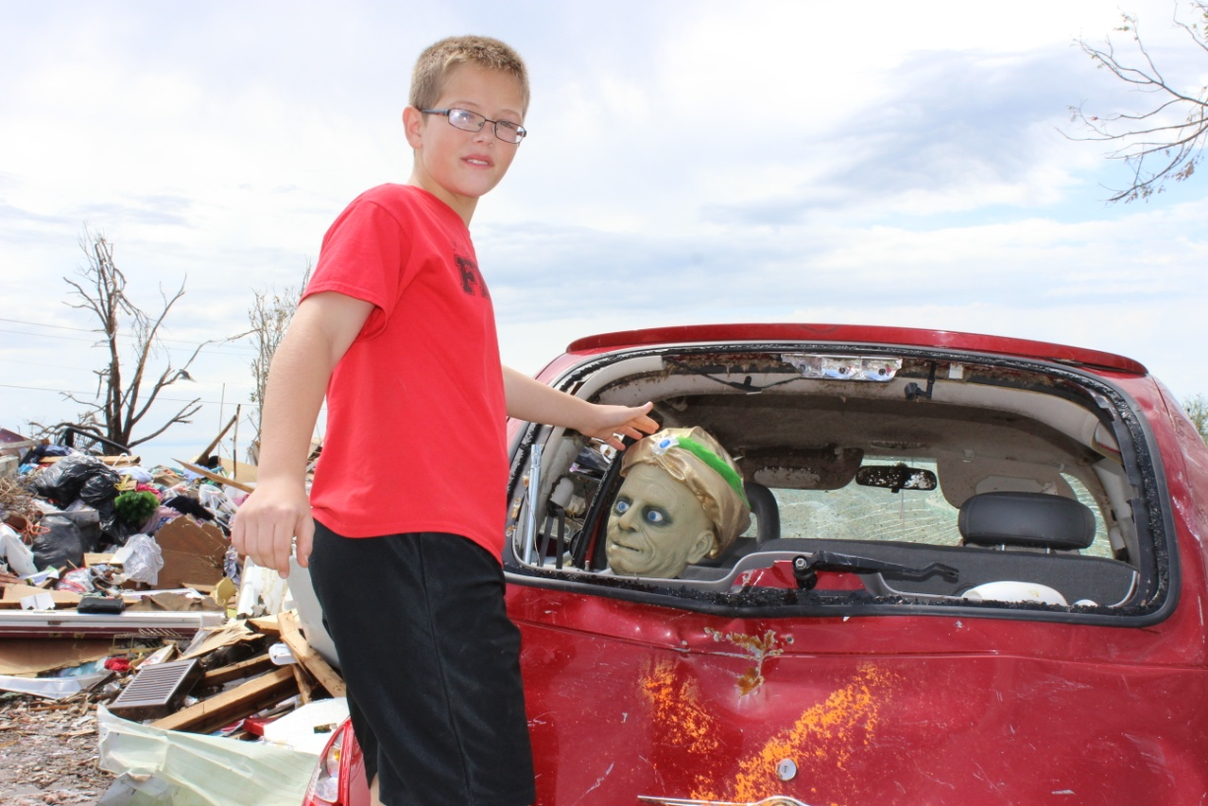
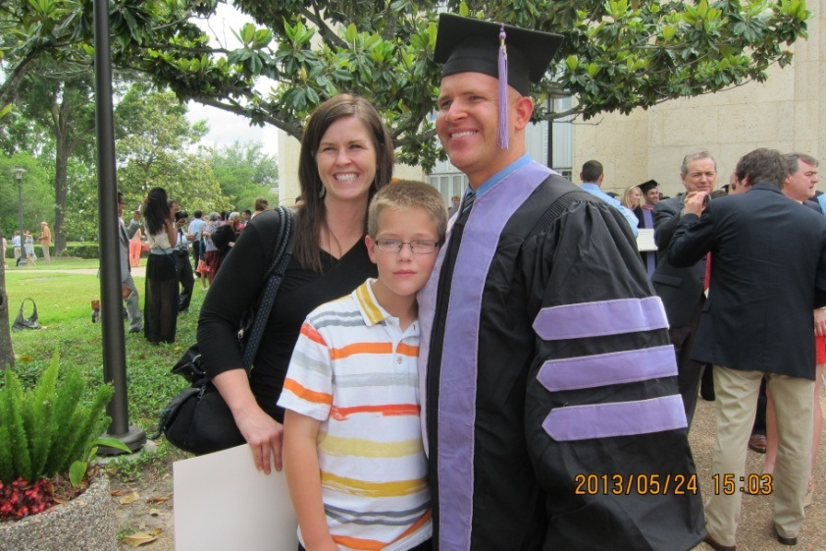
Colby’s Trip to Moore, Oklahoma and Dad’s Doctor of Dental Surgery

Slide 50
Ella’s Science Project page 1-2

Slide 51
Ella’s Science Project page 3-4

Slide 52
Taylor’s last swim, last run through, last photo at 1307 Emerald Green, & Rylander Talent Show

Slide 53
Notes

Slide 54
Find Quarter Section Corners at Cabin

Slide 55
Nelson Cabin Map

Slide 56
Reference Grid
26 36 46 56 66 76
25 35 45 55 65 75
24 34 44 54 64 74
23 33 43 53 63 73
22 32 42 52 62 72
11 21 31 41 51 61 71

Slide 57
More Detail Reference Grid
66.41 76.11 76.21 76.31 76.41
16.14
16.13
16.12
16.11
15.14
11.11 11.21 11.31 11.41 21.11

Slide 58
Notes

Slide 59
2013 Science Camp
What was best about 2013 Science Camp?
__________________________________
__________________________________
__________________________________
What would be your ideal 2014 Science Camp?
__________________________________
__________________________________
__________________________________

