Slide 1
Grant Nelson
Family History Fireside
8 May 2013

Slide 2
Family History is Fun and Easy
Fun:
You get to learn about your ancestors
You get to know where you came from
You get to know if you have any famous ancestors like Pilgrims or Pioneers
You get to be on computers on Sunday (otherwise not allowed)
My mom has limited me to only work on Sundays because I have been spending too much time doing family history
Easy:
How many of you clean your house or have chores at home?
I have chores at home too
Family History is Soooooo much easier than doing my chores
If you make any mistakes it is easy to fix
Computers help make searching and learning about ancestors easy

Slide 3
Faith In God
“Prepare a pedigree chart with your name and your parents’ and grandparents’ names. Prepare a family group record for your family and share a family story. Discuss how performing temple work blesses families”
I asked my Dad how to do a family group record; he was clueless
He told me to call Linda Culbertson and invite her to Family Home Evening; Linda is a ward family history consultant
Linda came over for about an hour to help me learn
We called my Grandma and she provided lots of information to me
My dad had asked Grandma for information last Summer but she wasn’t very helpful to him
My Grandma isn’t active in church right now
She was very helpful to me; she even gave me her login password to ancestry.com

Slide 4
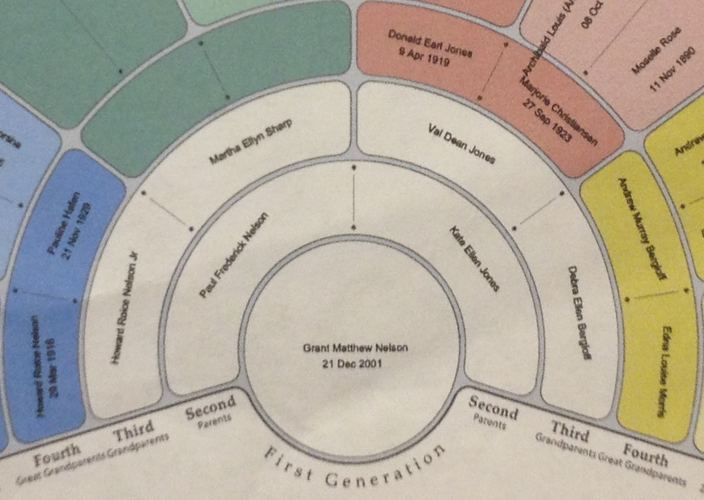

Slide 5
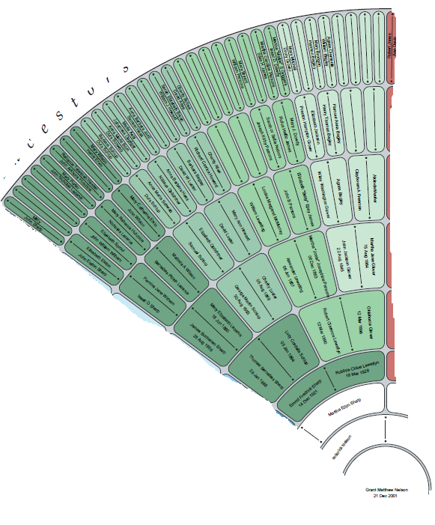

Slide 6
Family History Ties Generations Together
Baba Marti
Baba Marti is my Grandma
Baba is short for Babushka , the Russian word for Grandma
Baba Marti is not active in the church
I was able to connect with her on family history
Stories:
Oklahoma Glover
Baba Marti is coming to visit this summer and I plan to ask her to tell me more stories
I am learning about my ancestors and feel closer to them

