Slide 1
Science Camp #110808.2
8-10 August 2011 @ Nelson Cabin on Cedar Mountain
and surrounding area
Advisors
H. Roice Nelson, Jr. and Paul F. Nelson
Attendees
Ethan E. Nelson, Grant M. Nelson, Colby C. Wright

Slide 2
A. Safety
Never go anyplace alone!
Exception is if one of you is hurt, then:
One of you stay and help the person hurt.
The other one run and get help.
If you get lost stay put, we will find you.
If you hear a rattlesnake do not move quickly, just slowly move away from the sound.
Do not run with a knife open. Use knife safety.
If you cut yourself, apply pressure to the wound to stop bleeding, and send for help.
Never point an arrow in a cocked bow at any person.
Drink lots and lots and lots of water.
Do not go swimming unless an adult is with you.
Do not start branches on fire and swing them around where others can be hurt.
Use common sense and think before you act.

Slide 3
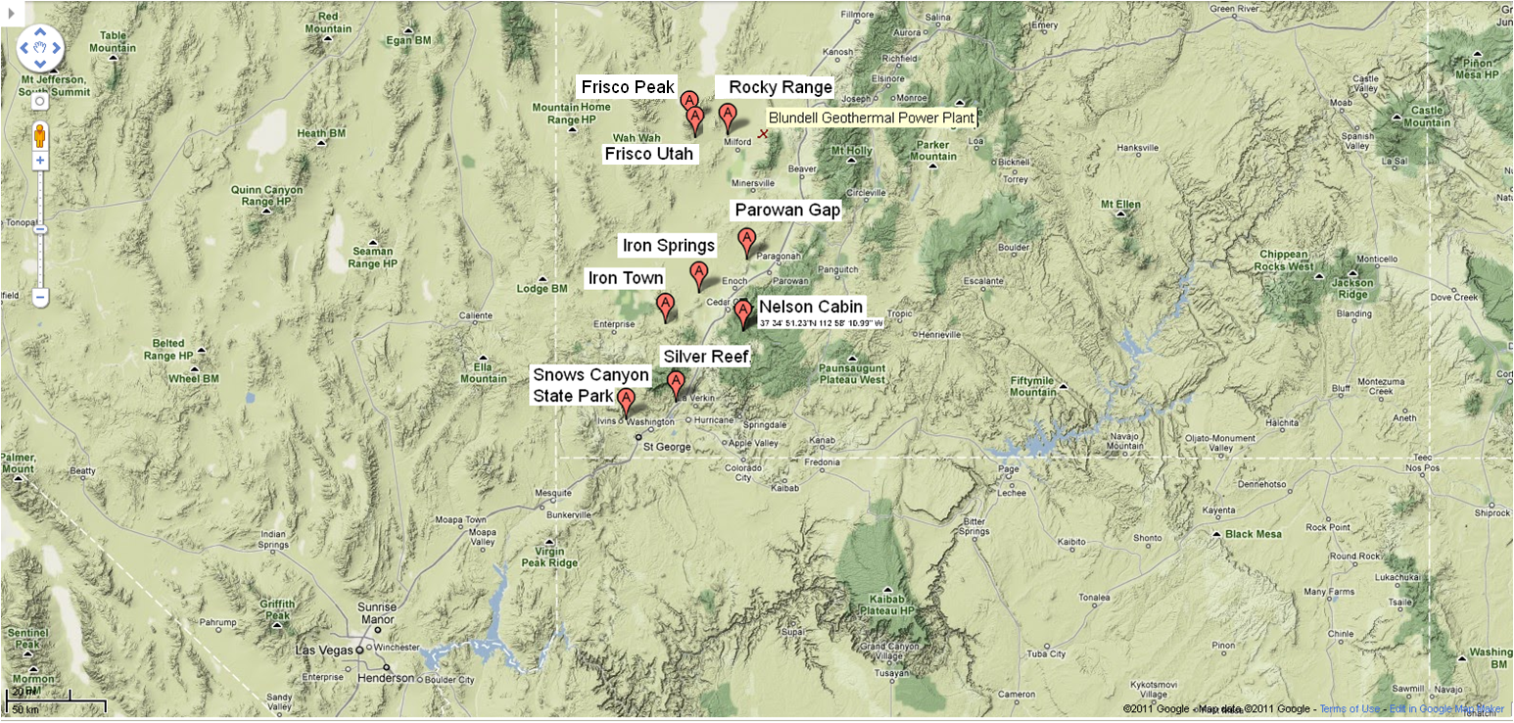
Mines in Southwest Utah

Slide 4
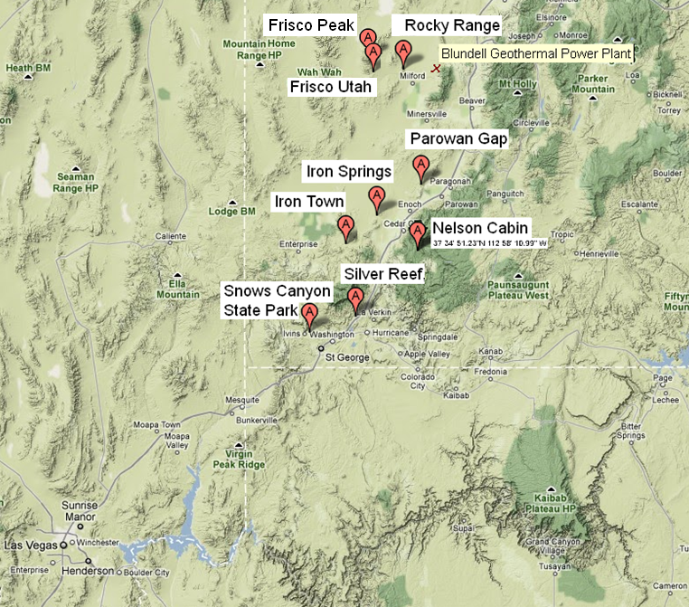
B. Geographic Context
Nelson Cabin
Kolob Reservoir
Silver Reef
Snows Canyon
Volcano
Coal Mines
Parowan Gap
Rocky Range Mines
Frisco
UU Frisco Peak Telescope
Iron Mine
Iron Town

Slide 5
Notes

Slide 6
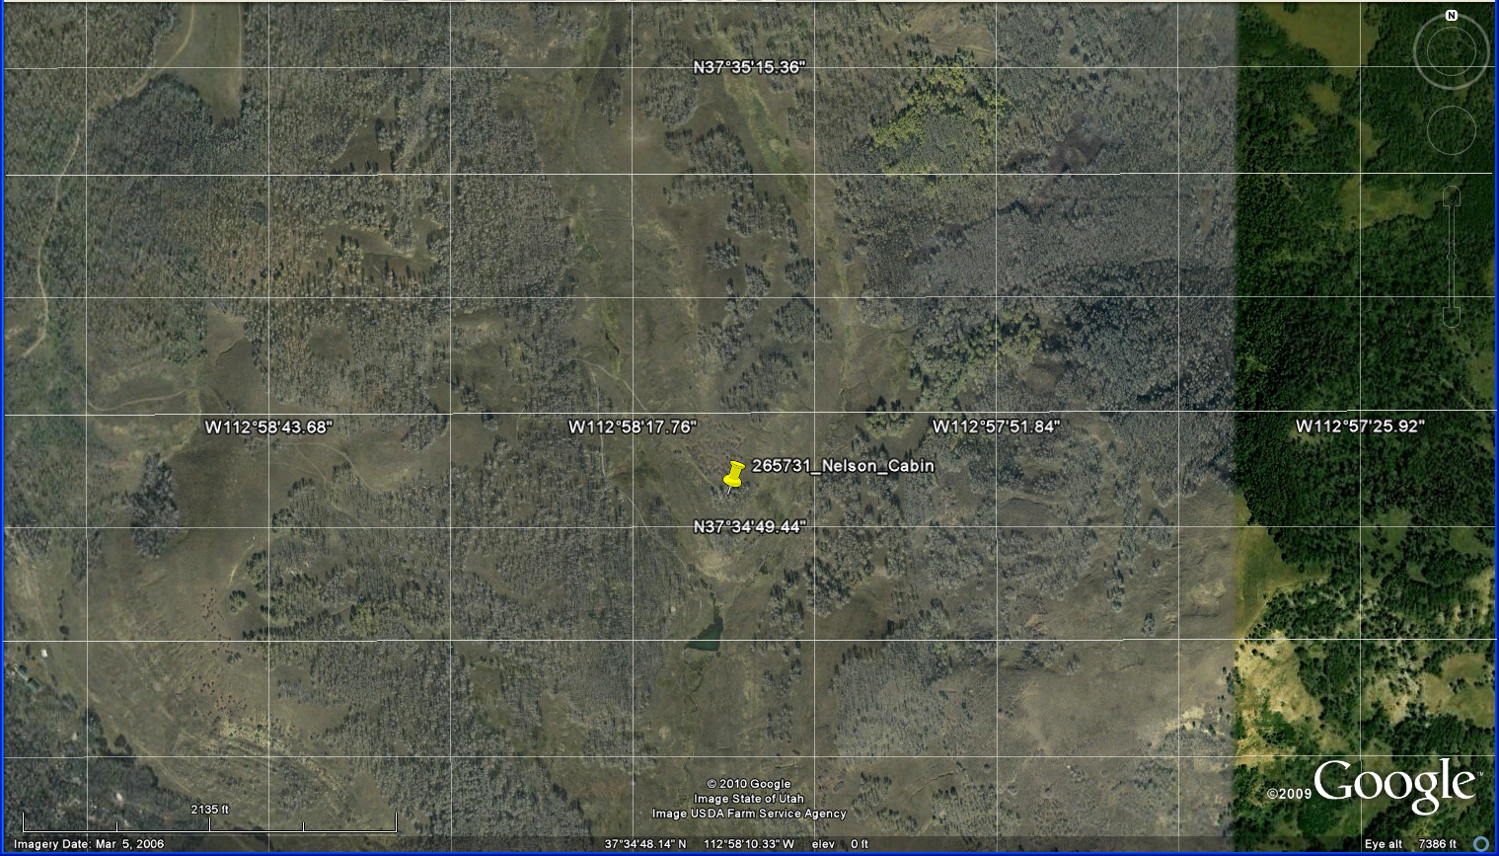
B.1. Nelson Cabin Map

Slide 7
B.1. Reference Grid
26 36 46 56 66 76
25 35 45 55 65 75
24 34 44 54 64 74
23 33 43 53 63 73
22 32 42 52 62 72
11 21 31 41 51 61 71

Slide 8
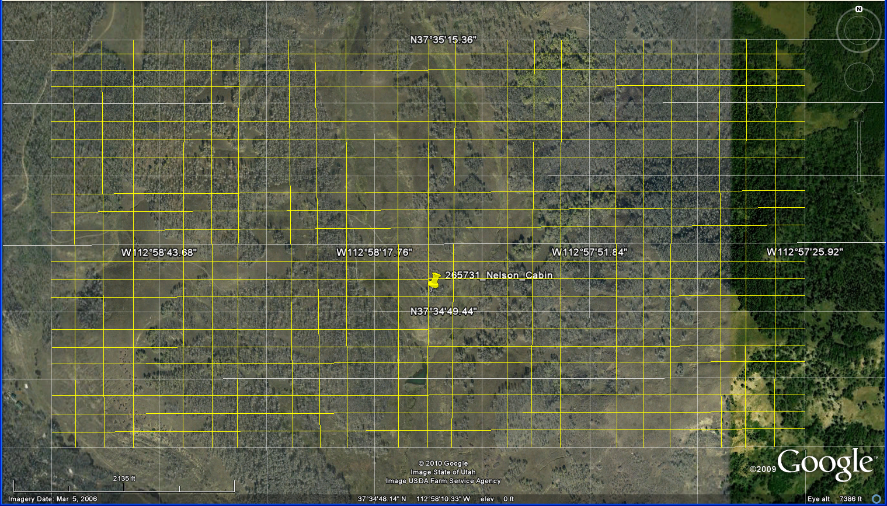
B.1. More Detail Reference Grid
66.41 76.11 76.21 76.31 76.41
16.14
16.13
16.12
16.11
15.14
11.11 11.21 11.31 11.41 21.11

Slide 9
Notes

Slide 10
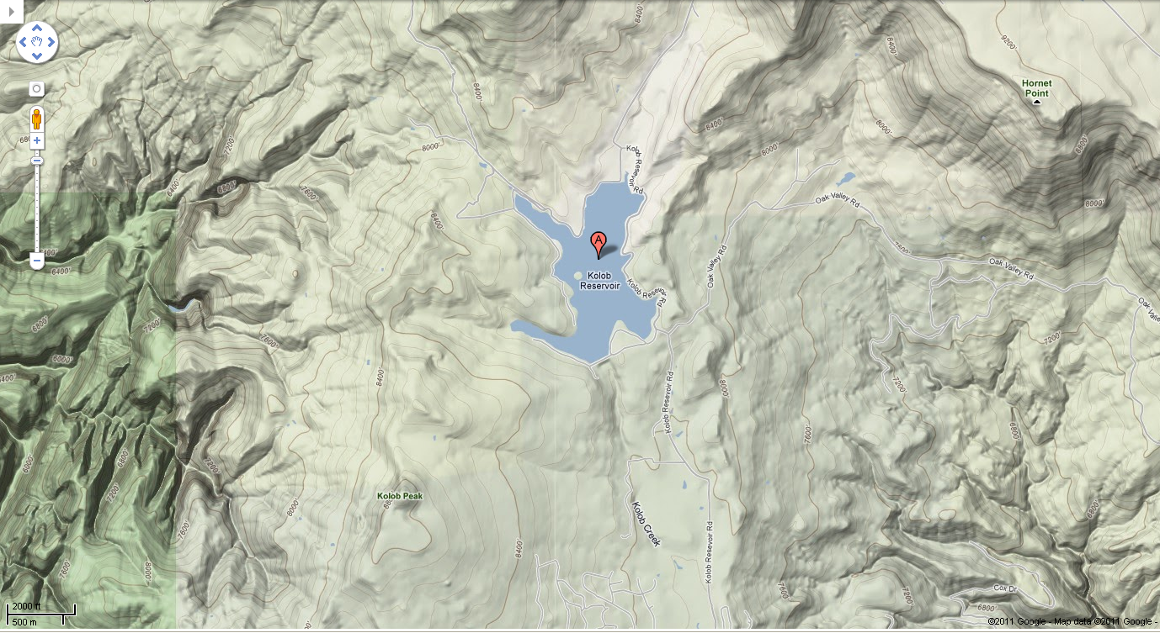
B.2. Kolob Reservoir

Slide 11
Notes

Slide 12
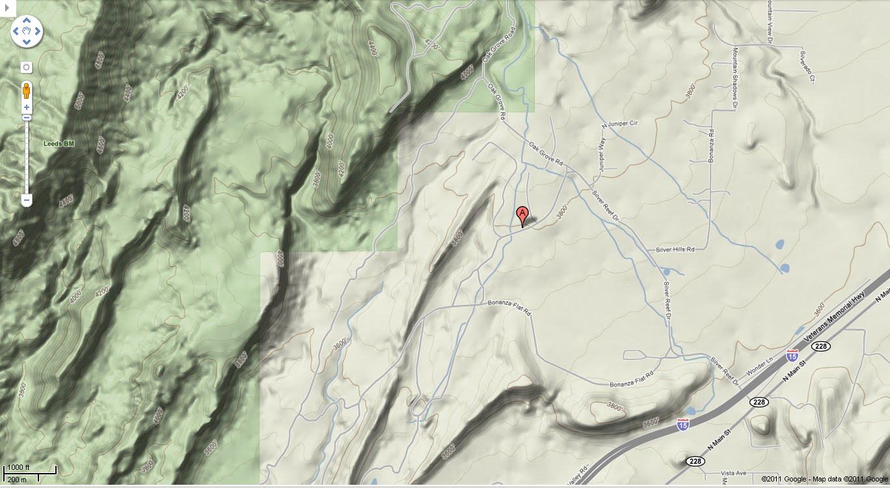
B.3. Silver Reef

Slide 13
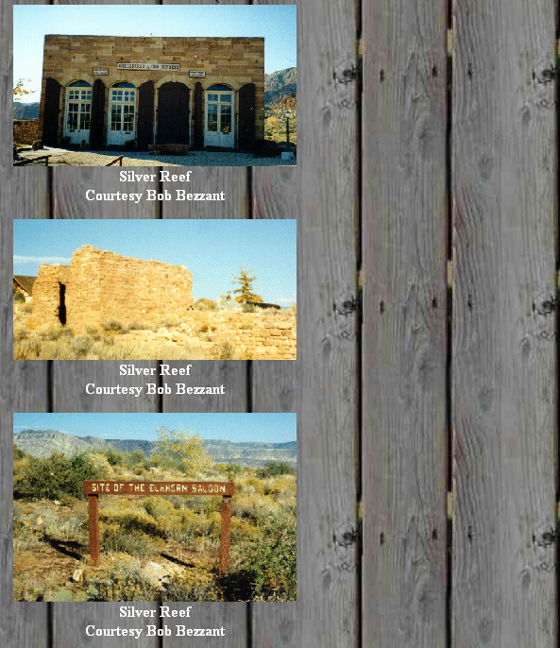
B.3. Silver Reef, a Mining Ghost Town
SILVER REEF
NAME: Silver Reef COUNTY: Washington ROADS: 2WD Grid #: 7 CLIMATE: Cool winter with possible snow, warm summer. BEST TIME TO VISIT: Anytime. COMMENTS: A few current residents. REMAINS: Many old buildings. Silver Reef was discovered between 1866 and 1870 (There are many different stories about the founding of this town) However in 1874 a man named William T Barbee is credited with getting the mining going. In 1875 he had 22 claims here. In 1876 Silver Reef became an established town. Main street was over a mile long. Silver Reef had over 2000 people living here. There were hotels, 9 stores, 6 saloons, a bank, several restaurant, a hospital, 2 dance halls, 2 news papers, a china town and 3 cemeteries. In 1891 the last mine shut down, about 25 million dollars worth of ore had been taken from the mines here. Between 1891 and 1901 another $250,000 of ore was taken out of the area. The old Wells Fargo Express office is on the National Historical Register and is now a museum. The old bank is now a gift shop. Some of the area has been preserved for its history and is worth visiting. A lot of the surrounding areas of the old town are now homes and housing developments and are restricted to public access. Submitted by Bob Bezzant.
http://www.ghosttowns.com/states/ut/silverreef.html

Slide 14
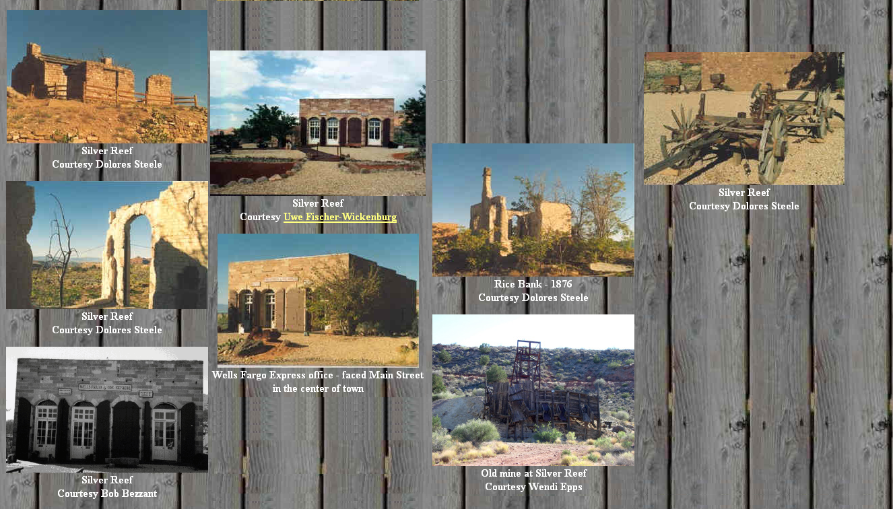
B.3. Silver Reef

Slide 15
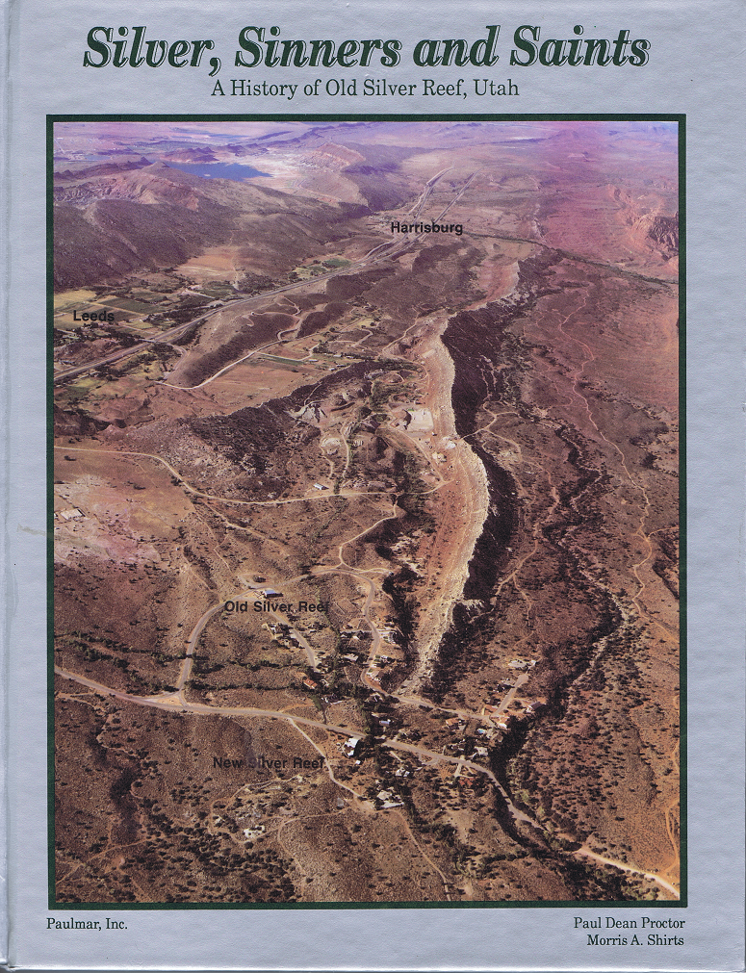
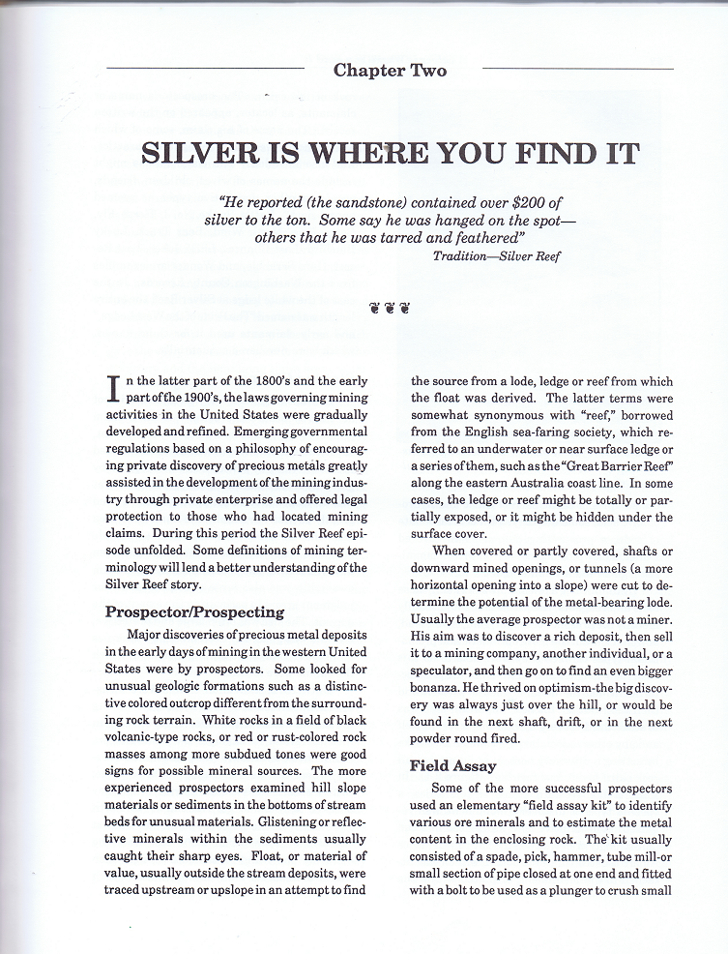
Grandma’s Dad’s First Historical Book

Slide 16
Notes

Slide 17
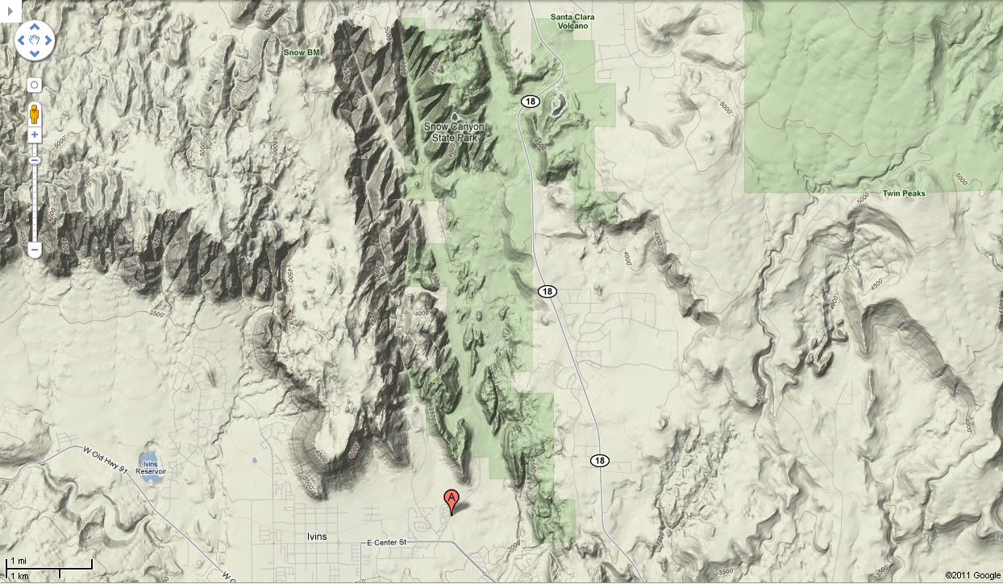
B.4. Snows Canyon

Slide 18
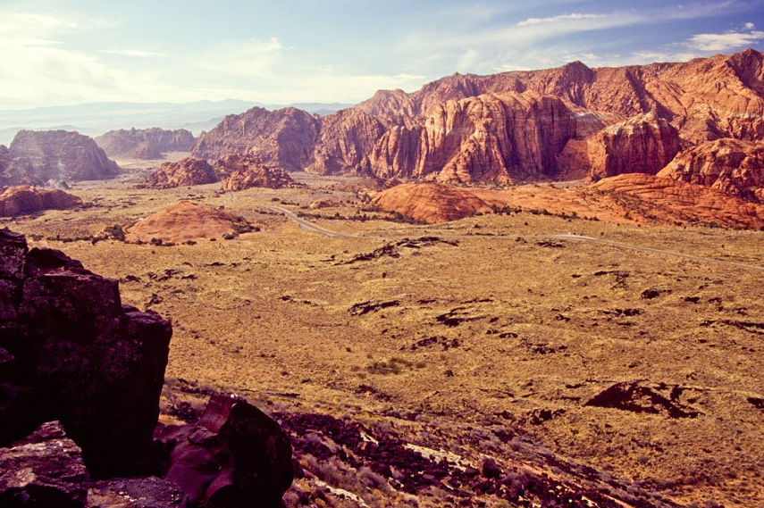
B.4. Snows Canyon State Park

Slide 19
Notes

Slide 20
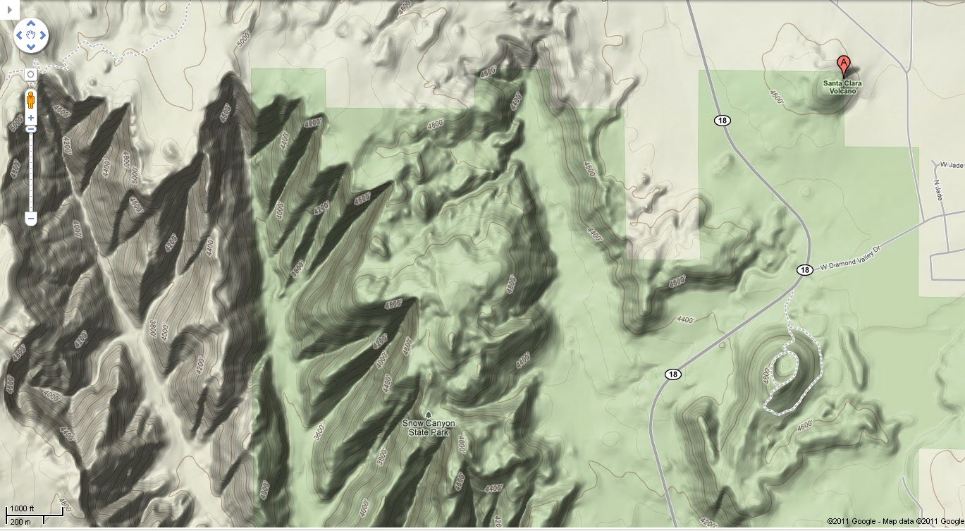
B.5. Santa Clara Volcano

Slide 21
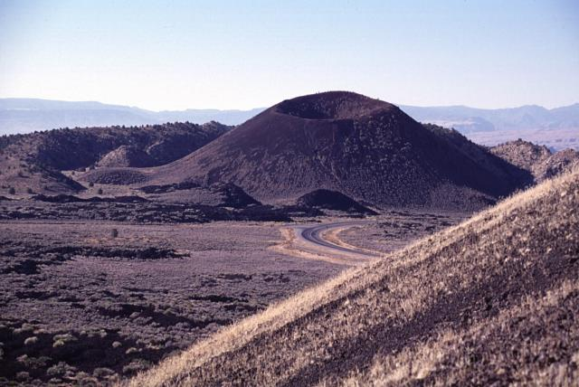
from NEW AGE FOR THE SANTA CLARA (SNOW CANYON STATE PARK) BASALT FLOW by Grant C. Willis, Robert F. Biek, and Janice M. Hayden
In the fall of 2005, we finally found the charcoal we had been looking for – a short woody branch preserved in loose sand just below the lava flow that appeared to have been burned by the advancing lava. The lab (Beta Analytic, Inc.) struggled with the sample, probably because of the high temperature to which it had been subjected, but finally obtained an age of 27,270 ± 250 radiocarbon years before present. We feel confident that this age is reliable, but we hope we can someday confirm or refute the results by finding another sample and using another dating method.
Is the Santa Clara flow the youngest lava flow in Utah, as some have suggested? No – not even close. Though other young flows are poorly dated for similar reasons, we are confident that some flows in the Fillmore-Black Rock Desert area in central Utah, and on the Markagunt Plateau north of Zion National Park, are much younger. The Ice Springs flow near Fillmore may be less than 1000 years old (C.G. Oviatt, UGS Special Studies 73).
http://geology.utah.gov/surveynotes/snt38-3.pdf
From: http://en.wikipedia.org/wiki/Santa_Clara_Volcano

Slide 22
Notes

Slide 23
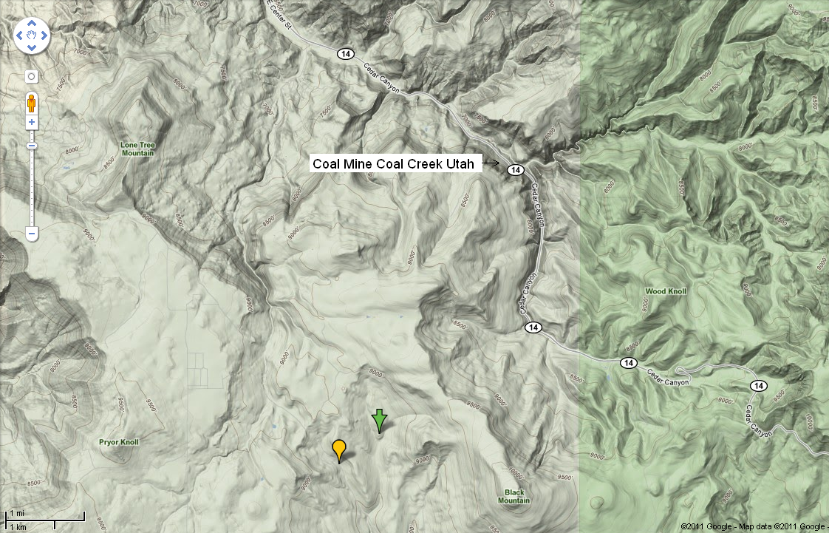
B.6. Coal Mines Cedar Canyon

Slide 24
Notes

Slide 25
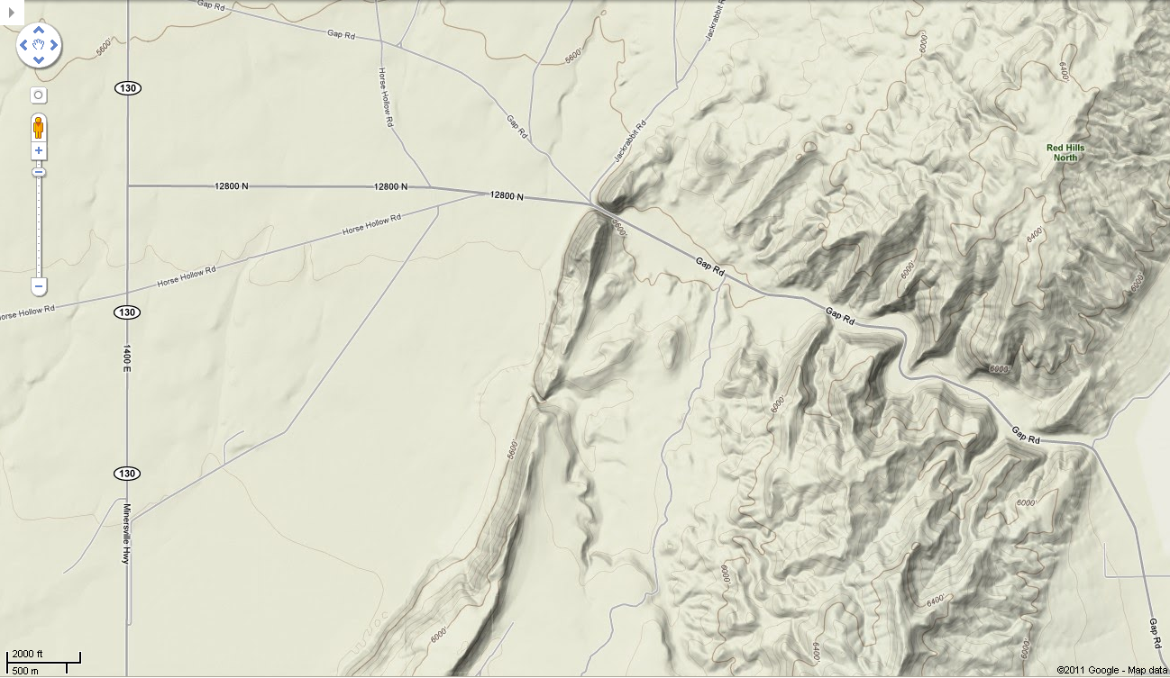
B.7. Parowan Gap

Slide 26
Notes

Slide 27
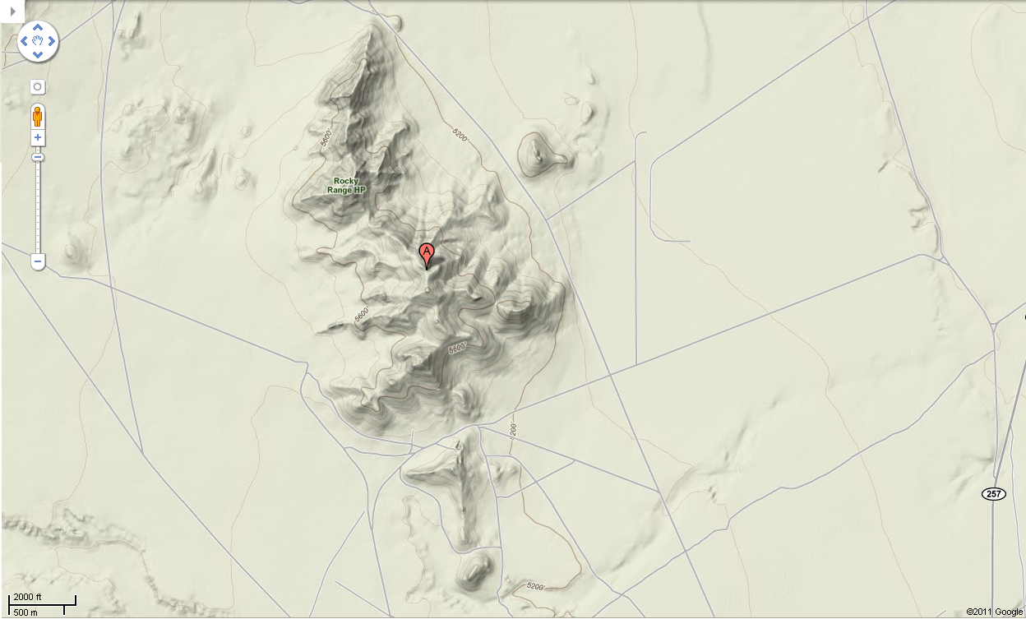
B.8. Rocky Range Mine

Slide 28
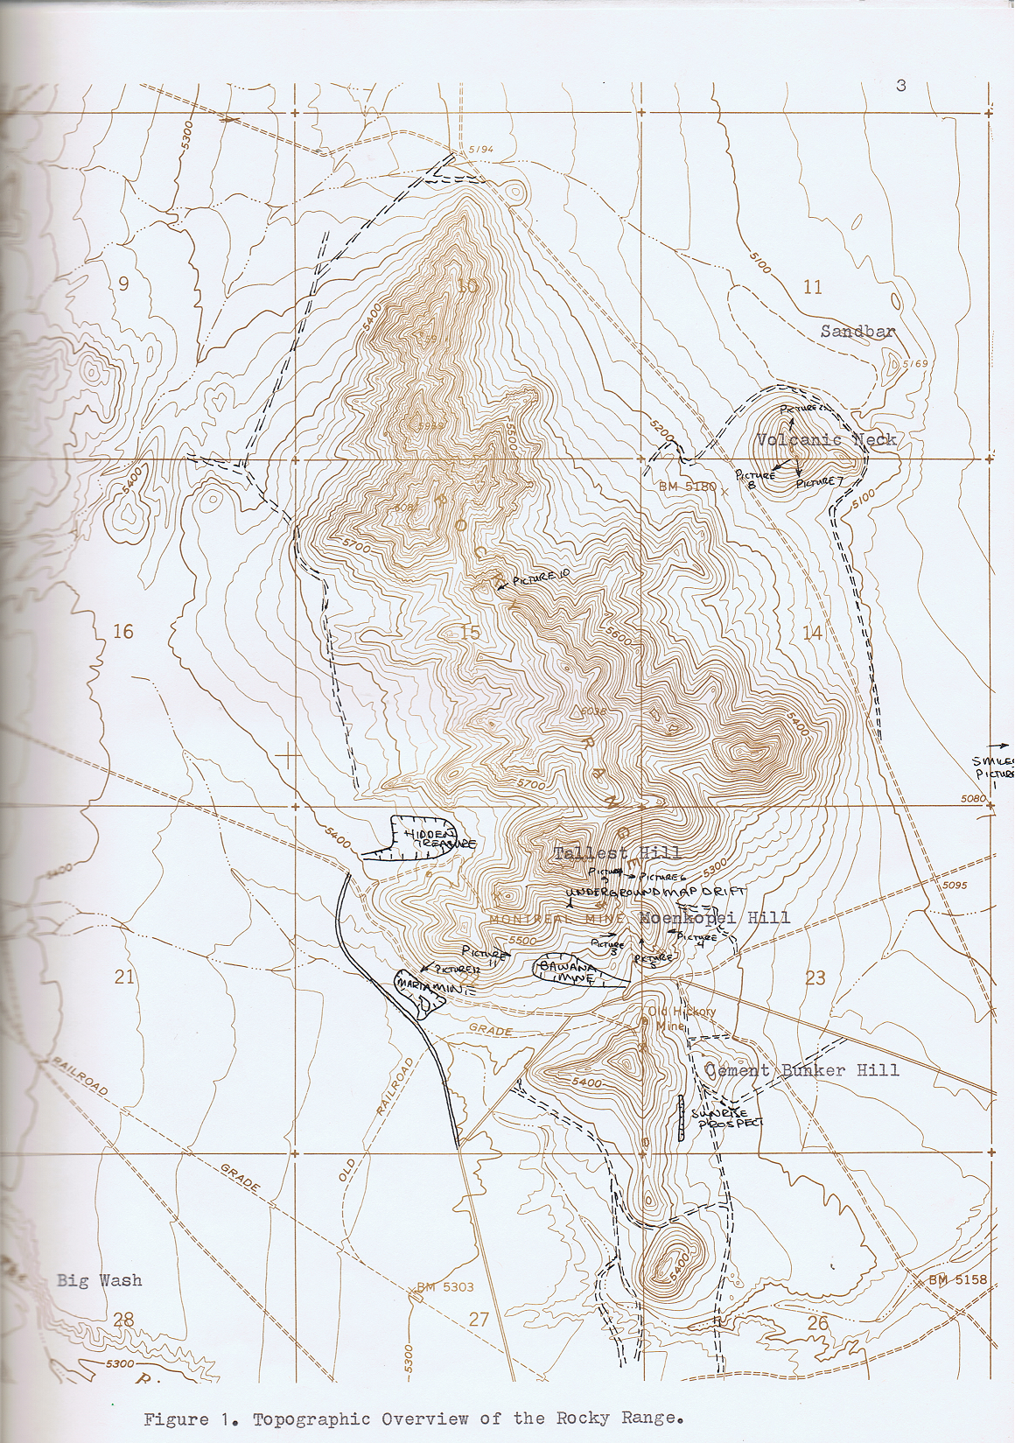
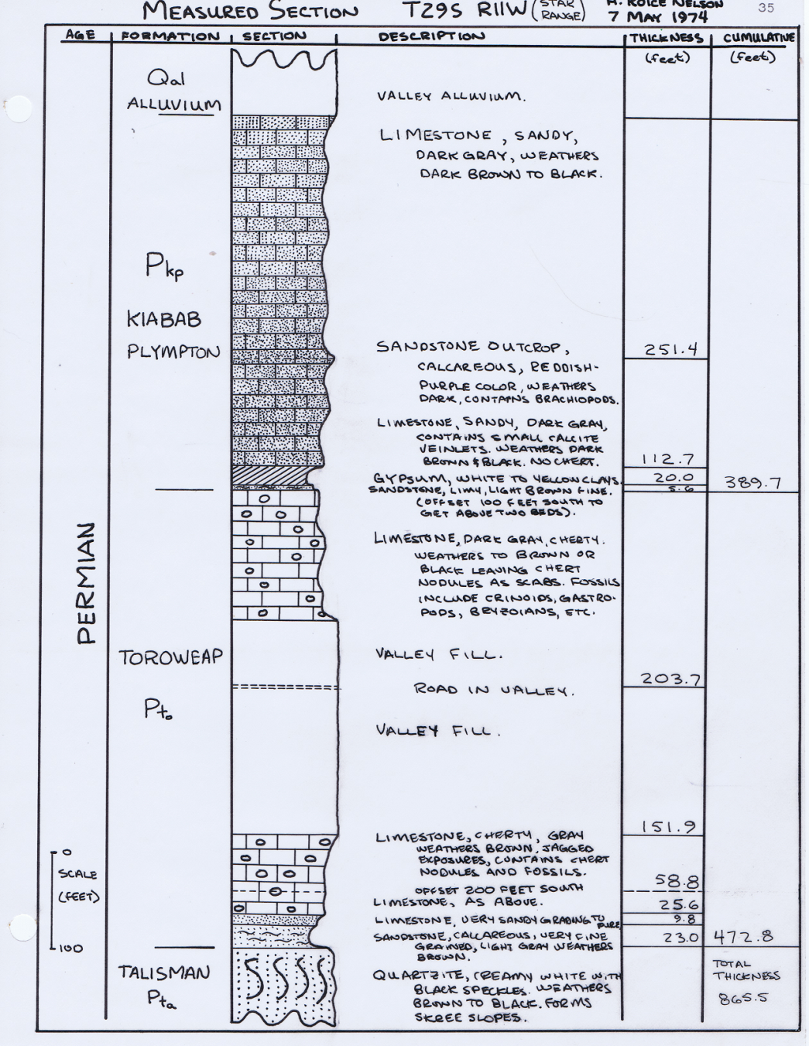
Topographic Overview & Type Log Rocky Range, Beaver County, Utah

Slide 29
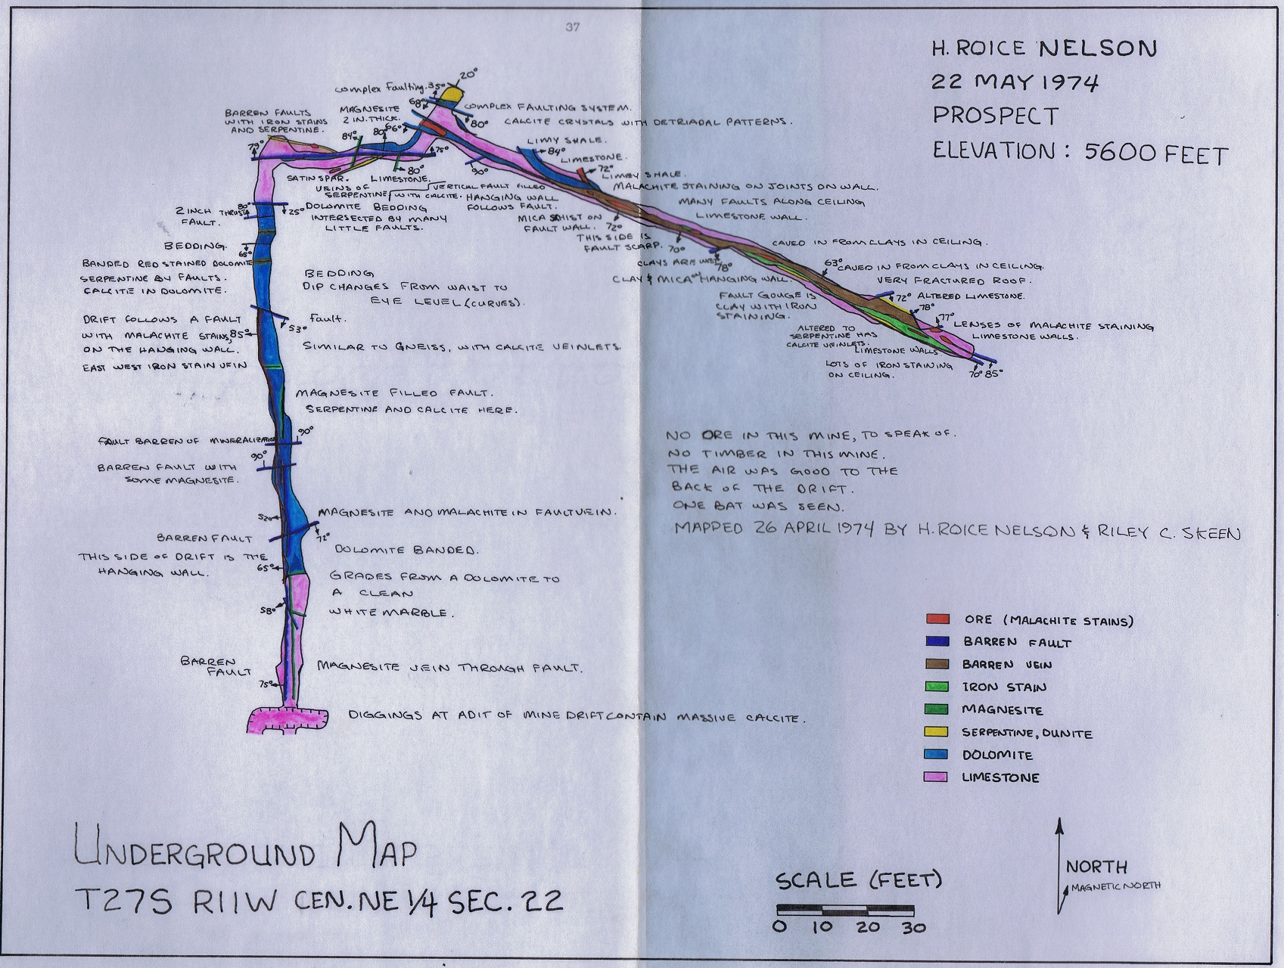
Underground Map

Slide 30
Notes

Slide 31
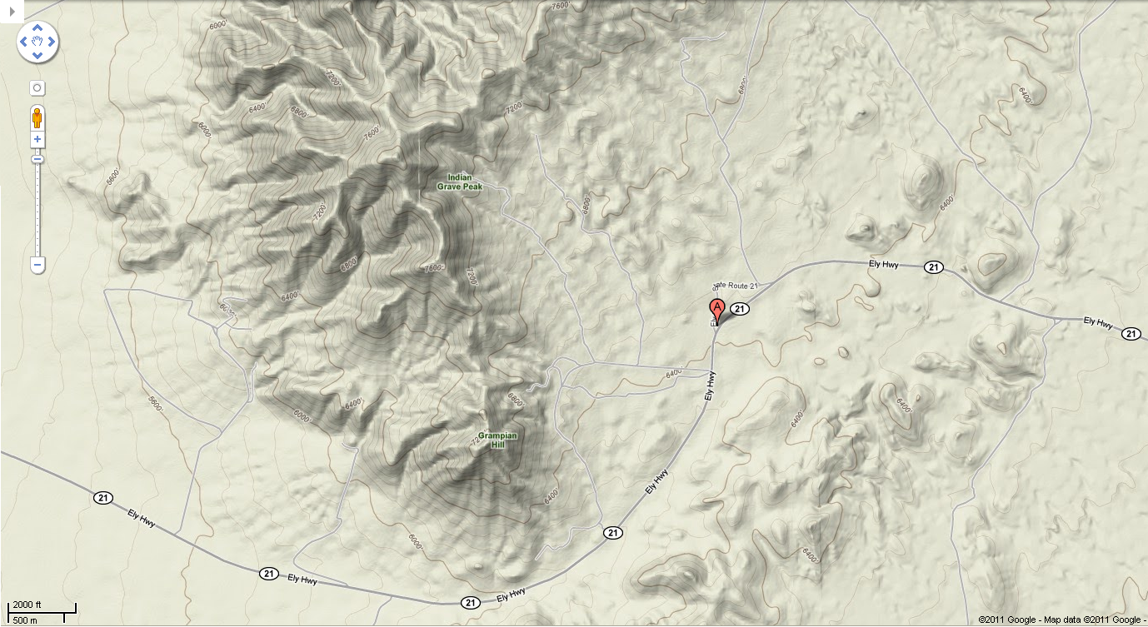
B.9. Frisco

Slide 32
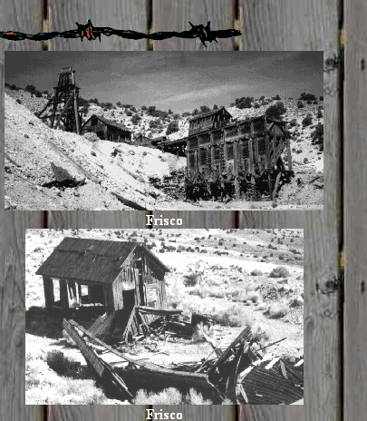
B.9. Frisco, Utah a Mining Ghost Town
FRISCO
NAME: Frisco COUNTY: Beaver ROADS: 2WD Frisco, Utah, is just off route 21, 15 miles west of Milford. Grid #: 7 CLIMATE: Cool winter with possible snow, warm summer. BEST TIME TO VISIT: Anytime. COMMENTS: Right off the highway. Some land is marked no trespassing. REMAINS: Too much to list, make sure to see the 5 Beehive Kilns. Silver ore was discovered here in 1875. The town of Frisco soon followed and was named Frisco after the San Francisco mountains where the mine is located. A smelter was built here and charcoal ovens were built to make fuel for it (see photo). The town had 23 saloons. Gun fights and killings were common. Water was scarce here and had to be hauled in. In 1880 the railroad built to the town. The population of Frisco was around 6000 people. There was a hospital, hotels, churches, school, news paper and many stores. In 1885 the mine caved in and the town soon all but died. (No one was killed in the cave in). Up to the time of the cave in the mine had produced 54 million dollars worth of ore. A few people stayed and dug new shafts after the cave in but most was gone and only a couple stores stayed open. The mine made another 20 million dollars by 1913. By 1920 everyone had moved away and the town was dead. Submitted by Bob Bezzant. (http://www.ghosttowns.com/states/ut/frisco.html)

Slide 33
B.9. More About Frisco, Utah
Located in Beaver County, Utah are the silent remains of the once booming mining camp of Frisco . Though, its life was short, it was filled with history, from millions of dollars in ore taken from the Horn Silver Mine to shoot-outs in its dusty streets. Today its crumbling foundations, charcoal ovens, and silent cemetery speak eloquently of its rich and varied past.
Frisco‘s story starts with two prospectors by the names of James Ryan and Samuel Hawks in September, 1875. The pair worked at the Galena Mine in the San Francisco Mining District, which embraced approximately seven square miles on both flanks of the San Francisco Mountains. One day while on their way to work, they stopped to test a large outcropping for ore. When they found a solid ore body, they immediately staked a claim. Fearing that the mineral body was not very large, they decided to sell their claim rather than work it. Sadly for Ryan and Hawks, the new owners extracted some 25,000 tons of ore with high silver content by the end of the 1870s.
Near the mine, the town of Frisco soon sprouted up, named for the San Francisco Mountains. Another mine called the Horn Silver Mine was also discovered in 1875, and would soon become largest producer in the area. With the success of the Horn Silver Mine, the Frisco Mining and Smelting Company expanded its workings in July 1877 by constructing a smelter that included five beehive charcoal kilns. Frisco soon developed as the post office and commercial center for the district, as well as the terminus of the Utah Southern Railroad extension from Milford, some fifteen miles to the east.
Other mines located in the district included the Blackbird, Cactus, Carbonate, Comet, Imperial, King David, Rattler, and Yellow Jacket, but the Silver Horn was bar far the largest.
By 1879 the United States Annual Mining Review and Stock Ledger was calling the Silver Horn Mine "the richest silver mine in the world now being worked." Frisco was bustling and on June 23, 1880, the Utah Southern Railroad Extension steamed into town, allowing the mines the opportunity for less expensive shipping.
Though there were a number of roaring mining camps in the San Francisco district, Frisco soon gained a reputation for being the wildest. Like many boomtowns, its streets were lined with over twenty saloons, gambling dens and brothels. Reaching a peak population of nearly 6,000, vice and crime became prevalent in the town. One writer described it as “Dodge City, Tombstone, Sodom and Gomorrah all rolled into one."
Murders were said to have been so frequent that city officials contracted to have a wagon pick up the bodies and take them to boot hill for burial. Eventually, a lawman from Pioche, Nevada was hired and given free reign to "clean up the town.” When the tough marshal appeared on the scene, he allegedly told the town that he had no intentions of making arrests or building jail. Instead, the lawless element had two options – get out of town or get shot. Apparently, some of the wicked did not take the new marshal seriously as he reportedly killed six outlaws on his first night in town. After that, most of the lawless moved on and Frisco became a milder place for its citizens.
On the morning of February 12, 1885, when the miners reported for duty, they were told to wait as tremors were shaking the ground. Taking precautions, as several cave-ins had previously occurred, the night shift came to the surface, and the day crew waited. Within minutes a massive cave-in occurred, collapsing tunnels down to the seventh level and shutting off the richest part of the mine. The cause of the collapse was blamed on inadequately timbered tunnels bearing the tremendous weight of the rain and snow soaked ground above. The collapse was so great that the cave-in was felt as far away as Milford, where some windows were reportedly broken. Fortunately, no one was killed, but cave-in spelled the eventual demise of Frisco .
By 1885 over $60,000,000 in zinc, copper, lead, silver, and gold had been hauled away from Frisco by mule train and the Utah Southern Railroad.
After the collapse of the mine, it began to produce again within a year, but never on the scale of its fabulous past.
By the turn of the century only fourteen businesses were still alive in Frisco and its population had decline to 500. By 1912, only twelve businesses existed in the dwindling town of 150. By the 1920s, Frisco was a ghost town.
In 1982, Frisco‘s kilns were placed on National Register of Historic Places.
In 2002, a mining company began to rework the mines of Frisco , so only the charcoal kilns and cemetery are accessible today.

Slide 34
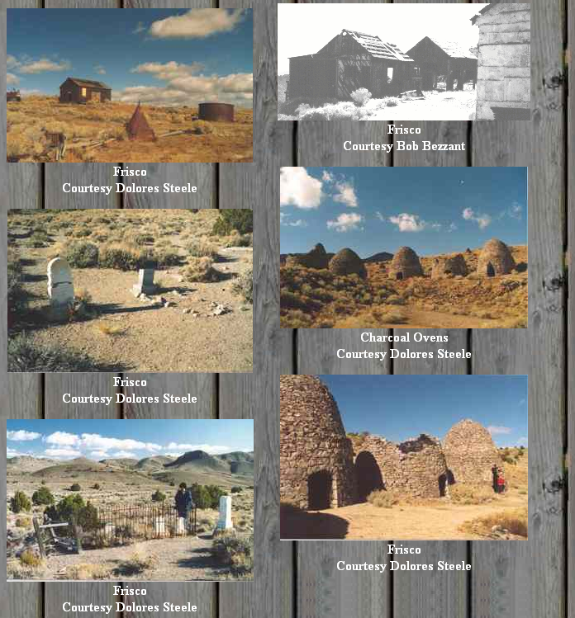
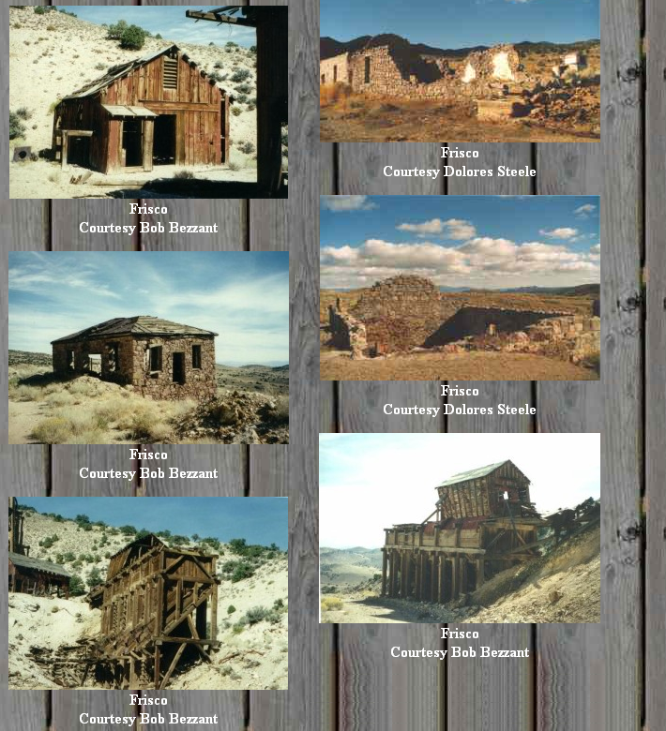
B.9. Frisco Photos

Slide 35
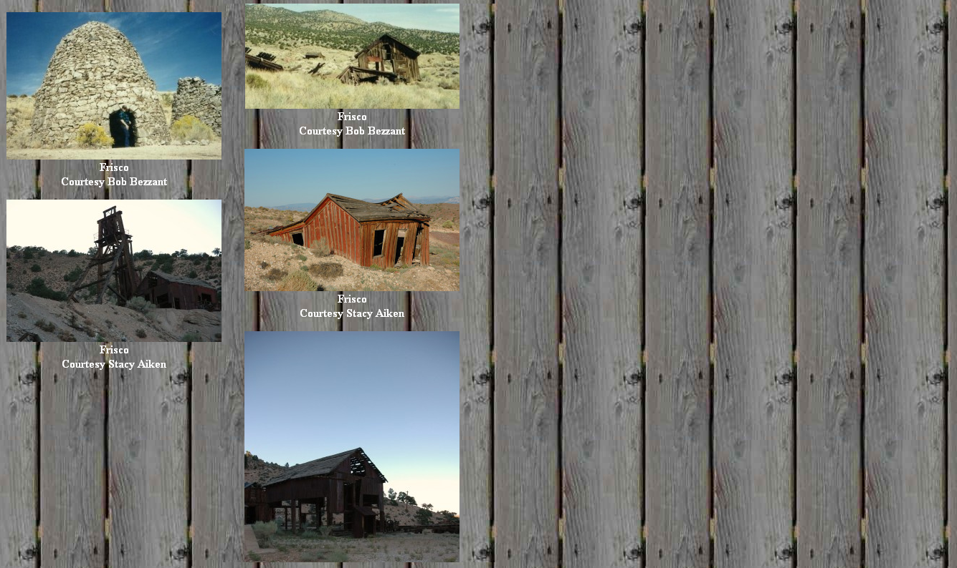
B.9. More Frisco Photos

Slide 36
Notes

Slide 37
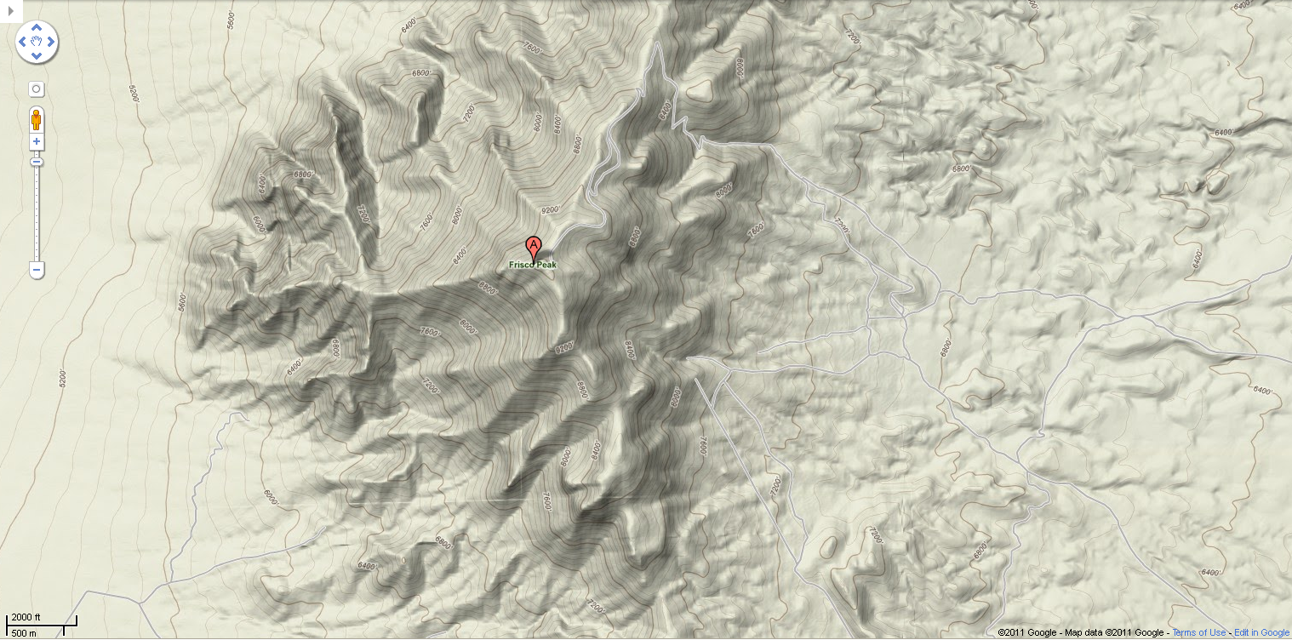
B.10. University of Utah Observatory Frisco Peak

Slide 38
Notes

Slide 39
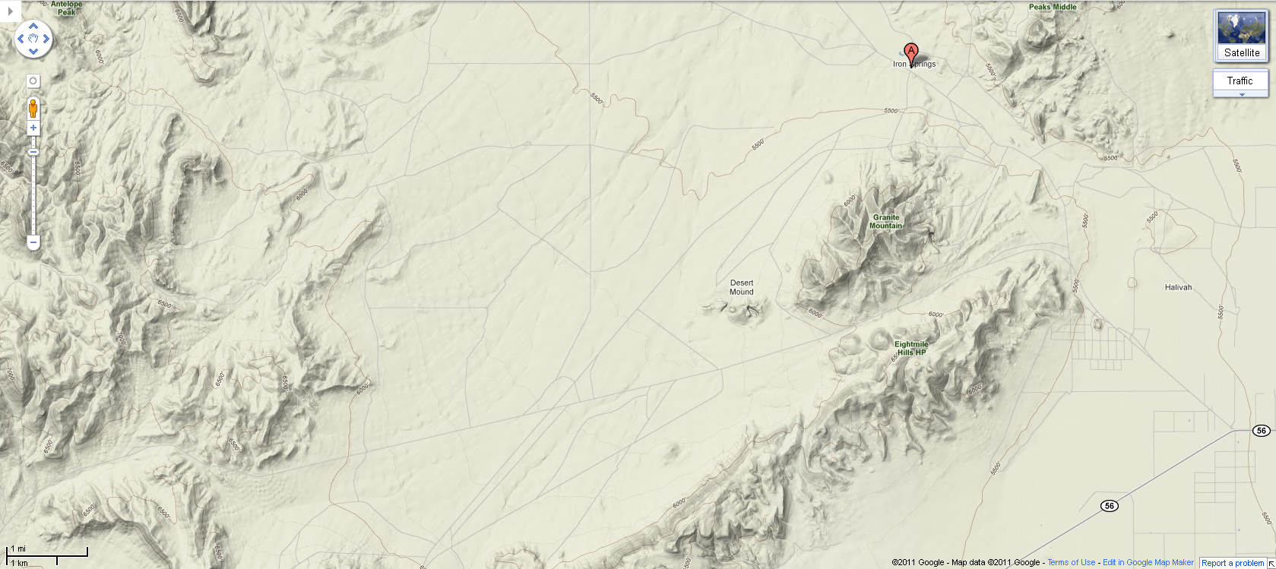
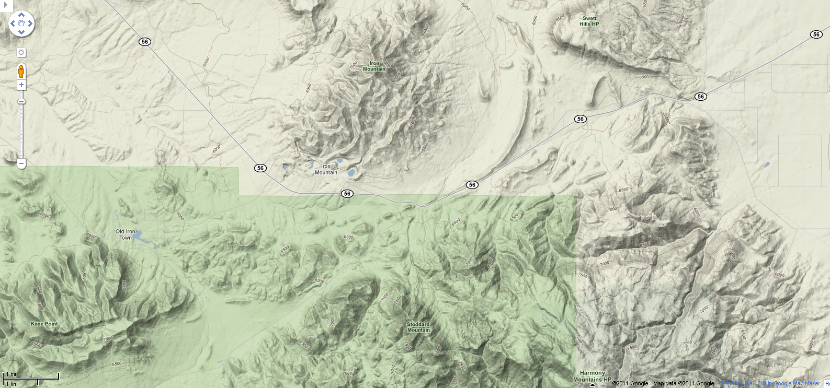
B.11. Iron Mountain / Iron Springs

Slide 40
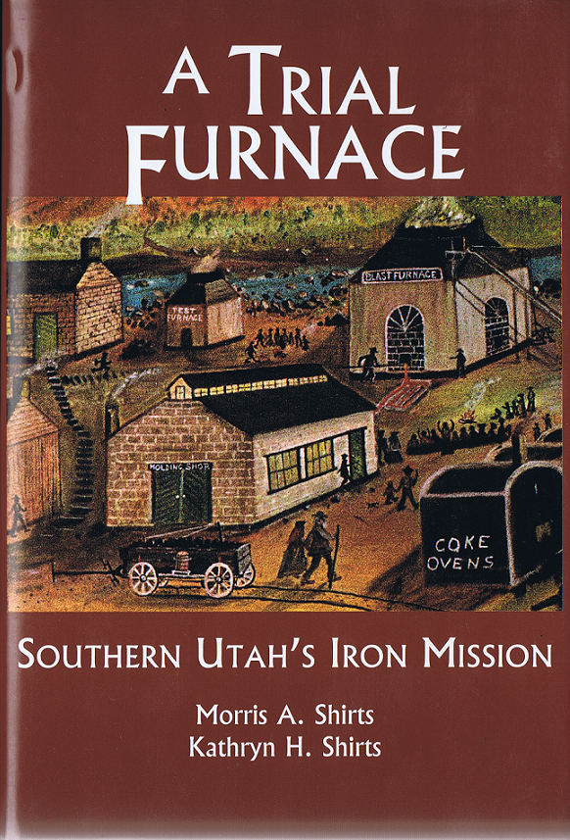
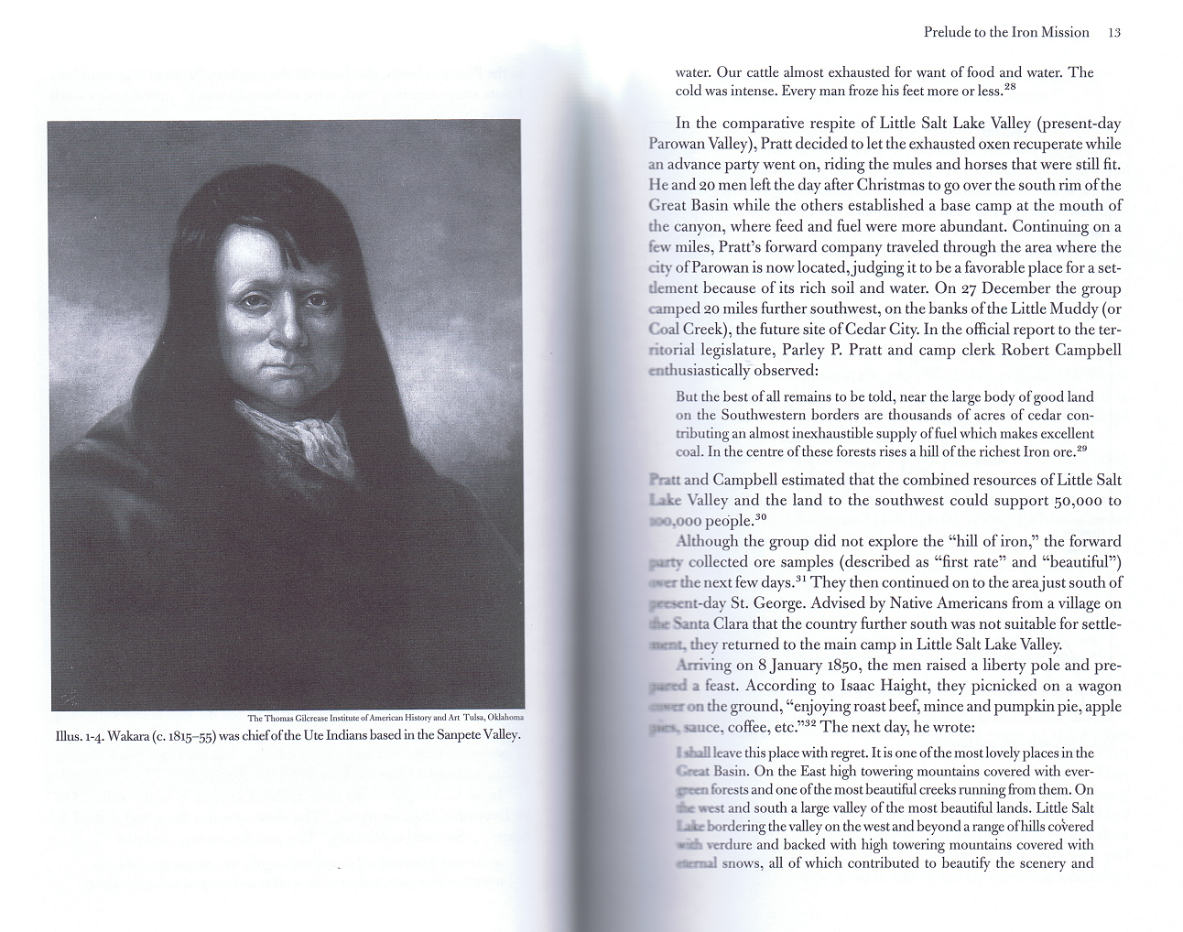
Grandma’s Dad’s Second Historical Book

Slide 41
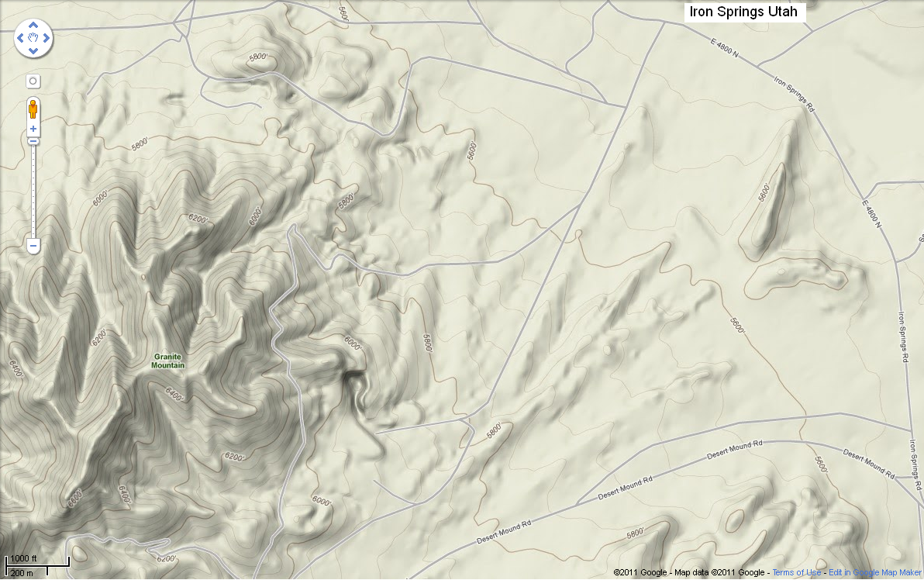
B.11. Iron Springs Mine

Slide 42
Notes

Slide 43
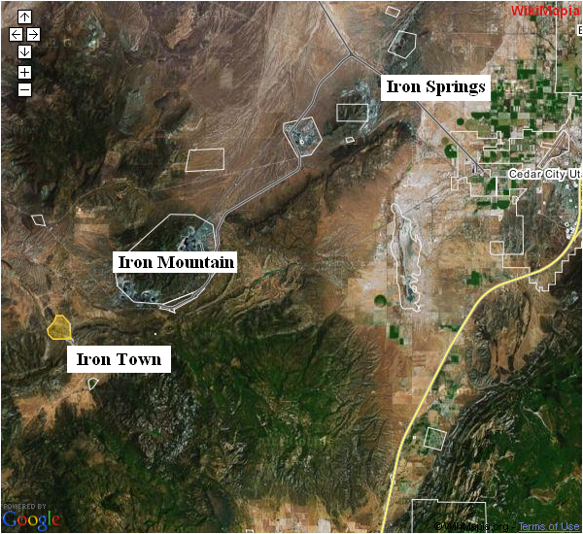
B.11. Iron Town, Iron Mountain, & Iron Springs

Slide 44
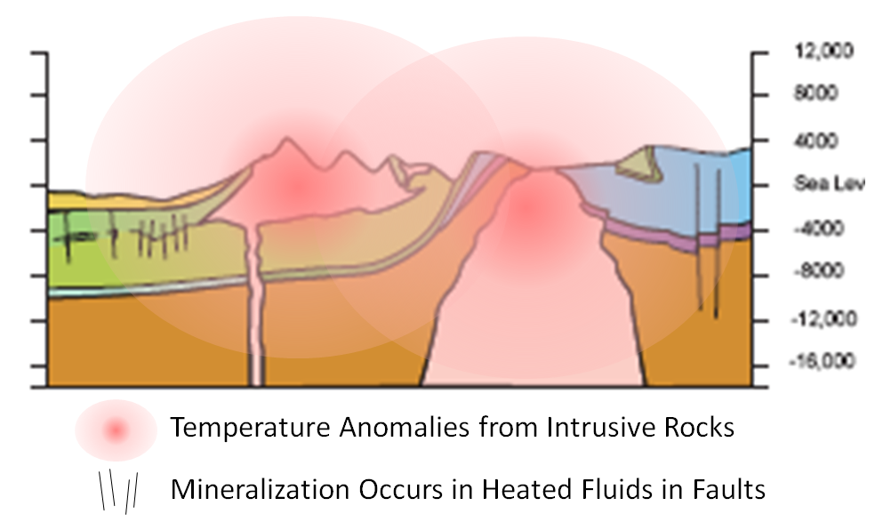
Why are there mines?

Slide 45
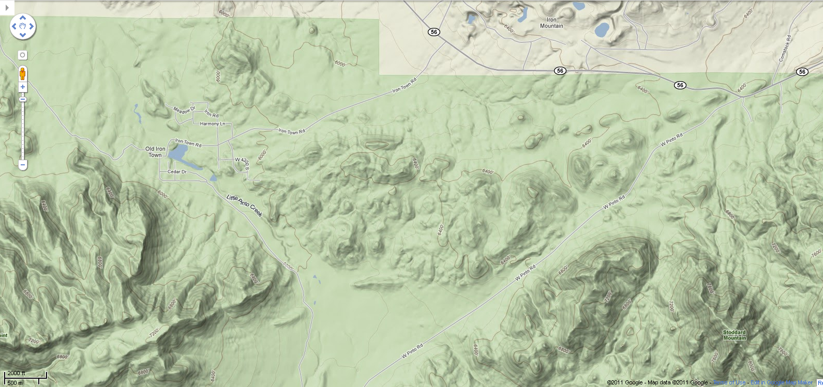
B.12. Iron Town

Slide 46
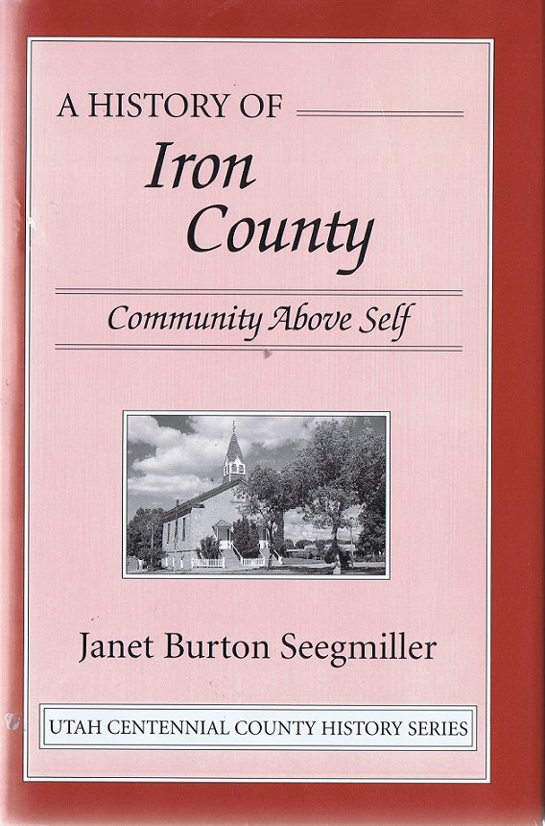
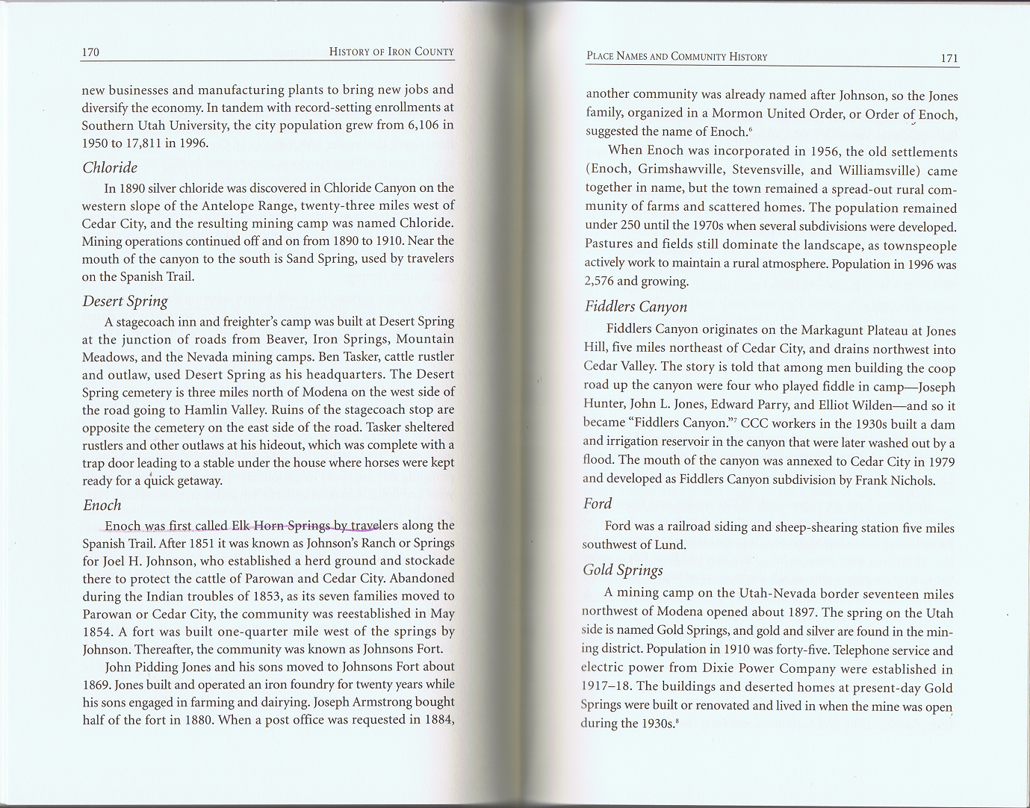
Friend’s History of Iron County

Slide 47
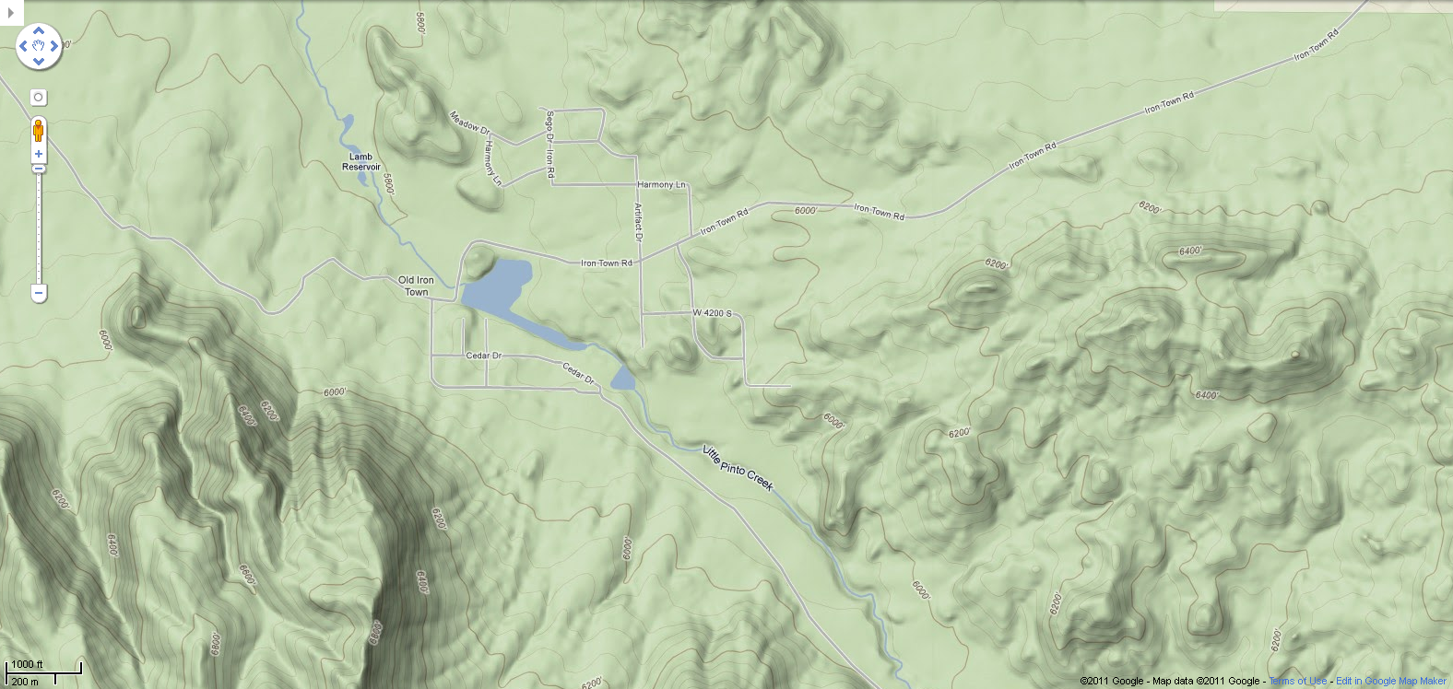
B.12. Iron Town Zoom

Slide 48
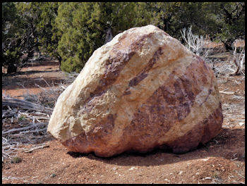
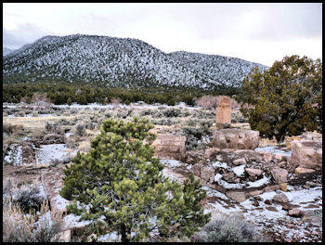
B.12. Iron Town, a Smelting Ghost Town
Pretty rock formations and boulders like this are along the route to Iron Town. The area was discovered in 1868 by Peter Shirts. The area then was known as Iron City. Later Ebenezer Hanks invested in the iron ore mine under the name of the Union Iron Company, later known as the Great Western Iron Company. In 1870 there were 97 people living in Iron City.
More of the walls and foundations of the foundry building. A chimney still stands in the back. A lot of this was vandalized and the walls and artifacts are gone. This area is still one of the richest iron ore deposits in the United States.
The old furnace here could process 2,500 lbs of ore a day. The original mine closed down in 1876. Columbus Steel took over and in 1923 the Union Pacific railroad ran a spur into the mine sending over 500 tons a day to Northern Utah. By the mid-1980's the mine was shut down again due mostly to foreign prices being too low to keep producing ore here in the US.

Slide 49
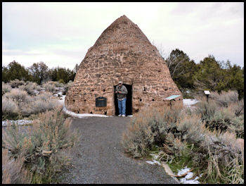
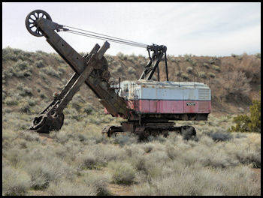
B.12. Town
The old furnace here could process 2,500 lbs of ore a day. The original mine closed down in 1876. Columbus Steel took over and in 1923 the Union Pacific railroad ran a spur into the mine sending over 500 tons a day to Northern Utah. By the mid-1980's the mine was shut down again due mostly to foreign prices being too low to keep producing ore here in the US.
To the right is an old BuCyrus Erie shovel that was once part of the Iron Ore Mine. This old shovel is at the entrance to the landfill.
http://www.in-the-desert.com/irontown.html

Slide 50
Notes

Slide 51
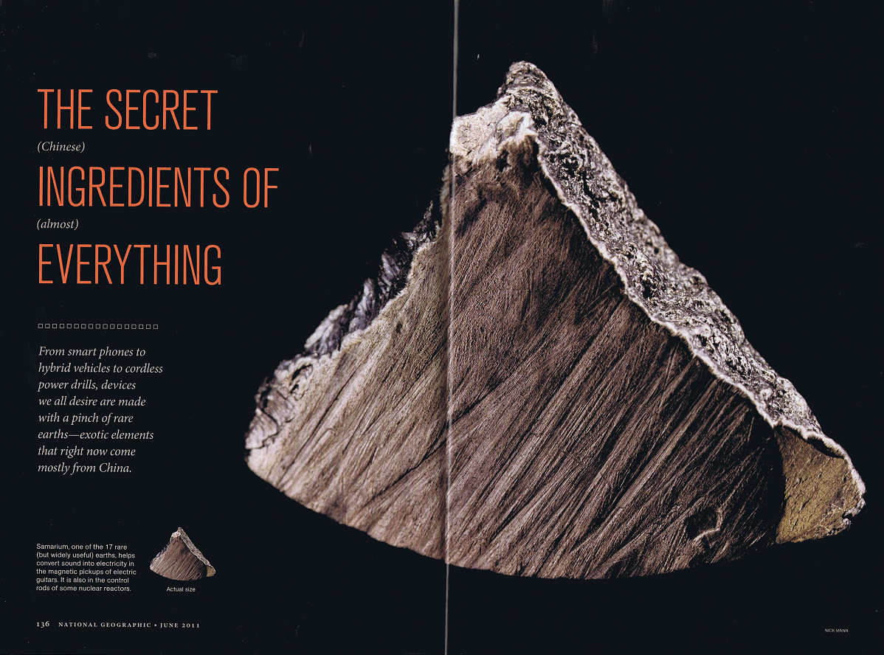
C.1. Rare Earths

Slide 52
C.2. Rare Earths

Slide 53
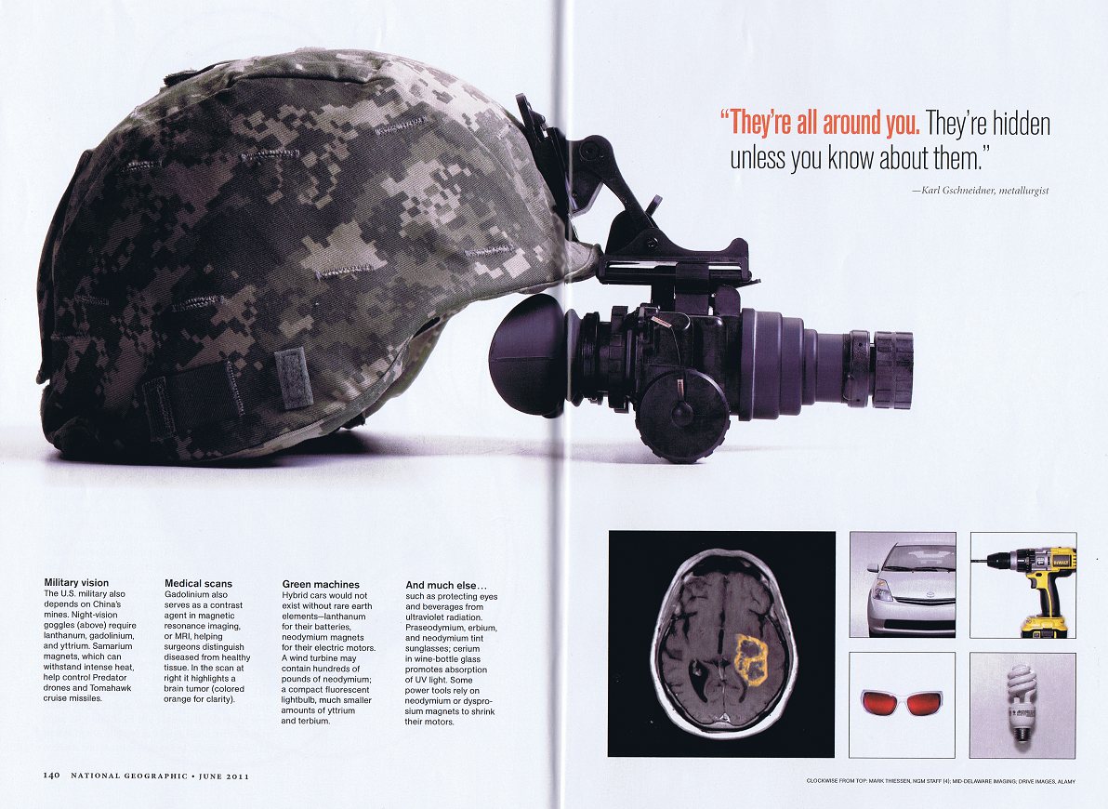
C.3. Rare Earths

Slide 54
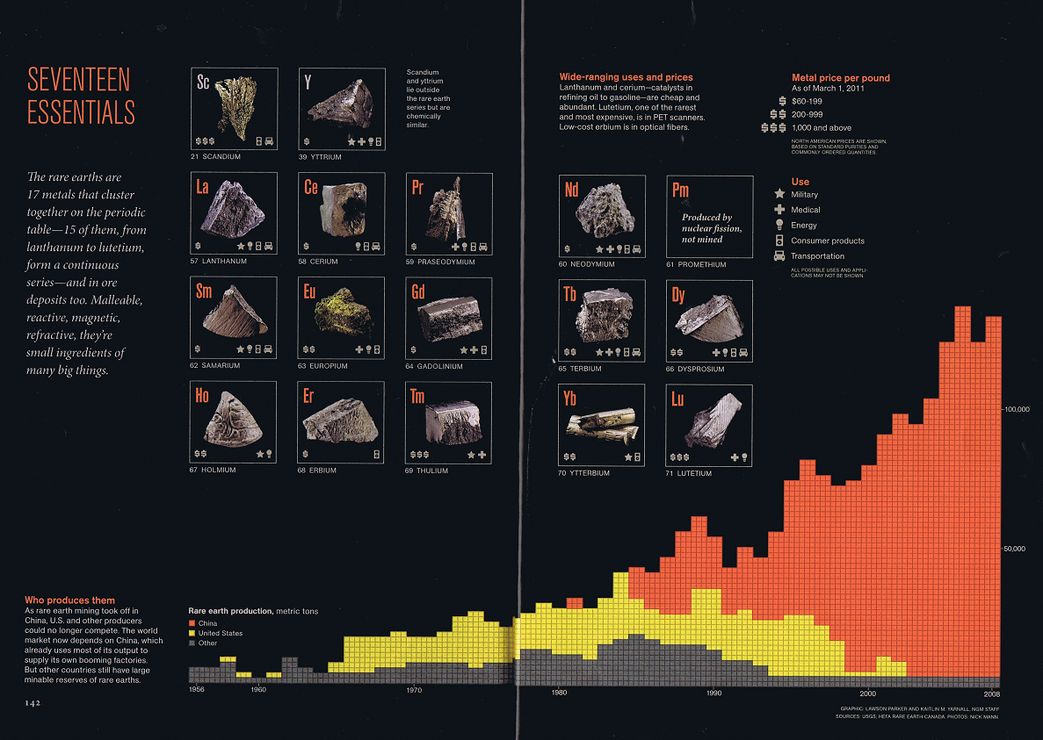
C.4. Rare Earths

Slide 55
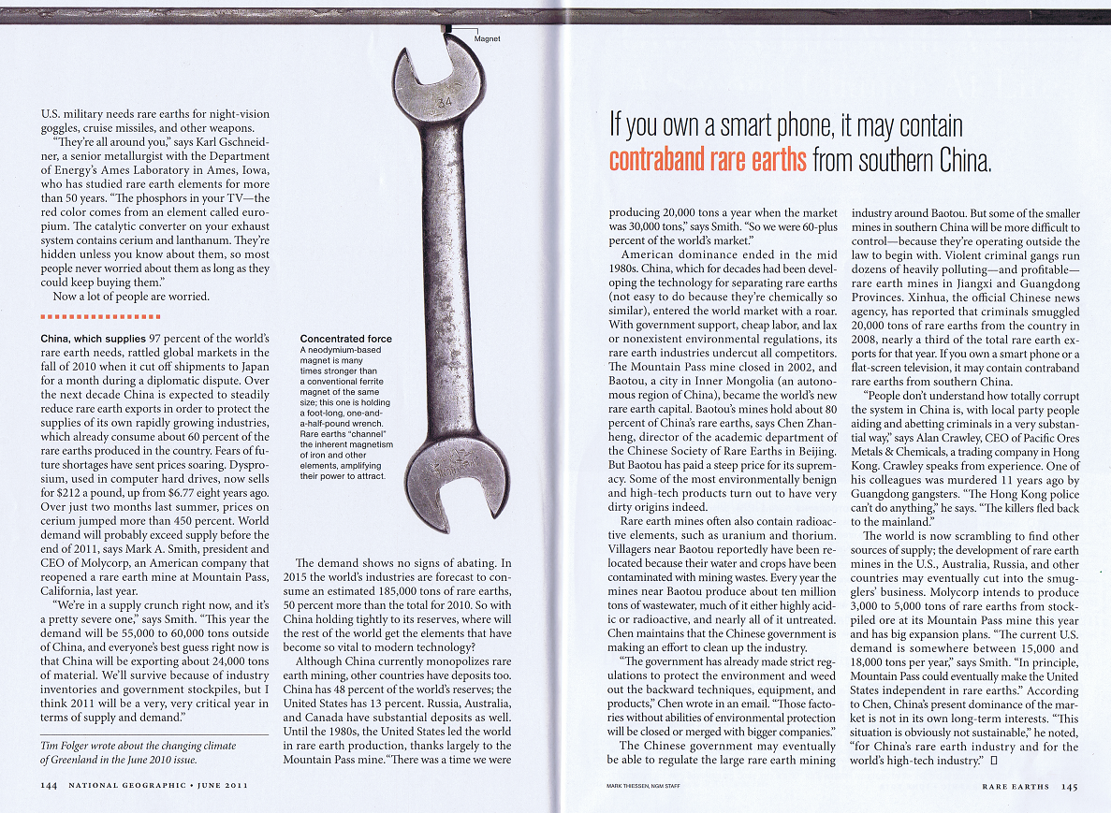
C.5. Rare Earths

Slide 56
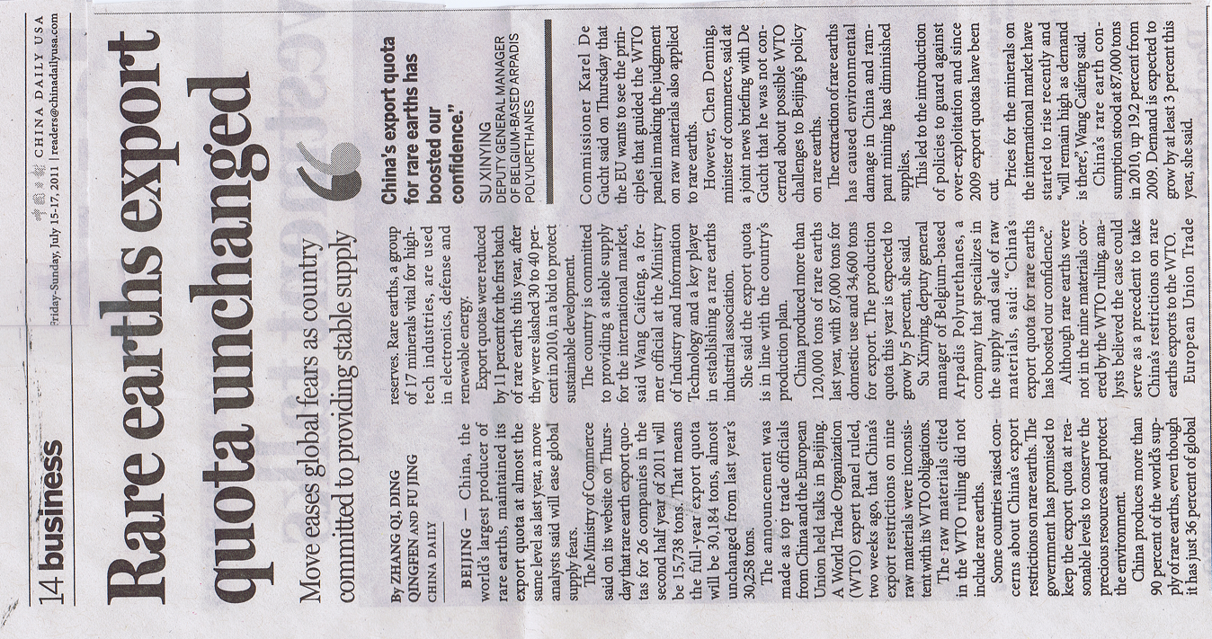
C.6. Rare Earths

Slide 57
Notes

Slide 58
D. Music and Genealogy
Activities:
Learn to play your harmonica.
Review Grandpa’s book of songs, select one of the songs to sing with him around the campfire, and write about your feelings in your notebook.
Learn about and think about the sacrifices of those who provided you with your DNA:
Write something you learned about one of your ancestors in your notebook.

Slide 59
Notes

Slide 60
2011 Science Camp
What was best about 2011 Science Camp?
__________________________________
__________________________________
__________________________________
What would be your ideal 2012 Science Camp? (remember, Ella and Taylor will join us in 2012)
__________________________________
__________________________________
__________________________________

