Slide 1
Science Camp #100707.1
7-10 July 2010 @ Nelson Cabin on Cedar Mountain
Advisors
H. Roice Nelson, Jr. and Paul F. Nelson
Attendees
Ethan E. Nelson, Grant M. Nelson, Colby C. Wright

Slide 2
1. Safety
Never go anyplace alone!
Exception is if one of you is hurt, then:
One of you stay and help the person hurt.
The other one run and get help.
If you get lost stay put, we will find you.
If you hear a rattlesnake do not move quickly, just slowly move away from the sound.
If you cut yourself, apply pressure to the wound to stop bleeding, and send for help.
Drink lots and lots and lots of water.
Do not go swimming unless an adult is with you.
Do not start branches on fire and swing them around where others can be hurt.
Use common sense and think before you act.

Slide 3
2. Geographic Context
Activities:
Study each image to understand view relative to the map:
Draw arrow on map from the Nelson cabin to the place of interest.
North is straight up, measure the angle to north with a compass.
Use compass to orient your view towards different places.
Compare the map view with terrain and satellite views.
Identify best fishing pond on the next 20 pages:
Why is it best?
Why can fish not grow in Quipacha?
Why do fish not take bait in Navajo Lake?
Identify where there are volcanic rocks.
Identify where there are metamorphic rocks.
Identify where there are sedimentary rocks.
Identify where the best skiing on planet earth is.
Write about what you learn in your notebook.

Slide 4
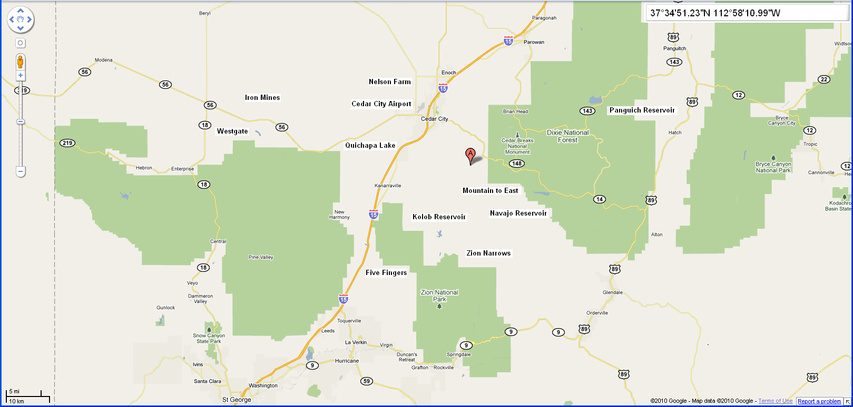
Nelson Cabin and Surrounding Area

Slide 5
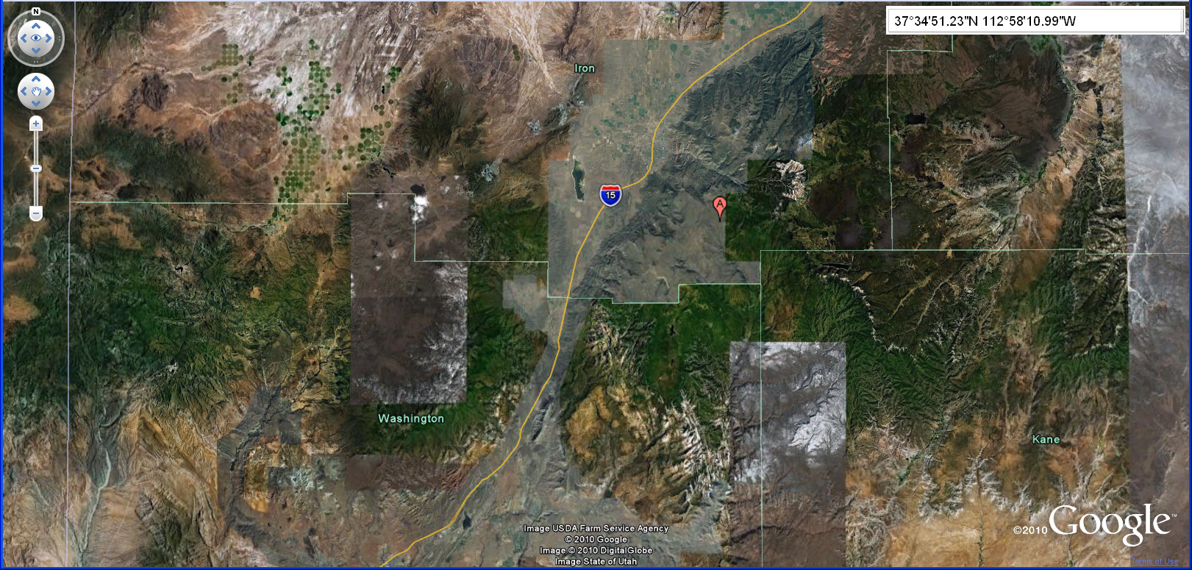
Nelson Cabin and Earth View

Slide 6
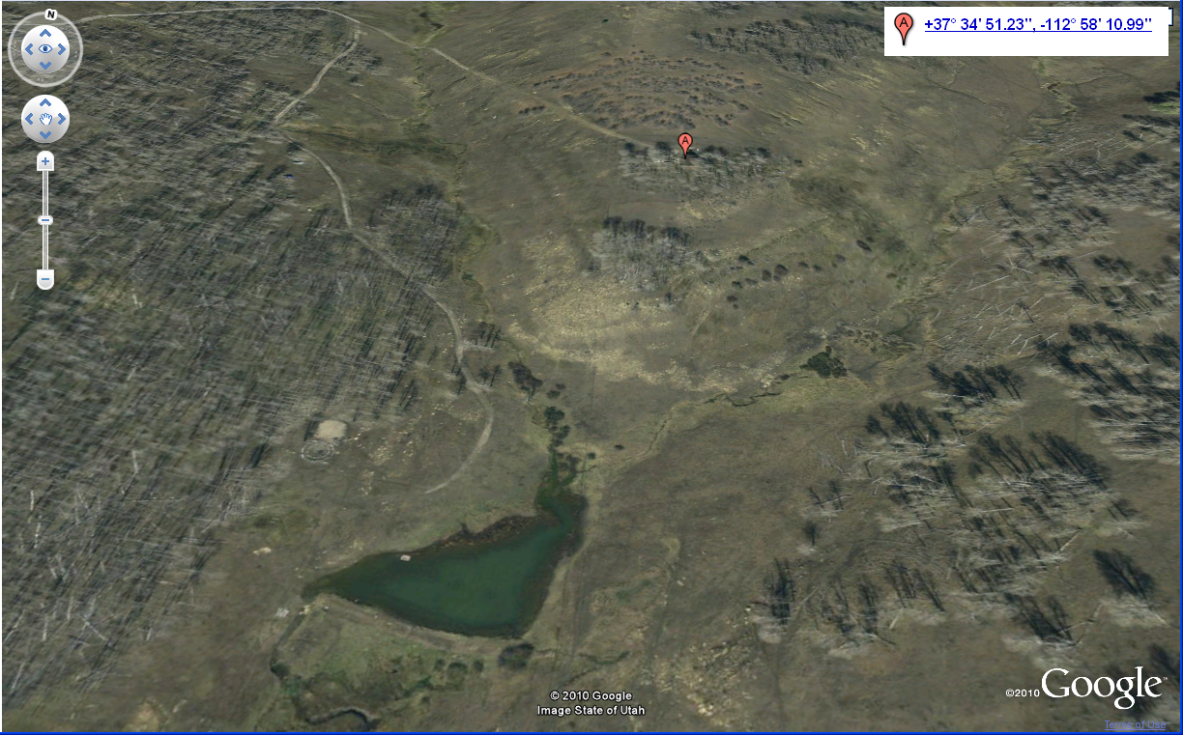
Nelson Cabin and Pond

Slide 7
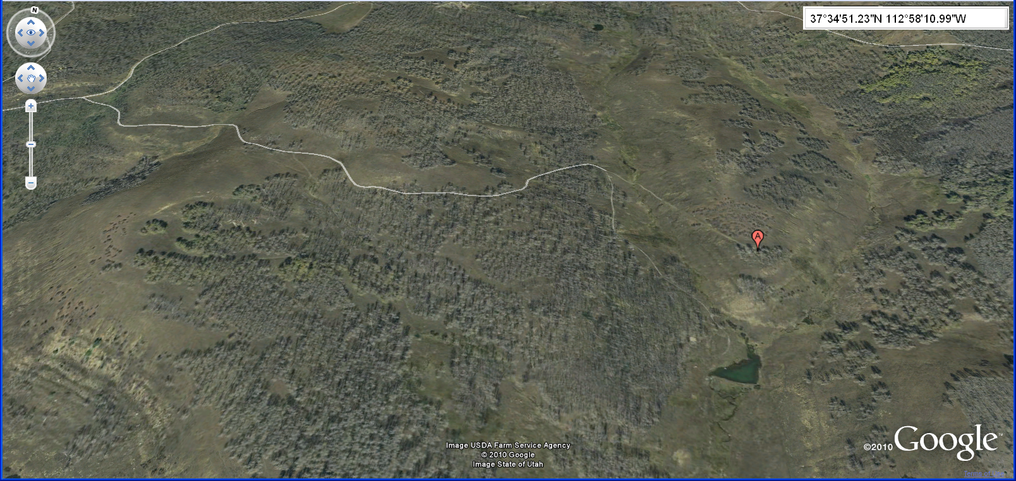
Road into the Nelson Cabin

Slide 8
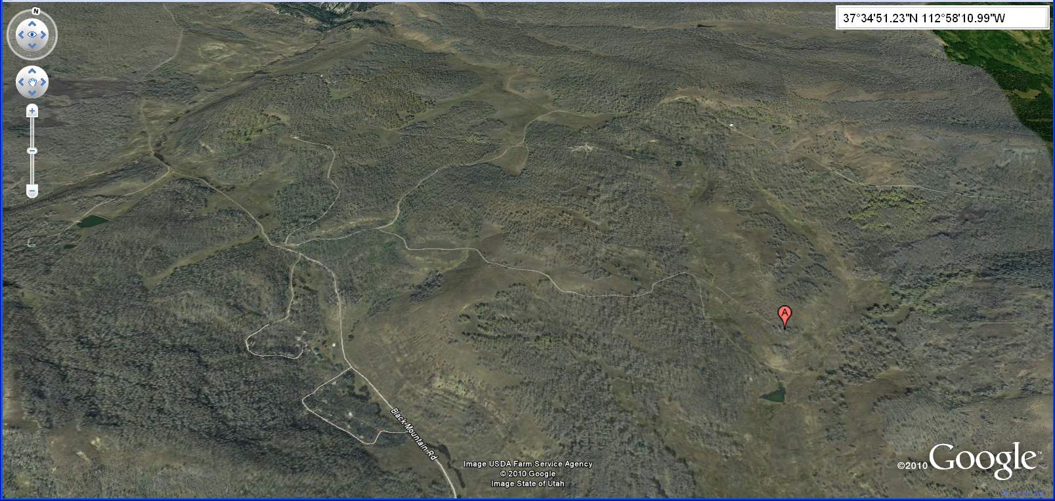
Road from Right Hand Canyon

Slide 9
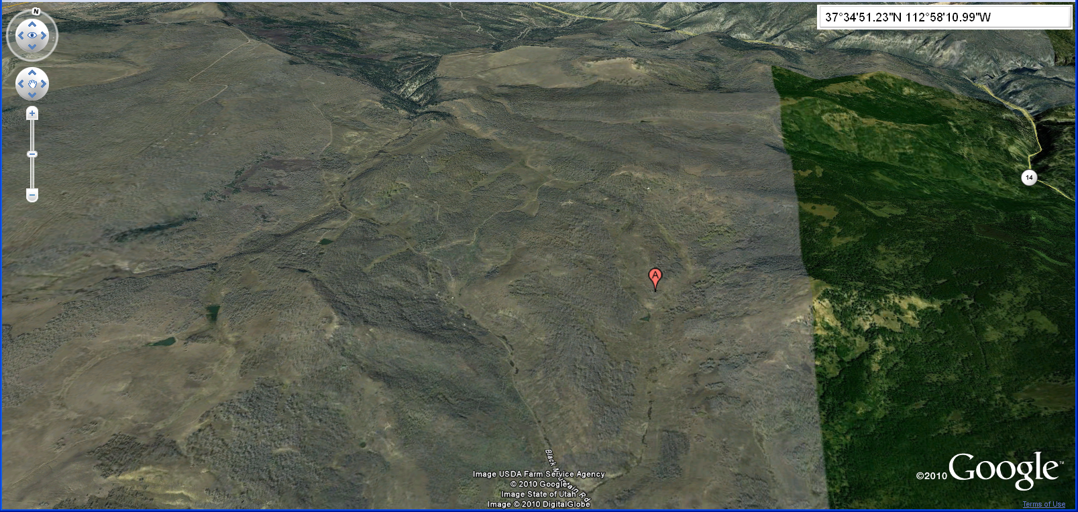
Distance from Highway 14

Slide 10
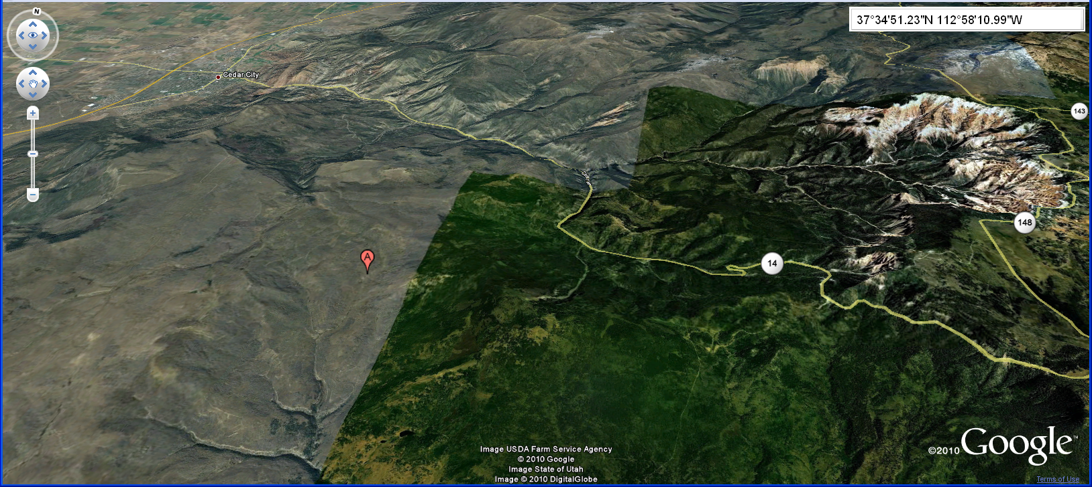
Relationship to Cedar Breaks

Slide 11
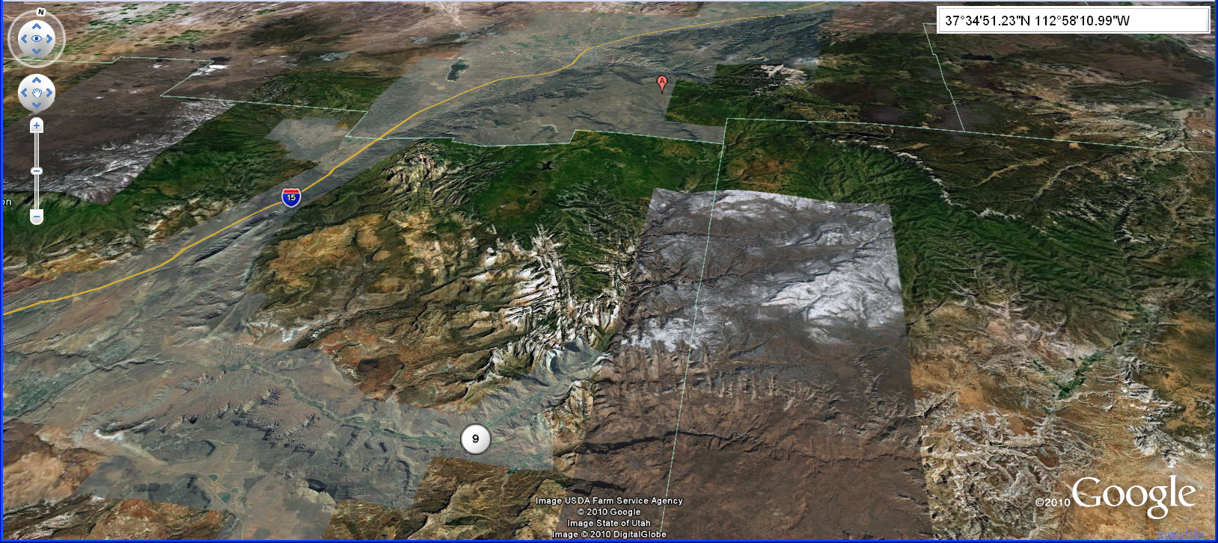
Looking North from Zion Canyon

Slide 12
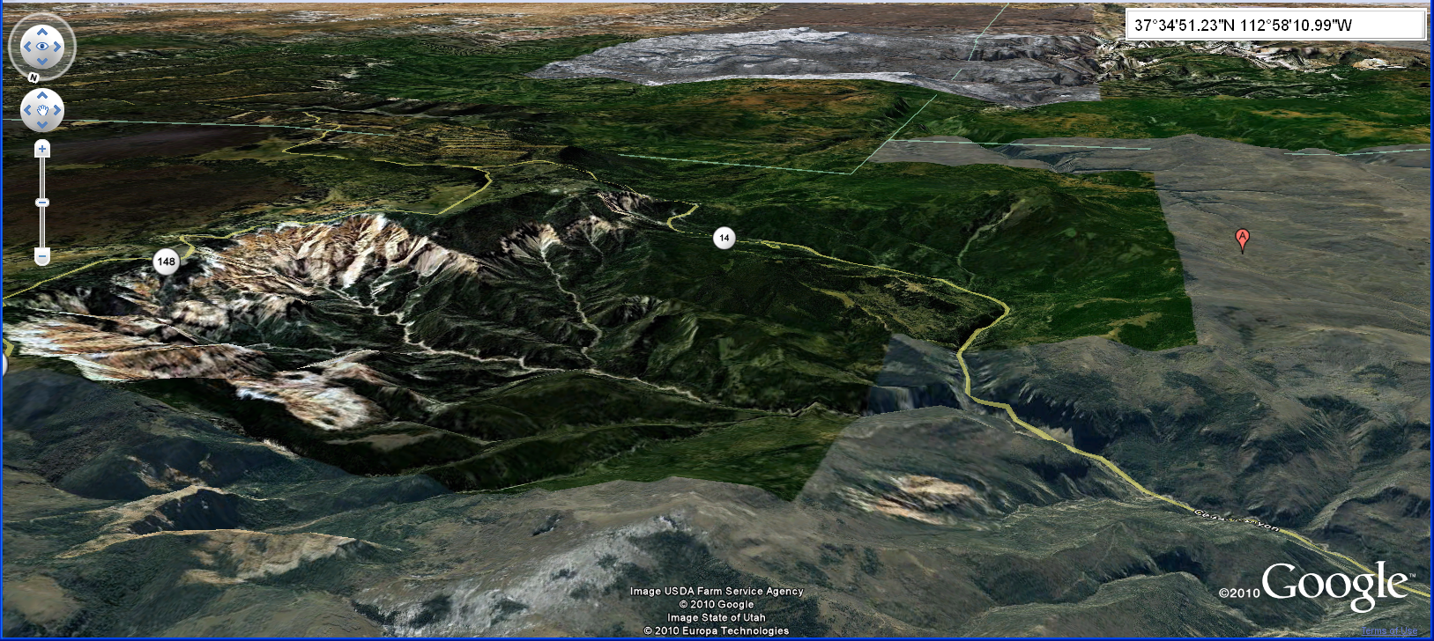
Looking South at Cedar Breaks and Zion Canyon

Slide 13
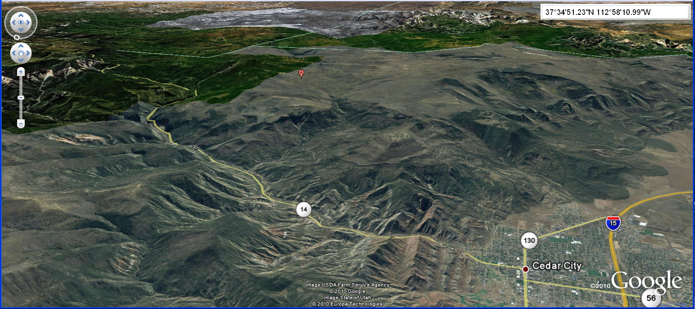
Looking Southeast from Cedar City

Slide 14
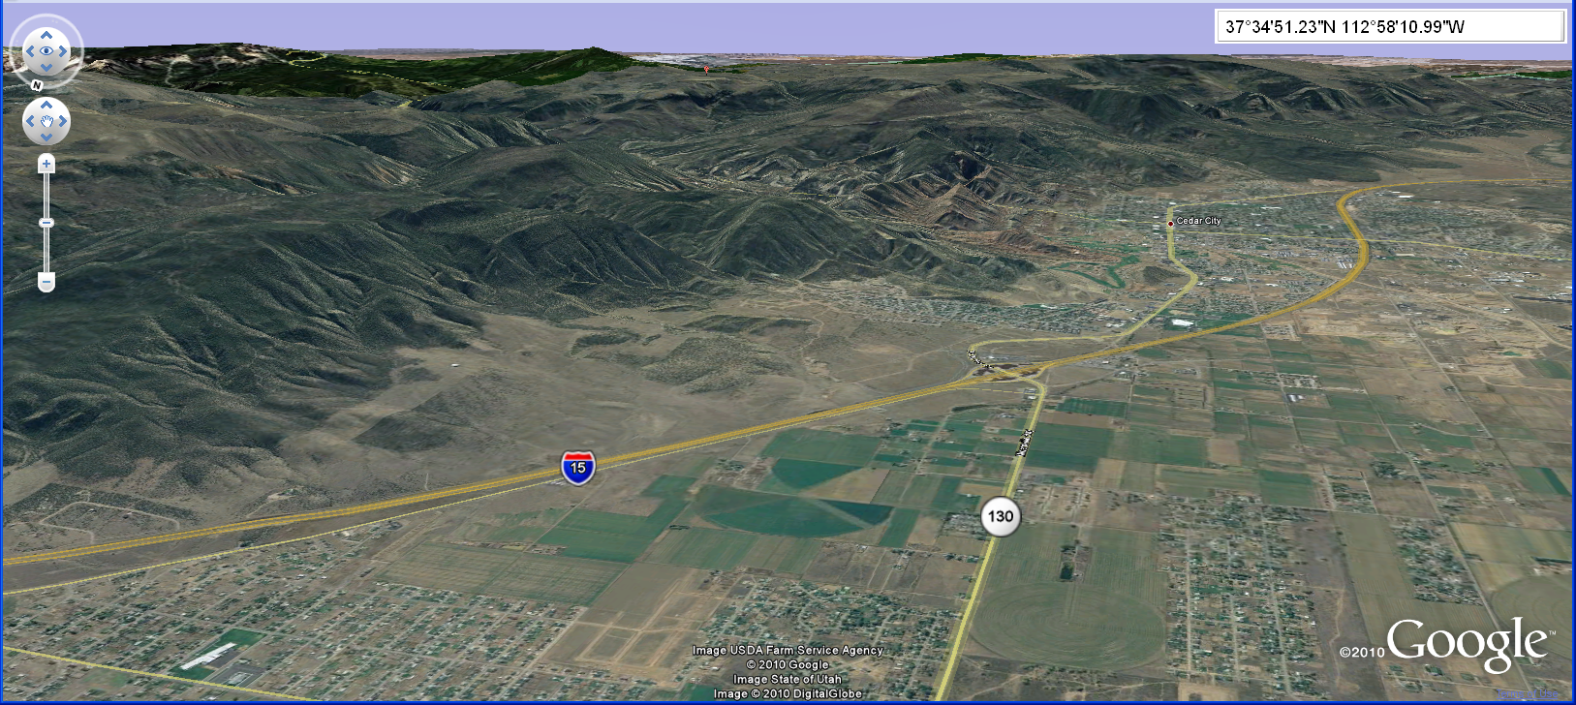
Looking Southeast from Nelson Farm

Slide 15
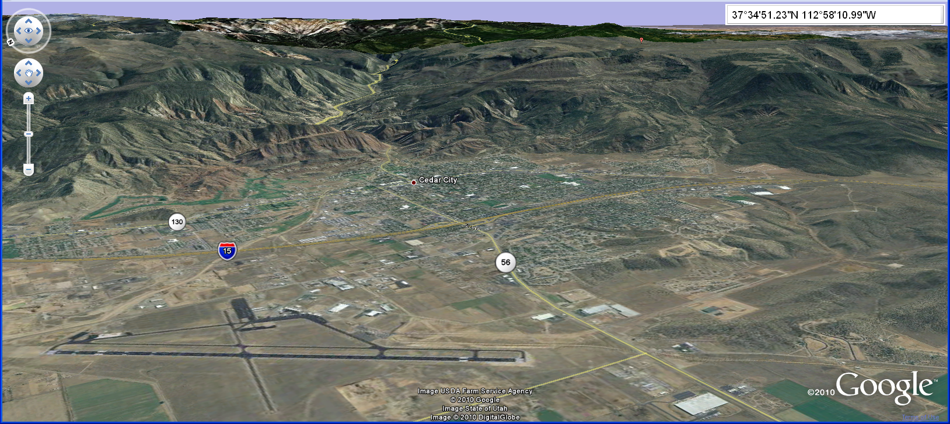
Looking East from Cedar Airport

Slide 16
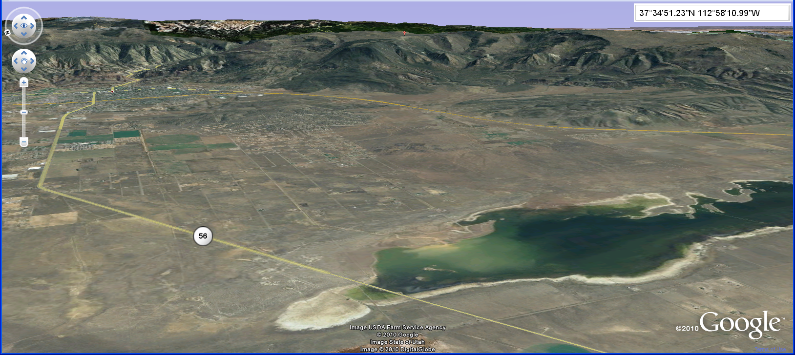
Looking East from Lake Quichapa

Slide 17
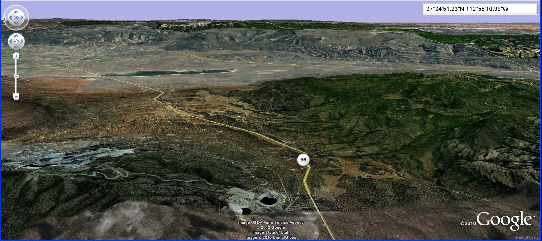
Looking East from Iron Mines

Slide 18
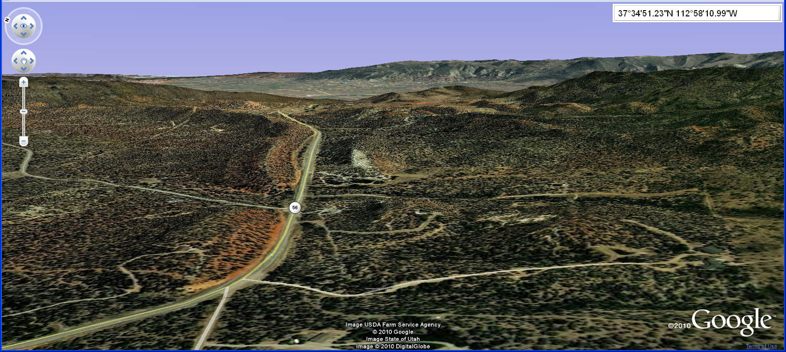
Looking East from Westgate

Slide 19
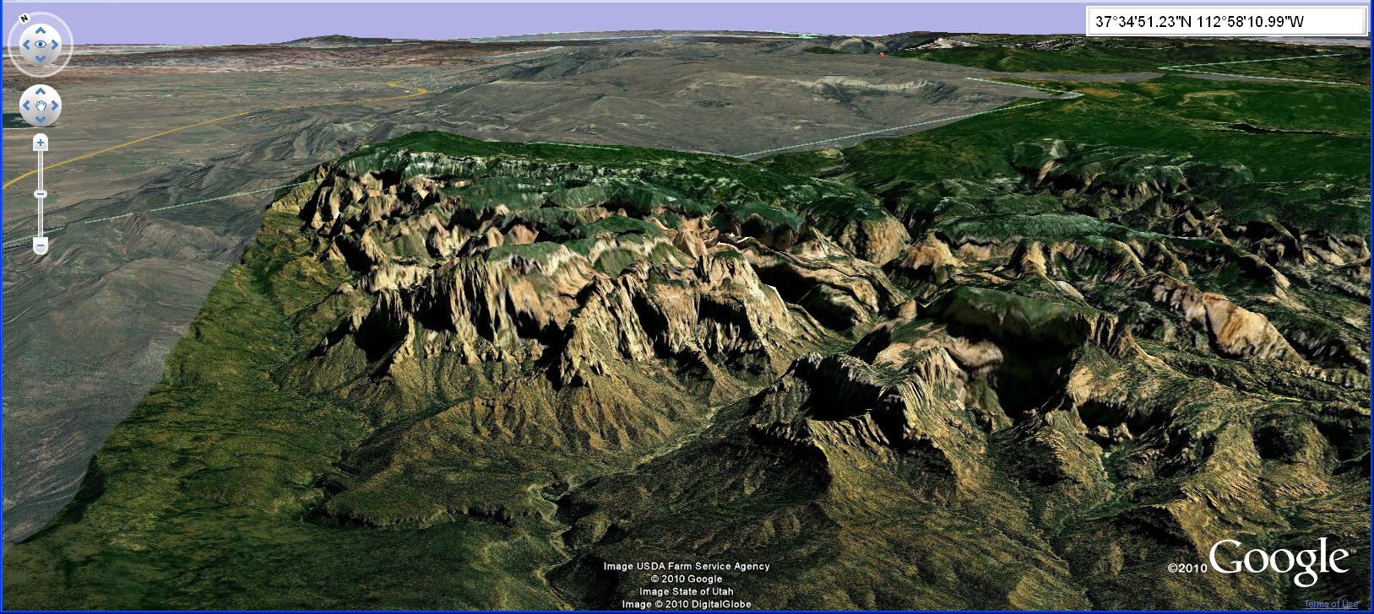
Looking Northeast from Five Fingers

Slide 20
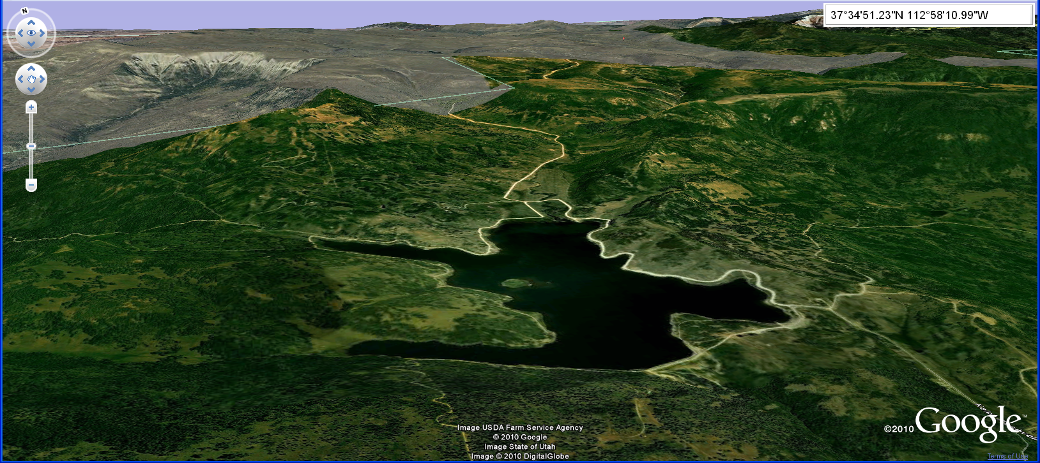
Looking North from Kolob Reservoir

Slide 21
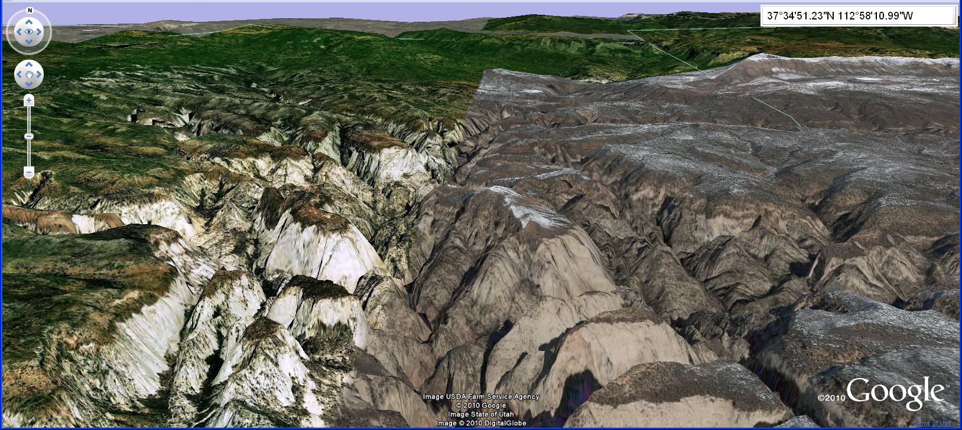
Looking North from Zion Narrows

Slide 22
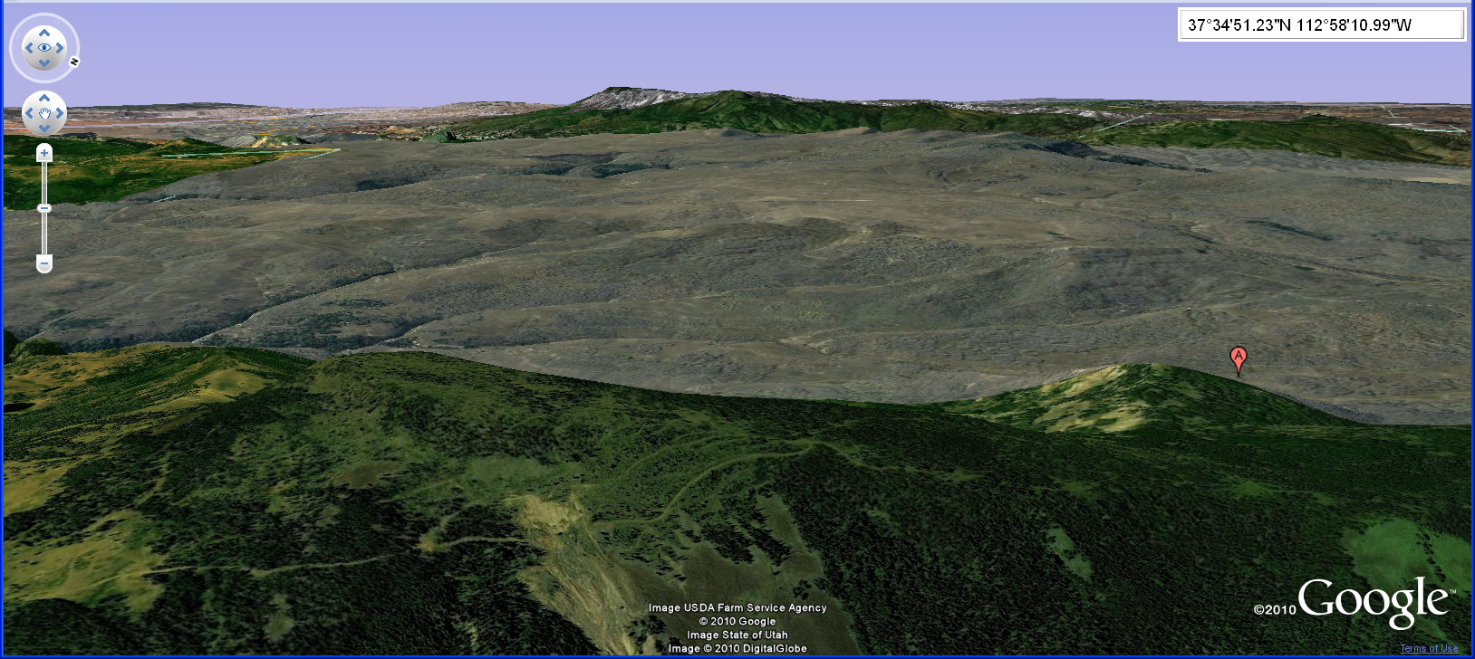
Looking West from Mountain Top

Slide 23
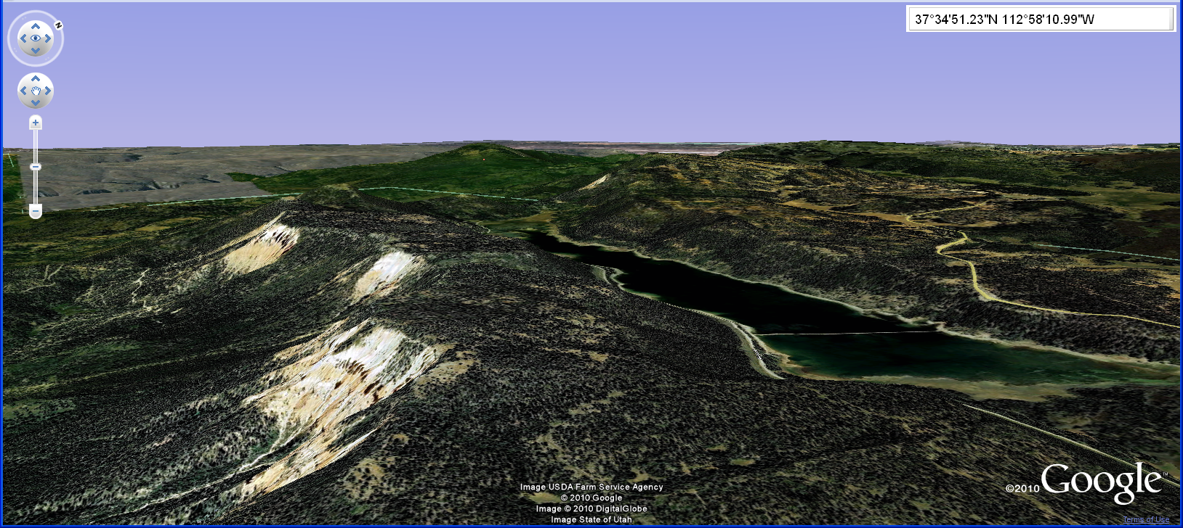
Looking West from Navajo Reservoir

Slide 24
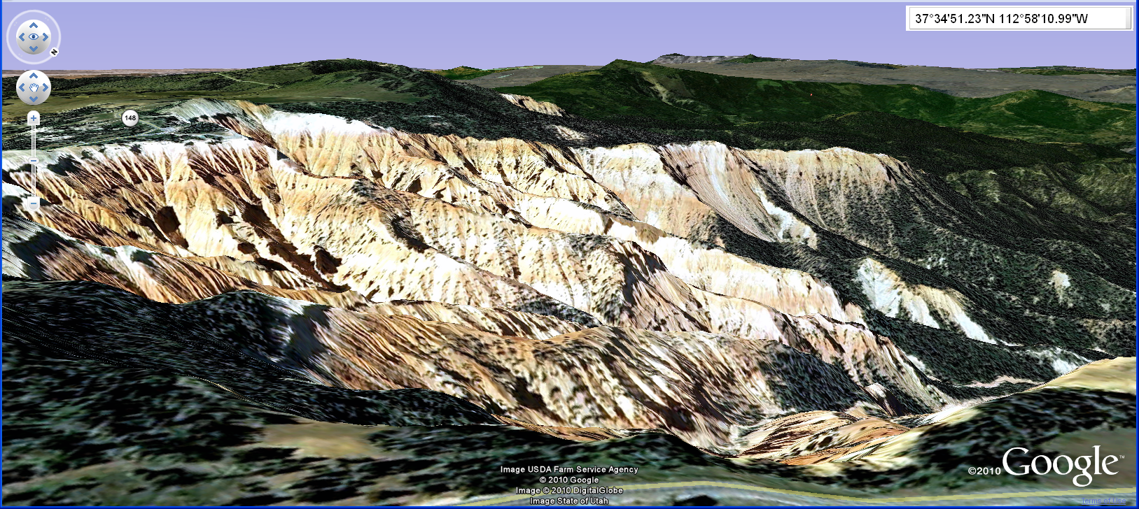
Looking Southwest from Cedar Breaks

Slide 25
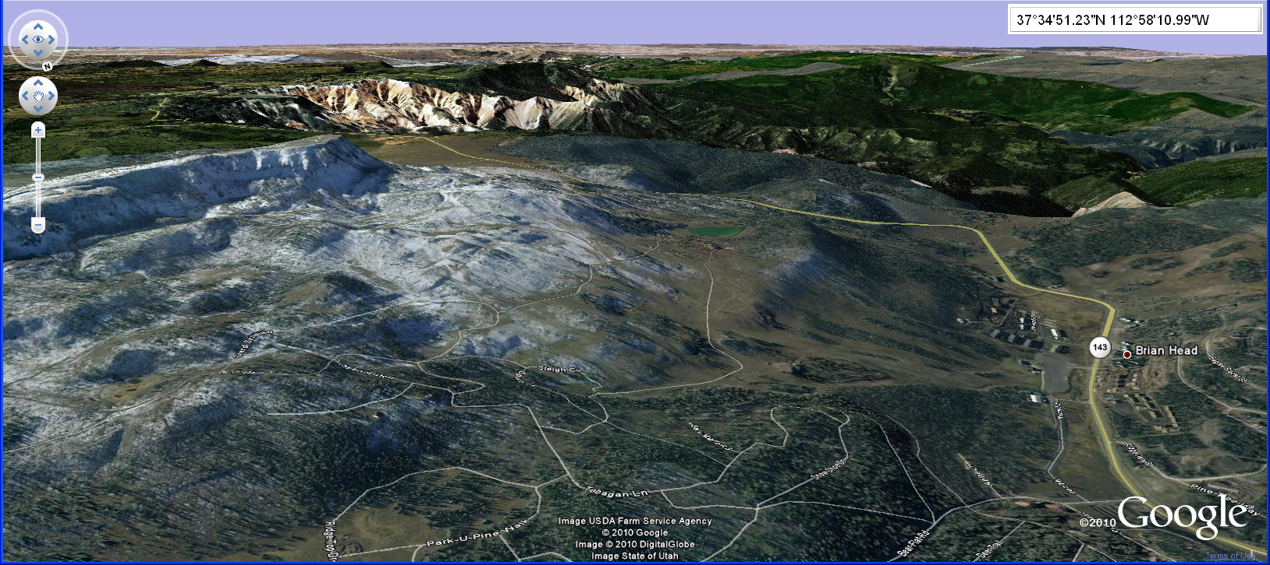
Looking West from Brian Head

Slide 26
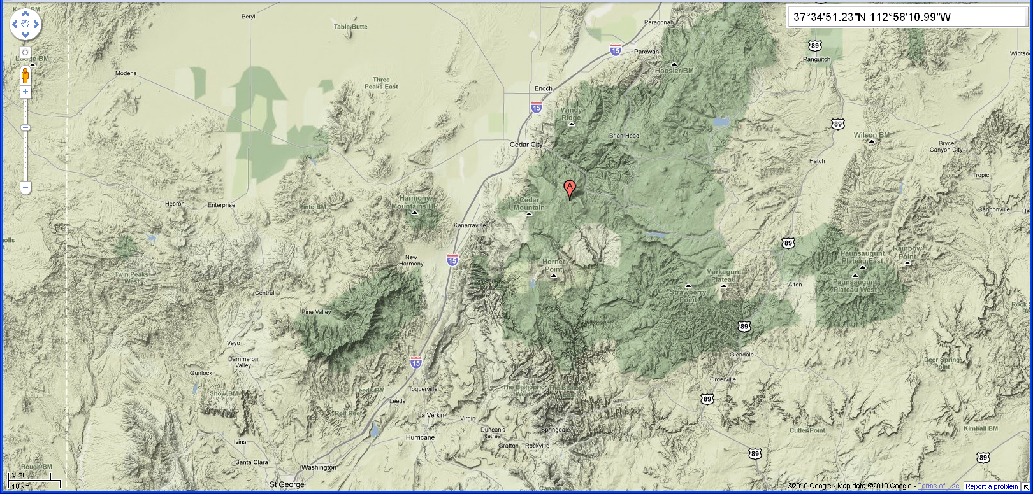
Nelson Cabin and Terrain View

Slide 27
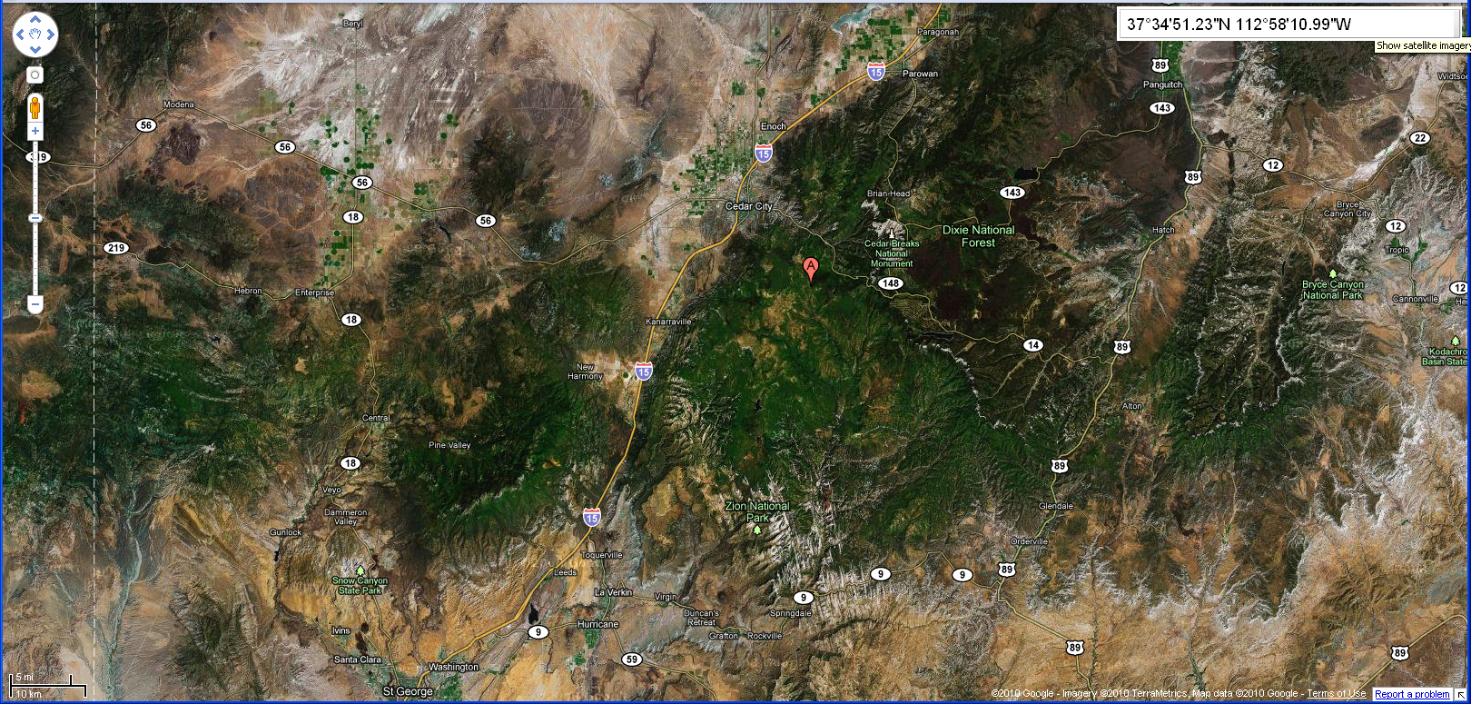
Nelson Cabin and Satellite View

Slide 28
3. Fishing
Activities:
Find and select bait.
Document what bait works and what doesn’t.
Note the time you fish in your notebook.
Learn how to and clean a fish.
Cook the fish you catch.
Where does the water in the lake come from?
Write about everything in your notebook.

Slide 29
4. Mapping Science
Activities:
Identify where the cabin gets:
Water;
Power; and
Where sewage goes.
Select a grid cell, identify and mark the corners, then study rocks, soil, plants, and bugs within the grid cell:
List all science questions that come to mind for the area; and
Compare your questions with questions for other areas.
Listen to sounds, smell orders, taste plants, describe colors, and make notes in your notebook about everything you learn.
Study your area at different times of the day. Write down what is different at different times of the day.
Review and Understand Genealogy “Map.”

Slide 30
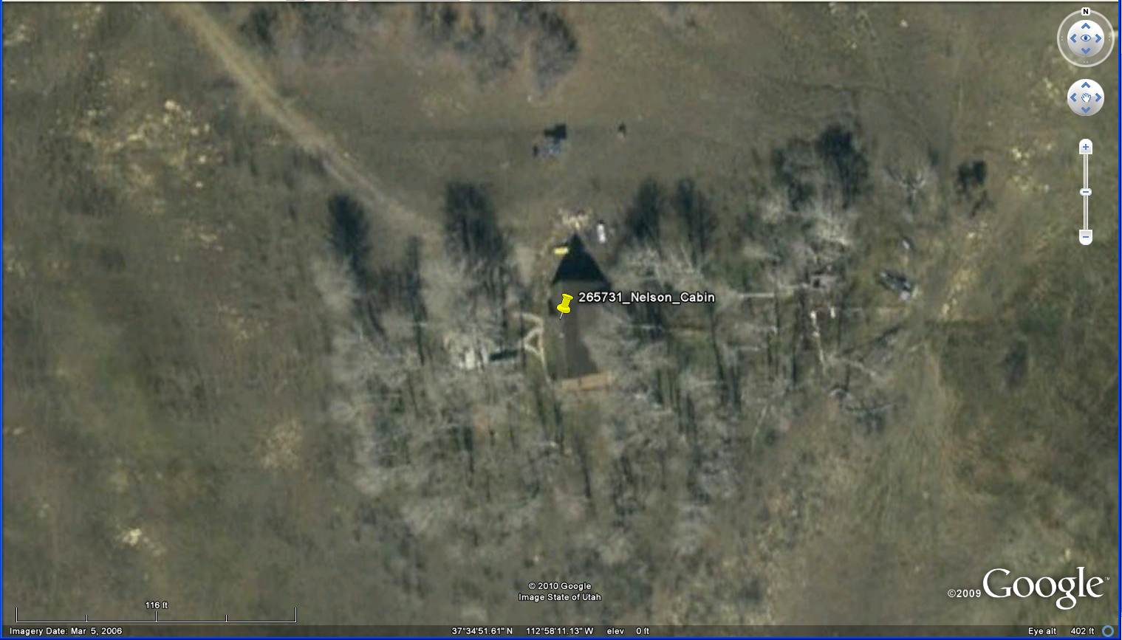
Identify Water, Sewage, Power

Slide 31
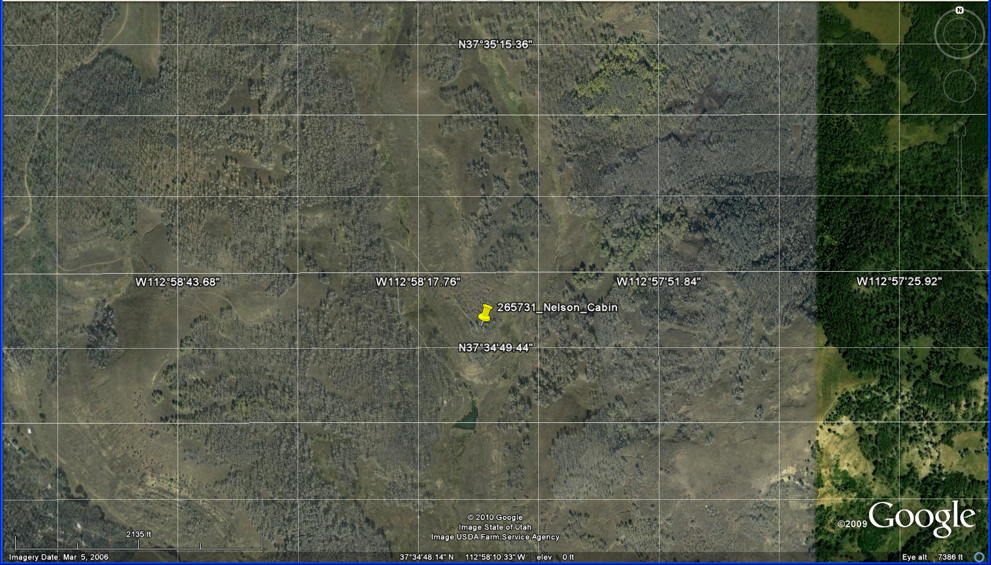
Map Science Questions

Slide 32
Map Reference Grid
26 36 46 56 66 76
25 35 45 55 65 75
24 34 44 54 64 74
23 33 43 53 63 73
22 32 42 52 62 72
11 21 31 41 51 61 71

Slide 33
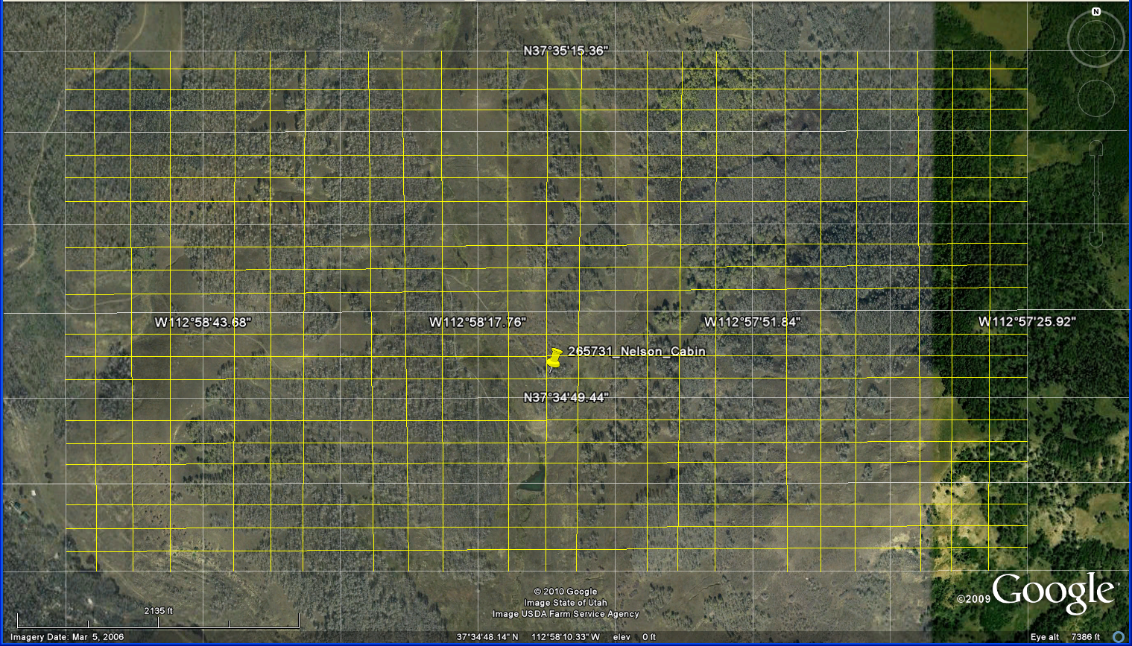
More Detail Reference Grid
66.41 76.11 76.21 76.31 76.41
16.14
16.13
16.12
16.11
15.14
11.11 11.21 11.31 11.41 21.11

Slide 34
Empty Large Grid

Slide 35
Empty Tight Grid

Slide 36
5. Condensation
Activities:
Review 3 John Boyce and Colby Wright videos.
Review the design of the condenser.
Read articles about condensation.
Measure amount of H2O condensed each morning.
Estimate amount of water from larger condensers.
Figure out the cost of generating water this way.
Compare this to the cost of the Lake Powell Pipeline.
Write about condensation in your notebook.

Slide 37
Condensation - Wikipedia
Condensation is the change in the phase of matter from the gaseous phase (of an element/ chemical species) into liquid droplets or solid grains of the same element/ chemical species. Upon the slowing-down of the atoms/ molecules of the species, the overall attraction forces between these prevail and bring them together at distances comparable to their sizes.
Since the condensing atoms/ molecules suffer from reduced degrees of freedom and ranges of motion, their prior kinetic energy must be lost/ transferred to an adsorbing colder entity — either a center of condensation within the gas volume (colder molecules of the species, cold grains of dust etc.) or some contact surface. Condensation is initiated by the formation of atomic/ molecular clusters of that species within its gaseous volume — like rain drop or snow-flake formation within clouds — or at the contact between such gaseous phase and a (solvent) liquid or solid surface.
A few distinct reversibility scenarios emerge here with respect to the nature of the surface.
absorption into the surface of a liquid (either of the same species or one of its solvents) — is reversible as evaporation.^{[1]}.
adsorption (as dew droplets) onto solid surface at pressures and temperatures higher than the specie's triple point — also reversible as evaporation.
adsorption onto solid surface (as supplemental layers of solid) at pressures and temperatures lower than the specie's triple point — is reversible as sublimation.
Condensation commonly occurs when a vapor is cooled and/or compressed to its saturation limit when the molecular density in the gas phase reaches its maximal threshold. Vapor cooling and compressing equipment that collects condensed liquids is called "condenser".
Psychrometry measures the rates of condensation from and evaporation into the air moisture at various atmospheric pressures and temperatures. Water is the product of its vapor condensation — condensation is the process of such phase conversion.

Slide 38
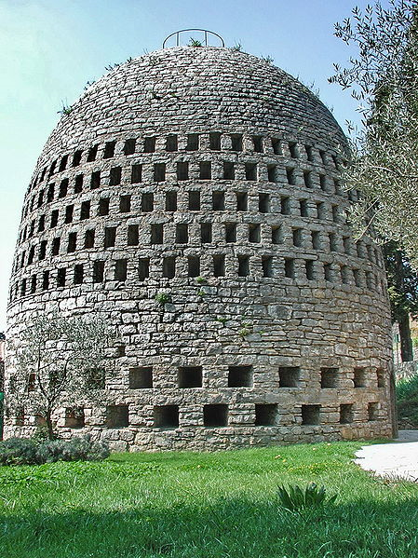
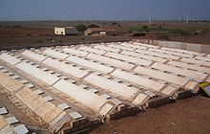
Air Wells
High-mass air well of Belgian engineer Achile Knapen in Trans-en-Provence.
A 550 square metres (660 sq yd) radiative condenser in northwest India.

Slide 39
Air Well Description - Wikipedia
An air well or aerial well is a structure or device that collects water by promoting the condensation of moisture from air.^{[2]} Designs for air wells are many and varied, but the simplest designs are completely passive, require no external energy source and have few, if any, moving parts. A related, but quite distinct, technique of obtaining atmospheric moisture is the fog fence. An air well should not be confused with a dew pond. A dew pond is an artificial pond intended for watering livestock. The name dew pond (sometimes cloud pond or mist pond) derives from the widely held belief that the pond was filled by moisture from the air.^{[3]} In fact, dew ponds are primarily filled by rainwater.^{[4]}
All air well designs utilise a substrate with a temperature sufficiently low so that dew forms. This condensation releases latent heat which must be dissipated. Cooling of the substrate is typically achieved by radiating heat to the sky, during periods of cool breezes (particularly at night), or by conduction to some other heat sink.
Three principal designs are used for air wells: high mass, radiative and active. High-mass air wells were used in the early 20th century, but the approach failed. From the late 20th century, onwards, low-mass, radiative collectors proved to be much more successful. Thirdly, active collectors collect water in the same way as a dehumidifier, although the designs work well, they require an energy source making them uneconomical except in special circumstances. New, innovative designs seek to minimise the energy requirements of active condensers or make use of renewable energy resources.

Slide 40
Emissivity - Wikipedia
The emissivity of a material (usually written ε or e) is the relative ability of its surface to emit energy by radiation. It is the ratio of energy radiated by a particular material to energy radiated by a black body at the same temperature. It is a measure of a material's ability to radiate absorbed energy. A true black body would have an emissivity = 1, while any real object would have an emissivity < 1 . Emissivity is a dimensionless quantity, so it does not have units.
In general, the duller and blacker a material is, the closer its emissivity is to 1. The more reflective a material is, the lower its emissivity. Highly polished silver has an emissivity of about 0.02.

Slide 41
6. Water Coloring and Acrylics
Activities:
Use water “milked” from the atmosphere.
Do a sunrise/sunset wash.
Draw in mountain top and/or trees and/or cabin with pencils and highlight these with markers.
Write thoughts about painting science in your notebook.

Slide 42
7. Music and Genealogy
Activities:
Learn to play your harmonica.
Review Grandpa’s book of songs, select one of the songs to sing with him around the campfire, and write about your feelings in your notebook.
Learn about and think about the sacrifices of those who provided you with your DNA:
Write something you learned about one of your ancestors in your notebook.

Slide 43
2011 Science Camp
What was best about 2010 Science Camp?
__________________________________
__________________________________
__________________________________
What would be your ideal 2011 Science Camp?
__________________________________
__________________________________
__________________________________

