Slide 1

Merry Christmas
and a
Happy New Year
to you and yours!
(more at http://www.walden3d.com/photos/Christmas/Christmas_Cards/2013_Christmas_Card )
Dear Friends and Family,
Hello to all from Houston and Cedar City. Our year has been consumed selling our house at 1307 Emerald Green (1) (2), moving (3) (4), having a hawk see us off (5), looking forward to the view of the lake and the natatorium from our condo (6), losing the air conditioner between Ft. Stockton and Phoenix (7), unloading the truck in Utah, then flying back to Houston and setting up an apartment (8). We made two trips back to Cedar, where the dining room started off full of boxes (9), getting the 130 boxes with the history of Landmark , HyperMedia, etc. in the garage (10), putting down wood floors and settling into our new living room (11), having bookcases built and setting up an office (12), then welcoming a new grandbaby (Rachel and Garrett’s Gwendolyn Ivy Olson) while experiencing our first snow storm (13). We set up a flicker site for those of you interested in photos of our kids, grandkids, science camp, fall colors in Zion, etc. (http://www.flickr.com/photos/100185671@N04/sets/). We really like our “penthouse” apartment with the lovely view (14) and our condo with the lovely sunsets (15). We look forward to when you visit us at either or both places. We hope & pray you and yours are happy and full of joy this Christmas Season.
With Love,
H. Roice Nelson, Jr. &
Andrea Shirts Nelson
529 Barker Clodine #18304
Houston, TX 77094
or
2155 West 700 South #31
Cedar City, UT 84720

Slide 2
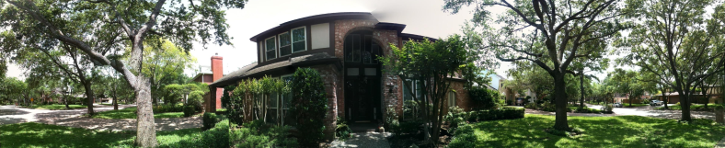
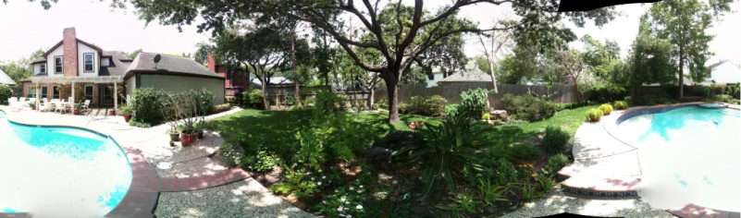
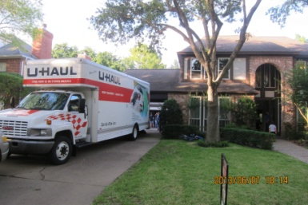
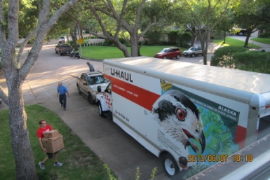
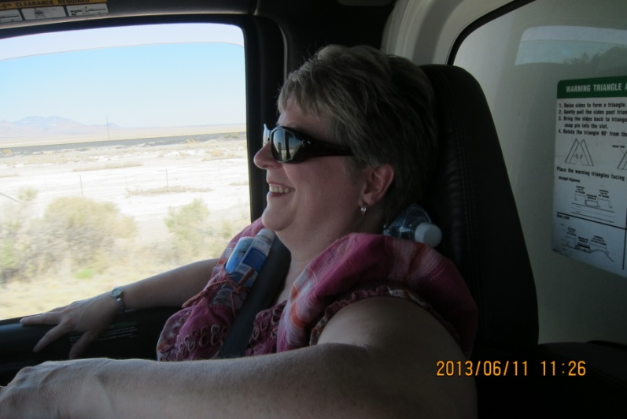
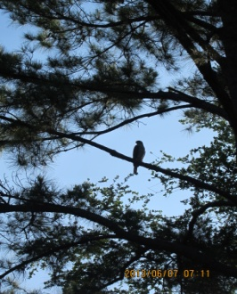
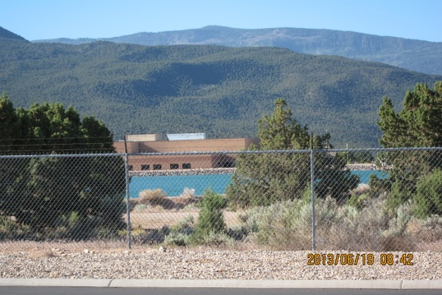
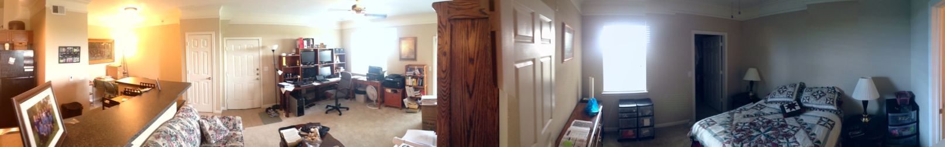
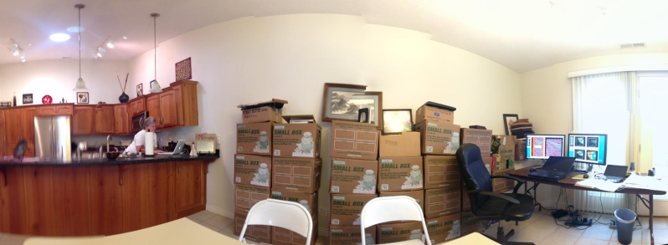
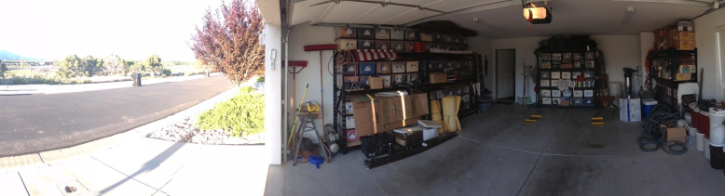
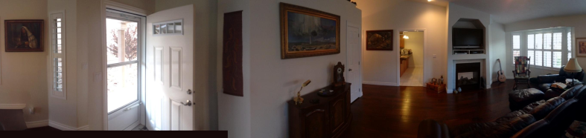
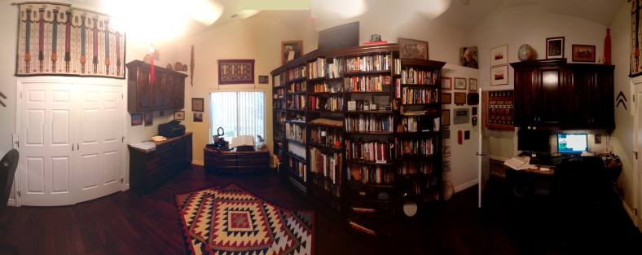
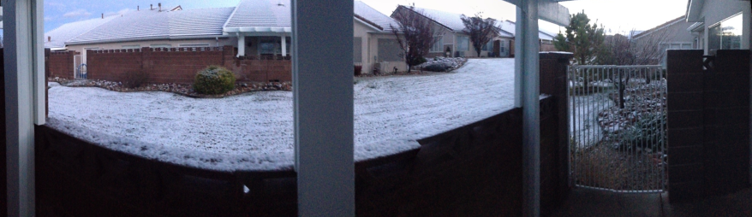
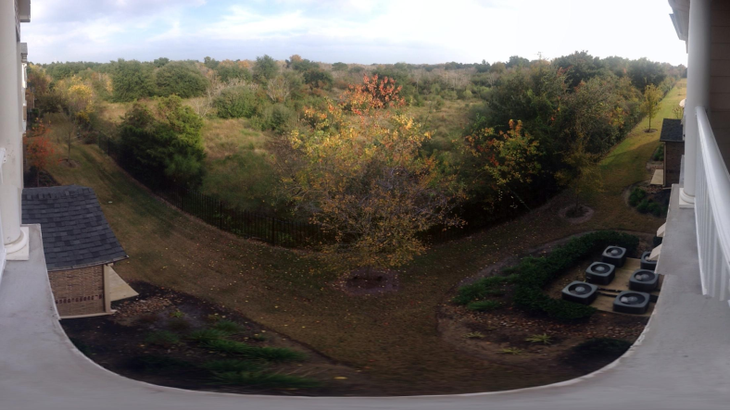
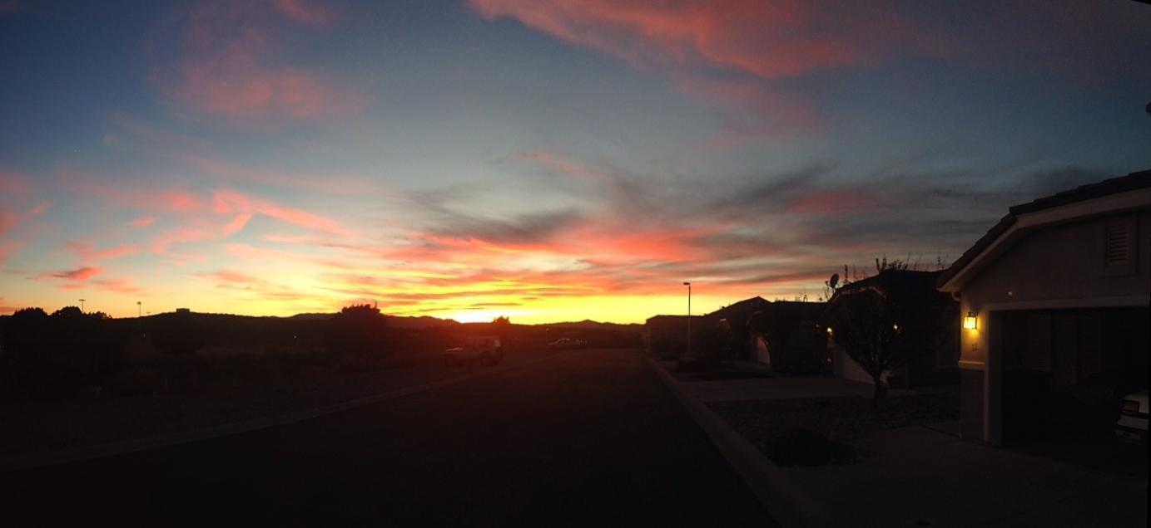
1
4
2
2
3
5
6
7
8
9
10
11
12
13
14
15

Slide 3

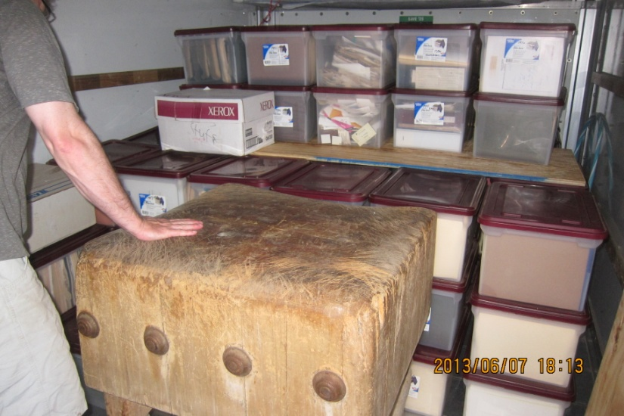

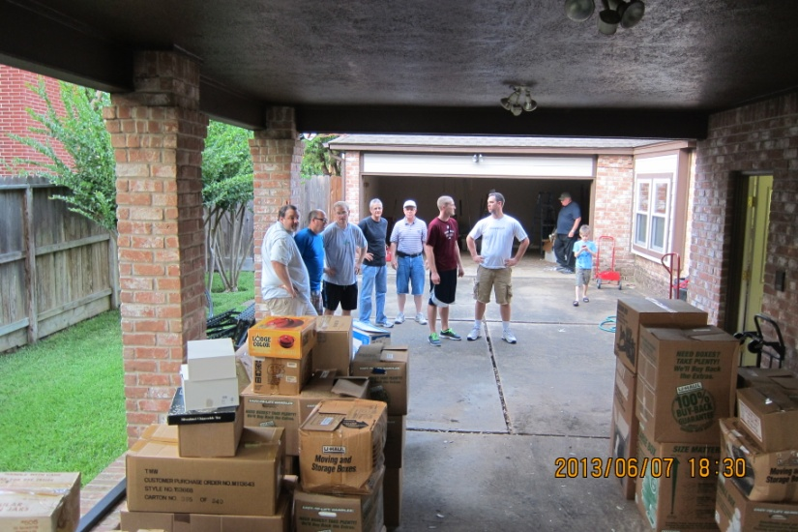
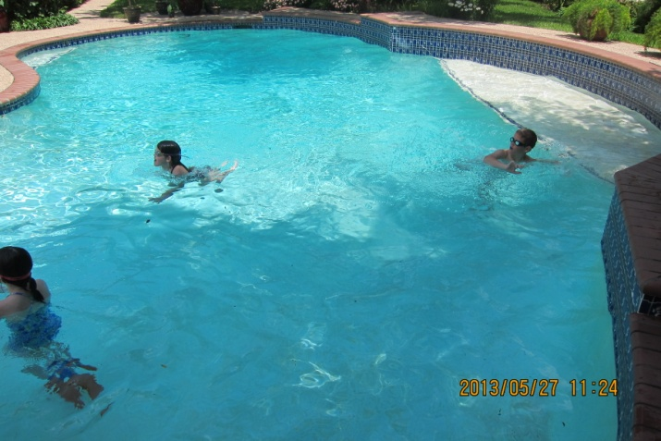




Slide 4
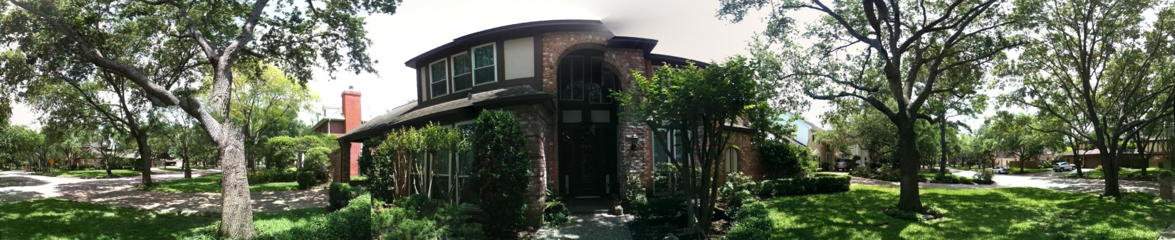
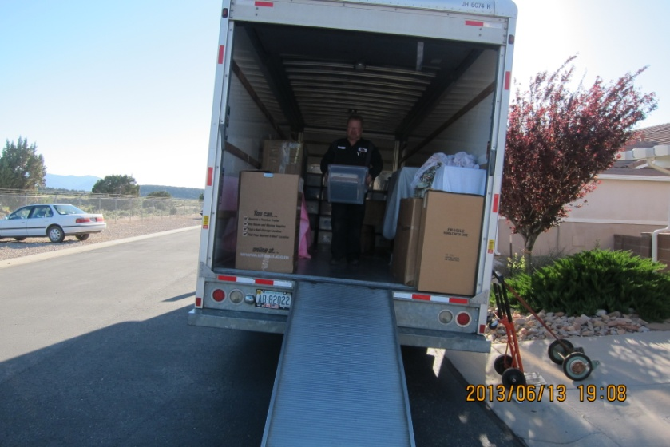


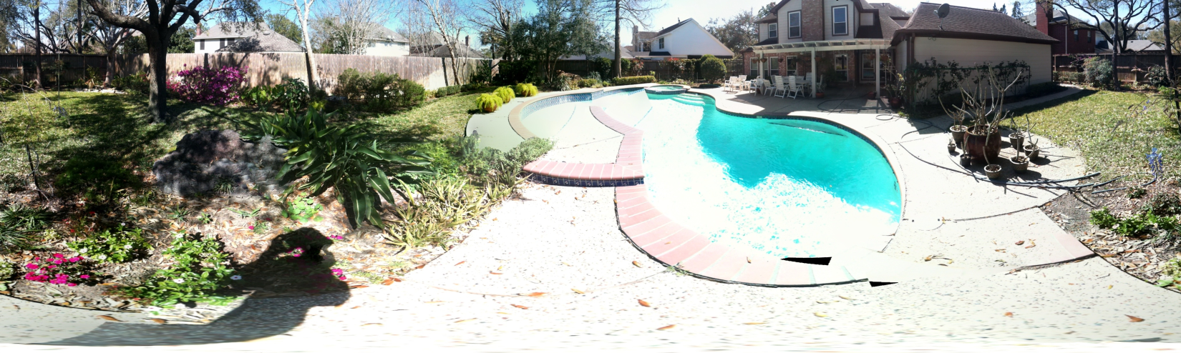

Slide 5

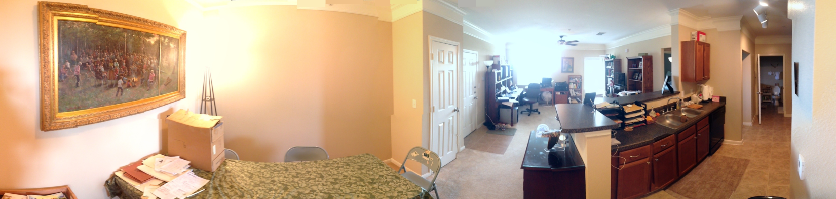
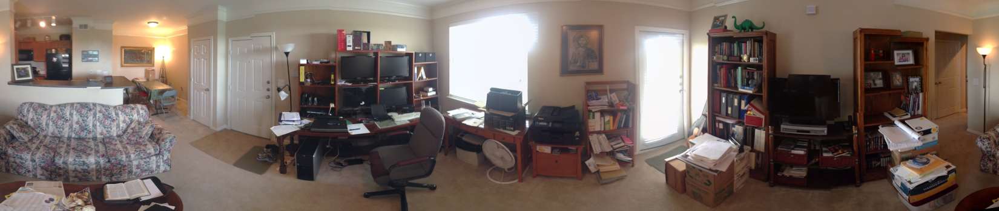
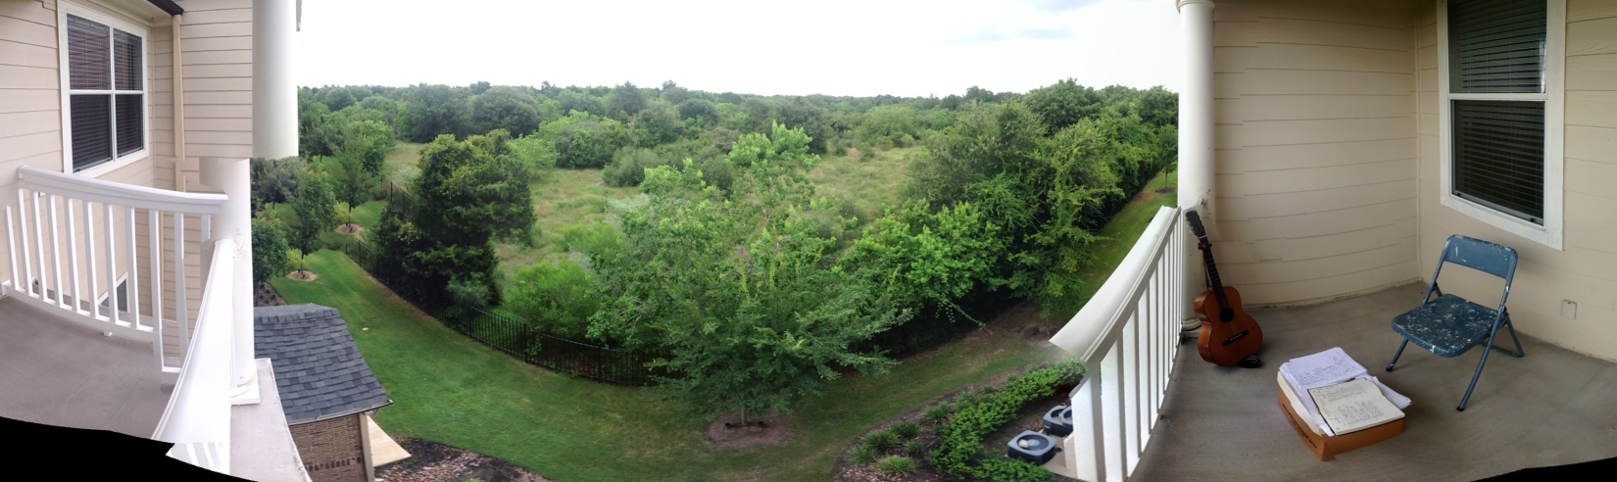

Slide 6



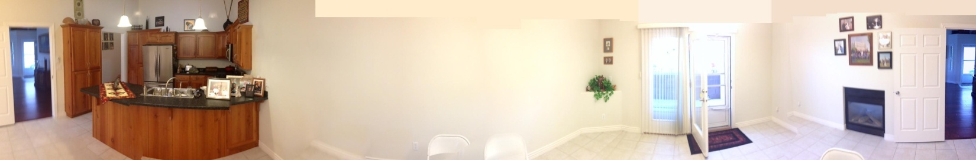
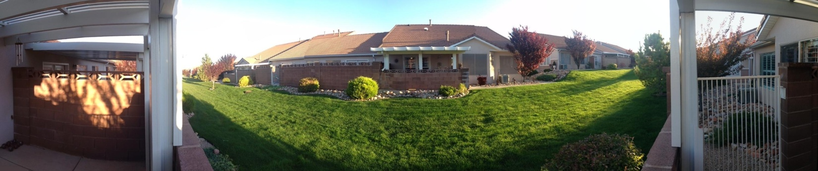

Slide 7
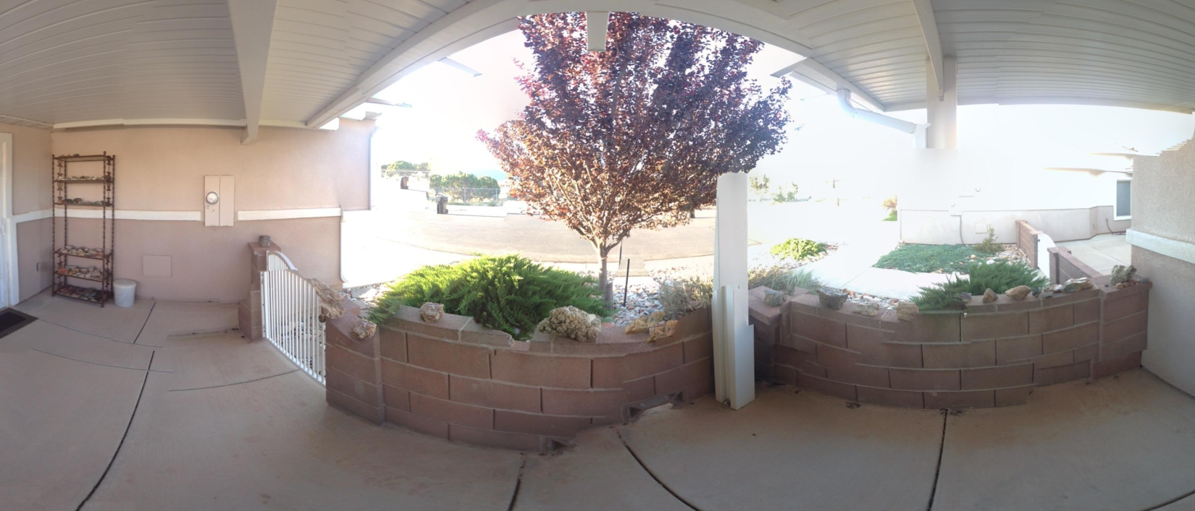
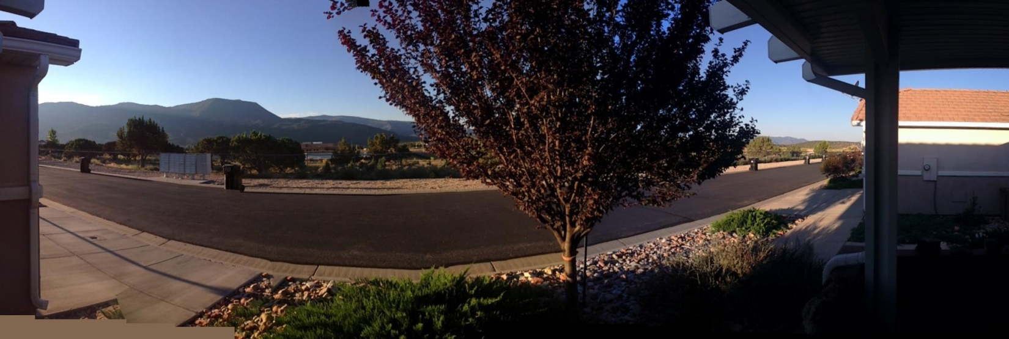
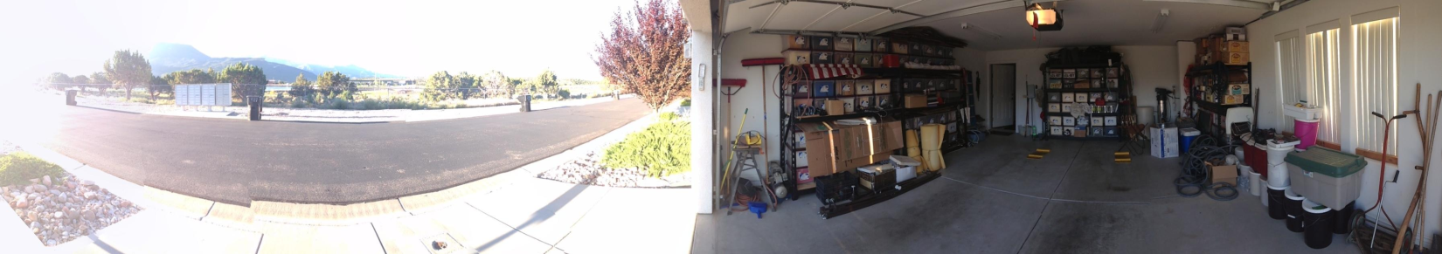
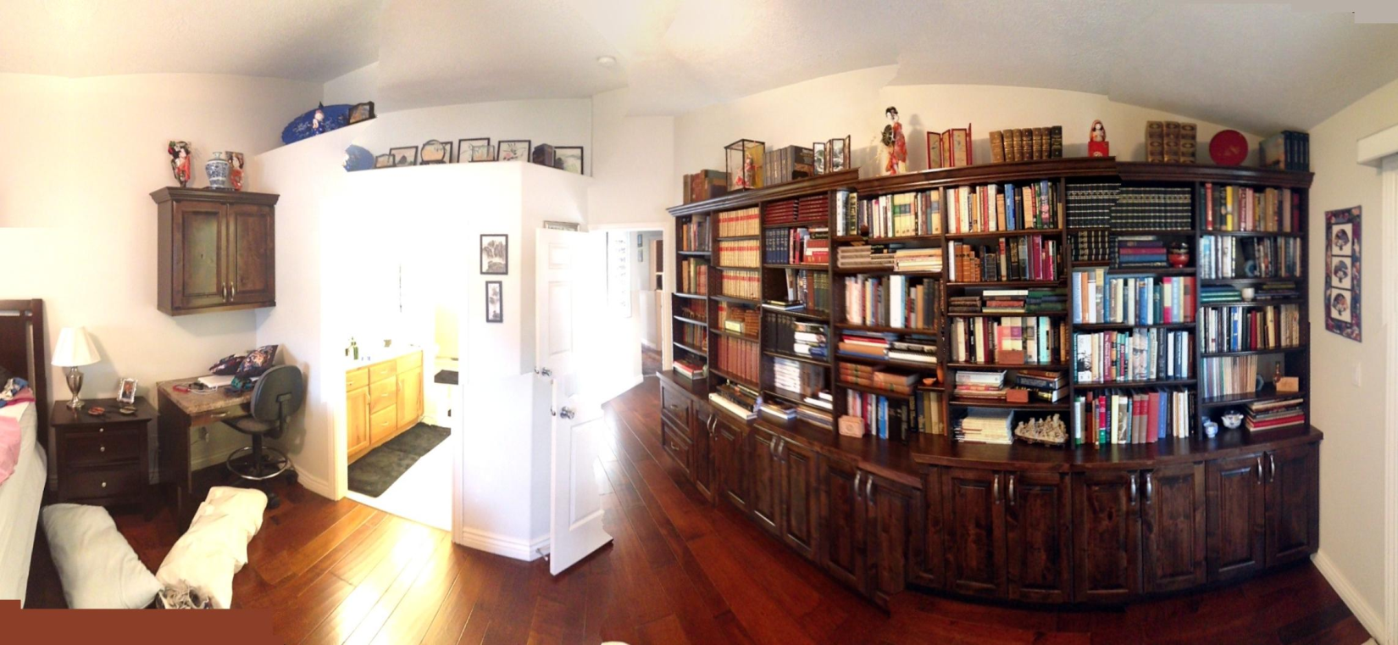

Slide 8
