Slide 1

Dear Friends and Family,
We are glad to close out 2011. We have obtained a second small retainer, and so 2012 promises to be a significant improvement over 2011. We have each walked over 900 miles this year (1). The big family event of the year was Sara Ellyn’s marriage to Tim Sullivan in Austin (2). Grandkids Grant, Quentin, Taylor, Ethan, Halle, Ella, Colby, and Dallin (3), Sarah J. & Sara Ellyn & Sarah N. (4), Roice & Sarah N. (5), Ben & Sarah J. (6), Paul & Kate (7), Joshua & Audrey (8), Rob and his girlfriend Jules (9), and Matt & Heather (10) attended. Audrey, Melanie, Rachel, and Bridget (11), and Audrey, Heather, Andrea, & Rachel (12) all enjoyed the festivities. Rachel and Garret visited Matt in Cedar City (13). Andrea made a beautiful quilt for Matt (14). It was another grandchild graduate for Grandma Shirts (15). We had our second Grandkids science camp (16). Roice taught a course in Dubai (17). SUU restored the donated Willys Whippet (18). Audrey sent photos of Sophie and Izzy (19). We have been Houston Temple Ordinance Workers since February 2009, and spend each Thursday afternoon serving in the temple (20). This service has increased our love and appreciation for our Lord and Savior, Jesus Christ. We shared last Christmas morning with Jared, Melanie, Colby, Taylor, Halle, Avalyn, Sara Ellyn, and Tim (21), and expect to be back there this year.
We hope and pray this Christmas Season finds you happy.
With Love,
H. Roice Nelson, Jr. &
Andrea Shirts Nelson
1307 Emerald Green
Houston, TX 77094
Merry Christmas
and a
Happy New Year
to you and yours!
(more at http://www.walden3d.com/photos/Christmas/Christmas_Cards/2011_Christmas_Card )

Slide 2
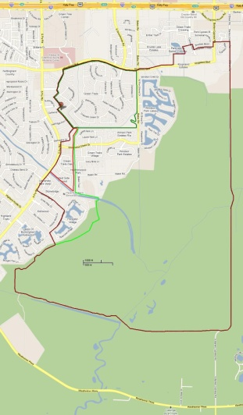
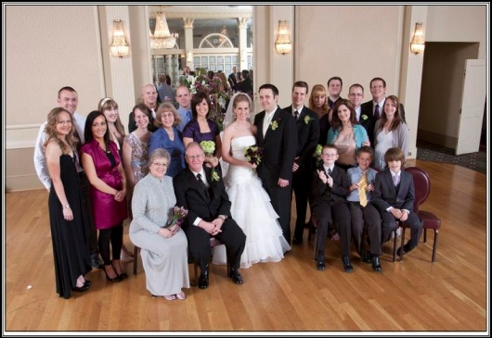
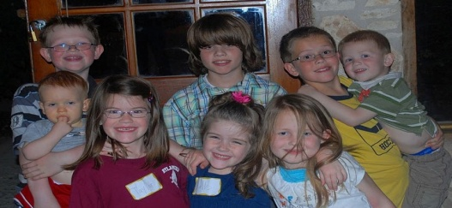
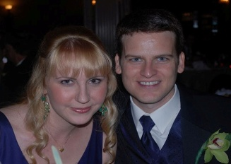
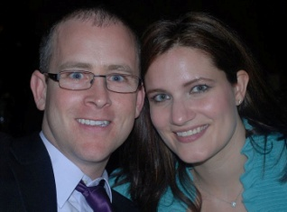
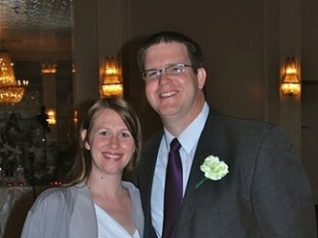
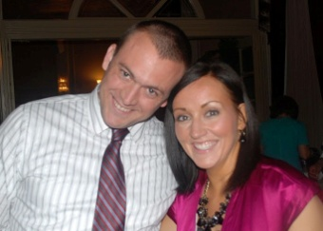
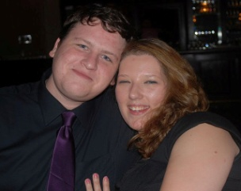
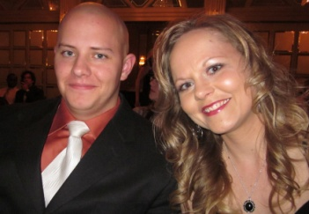
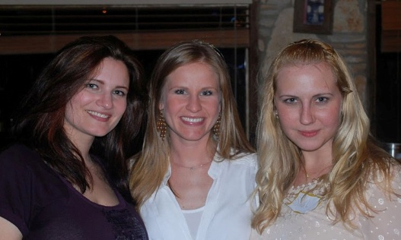
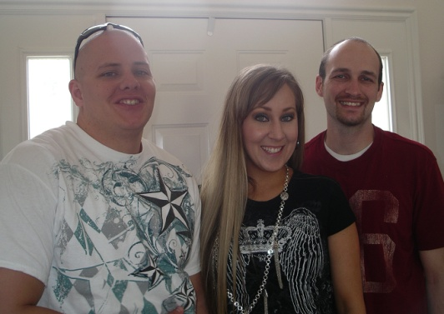
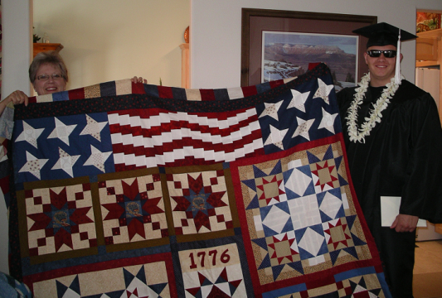
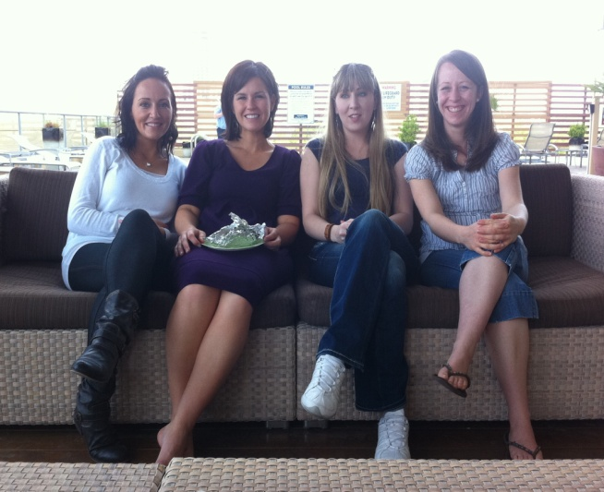
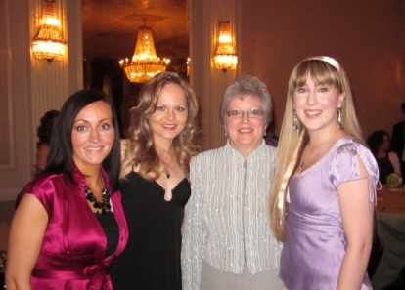
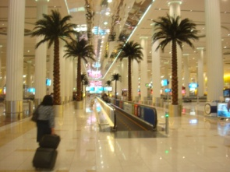
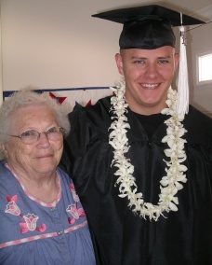
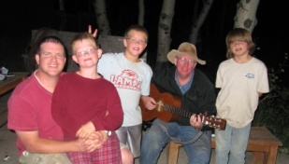
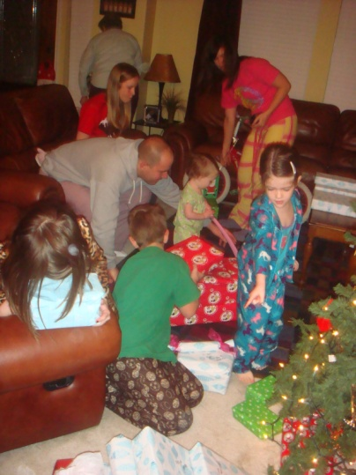
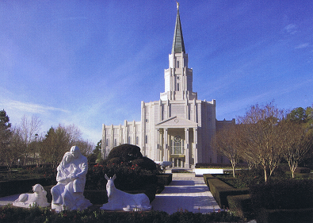
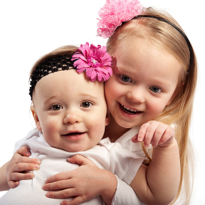
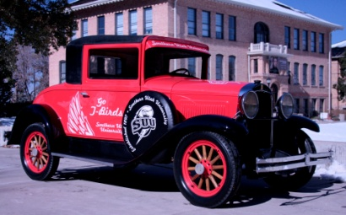
1
2
5
6
7
3
8
9
10
4
13
14
11
12
17
15
16
21
20
19
18

