Slide 1

Dear Friends and Family,
We are glad to close out 2011. We have obtained a second small retainer, and so 2012 promises to be a significant improvement over 2011. We have each walked over 900 miles this year (1). The big family event of the year was Sara Ellyn’s marriage to Tim Sullivan in Austin (2). Grandkids Grant, Quentin, Taylor, Ethan, Halle, Ella, Colby, and Dallin (3), Sarah J. & Sara Ellyn & Sarah N. (4), Roice & Sarah N. (5), Ben & Sarah J. (6), Paul & Kate (7), Joshua & Audrey (8), Rob and his girlfriend Jules (9), and Matt & Heather (10) attended. Audrey, Melanie, Rachel, and Bridget (11), and Audrey, Heather, Andrea, & Rachel (12) all enjoyed the festivities. Rachel and Garret visited Matt in Cedar City (13). Andrea made a beautiful quilt for Matt (14). It was another grandchild graduate for Grandma Shirts (15). We had our second Grandkids science camp (16). Roice taught a course in Dubai (17). SUU restored the donated Willys Whippet (18). Audrey sent photos of Sophie and Izzy (19). We have been Houston Temple Ordinance Workers since February 2009, and spend each Thursday afternoon serving in the temple (20). This service has increased our love and appreciation for our Lord and Savior, Jesus Christ. We shared last Christmas morning with Jared, Melanie, Colby, Taylor, Halle, Avalyn, Sara Ellyn, and Tim (21), and expect to be back there this year.
We hope and pray this Christmas Season finds you happy.
With Love,
H. Roice Nelson, Jr. &
Andrea Shirts Nelson
1307 Emerald Green
Houston, TX 77094
Merry Christmas
and a
Happy New Year
to you and yours!
(more at http://www.walden3d.com/photos/Christmas/Christmas_Cards/2011_Christmas_Card )

Slide 2
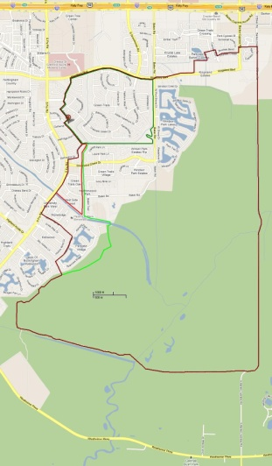
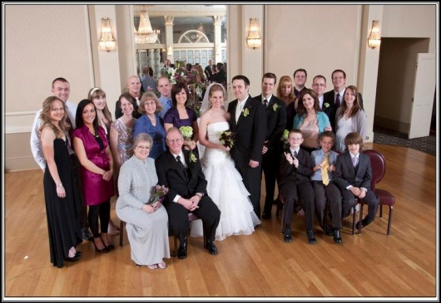
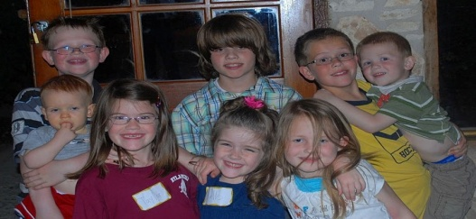
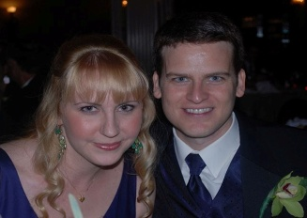
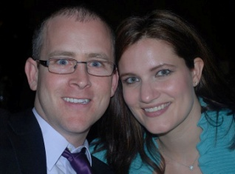
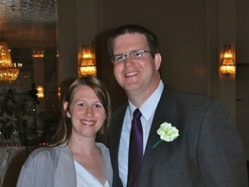
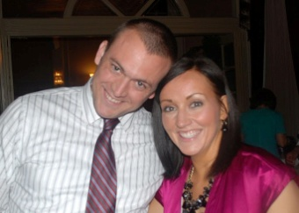
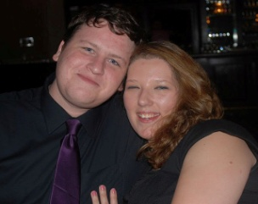
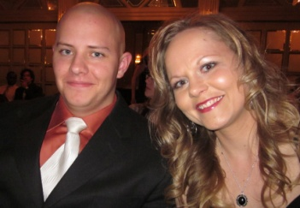
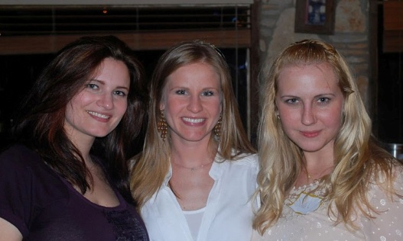
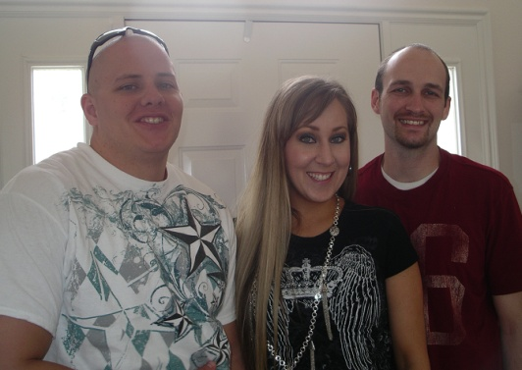
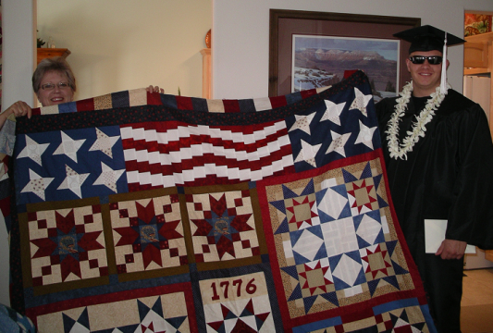
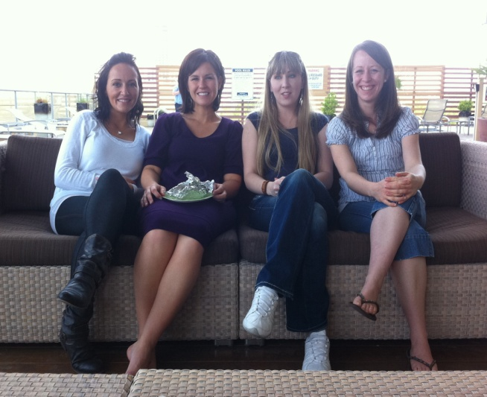
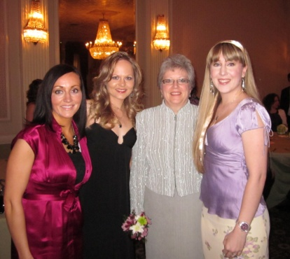
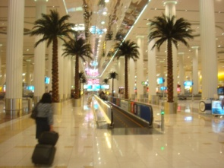
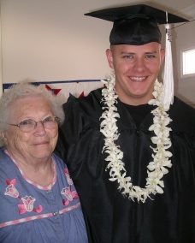
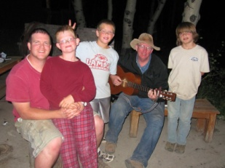
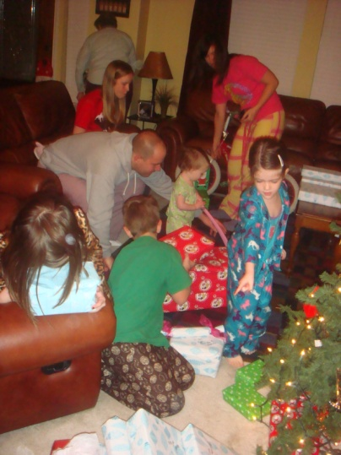
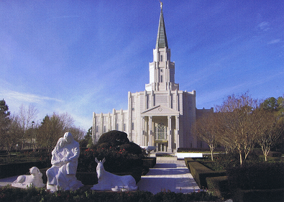
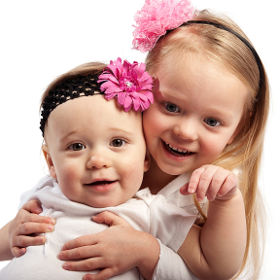
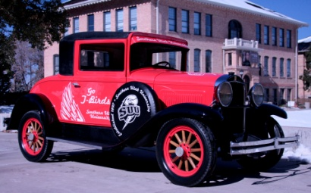
1
2
5
6
7
3
8
9
10
4
13
14
11
12
17
15
16
21
20
19
18

Slide 3
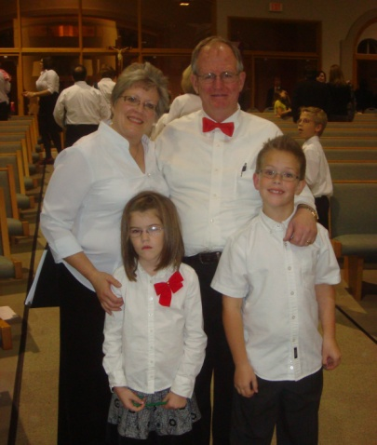
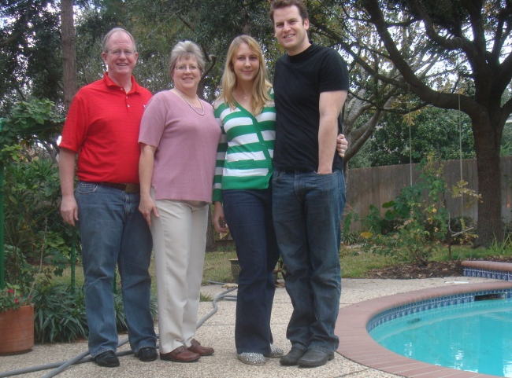
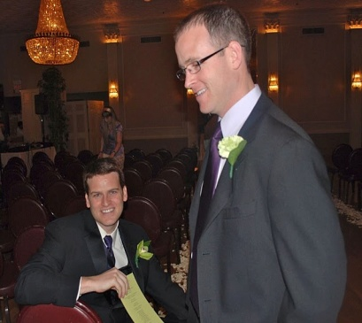

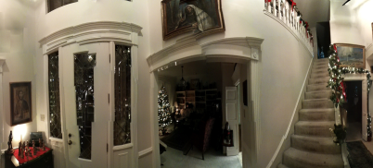
2
1
3
2
4
5
6
9
7
8
10
11
12
13
14
15
16
17

Slide 4
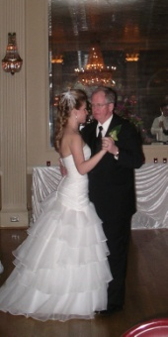
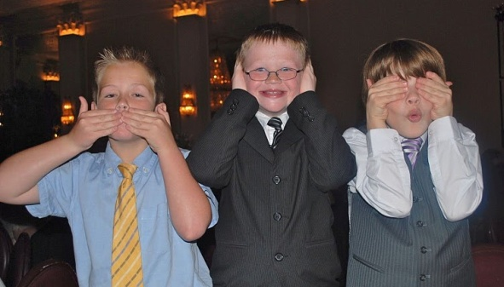
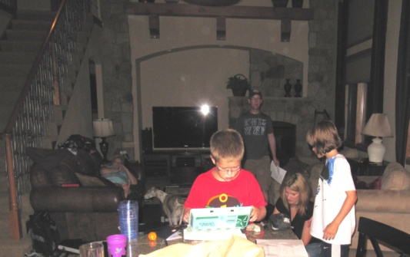
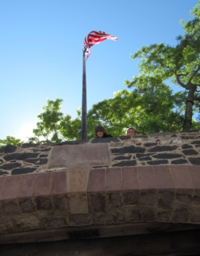
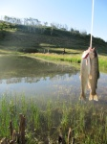
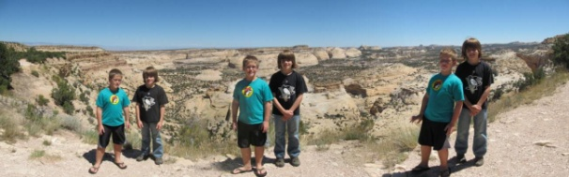
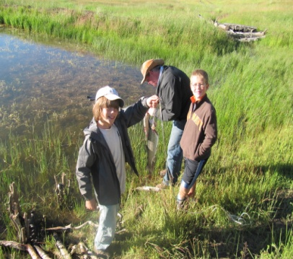
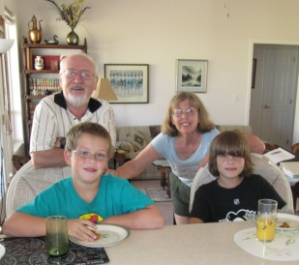
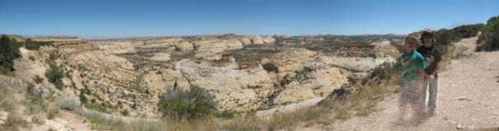
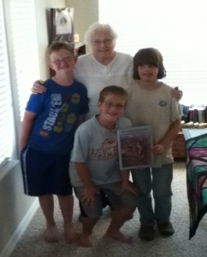
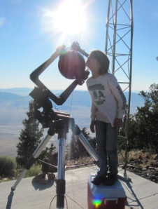
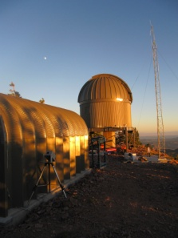
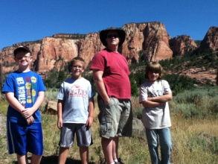
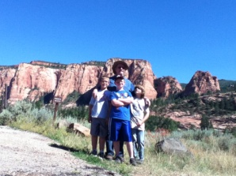
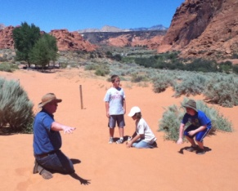
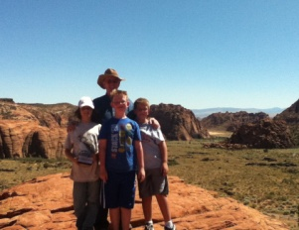
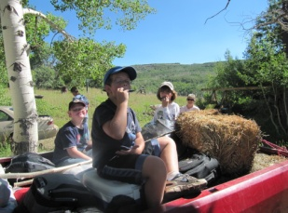
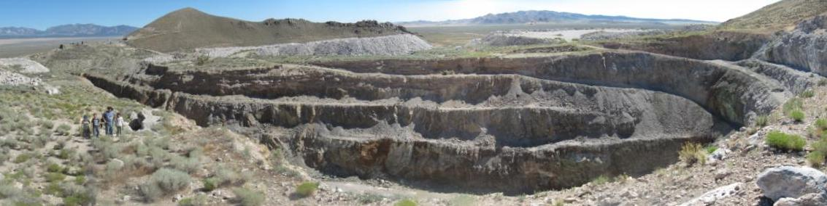
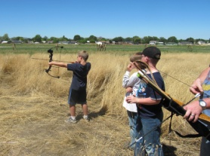
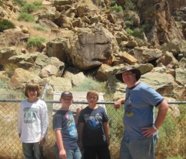
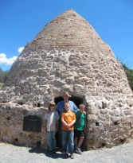
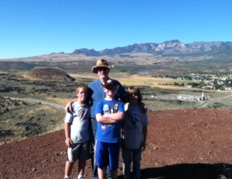
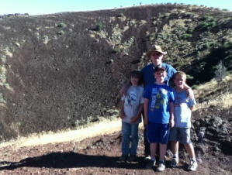
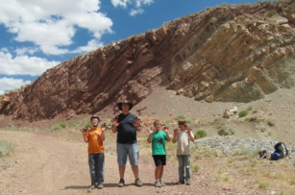
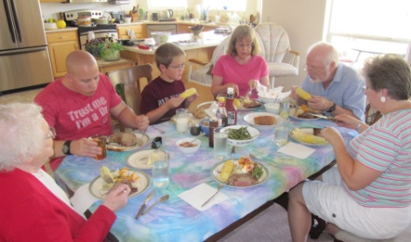












19
20
21
18
23
24
22
25
30
26
27
28
29
32
33
31
36
34
35
39
37
38
43
40
41
42
44
48
45
46
47
49

Slide 5
Dear Family and Friends,
We are glad to close out 2011. We have obtained a second small retainer, and so 2012 promises to be a significant improvement over 2011, with a small positive cash flow starting this month (not counting debts we have run up). Along with financial struggles, we have been greatly blessed, as shown by these two pages of photos. Our camera was broken, and so even though there are a lot of photos on these two pages, they are mostly from other people’s cameras. When we extended the Walden 3-D, Inc. phone account we got “free” i-Phones, and so we now have cameras again.
The photos are not chronological. They start with us and Colby & Taylor at the LDS-Epiphany concert in 2010 (1). Taylor sang with us again this year. Rachel and Garret came to Cedar City to visit Matt (2 top). Andrea made a beautiful quilt for Matt (2 middle). It was another grandchild graduate for Grandma Shirts (2 bottom). Roice and Sarah visited us at Christmas last year (3). We shared Christmas morning with Jared, Melanie, Colby, Taylor, Halle, Avalyn, Sara Ellyn, and Tim (4). Rob joined us to Utah with us for a Shirts Reunion between last Christmas and New Years. Audrey sent us the photos of Sophie and Izzy (5).
The big family event of the year was Sara Ellyn’s marriage to Tim Sullivan in Austin. Audrey, Melanie, Rachel, and Bridget are shown at a breakfast (6). Roice and Ben looked great in their tuxes (7). In fact, the whole family looked great (8). Starting back left are Andrea’s daughters Heather, Audrey & her husband Joshua, Rachel, and son Matt. In front of Matt and in back of us is our niece Bridget, and Roice’s sister Sara. Next is Roice’s daughter Melanie & her husband Jared, Sara Ellyn & her new husband Tim, son Roice & his wife Sara, Rob, Ben & his wife Sara, as well as Paul & his wife Kate. Paul’s son Grant, Melanie’s son Colby, and Ben’s son Ethan are on the front right. The four photos surrounding (9) are, clockwise from 11:00, Roice & Sarah N., Ben & Sarah J., Joshua & Audrey, and Paul & Kate. The three Sara(h)’s are in (10). Audrey, Heather, Andrea, and Rachel are in (11). Rob and his girlfriend Jules are in (12). Matt and Heather are in (13). Grandkids Grant, Quentin, Taylor, Ethan, Halle, Ella, Colby, and Dallin are in (14). We have been Houston Temple Ordinance Workers since February 2009, and spend each Thursday afternoon serving in the temple (16). This service has increased our love and appreciation for our Lord and Savior, Jesus Christ. We have Christmas lights (17) and nativity up (15), and expect a quiet Christmas with Matt this year.
A key theme of this year has been exercise. Roice has walked/ran around the 10+ mile block 68 times (red on 18), and around the 3 mile block 75 times (green on 18), for an annual exercise effort of over 905 miles. Andrea has joined on many of these excursions and has probably walked over 900 miles with her walking ladies walking most mornings. The drought kept the mosquitoes down, and we enjoy our beautiful and peaceful walks. Roice has got in good enough shape he can run around the small block, and has run 6 miles on the long block. However, he has not lost much weight. Need to cut down the stress and the amount eaten in the evenings. Oh well! Roice enjoyed the dance with Sara Ellyn (19), and didn’t get winded. The three monkeys (20), Colby (Melanie & Jared), Grant (Paul & Kate), and Ethan (Ben & Sarah), have become good friends.
We encouraged this with our Second Annual Nelson Grandkids Science Summer Camp. Colby rode with us to Ben & Sarah’s in Windsor, Colorado (21). We picked up Ethan and drove across the San Rafael Swell (24) to Cove Fort (22) and to Aunt Sara and Uncle Des Penny’s place (23). Grant and Ethan caught fish (25), we sang around the campfire (26), visited Silver Reef, and Grandma Shirts showed the boys Grandpa Shirts book about Silver Reef (27). The University of Utah hosted us at their new observatory outside of Milford. Ethan was caught looking at the sun (28) and carving a stick at the base of the observatory (29). We visited the east side of Zion Canyon (30), and Snows Canyon (31 top left) , where we climbed one of the Jurrassic sand dunes (31 top right). We climbed a volcano (30 bottom two photos). Colby and Ethan got pretty good on the harmonica (32), and we visited a silver & gold mine (33). We visited an iron mine, and the kids (including Paul) put shot gun shells on their fingers (34). We shot arrows (35), looked at Indian petroglyphs (36 left), and looked at the beehive smelters at Old Iron Town (36 right). The kids met Roice’s Aunt Shirley and Uncle Willis Gurr (37) and we feasted with Grandma Shirts, Matt, Sara & Des (38). Colby played harmonica with Roice and Uncle Des (39), and visited Roice’s cousin Darrel & Nancy (43). Darrel & Nancy will be hosting the Nelson Reunion on July 6th, 2012 at their house. Paul and Grant drove home to Logan, Ethan caught a flight from Vegas to Denver, and Colby stayed with us and rode all the way back to Houston. Colby also got to see Bengt & Ellyn Nelson’s grave (40), and the house Bengt built for his daughter Sarah Catherine Hunter (41). He saw the 1929 Studebaker Grandma Nelson sold to Tom Gardner (42) and Old Main (bottom 44), which Bengt Nelson was the stone mason for. Southern Utah University rebuilt the 1929 Willys Whippet Roice donated (44 top), and have used it for the President to ride in this year’s Homecoming Parade. We will ride in it at during the Nelson reunion.
We hosted Jared’s family for a Labor Day Reunion (45). Roice taught a course in Dubai (46). Sara Ellyn, Rob, Matt, Tim, and Roice visited us for Thanksgiving (47) after we spent the day in Vidor with Jared’s family (48). Roice spends most of his time interpreting 3-D seismic on an SMT workstation (49), and we are very pleased to have the additional retainer, which will involve interpreting 2-D seismic on a Landmark workstation.
We hope and pray this Christmas Season finds you happy.
With Love,

Slide 6
Thoughtlet titles for 2011 (send a request to Roice for conversion of notes to a pdf file for specific titles):
1101 Blizzard
1102 Proposals
1103 Investment Visas
1104 Colby’s First Pinewood Derby
1105 GSH Re-Publication
1106 Web Page Competition
1107 Prime the Pump
1108 Chuck Sharp
1109 Swine Flu
1110 Primary Sharing Time
1111 Building Towers
1112 Blisters
1113 Jerry Allen
1114 Farmer, Missionary, or Salesman
1115 Sara Ellyn and Tim Sullivan’s Wedding
1116 Bob West
1117 Atlas Shrugged – Part 1
1118 Old
1119 Matt’s Graduation from SUU
1120 TOP (Texas Oil Producers)
1121 Fun Run
1122 Bakken Whitepaper
1123 Sexual Abuse
1124 Matt’s Homecoming
1125 Father’s Day 2011
1126 The Hobbit
1127 Back to Seismic City
1128 Used Car Salesman
1129 Bernie’s Rabbits
1130 Last Harry Potter Movie
1131 Herding Cats
1132 Drive to Utah
1133 Science Camp 2011
1134 St. George to Houston in 24 Hours
1135 Republican Questionnaire
1136 Double Fast Offerings
1137 Anniversary of 9/11
1138 Cavalier
1139 Wills
1140 Abduhl-Hafez
1141 Microsoft Cloud
1142 Yoram Shoham
1143 Astronaut Application
1144 Rolled Eyes
1145 Tim Terry
1146 i-Phone
1147 Home Alone with Matt
1148 Willys Whippet
1149 Venting
1150 Getting Old
1151 Panic Attack
1152 Perdido Study Area

