Slide 1
Merry Christmas
and a
Happy New Year
to you and yours!
(more at http://www.walden3d.com/photos/Christmas/Christmas_Cards/2017_Christmas_Card )
H. Roice Nelson, Jr. &
Andrea Shirts Nelson
2155 West 700 South #31
Cedar City, UT 84720
Dear Friends and Family,
We had more visitors in 2017 than in 2016, and we look forward to the number increasing every year, especially when you are able to visit us in Cedar. Highlights for this year included spending time with family and friends here, in northern Utah, in Ft. Collins, in Texas, and watching the 2017 eclipse at Palisades Reservoir in Southern Idaho. The bulbs on the left Christmas tree are from Roice & Sarah’s tiny planet video of the eclipse. The bulbs on the right tree are kids and grandkids. Roice continues working on commercialization of lightning analysis. A new patent on calculating resistivity maps and volumes issued. Still believe sales will come. Andrea still quilts. We had our second garden at Aunt Shirley and Uncle Willis’ place. The Science Camp theme was 8G (Geography, Genetics, Genealogy, Grandma, Grandpa, Geology, Geophysics, & Guitar). The Cedar City Temple was dedicated, we are temple ordinance workers, and the photo is after initiatory on the first day it was open. Andrea is now the Relief Society President. Roice is a Family History Consultant. We sang Mozart’s Requiem in Latin (hard), The Messiah, Roice sang in the 4 Master’s Singer’s concerts, and posted his version of the Psalms. We enjoyed more field trips with the Rock Club and have a nice collection of local rocks. All in all a good year.
We hope & pray you and yours are happy and full of joy this Christmas Season.
With Love,

Slide 2
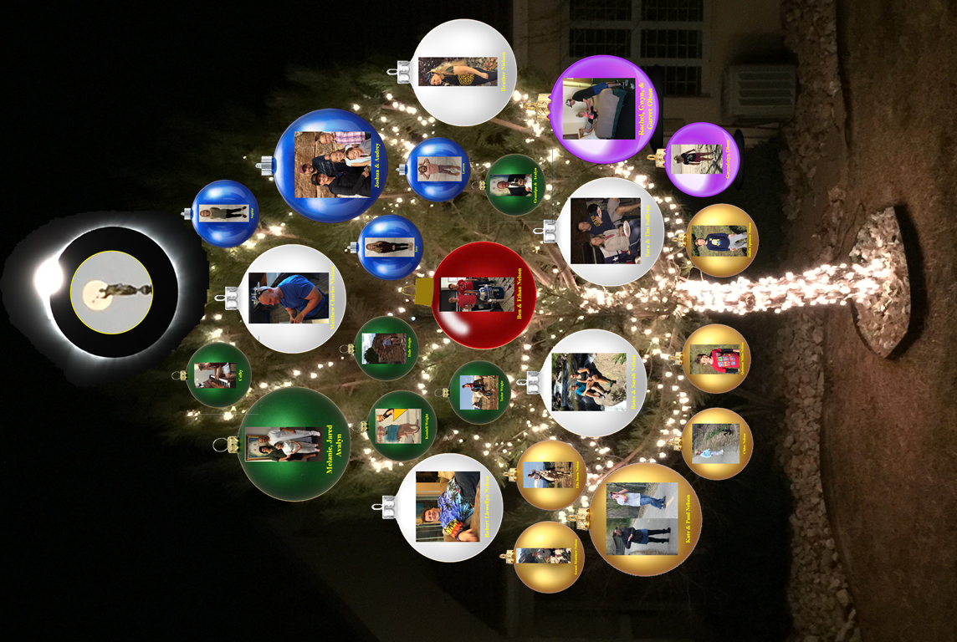
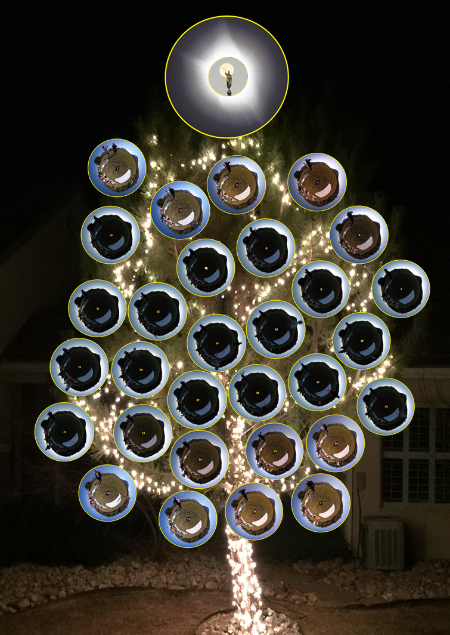
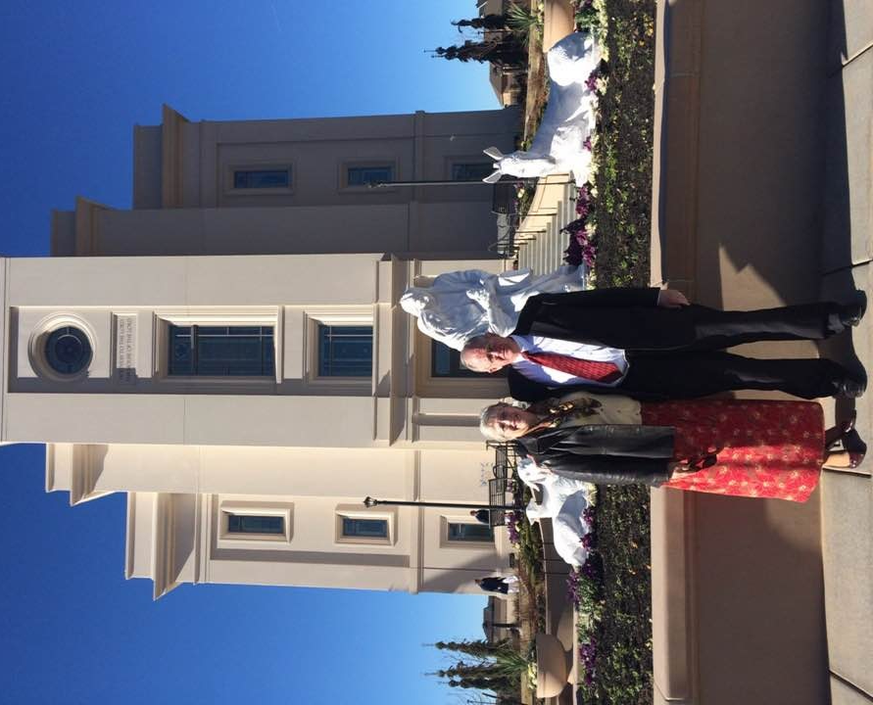
Christmas 2017 Cedar City, Utah

Slide 3
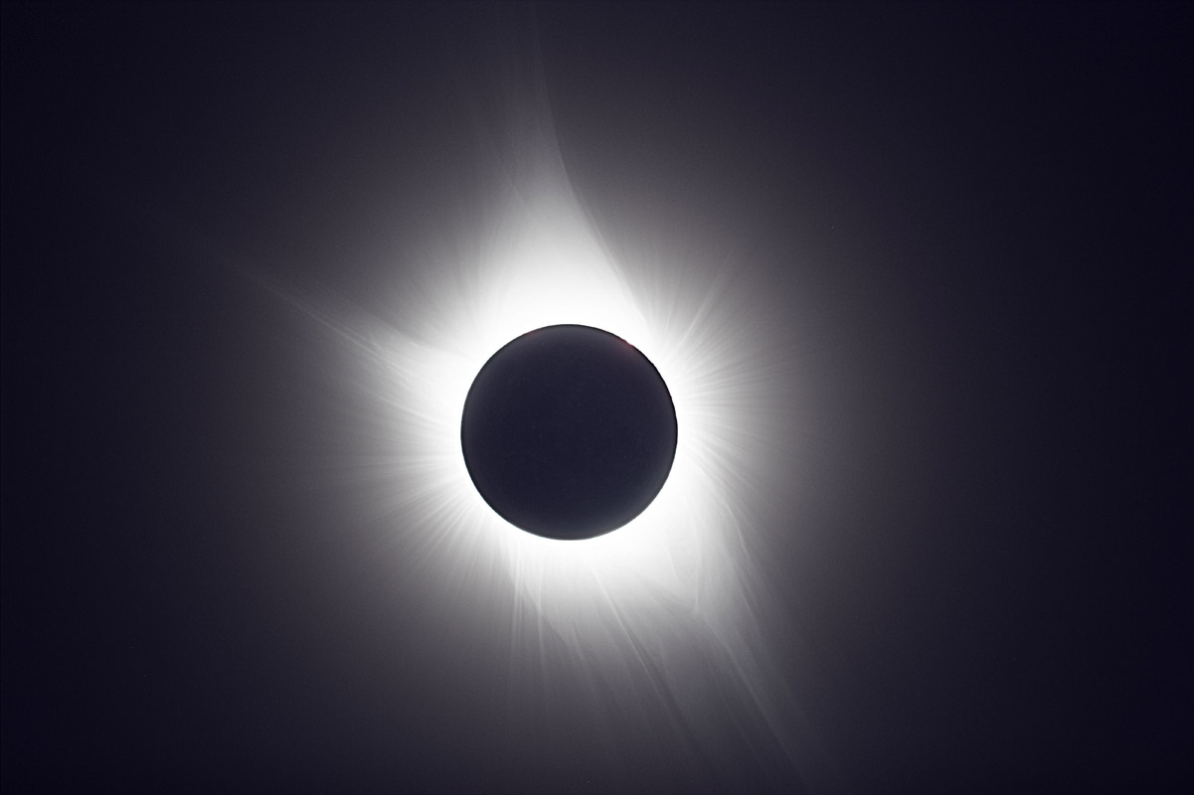

Slide 4
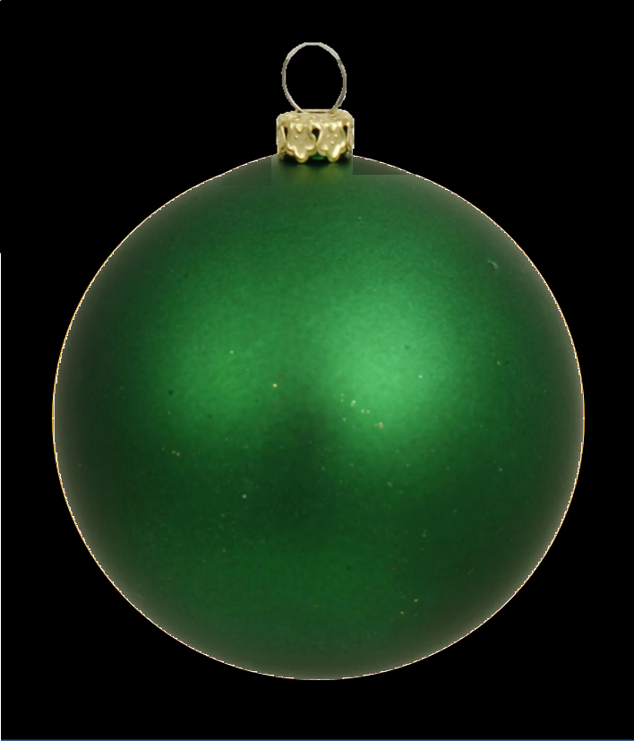
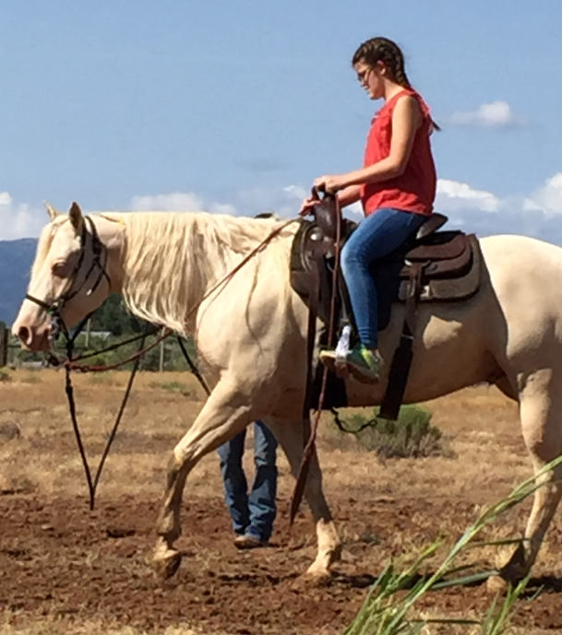
Taylor Wright

Slide 5
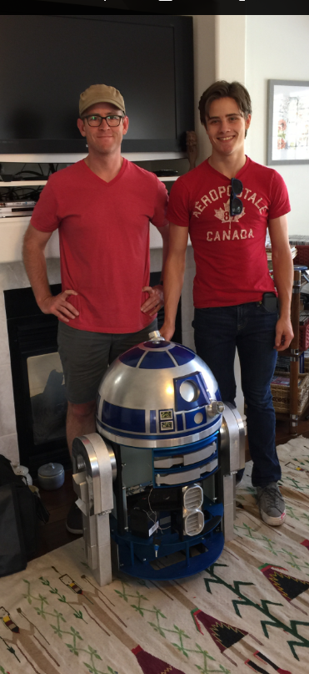
Ben & Ethan Nelson

Slide 6
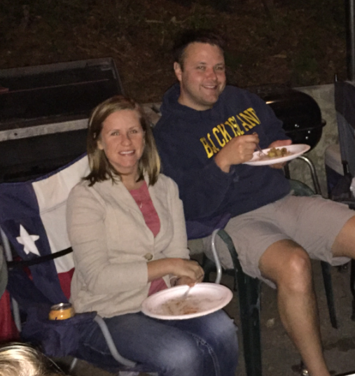
Sara & Tim Sullivan

Slide 7
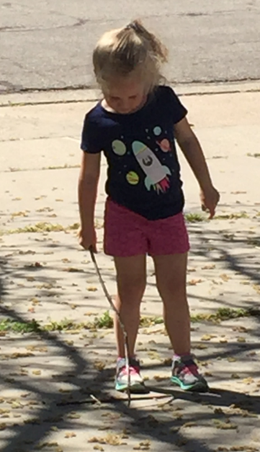
Gwyndolyn Olson

Slide 9
