Slide 1
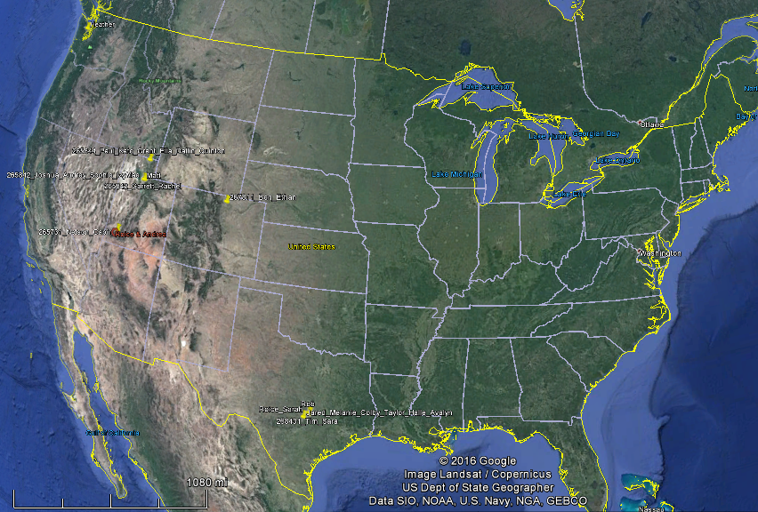
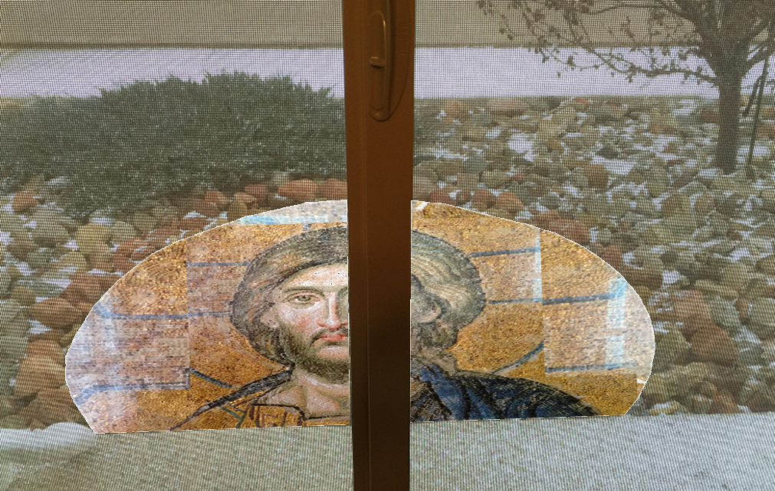
Nelson Christmas 2016
Heather
Paul & Kate:
Grant
Ella
Dallin
Quinten
Chloe
Audrey & Joshua
Sophie
Isabella
Lauren
Matt
Rachel & Garret
Gwendolyn
Maxine
Ben
Ethan
Roice & Andrea
Melanie & Jared
Colby
Taylor
Halle
Avelyn
Kendall
What I see, looking out my office window.
Rob
Roice & Sarah
Sara & Tim
10
1
5
14

Slide 2
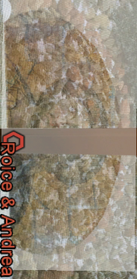
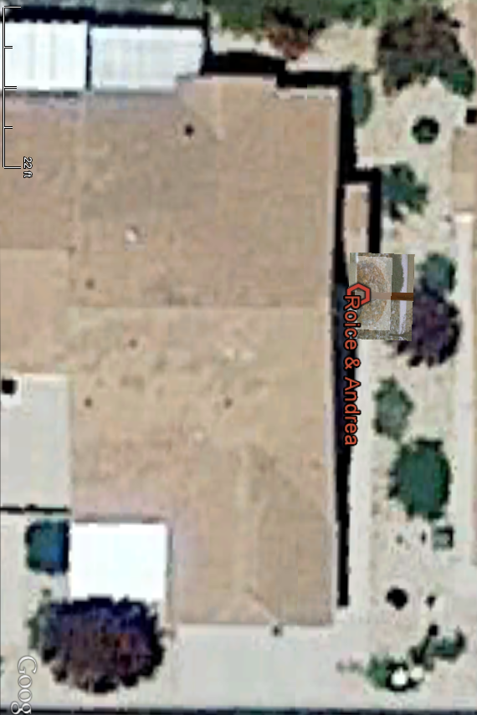
2155 W 700 S #31, Cedar City, Utah Christmas 2016

Slide 3
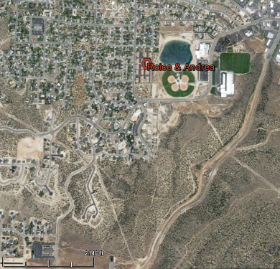
Christmas 2016 Ward Family & Spiritual Guidance
Cedar City Temple
Maxine Shirts
(Andrea’s Mom)
Hillcrest Ward Meeting House

Slide 4
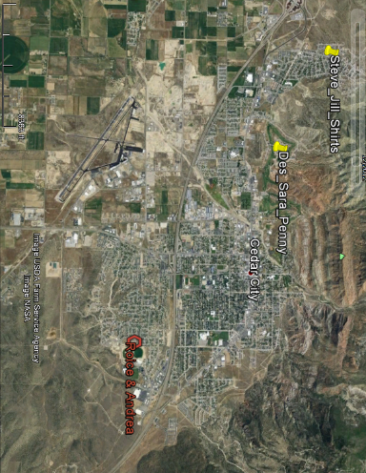
Andrea’s Brother & Mom & Roice’s Sister Cedar City, Utah Christmas 2016
Steve & Jill Shirts
Sara & Des Penny
Maxine Shirts

Slide 5
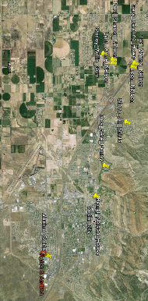
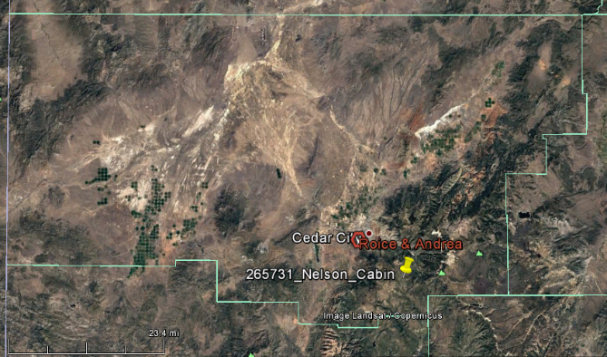
Iron, Washington, & Garfield Counties Christmas 2016 50+ Cousins

Slide 6
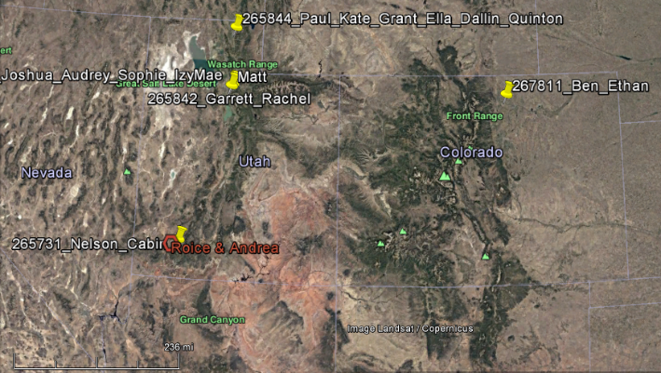
10 of 15 Grandkids within a 1 Day Drive Christmas 2016 we hope to see all 15 because Melanie’s Family is coming to Ft. Collins
Paul & Kate:
Grant
Ella
Dallin
Quinten
Chloe
Audrey & Joshua
Sophie
Isabella
Lauren
Ben
Ethan
Rachel & Garret
Gwendolyn

Slide 7
Merry Christmas 2016

Slide 8
Merry Christmas
and a
Happy New Year
to you and yours!
(more at http://www.walden3d.com/photos/Christmas/Christmas_Cards/2016_Christmas_Card.pdf )
H. Roice Nelson, Jr. &
Andrea Shirts Nelson
2155 West 700 South #31
Cedar City, UT 84720
Dear Friends and Family,
We had visitors again in 2016, and look forward to whenever you are able to visit us in Cedar. Decided this year’s card will show how our family is scattered. It has been an interesting year. The lightning technology is getting better and better. However, both the oil & gas and mining industries have been in the ditch this year, and so there have not been as many sales as we expected. They will come. Andrea has quilted a lot (to distract her from financial worries). We had a garden out at my Grandma Nelson’s garden, where Aunt Shirley and Uncle Willis live now. Melanie visited for Science Camp and told me she has never seen people work so hard for their food. Hopefully you will all be prepared to do the same, if ever required to. We love our callings as Family History Consultants, and enjoy working at the Family History Center every Tuesday afternoon. We were able to sit and stand together as we sang in The Messiah this year. I enjoy Master’s Singers. The practices are more fun than the concerts. We have enjoyed field trips with The Southern Utah Rock Club. All in all a good year.
We hope & pray you and yours are happy and full of joy this Christmas Season. Weather permitting, we plan to drop in on Ben and Ethan in Ft. Collins and help babysit Melanie and Jared’s kids while they go to the Ft. Collins temple when one of Jared’s cousins gets married.
With Love,

