Slide 2
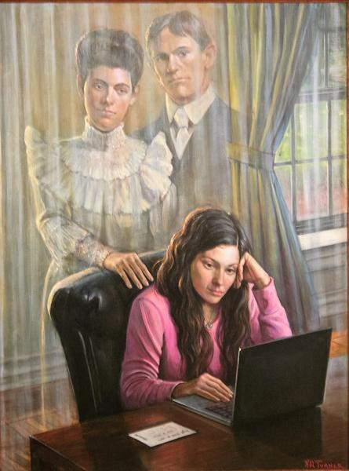
The Spirit of Elijah
www.missionarymommamall.com
www.KennethTurnerArt.com
www.turnerchapmangallery.com
E-mail: KennethTurnerArt@gmail.com
Phone: 979-733-0400
9”x12” $ 110
12”x16” $ 165
18”x24” $ 450
24”x32” $ 770
30”x40” $1,200

Slide 3
www.missionarymommamall.com
www.KennethTurnerArt.com
www.turnerchapmangallery.com
E-mail: KennethTurnerArt@gmail.com
Phone: 979-733-0400
The Spirit of Elijah

Slide 4
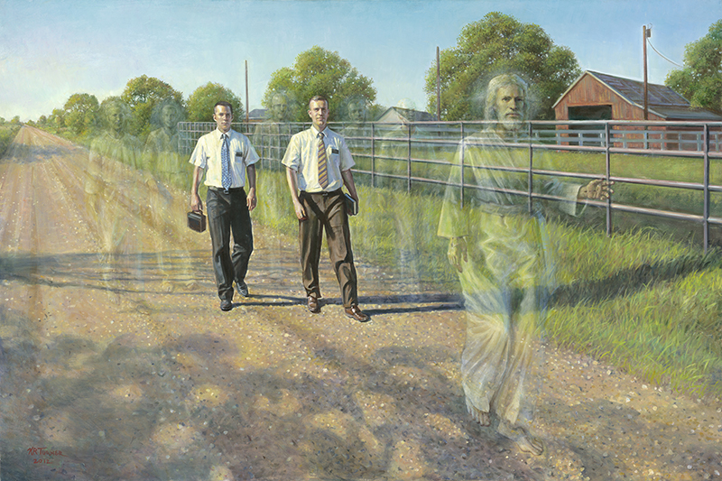
“I will go
before
your face”
www.missionarymommamall.com
www.KennethTurnerArt.com
www.turnerchapmangallery.com
KennethTurnerArt@gmail.com
Phone: 979-733-0400
Sister Version Available

Slide 5
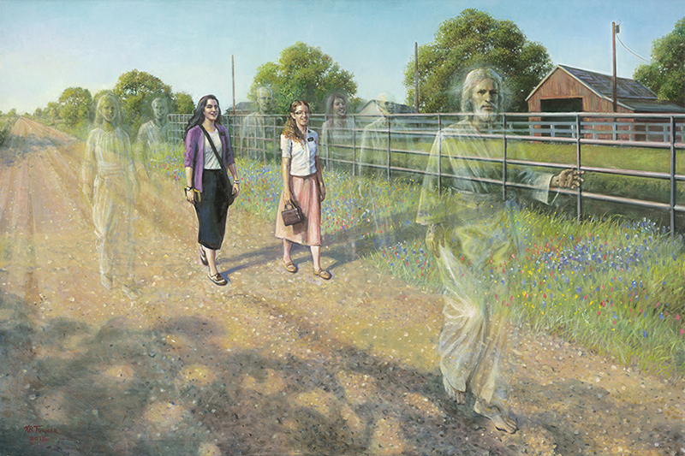
“I will go
before
your face”
www.missionarymommamall.com
www.KennethTurnerArt.com
www.turnerchapmangallery.com
KennethTurnerArt@gmail.com
Phone: 979-733-0400
Elder Version Available

Slide 6
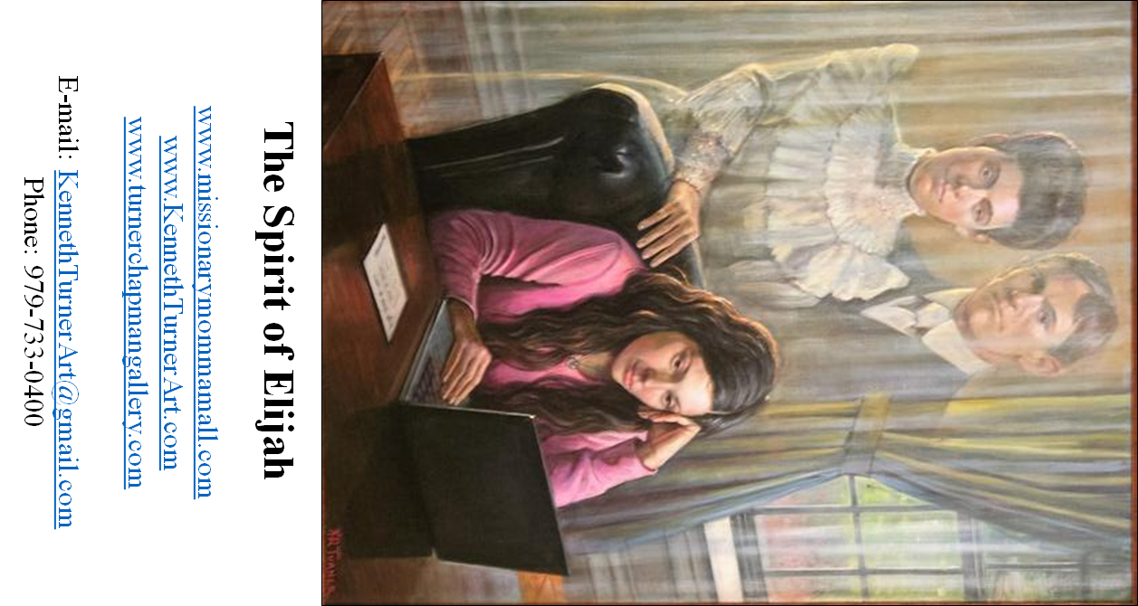

Slide 7
