Slide 1
Science Camp #140703.5
03-05 July 2014 @ the Nelson Condo, the Nelson Cabin
on Cedar Mountain, and the surrounding area
Advisors
H. Roice Nelson, Jr., Andrea S. Nelson,
Benjamin B. Nelson, Paul F. Nelson, & Sara Ellen Sullivan
Attendees
Ethan E. Nelson, Grant M. Nelson, Colby C. Wright,
Taylor R. Wright, Ella D. Nelson, Halle N. Wright

Slide 2
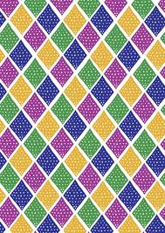
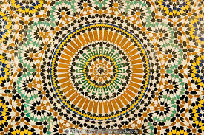
Patterns
“Who serve unto the example and shadow of heavenly things, as Moses was admonished of God when he was about to make the tabernacle: for, See, saith he, that thou make all things according to the pattern shewed to thee in the mount.”
Hebrews 8:5

Slide 3
Safety
Never go anyplace alone, including during the July 4th Parade!
Exception is if one of you is hurt, then:
One of you stay and help the person hurt.
The other one run and get help.
If you get lost stay put, we will find you.
If you hear a rattlesnake do not move quickly, just slowly move away from the sound.
Do not run with a knife open. Use knife safety.
If you cut yourself, apply pressure to the wound to stop bleeding, and send for help.
Never point an arrow in a cocked bow or a gun at any person.
Drink lots and lots and lots of water.
Do not go swimming unless an adult is with you.
Do not start branches on fire and swing them around where others can be hurt.
Use common sense, and think before you act.

Slide 4
Schedule Monday - Thursday
Monday - Tuesday:
Colby, Taylor, Halle, Grandpa, and Grandma drive to Utah.
Visit the South Rim of The Grand Canyon.
Wednesday:
Meet Paul, Grant, and Ella in Cedar City, unload the U-Haul, decide on meals, and go fishing.
Review and print and get bound the books for Science Camp.
Thursday:
Breakfast @ the Condo.
8:00 Dust Devil Ranch service and ridding horses
10:00 Pete Larson at InfoWest and in the field showing a repeater.
12:00 Lunch sandwiches while we visit last year’s Geocache up Fiddler’s Canyon.
2:00 Showers and get ready for reports and Shakespeare.
3:30 set up for presentations and Aunt Sara Ellyn arrives.
4:00n Song, Patterns, technology breakthroughs, 2013 School Science Presentations.
Dinner at Aunt Sara’s with Audrey and her kids.
6:30 Theater Preview, Greenshow, Shakespeare’s Comedy of Errors in the Old West.

Slide 5
Schedule Friday - Sunday
Friday:
7:00 Neighborhood Pancake Breakfast, provided by LDS Hillcrest Ward.
9:30 4th of July Parade and lunch at the City Park.
Visit Cemetery and Veterans Monument.
To the Nelson Cabin in the afternoon.
“Be-a-man camp-out”:
Prepare tin foil dinner, and hike to the top of the hill to the east of the cabin.
Select a campsite, set up hammocks, collect wood, cook dinner.
Tell stories. Watch the sunrise over Cedar Breaks.
“Girl’s Night Out / In”:
Fish, explore, and prepare dinner.
Drive back to the “C” and watch fireworks from Cedar Mountain.
Back to the cabin, s’mores, stories and watch the sunrise across the valley.
Saturday:
10:00 back together.
Discussion about patterns and computers and programming.
Rocket Launches, hot lava, water races, etc.
Those that want to stay at the cabin Saturday night are welcome to.
Sunday:
Roice and Andrea and Wrights to church at 11:00.

Slide 6
Job Chart
 | Wednesday | Thursday | Friday Evening | Saturday Morning | Saturday Afternoon
Ethan | Arrive Late Review Notes | Prepare Breakfast | Prepare & Clean-Up after Dinner | Lunch Clean Up | Clean Cabin
Grant | Review Notes | Breakfast Dishes | Prepare & Clean-Up after Dinner | Prepare Lunch | Clean Cabin
Colby | Review Notes | Set up lunch sandwiches | Prepare & Clean-Up after Dinner | Prepare Lunch | Clean Cabin
Taylor | Review Notes | Clean up lunch garbage | Prepare & Clean-Up after Dinner | Prepare & Clean Up Breakfast | Clean Cabin
Ella | Review Notes | Dinner Dishes at Aunt Sara’s | Prepare & Clean-Up after Dinner | Prepare & Clean Up Breakfast | Clean Cabin
Halle | Review Notes | Dinner Dishes at Aunt Sara’s | Prepare & Clean-Up after Dinner | Prepare & Clean Up Breakfast | Clean Cabin

Slide 7
Notes

Slide 8
Why are Patterns important?
To show relationships.
To show trends.
To provide context.
To teach.
Shortly a developer asked me, what are the most know-worthy patterns - in context of Java EE. My answer was:
Facade: it decouples independent classes, and more important, decreases (makes the interface more coarse grained) the granularity. Session Facade from Java EE is a sample.
Adapter: makes incompatible things compatible. Especially important in server programming, in case you have to talk to legacy backend systems like SAP, CICS or IMS. Business Delegate in J2EE 1.4 (catches RemoteExceptions and throws something else), DAOs or JCA Connectors are adapters.
Decorator: Enhances an interface (in our case the Facade), with additional aspects (it is actually the beginning of AOP :-)). In Java EE we have the Servlet Filter, Interceptors or implicit decoration with transactions, state or security. In Java SE the whole java.io package is a decorator.
Interface (actually not a standard pattern): is needed for encapsulation, decoupling the clients from the interface realization, and so is the beginning of service orientation or SOA.
Factory/Builder: encapsulates the creation of differnt implementations for a Java-Interface. Can be a part of a framework (see Spring or Java EE 5), or of project architecture.
Command: provides a simple and stable interface (often one method with name like execute, go, run, actionPerformed etc). The implementation provides the behavior, having the only the interface, it is not possible to see what happens :-). Command is the foundation of JMS, the whole SOA (stands for Same Old Architecture :-)) and also the event handling of frameworks like swing (ActionListener), or Struts (Actions).

Slide 9
A New Kind of Science

Slide 10
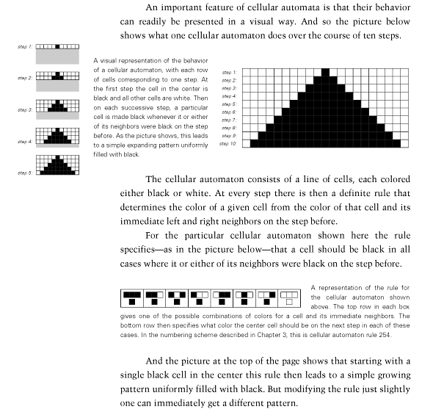
Cellular Automata

Slide 11
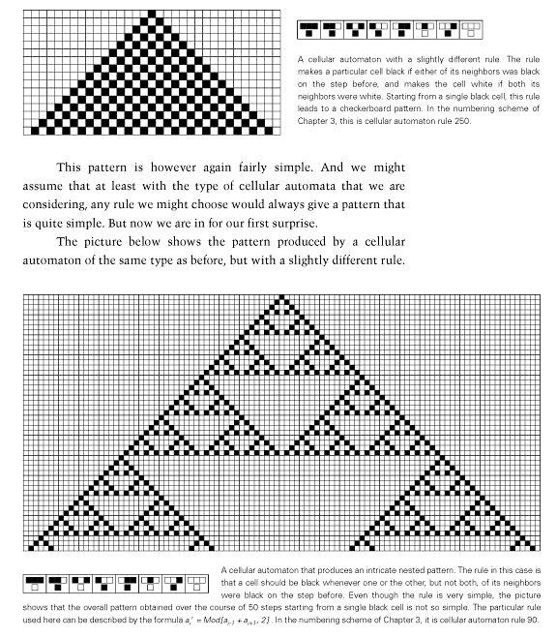
Patterns quickly become complex

Slide 12
Weaving was a first Pattern
Weaving code: learning computer programming through pattern and craft
February 17, 2014
A new collaborative project, “Weaving code:learning computer programming through pattern and craft.”
There is national policy drive [Britian] to teach computer programming in schools. However, there is a disconnect between programming, and socially-situated learning through play. Our research will bridge this gap, recognising the needs of people, particularly of children, to engage with the social and tangible in order to understand the abstract. Our core aim is to bring pattern making in weaving, together with pattern making in live coding of music, in a pedagogic context. This will ground abstract thinking in social activities, as a springboard for learning. We will reconnect computer programming with its origins in craft, drawing from the inspiration which Babbage and Lovelace took from the Jacquard loom, as well as the development of formal mathematics in Greek antiquity using loom metaphors.

Slide 13
Notes

Slide 14
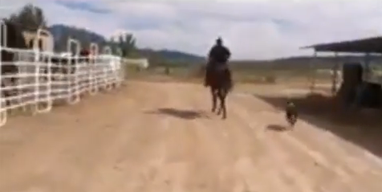
Dust Devil Ranch, Cedar City, Utah

Slide 15
Pete Larsen: InfoWest

Slide 16
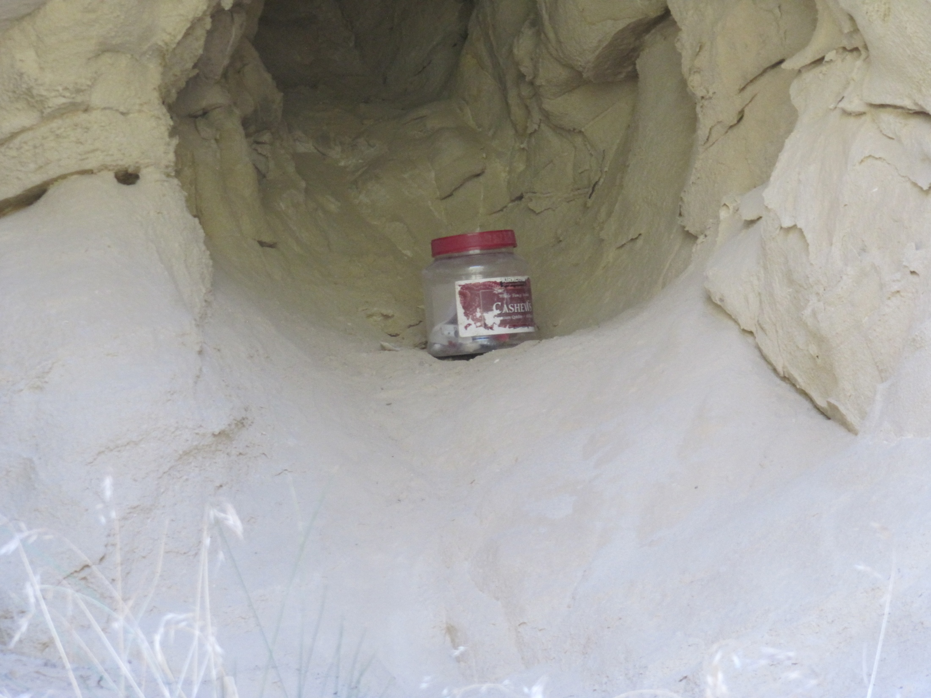
Fiddler’s Canyon Geocache

Slide 17
Notes

Slide 18
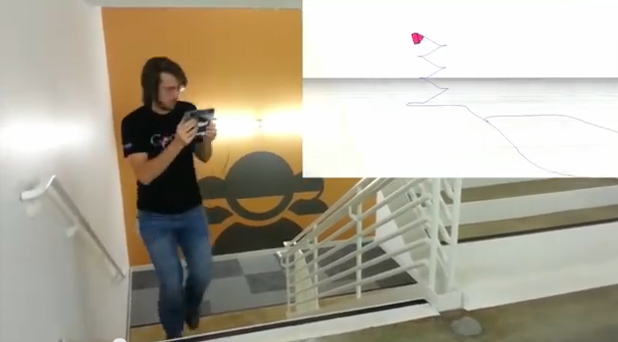
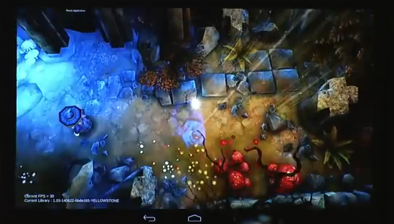
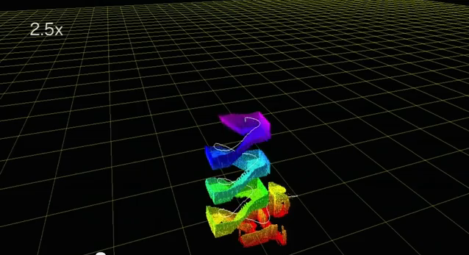
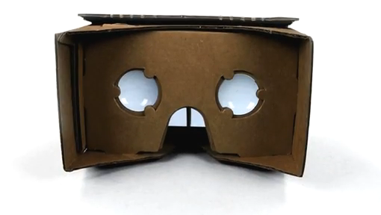
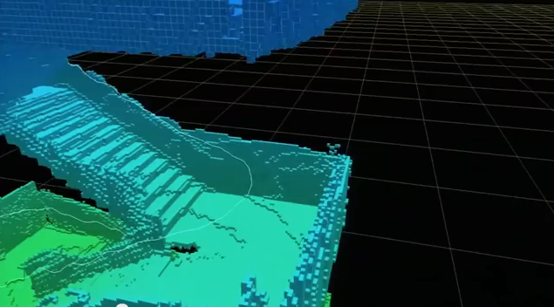
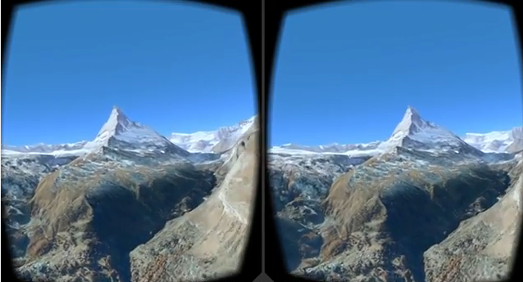
Tango & Cardboard VR from Google IO

Slide 19
Paul’s Report

Slide 20
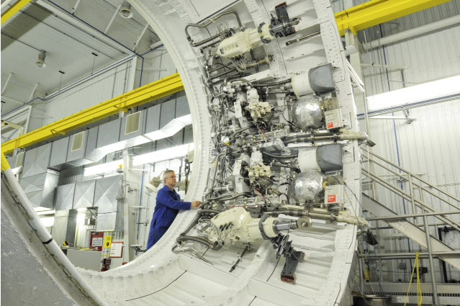
Patterns are Everywhere

Slide 21
Ethan’s Report
Ethan Nelson
Mrs. Tracy
Period 8
10/23/13
Problem Statement
Which type of internal structure withstands weight the best?
Variables
Independent Variable: Internal Structure type I will use trusses, columns, and load bearing walls as the three variables
Dependent Variable: The amount of weight each structure can hold.
Control Variable: Basic structure, type of weight, and material type.
Background Knowledge
Buildings are man made structures built for shelter. Buildings are supported by things called structural elements. These are the parts of a building that keep it standing. Three examples of structural elements are load bearing walls, columns, and trusses. Trusses are structural elements that can keep the ceiling from sagging and extreme weight. Load bearing walls are inter-walls running through the whole building and support all other walls. Columns are a structural element that do the same thing as load bearing walls but also support the floors.
Hypothesis
Load bearing walls will hold the most weight because it interlocks with other walls while columns and trusses sit separate. In addition, load bearing walls transfer weight to the foundation.

Slide 22
Ethan Materials & Procedure
Materials
Foam core
Cutting knife
foot long ruler
glue
weight
Procedure
1. Take foam core, matte board, a cutting knife, and a ruler to make a structure that will have a specific internal structure. Be sure to make each building the same design. Not doing this will affect the outcome of the data.
2. Repeat step 1 twice for two other structure types.
3. Take the balsa wood to create the three different structure types you will put inside each building.
4. Take all the items you have made and glue them together to make the three buildings.
5. Now that you have all the models you need take the first three and put a series of weights on each one.
6. Continue to put more and more weight until each structure has collapsed.
7. Record the data found in step 6.

Slide 23
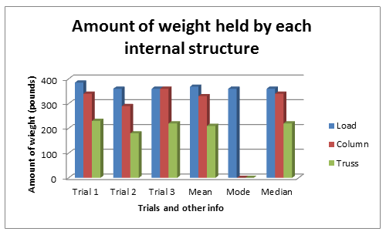
Ethan Data/Results

Slide 24
Ethan Conclusions
Conclusion
This study was done to see what internal structure element would hold the most weight. The three structural elements I used for this experiment were load bearing walls, columns, and trusses. The hypothesis was the load bearing walls would hold the most weight. The results showed that load bearing walls held the most weight with a whopping 385 lbs! Columns had the second most right behind load bearing walls at 360 lbs. And trusses had the least by a longshot at 210 lbs!
The results had to be the way they were because both load bearing walls and columns had wall and roof support so they held more weight and when it did collapse the weight slid off to one side. On the other hand trusses only supported the roof so when the weight fell it flattened the model like a pancake. Also, in a real world situation load bearing walls would be the safest because as the weight fell it slid off to one side. It didn't crush so therefore if you were inside, you wouldn't be crushed and probably would have survived. Although the experiment seemed accurate the models could have been made a little better. By that, the cuts should have been more straight, and the sizes of the pieces could have been more replicant.
Bibliography
http://en.wikipedia.org/wiki/Load-bearing_wall
http://en.wikipedia.org/wiki/Beam_(structure)
http://en.wikipedia.org/wiki/Building

Slide 25
Grant’s Report

Slide 26
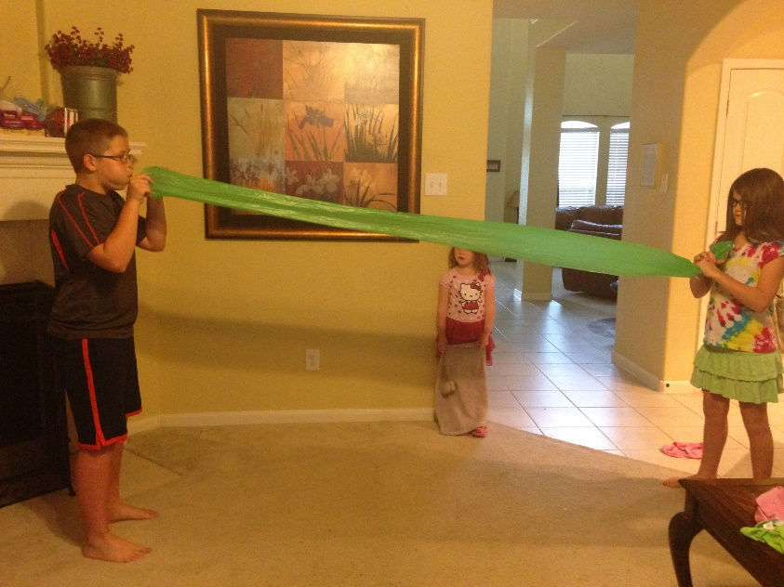
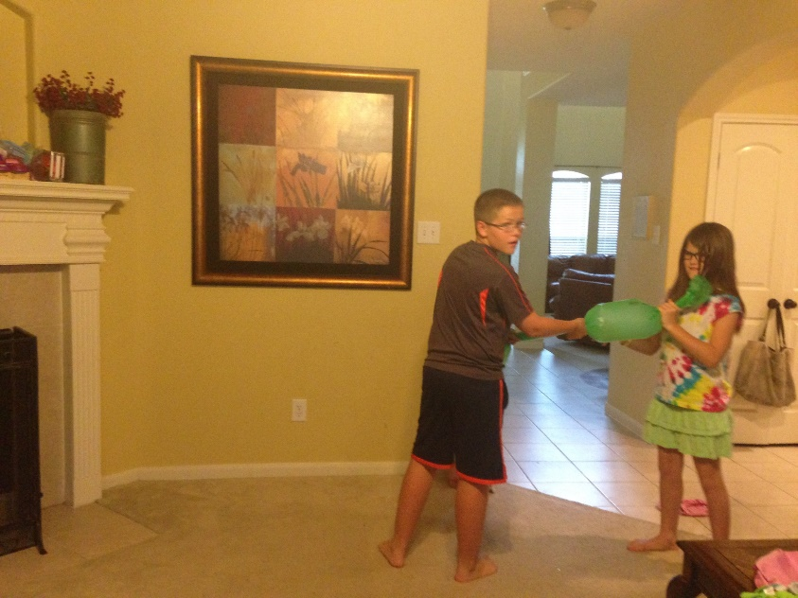
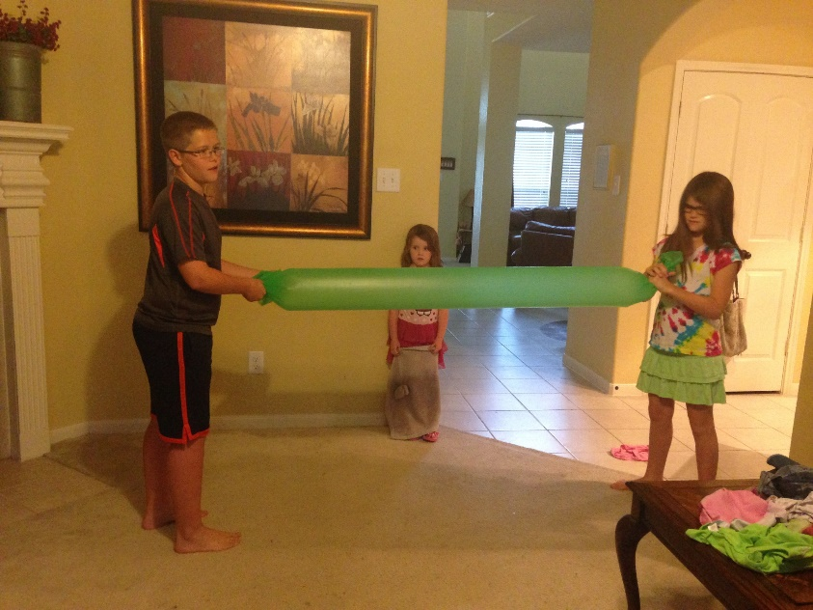
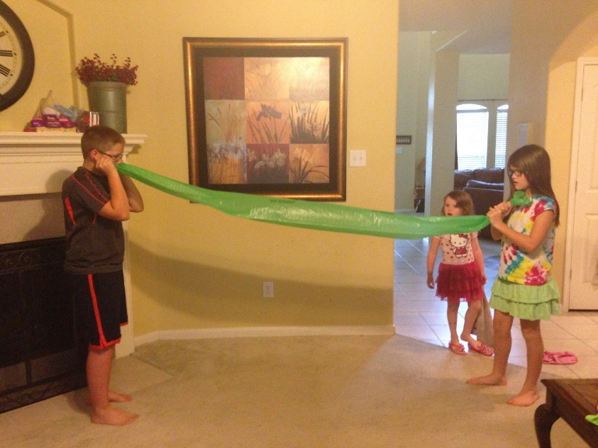
Colby’s Report

Slide 27
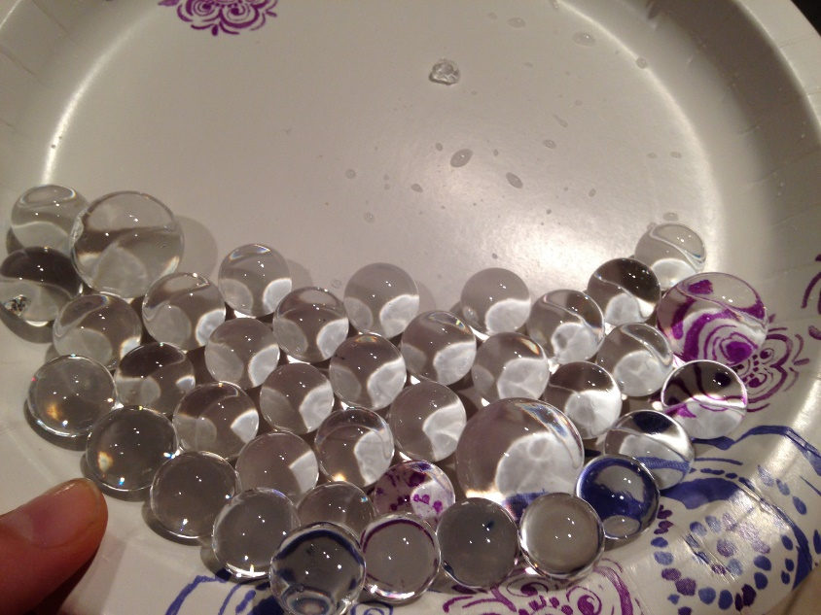
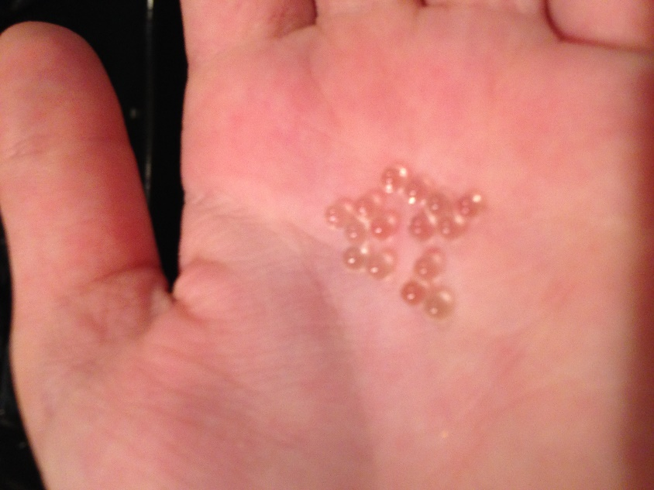
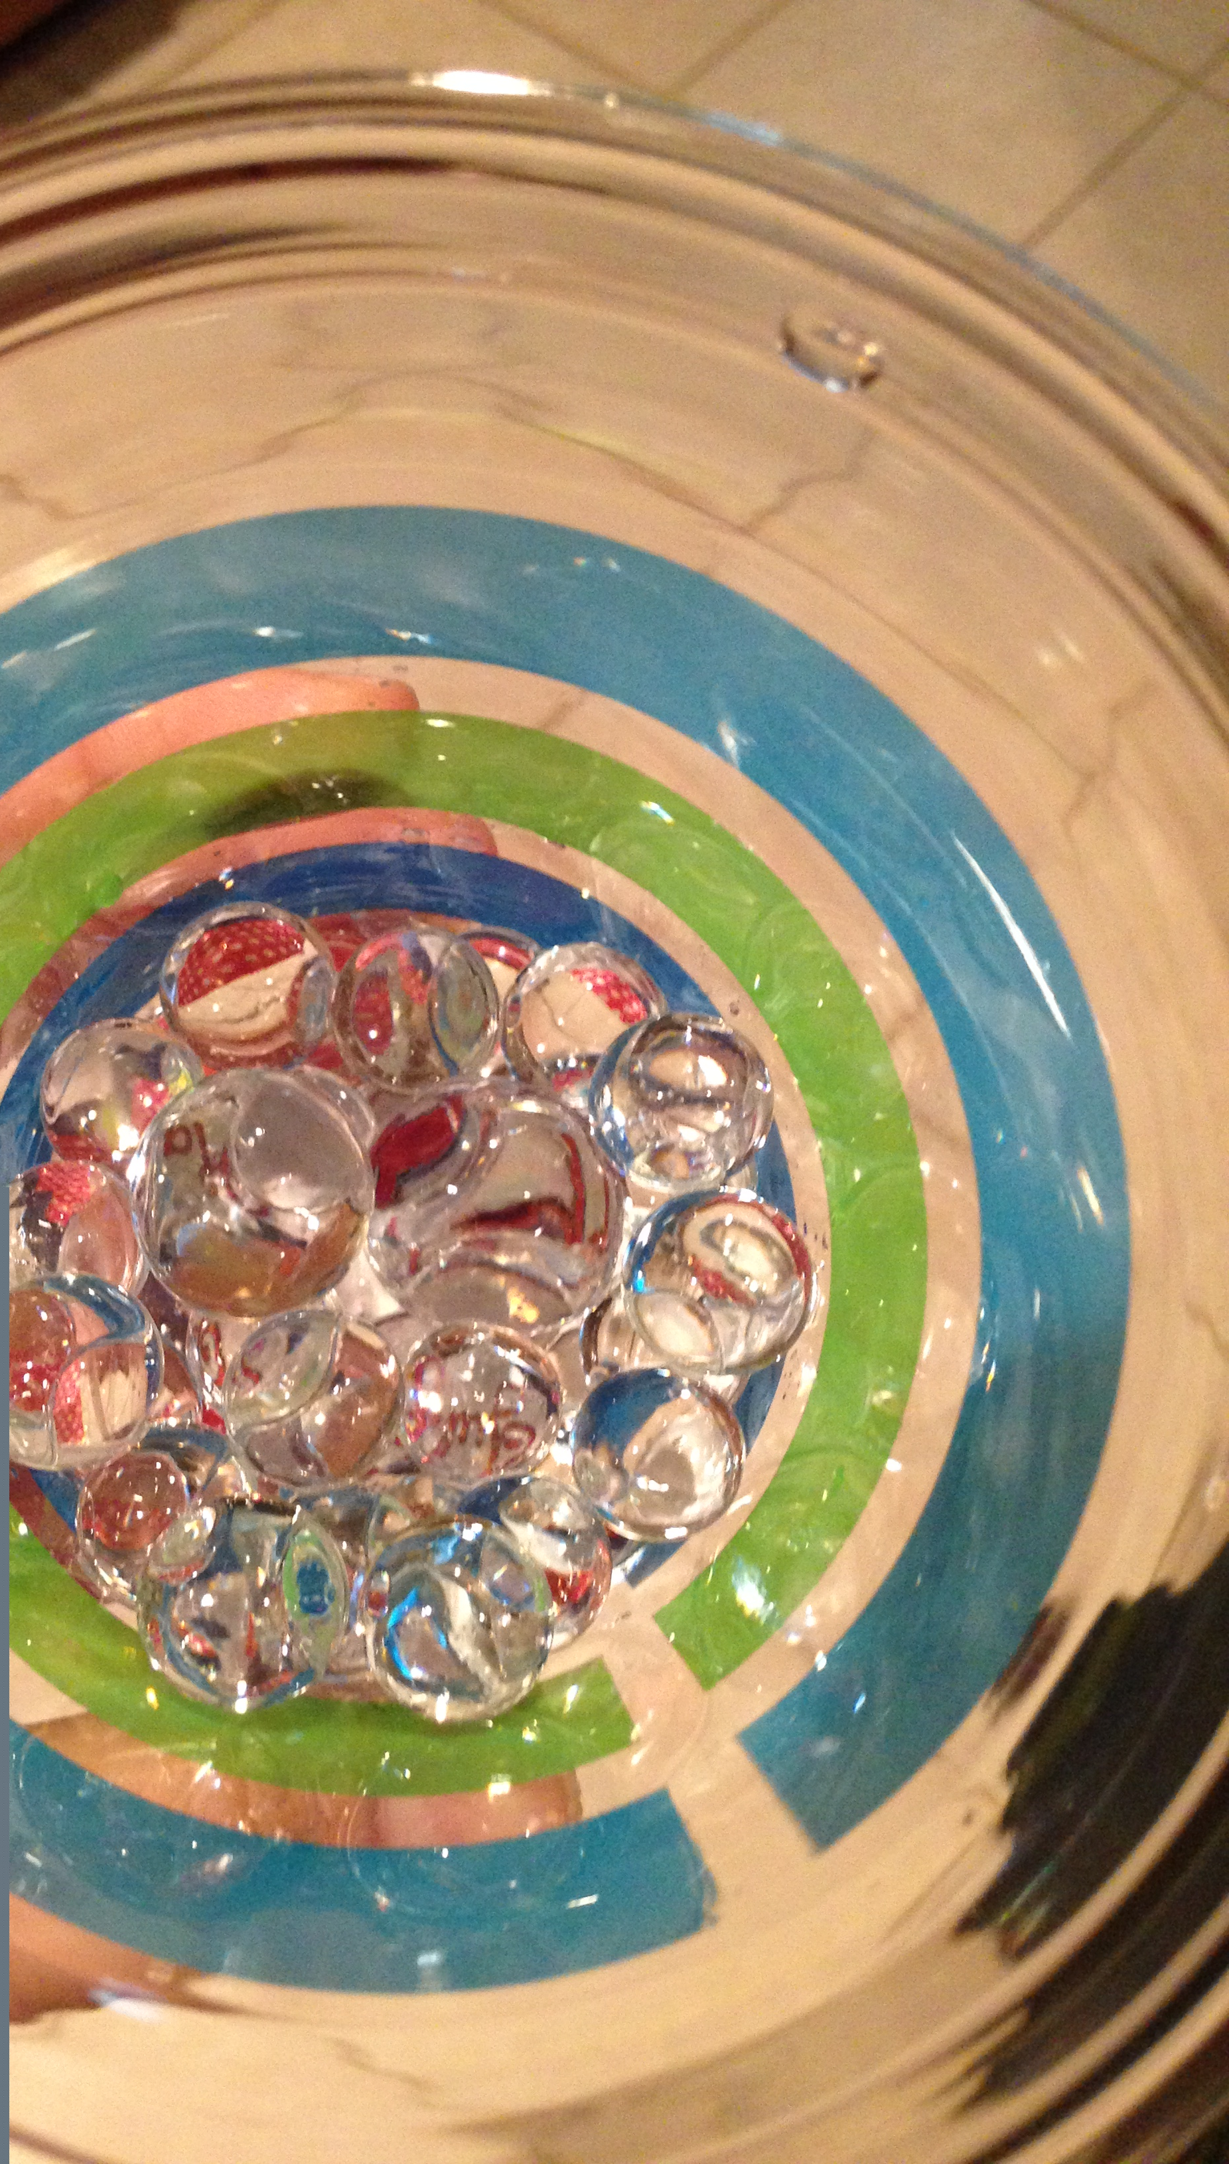
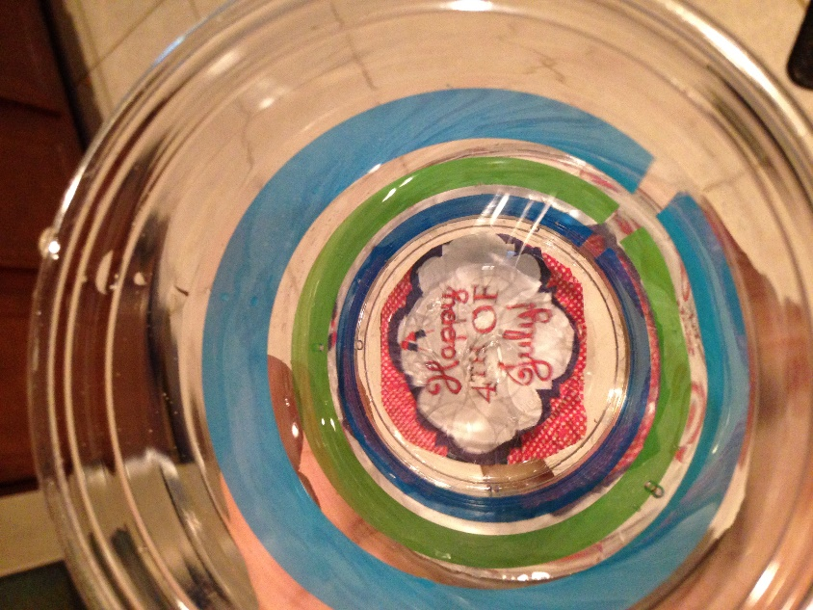
Taylor’s Report

Slide 28
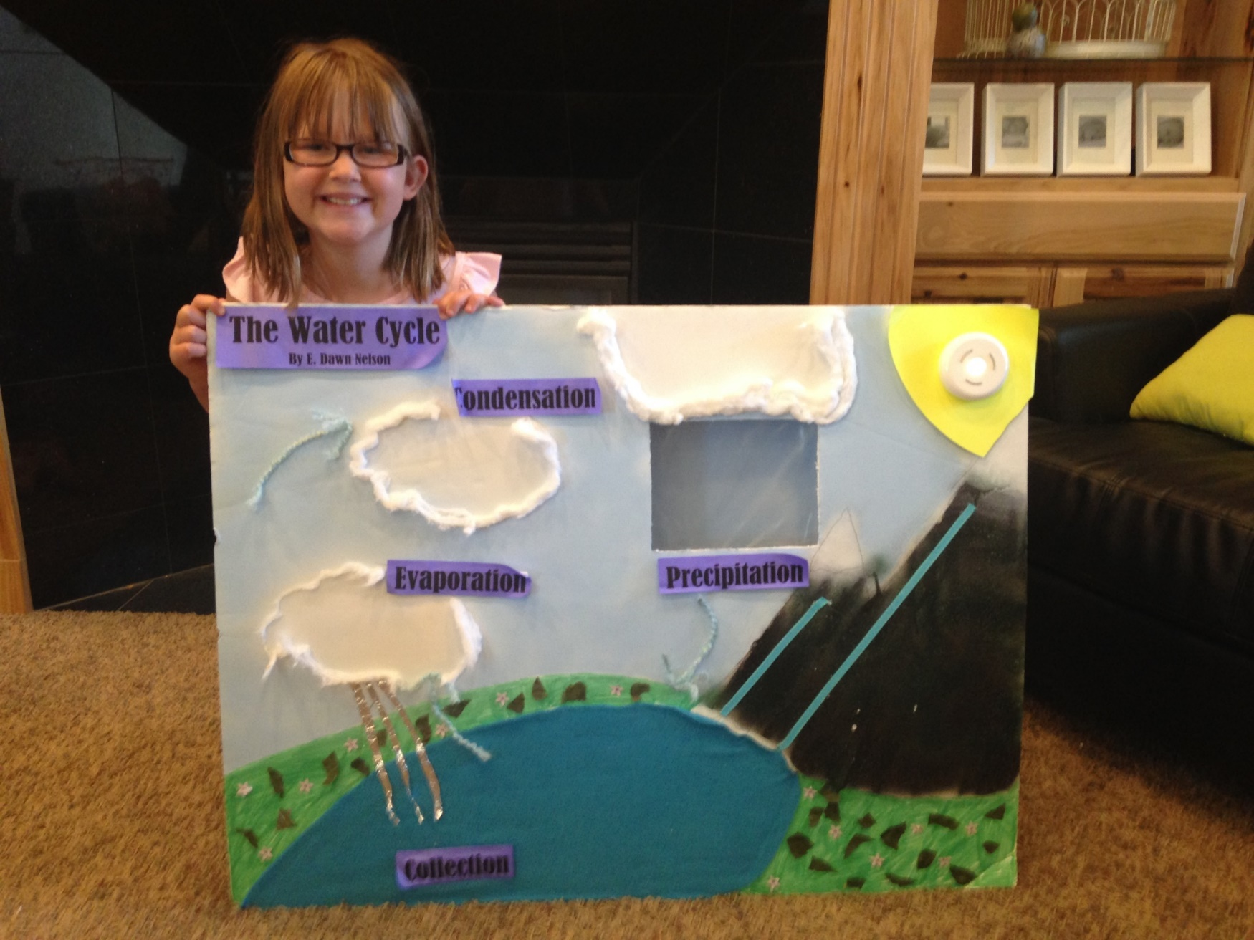
Ella’s Report

Slide 29
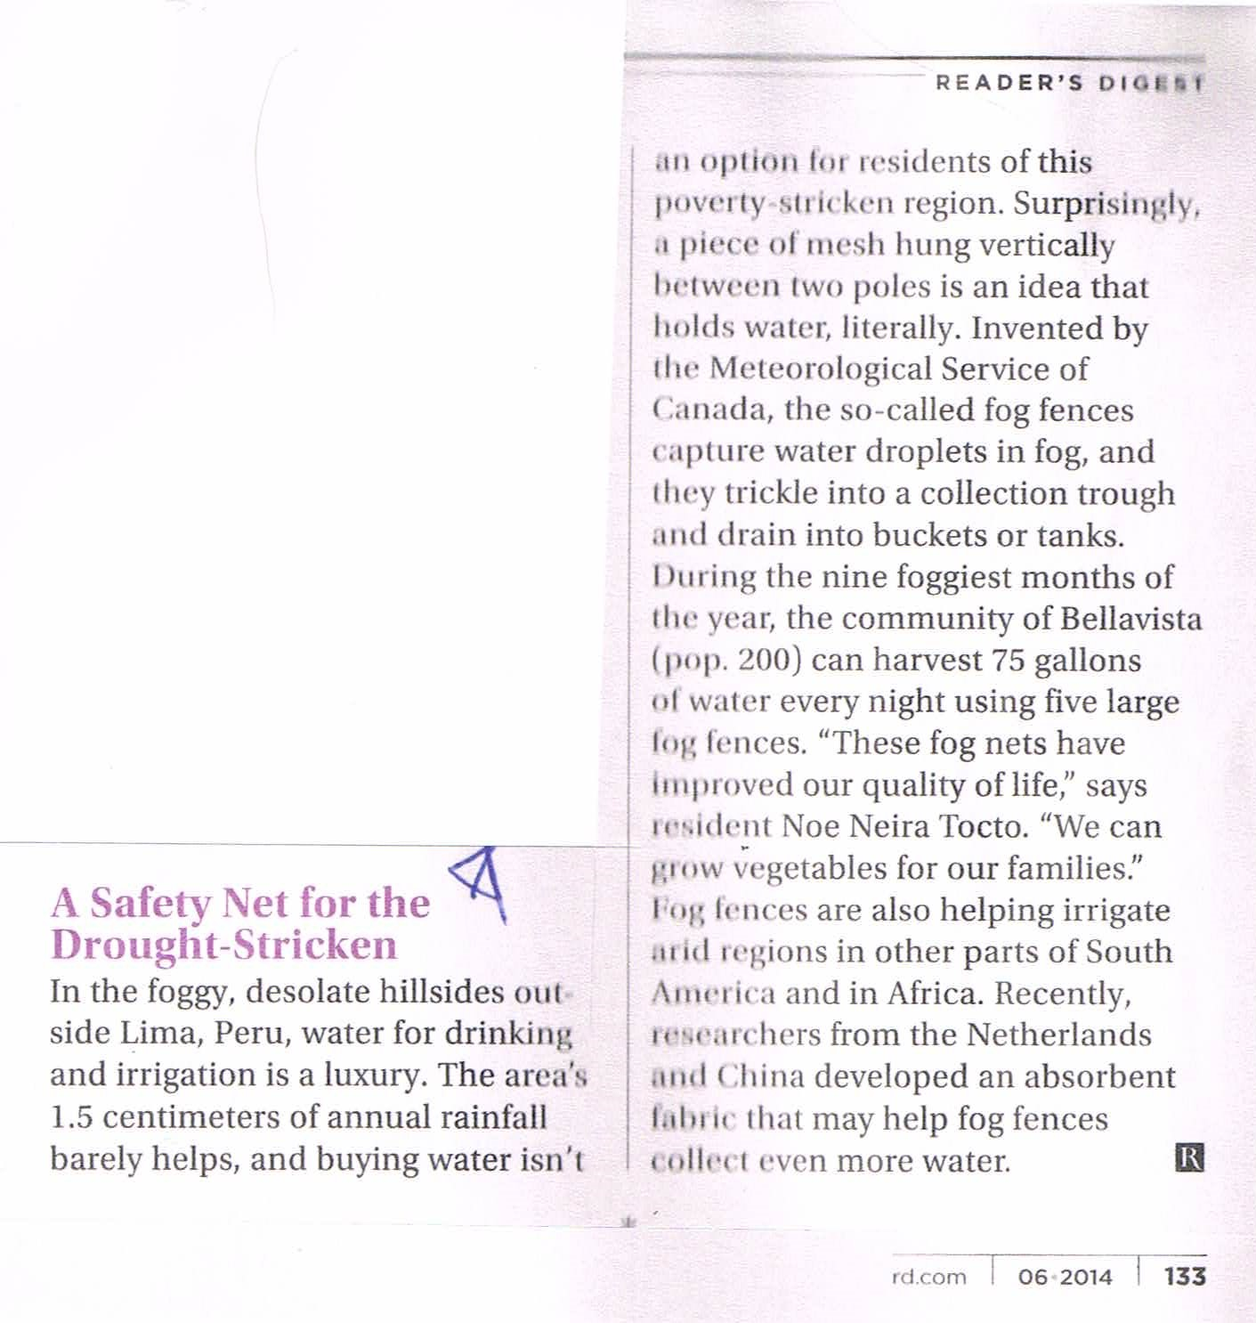
Condensation Update

Slide 30
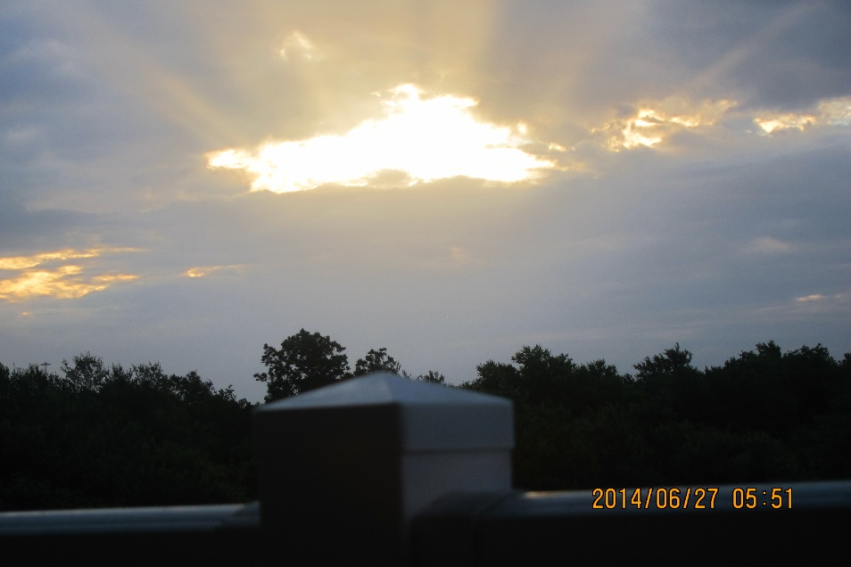
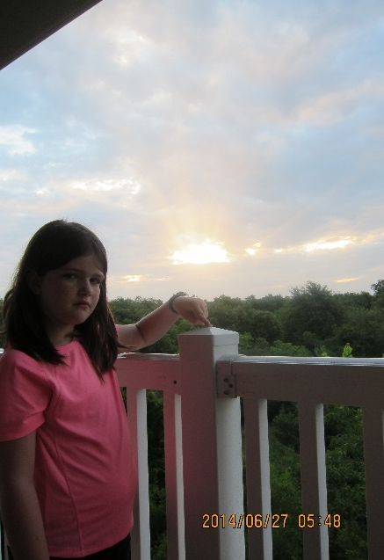
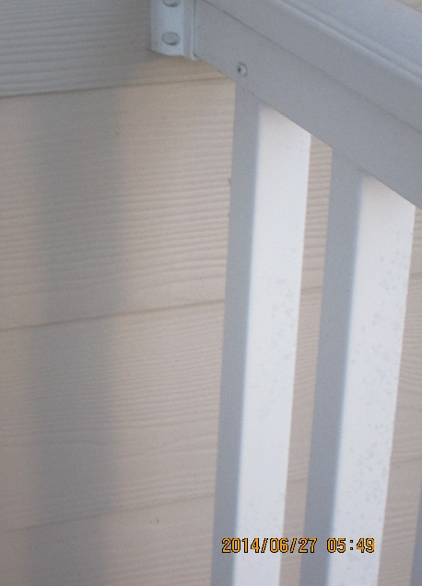
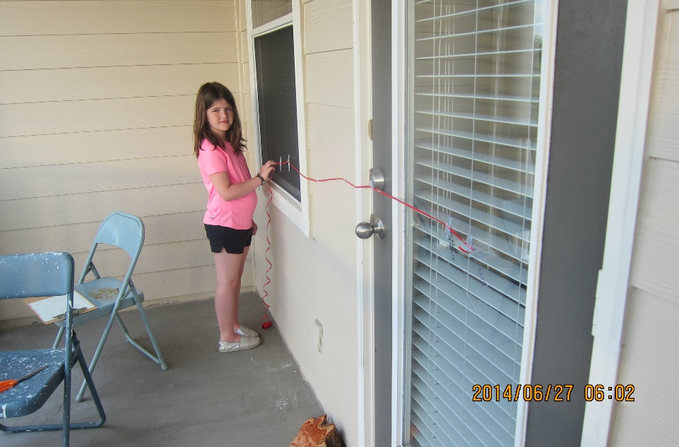
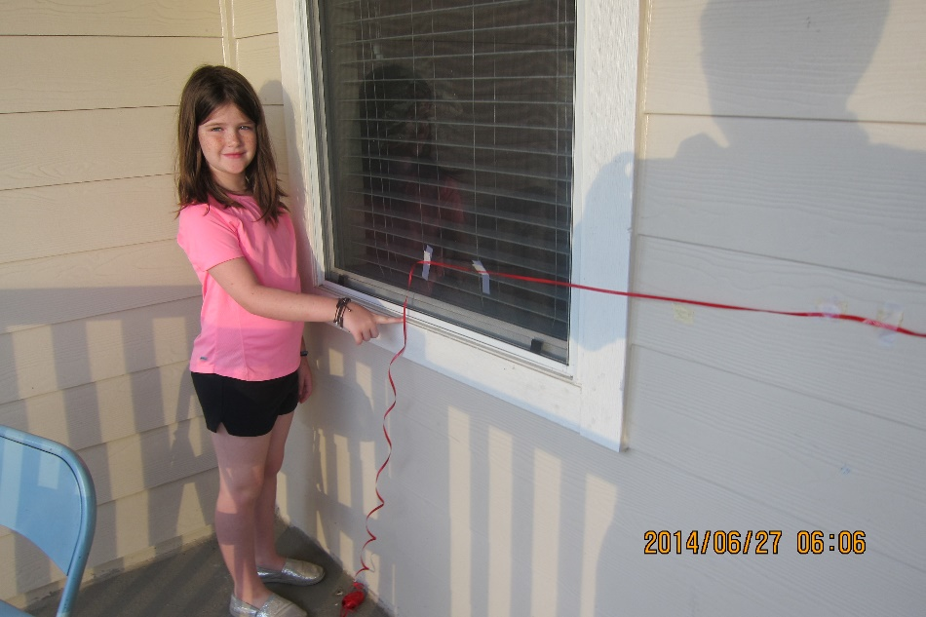
Halle’s Report

Slide 31
Notes

Slide 32
Water Bottle Rockets

Slide 33
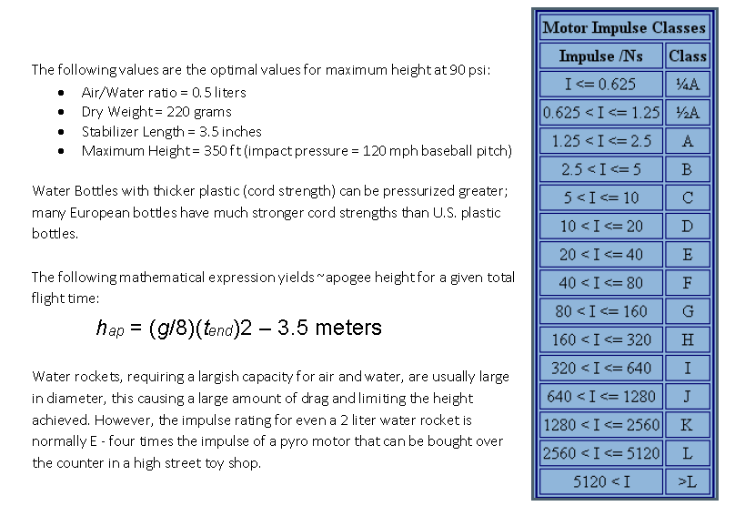
Water Bottle Rockets continued

Slide 34
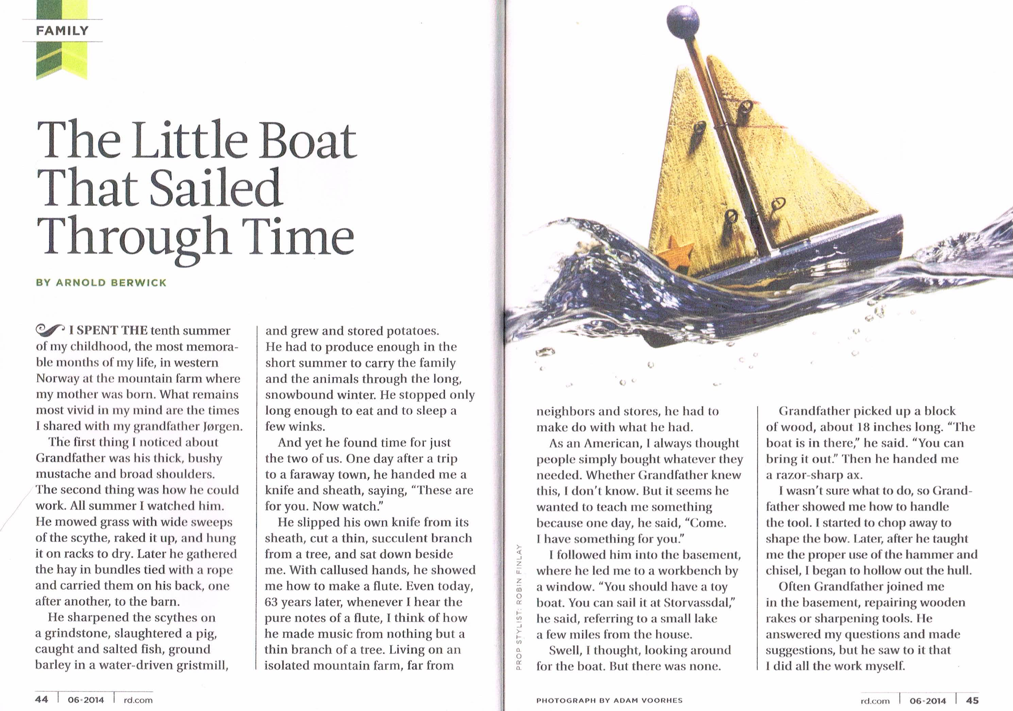
Grandpa 1

Slide 35
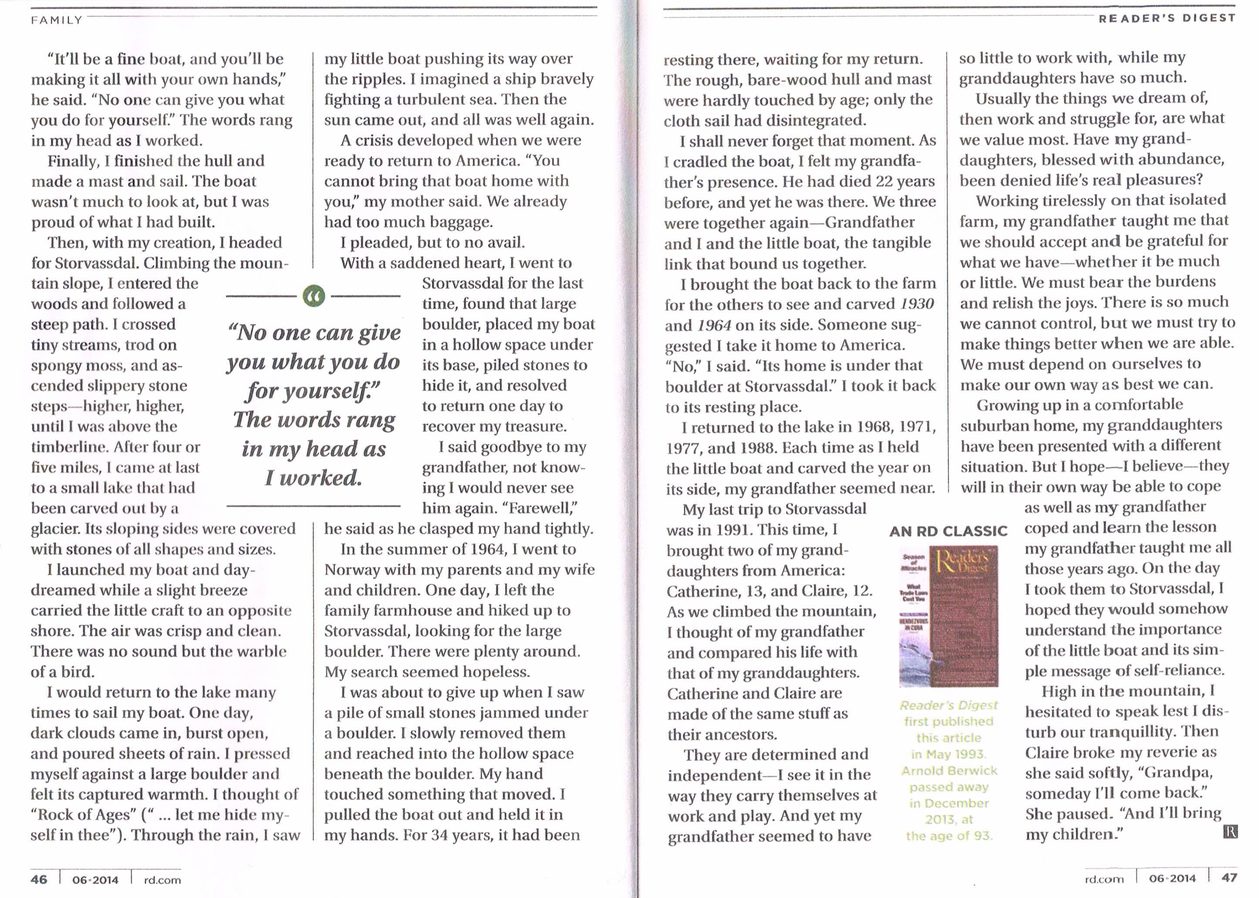
Grandpa 2

Slide 36
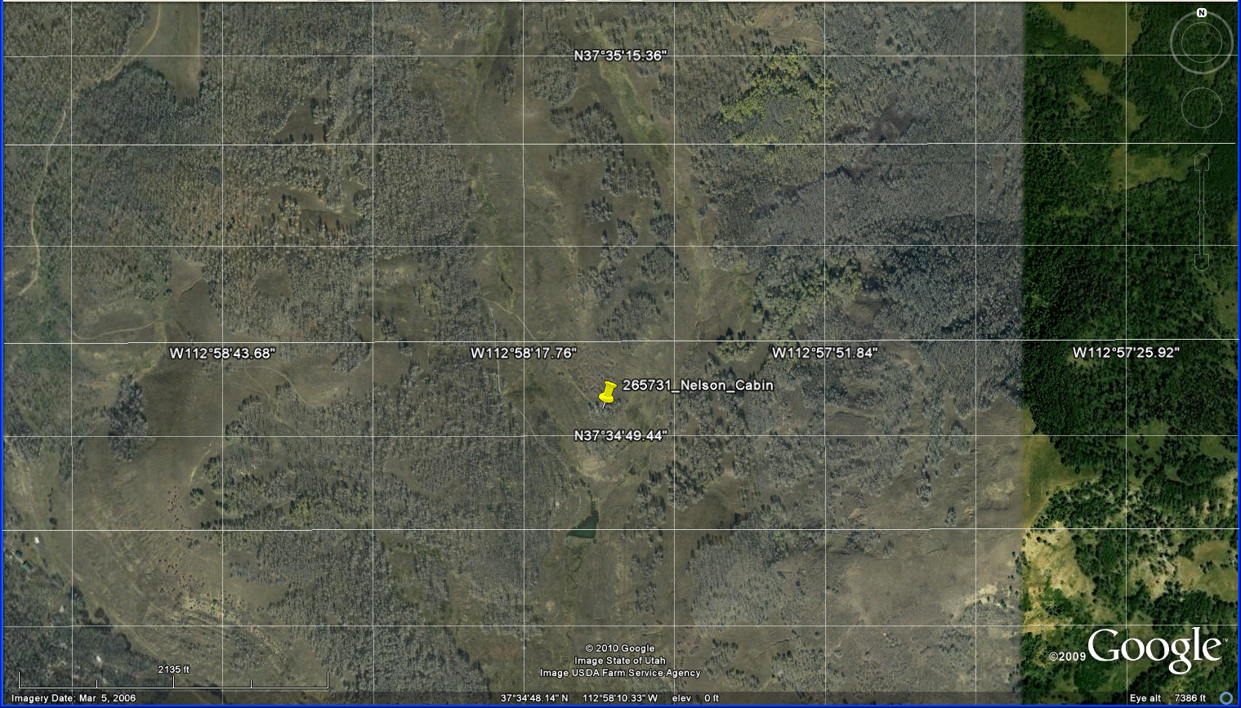
Nelson Cabin Map

Slide 37
Reference Grid
26 36 46 56 66 76
25 35 45 55 65 75
24 34 44 54 64 74
23 33 43 53 63 73
22 32 42 52 62 72
11 21 31 41 51 61 71

Slide 38
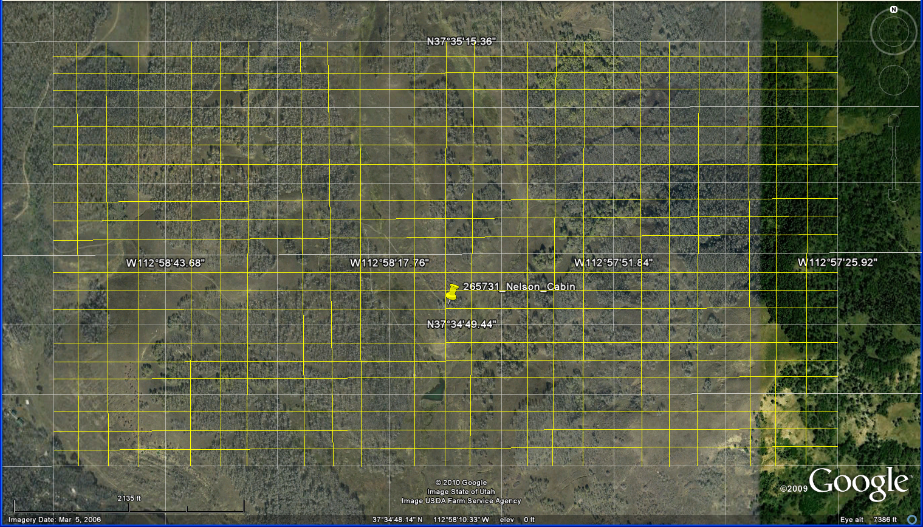
More Detail Reference Grid
66.41 76.11 76.21 76.31 76.41
16.14
16.13
16.12
16.11
15.14
11.11 11.21 11.31 11.41 21.11

Slide 39
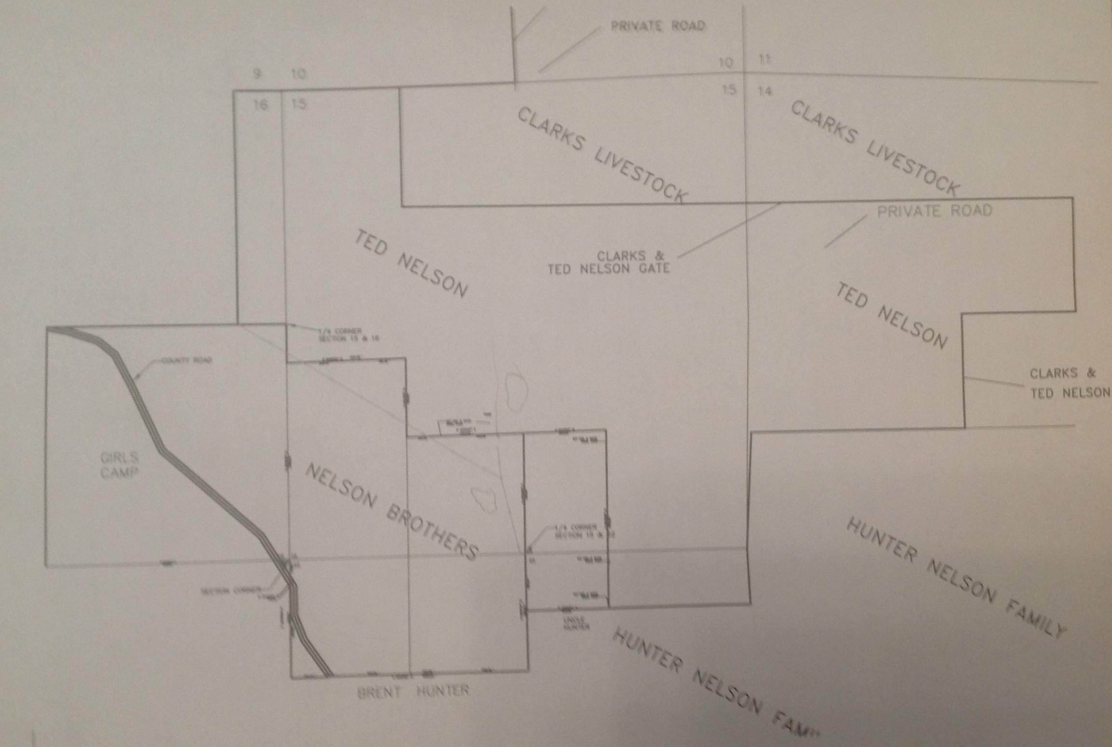
Find Quarter Section Corners at Cabin

Slide 40
Notes

Slide 41
2014 Science Camp
What was best about 2014 Science Camp?
__________________________________
__________________________________
__________________________________
What would be your ideal 2015 Science Camp?
__________________________________
__________________________________
__________________________________

