Slide 1
Science Camp #120627.3
27-29 June 2012 @ Nelson Cabin on Cedar Mountain
and surrounding area
Advisors
H. Roice Nelson, Jr., Andrea S. Nelson,
Benjamin B. Nelson, & Paul F. Nelson
Attendees
Ethan E. Nelson, Grant M. Nelson, Colby C. Wright,
Taylor R. Wright, & Ella D. Nelson

Slide 2
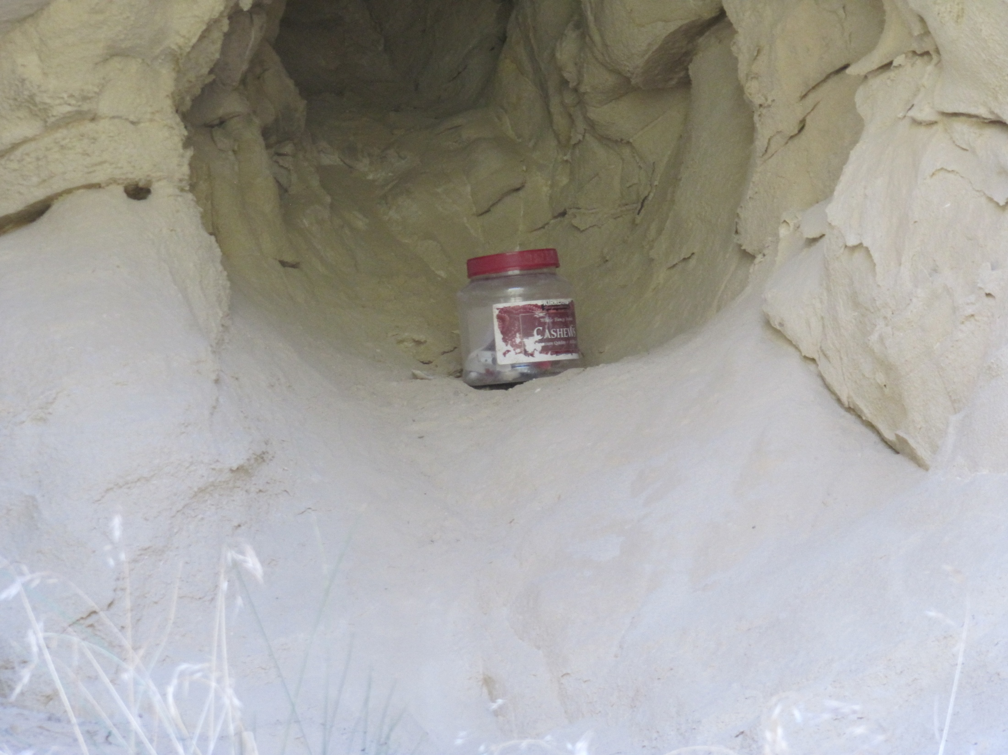
Fiddler’s Canyon Geocache

Slide 3
Geocaching
An outdoor sporting activity in which the participants use a Global Positioning System (GPS) receiver or mobile device and other navigational techniques to hide and seek containers, called "geocaches" or "caches", anywhere in the world.
It is a derivation of the outdoor sporting activity of Geotrekking.
A typical cache is a small waterproof container containing a logbook where the geocacher enters the date they found it and signs it with their established code name. Larger containers such as plastic storage containers (Tupperware or similar) or ammunition boxes can also contain items for trading, usually toys or trinkets of little value. Geocaching is often described as a "game of high-tech hide and seek,” sharing many aspects with benchmarking, trigpointing, orienteering, treasure-hunting, letterboxing, and waymarking.
Geocaches are currently placed in over 200 countries around the world and on all seven continents, including Antarctica, and the International Space Station. After more than 12 years of activity there are over 1.7 million active geocaches published on various websites. There are over 5 million geocachers worldwide
What are the rules of geocaching?
If you take something from the geocache (or "cache"), leave something of equal or greater value.
Write about your find in the cache logbook.
Log your experience at www.geocaching.com.
What do I need to go geocaching?
The only necessities are a GPS device or a GPS-enabled mobile phone so that you can navigate to the cache, and a Geocaching.com Membership.
Where are geocaches located?
Geocaches can be found all over the world. It is common for geocachers to hide caches in locations that are important to them, reflecting a special interest or skill of the cache owner. These locations can be quite diverse. They may be at your local park, at the end of a long hike, underwater or on the side of a city street.
Are there different types of geocaches?
Yes. There are currently over a dozen "cache types" in geocaching, with each cache type being a different variation of the game.

Slide 4
Geocaching (continued)
What does a geocache look like?
Geocaches vary greatly in size and appearance. In the field you will see everything from large, clear plastic containers to film canisters to a fake rock with a secret compartment. So, how do you find the cache?
The first step is to get a general idea of the cache's size. The size is shown on each cache page. A general overview of the cache size graphic is found below. Please note that these are just examples; sizes can vary.
Micro - Less than 100ml. Examples: a 35 mm film canister or a tiny storage box typically containing only a logbook or a logsheet. A nano cache is a common sub-type of a micro cache that is less than 10ml and can only hold a small logsheet.
Small - 100ml or larger, but less than 1L. Example: A sandwich-sized plastic container or similar.
Regular - 1L or larger, but less than 20L. Examples: a plastic container or ammo can about the size of a shoebox.
Large - 20L or larger. Example: A large bucket.
Other - See the cache description for information.

Slide 5
Geocaching (continued)
Can I move a cache once I find it?
Please do not move a cache from its original location. If you feel that the cache may not be located in the correct location, please email the cache owner directly or post a log on the cache listing page, notifying the owner of your concern. Cache owners are responsible for maintaining their cache placements.
What should I do if I discover that a cache has gone missing?
If you visit a cache location and the cache is missing, make sure to log the cache with a "Didn't find it" log so that the cache owner is notified. Cache owners who repeatedly receive "Didn't find it" logs should check to see that their cache has not been removed.
As a geocacher, if you notice that a cache page has an unusual number of "Didn't find it" logs, please let the local reviewer know or contact us. We rely on the geocaching community to let us know the status of caches in their area.
How do I log my find?
Instructions for logging a "Found It" are located at http://www.geocaching.com/about/logging.aspx. If you need to post another type of log, such as a "Didn't find it" or a Note, the same instructions apply, with one small change; instead of choosing "Found It" in the drop-down menu, you would choose the applicable log type.

Slide 6
Notes

Slide 7
GPS
What is a GPS device?
A GPS device is an electronic unit that can determine your approximate location (within around 6 - 30 feet) on the planet. Coordinates are normally given in latitude and longitude. You can use the device to navigate from your current location to another location. Some devices have their own maps, built-in electronic compasses, and voice navigation, depending on the complexity of the device.
How does GPS work?
Each GPS device is a computer that receives signals broadcast from GPS satellites. A device needs to read signals from at least three satellites at a time to calculate its general location by a process called trilateration.
With signals from four satellites, a GPS receiver can get a more accurate fix that includes altitude and the exact time, as well as latitude and longitude. The more satellite signals the receiver reads, the more accurate the position it reports to you.

Slide 8
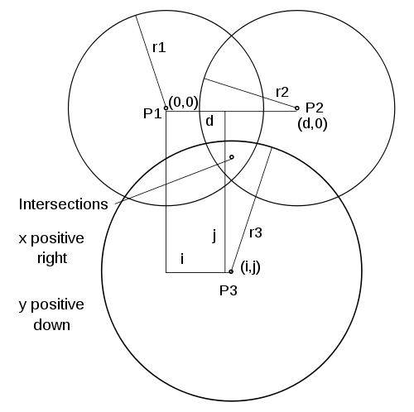
Trilateration
In geometry, trilateration is the process of determing absolute or relative locations of points by measurement of distances, using the geometry of circles, spheres , or triangles.In addition to its interest as a geometric problem, trilateration does have practical applications in surveying and navigation, including global positioning systems (GPS). In contrast to triangulation it does not involve the measurement of angles.
Figure 1. The plane, z=0, showing the 3 sphere centers, P1, P2, and P3; their x,y coordinates; and the 3 sphere radii, r1, r2, and r3. The two intersections of the three sphere surfaces are directly in front and directly behind the point designated intersections in the z=0 plane.

Slide 9
Notes

Slide 10
Ways to Geocache
Traditional/Basic: Must include a log book of some sort. It may or may not include trade or traceable items. A traditional cache is distinguished from other cache variations in that the geocache is found at the coordinates given and involves only one stage.
Multi-cache: This variation consists of multiple discoveries of one or more intermediate points containing the coordinates for the next stage; the final stage contains the log book and trade items.
Offset: This cache is similar to the multi-cache except that the initial coordinates are for a location containing information that encodes the final cache coordinates. An example would be to direct the finder to a plaque where the digits of a date on the plaque correspond to coordinates of the final cache.
Mystery/puzzle: This cache requires one to discover information or solve a puzzle to find the cache. Some mystery caches provide a false set of coordinates with a puzzle that must be solved to determine the final cache location. In other cases, the given location is accurate, but the name of the location or other features are themselves a puzzle leading to the final cache. Alternatively, additional information is necessary to complete the find, such as a padlock combination to access the cache.^{[20]}
Night Cache: These multi-stage caches are designed to be found at night and generally involve following a series of reflectors with a flashlight to the final cache location.
Challenge Cache: These caches require that a geocacher complete a reasonably attainable geocaching-related task before being able to log the find. Examples include finding a number of caches that meet a category, completing a number of cache finds within a period of time, finding a cache for every calendar day, etc.
Letterbox Hybrid: A letterbox hybrid cache is a combination of a geocache and a letterbox in the same container. A letterbox has a rubber stamp and a logbook instead of tradable items. Letterboxers carry their own stamp with them, to stamp the letterbox's log book and inversely stamp their personal log book with the letterbox stamp. The hybrid cache contains the important materials for this and may or may not include trade items. Whether the letterbox hybrid contains trade items is up to the owner.

Slide 11
Ways to Geocache (continued)
Locationless/Reverse: This variation is similar to a scavenger hunt. A description is given for something to find, such as a one-room schoolhouse, and the finder locates an example of this object. The finder records the location using their GPS hand-held receiver and often takes a picture at the location showing the named object and his or her GPS receiver. Typically others are not allowed to log that same location as a find.
Moving/Travelling: Similar to a traditional geocache, this variation is found at a listed set of coordinates. The finder uses the log book, trades trinkets, and then hides the cache in a different location. By updating this new location on the listing, the finder essentially becomes the hider, and the next finder continues the cycle. The hitchhiker concept (see above) has superseded this cache type on geocaching.com.
Virtual: Caches of this nature are coordinates for a location that does not contain the traditional box, log book, or trade items. Instead, the location contains some other described object. Validation for finding a virtual cache generally requires you to email the cache hider with information such as a date or a name on a plaque, or to post a picture of yourself at the site with GPS receiver in hand.
Earthcache: A type of virtual-cache which is maintained by the Geological Society of America. The cacher usually has to perform a task which teaches him/her an educational lesson about the earth science of the cache area.
Webcam: Similar to a virtual cache; there is no container, log book, or trade items for this cache type. Instead, the coordinates are for a location with a public webcam. Instead of signing a log book, the finder is often required to capture their image from the webcam for verification of the find.
Event Cache: This is a gathering organized and attended by geocachers. Physical caches placed at events are often active only for the event date.
Cache-In Trash-Out (CITO) Events: This variation on event caching is a coordinated activity of trash pickup and other maintenance to improve the environment.
Mega Event: An event that is attended by over 500 people. Mega Events are typically annual events, usually attracting geocachers from all over the world.

Slide 12
Ways to Geocache (continued)
GPS Adventures Maze Exhibit: An exhibit at various museums and science centers in which participants in the maze learn about geocaching. These "events" have their own cache type on Geocaching.com and include many non-geocachers.
Wherigo cache: A Wherigo cache is similar to a multi-stage cache hunt that uses a Wherigo cartridge to guide the player. The player plays the cartridge and finds a physical cache sometime during cartridge play, usually at the end. Not all Wherigo cartridges incorporate geocaches into game play. Wherigo caches are unique to the geocaching.com website.
BIT Cache(tm): Physical yet containerless caches, they are laminated cards with a URL and the password needed for logging. More information is available at www.BITcaching.com. They are listed exclusively on Opencaching.us -
Guest Book Cache: Physical guest books often found in museums, tourist information centers, etc. They are listed exclusively at Opencaching.us -
USB Cache: Paperless caches stored inside USB drives and embedded (with permission) into walls or other structures. The cache is retrieved by connecting a device that has a USB port and that is able to read standard text files. Also known as Dead Drop caches.
Sources:
http://en.wikipedia.org/wiki/Geocaching
http://en.wikipedia.org/wiki/Latitude_and_longitude
http://www.geocaching.com/guide/default.aspx
http://en.wikipedia.org/wiki/Trilateration

Slide 13
Terminology
There are various acronyms and words commonly used when discussing geocaching.
General (more here: http://www.geocaching.com/about/glossary.aspx):
Cache – A box or container that contains, at the very least, a logbook.
Geoswag – The items that can be found in some larger caches.
Georing – A term first coined by the South GA Geocachers group in 2011. It's the term used to refer to a notification tone made by a smartphone when a new cache is published.
Muggle – A non-geocacher.
Muggled - Being caught by a non-geocacher while retrieving/replacing a cache; also, a muggled cache has been removed or vandalized by a non-geocacher, usually out of misunderstanding or lack of knowledge.
Smiley – A cache find. Refers to the "smiley-face" icon attached to "Found It" logs on some listing sites.
BYOP – (Bring Your Own Pen/Pencil) The cache in question lacks a writing device for the logbook.
CITO – (Cache In Trash Out) and refers to picking up trash on the hunt.
CO – (Cache Owner) The person who is responsible for maintaining a cache, usually the person who hid it.
DNF – (Did Not Find) Did not find the cache container being searched for.
FIGS - Found in good shape.
FTF – (First To Find) The first person to find a cache container; less commonly one may see STF (second to find, or TTF, third to find).
FTL – (First To Log) The first person to log the find of a cache container online.
GPS – Short for Global Positioning System, also occasionally refers to the receiver itself.
GPSr – Short for GPS receiver.
PAF - Phone-A-Friend.
SGC - (Senior Geocacher) An experienced participant of the pursuit.

Slide 14
Logging a hunt:
TFTC – (Thanks For The Cache) This is often used at the end of logs to thank the cache owner.
TFTH – (Thanks For The Hunt or Hide or Hike) It shares the same purpose as TFTC, but can also be used when the cache was not found.
TN – (Took Nothing) no trade or traveling item was removed from the cache.
LN – (Left Nothing) no trade or traveling item was added to the cache.
XN – (eXchanged Nothing) combines the previous two acronyms; nothing was removed or added.
SL – (Signed Log) used when the participant visited the cache and signed its logbook.
TSIA – (The Streak is Alive) used when the participant has an active streak of continuous days finding a cache.
Note: the various acronyms in this section are often combined in various ways, such as "TNLNSL, TFTC!"
Location description or hint:
GRC – (GuardRail Cache) used in the description on where a cache may be hidden.
GZ – (Ground Zero or Geo-zone) refers to the general area in which a cache is hidden. For Example:- The cache is hidden at N50 35.195 W003 27.961
ICT – (Ivy Covered Tree) used in the description on where a cache may be hidden.
LPC – (Light/Lamp Post Cache) used in the description on where a cache may be hidden.
MKH – (Magnetic Key Holder) used in the description on the type of container used for the cache.
P&G - (Park and Grab) used to refer to a cache that is fairly close to the nearest parking spot, does not require hiking more than a tenth of a mile
PLC – (Parking Lot Cache) used in the description on where a cache may be hidden.
POR – (Pile Of Rocks) used in the description on where a cache may be hidden.
POS – (Pile Of Sticks or Stones) used in the description on where a cache may be hidden.
SL - (Skirt Lifter) refers to the metal or plastic skirt at the base of a lightpole, and used in reference to LPC caches (see LPC).
SOOP - (Something Out of Place) used to refer to a natural or other object that seems out of place, indicating a geocache is hidden in that spot
TOTT - (Tool of the Trade) can refer to any out of the ordinary tool needed/used to retrieve a cache. Most often used tongue-in-cheek to refer to the use of a ladder to get to an out-of-reach cache.
UFO – (Unnatural Formation of Objects) a pile of material that obviously did not form naturally and is a likely cache hiding spot.
UPS – (Unnatural Pile of Sticks) a piles of sticks that did not form naturally and where a cache may be hidden.

Slide 15
Notes

Slide 16
A. Safety
Never go anyplace alone!
Exception is if one of you is hurt, then:
One of you stay and help the person hurt.
The other one run and get help.
If you get lost stay put, we will find you.
If you hear a rattlesnake do not move quickly, just slowly move away from the sound.
Do not run with a knife open. Use knife safety.
If you cut yourself, apply pressure to the wound to stop bleeding, and send for help.
Never point an arrow in a cocked bow at any person.
Drink lots and lots and lots of water.
Do not go swimming unless an adult is with you.
Do not start branches on fire and swing them around where others can be hurt.
Use common sense and think before you act.

Slide 17
Schedule
Tuesday Night:
Camp Out at Aunt Shirley’s
Wednesday Morning:
Breakfast Grandma Shirts
Geocaching in Cedar
Nelson Cabin – Dutch Oven Dinner
Thursday
Taylor & Ella & Grandma to St. George
Ethan, Colby, & Grant to Mammoth Cave, Cascade Falls, & Fishing
Nelson Cabin – Hot Dogs
Friday
Geocaching in Cedar
Ride in SUU President’s Car
Visit Cemetery
Pizza
Geocaching in Cedar
Saturday
Go to Colorado and Logan

Slide 18
Job Chart
 | Tuesday | Wednesday | Thursday | Friday | Saturday
Ethan |  | Dinner Dishes | Prepare Dinner | Dinner Dishes | Clean Cabin
Grant |  | Breakfast Dishes | Dinner Dishes | Prepare Dinner | Clean Cabin
Colby | Dinner Dishes? | Lunch Dishes | Breakfast Dishes | Dinner Dishes | Clean Cabin
Taylor |  | Dinner Dishes | Prepare Breakfast | Breakfast Dishes | Clean Cabin
Ella |  | Prepare Dinner | Dinner Dishes | Prepare Breakfast | Breakfast Dishes

Slide 19
Notes

Slide 20
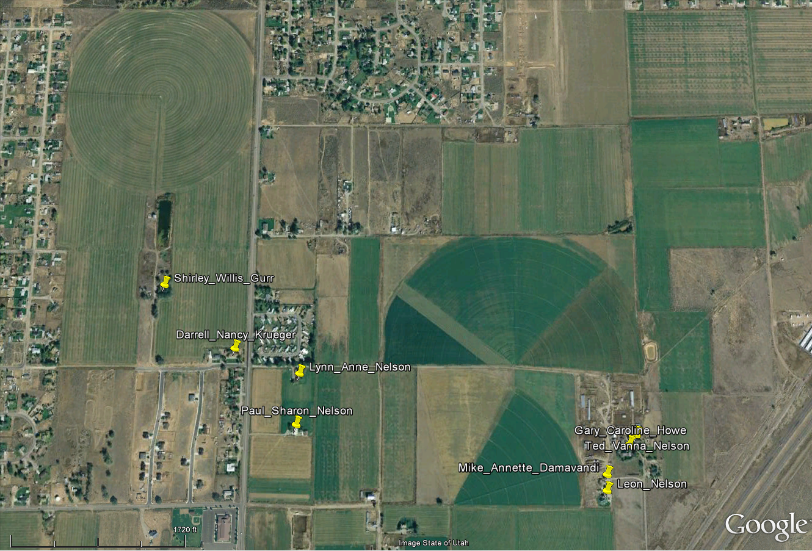
Nelson Farm & Relatives Houses

Slide 21
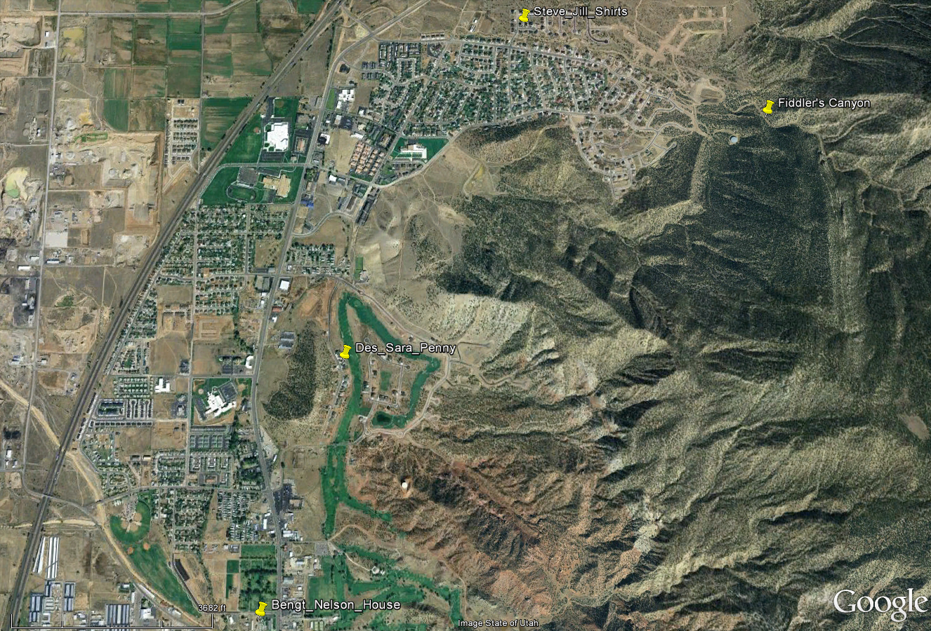
North Cedar & Relatives

Slide 22
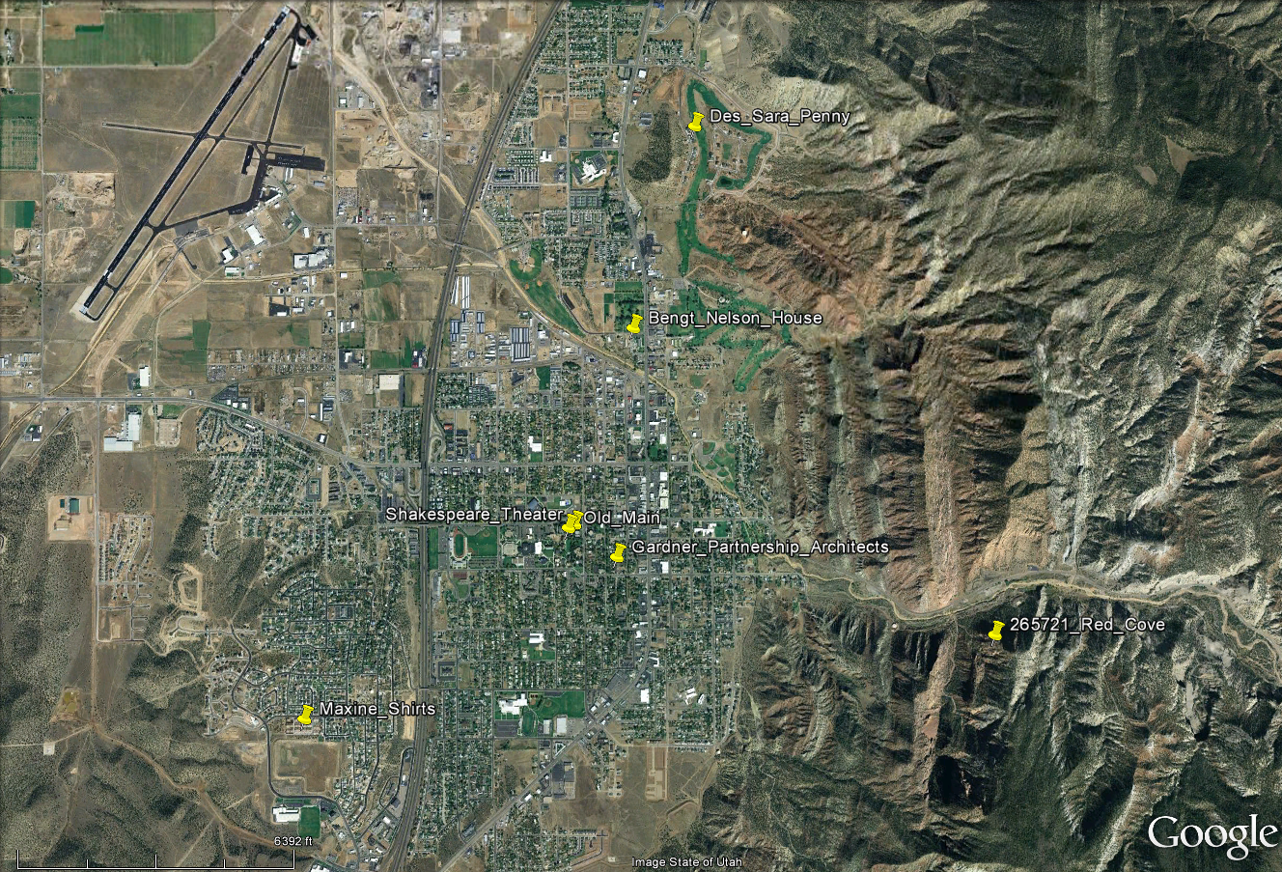
Cedar City & Relatives

Slide 23
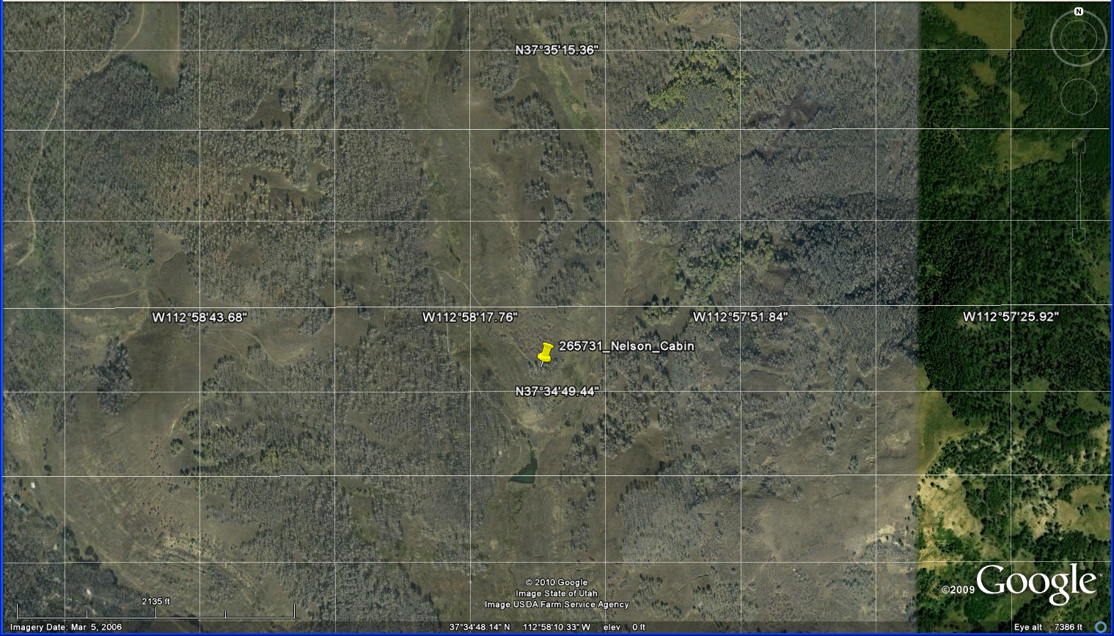
W.1. Nelson Cabin Map

Slide 24
W.1. Reference Grid
26 36 46 56 66 76
25 35 45 55 65 75
24 34 44 54 64 74
23 33 43 53 63 73
22 32 42 52 62 72
11 21 31 41 51 61 71

Slide 25
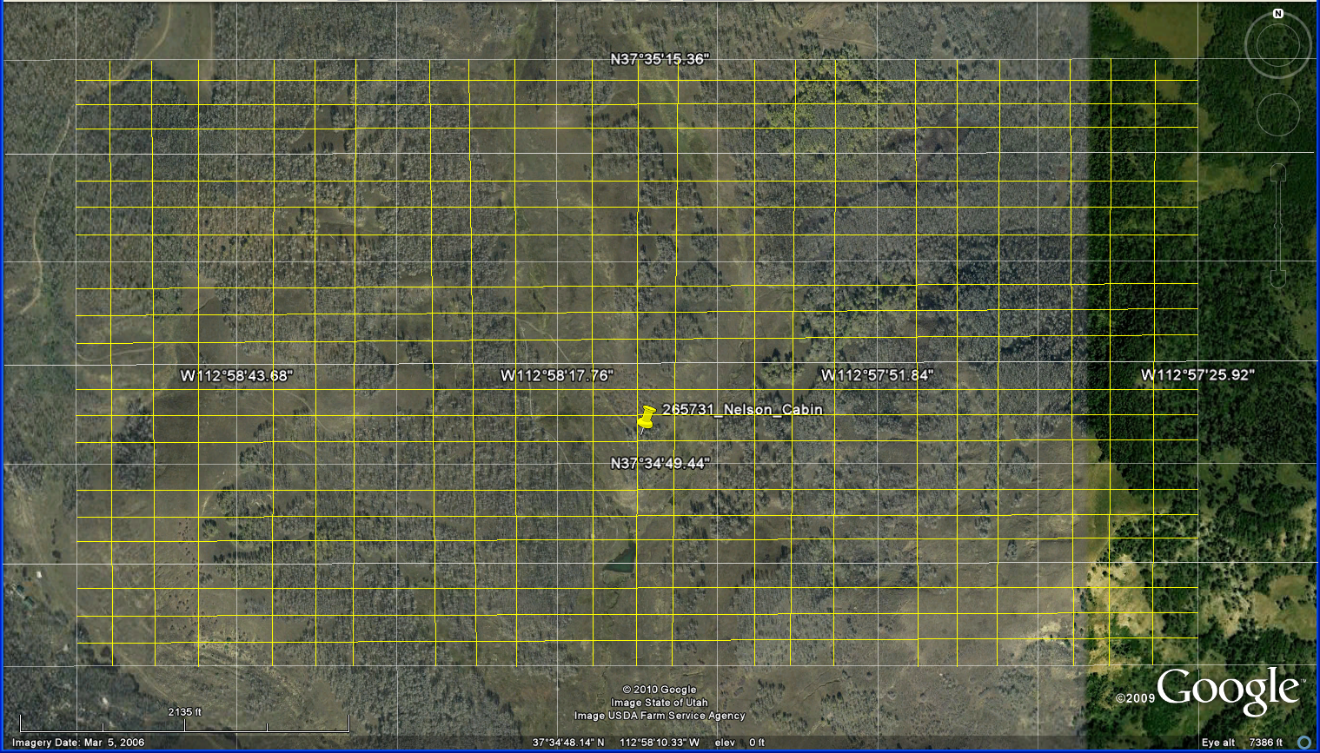
W.1. More Detail Reference Grid
66.41 76.11 76.21 76.31 76.41
16.14
16.13
16.12
16.11
15.14
11.11 11.21 11.31 11.41 21.11

Slide 26
Notes

Slide 27
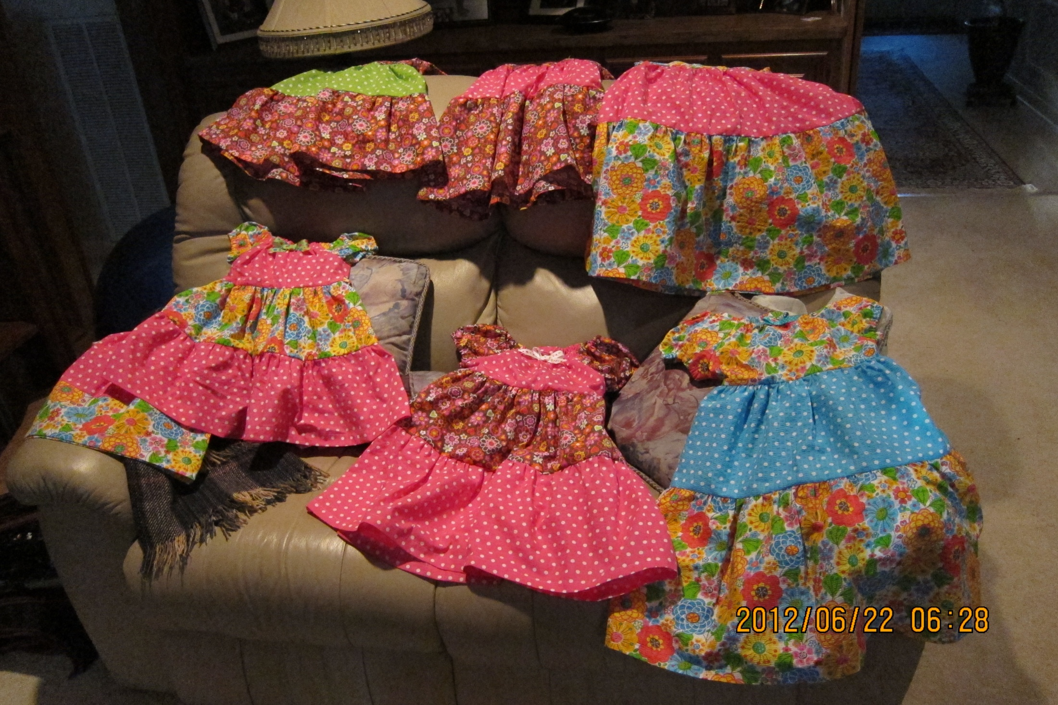
T. Girls Day – Pottery and Fingernails

Slide 28
T.B. Mammoth Cave Description
One of the most interesting features of the Dixie National Forest is the ancient lava beds that surround the pristine Navajo Lake and Duck Creek areas. This geologically recent lava flow represents the last of the extensive volcanism on Cedar Mountain. Geologists believe that some of this lava rock is not more than 2,000 years old. Much of the lava did not come from a central volcano but welled up from cracks and fissures in the earth’s surface. There is a profile of a cinder cone that can be seen on the north end of the Navajo Lake and Hwy U-14 junction.
Another interesting feature of the lava beds is Mammoth Cave. This tunnel or lava tube was formed by cooling lava and water. The cave is about ¼ mile long and is safe to explore if proper care is taken. Explorers will need to climb down to entrance so be sure to wear proper clothing and footwear. There are four caverns located inside the cave with the tunnel heading west being the largest. Please note that some areas of the cave may be blocked off during certain times of the year to protect the essential habitat for wildlife.

Slide 29
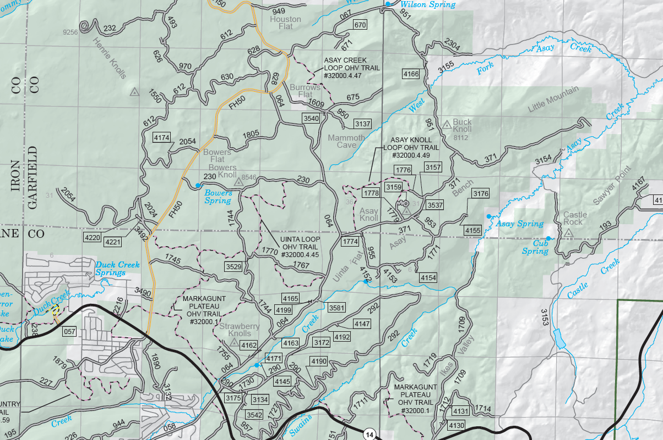
T.B. Mammoth Cave

Slide 30
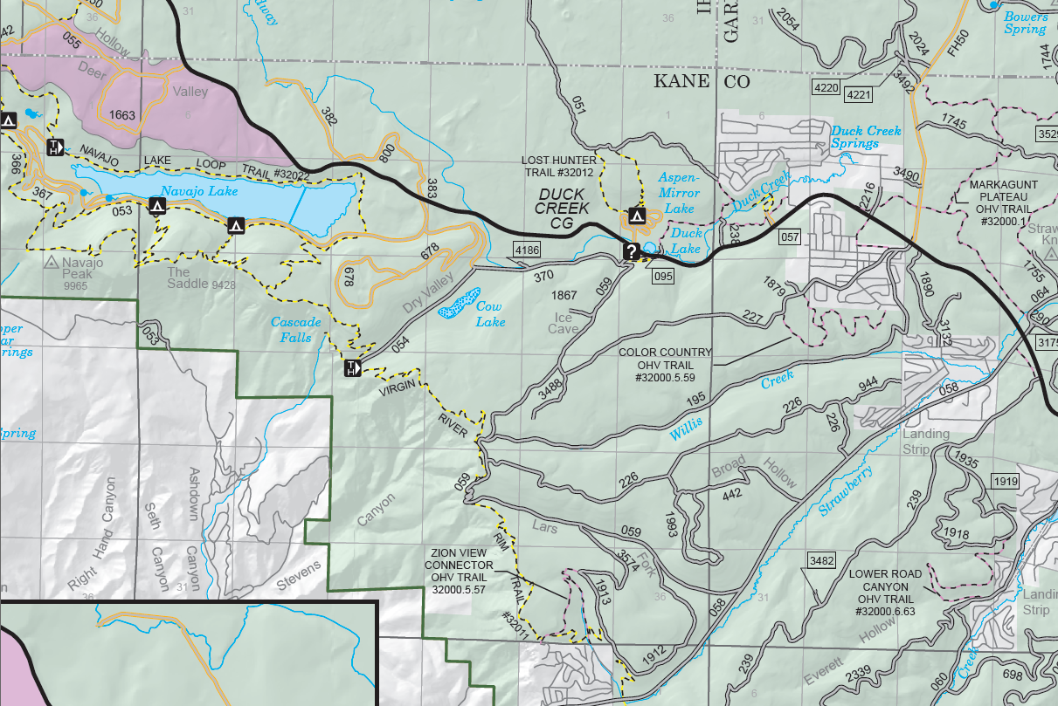
T.B. Cascade Falls

Slide 31
Notes

Slide 32
1

Slide 33
2

Slide 34
Notes

Slide 35
3

Slide 36
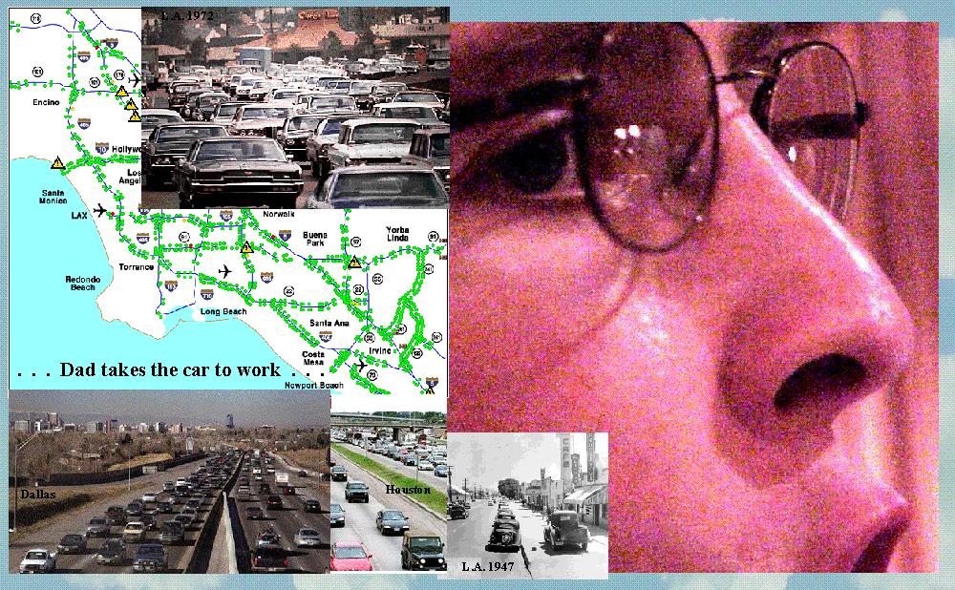
4

Slide 37
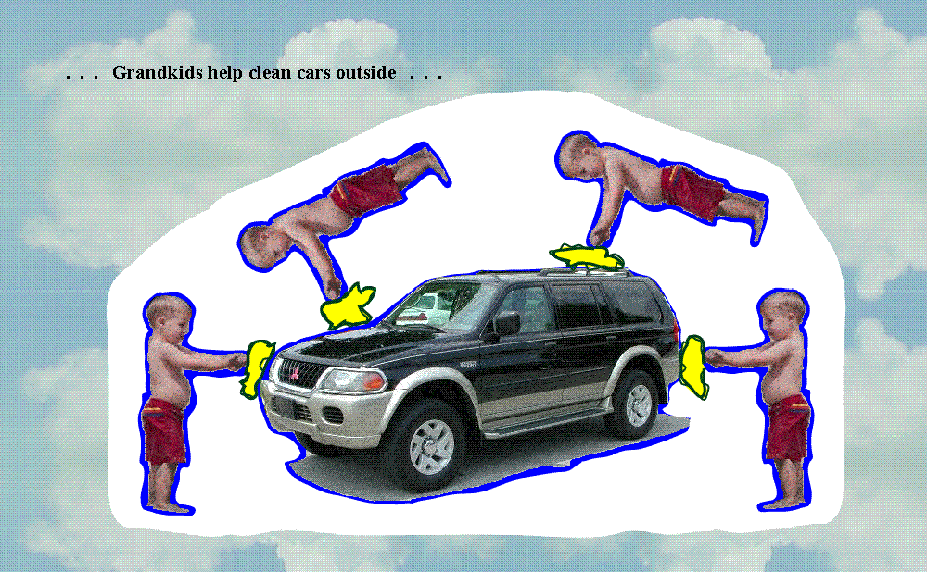
5

Slide 38
6

Slide 39
19

Slide 40
Notes

Slide 41
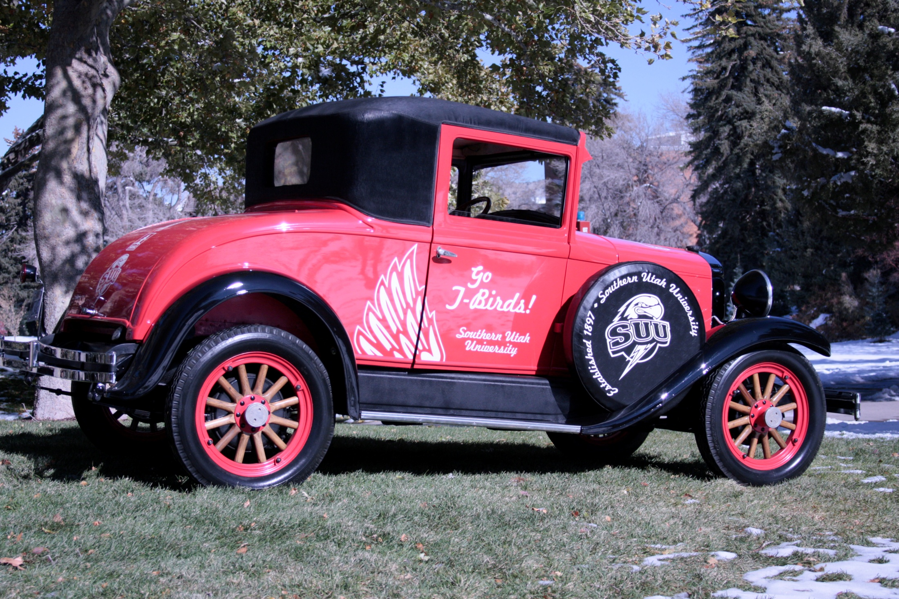
20

Slide 42
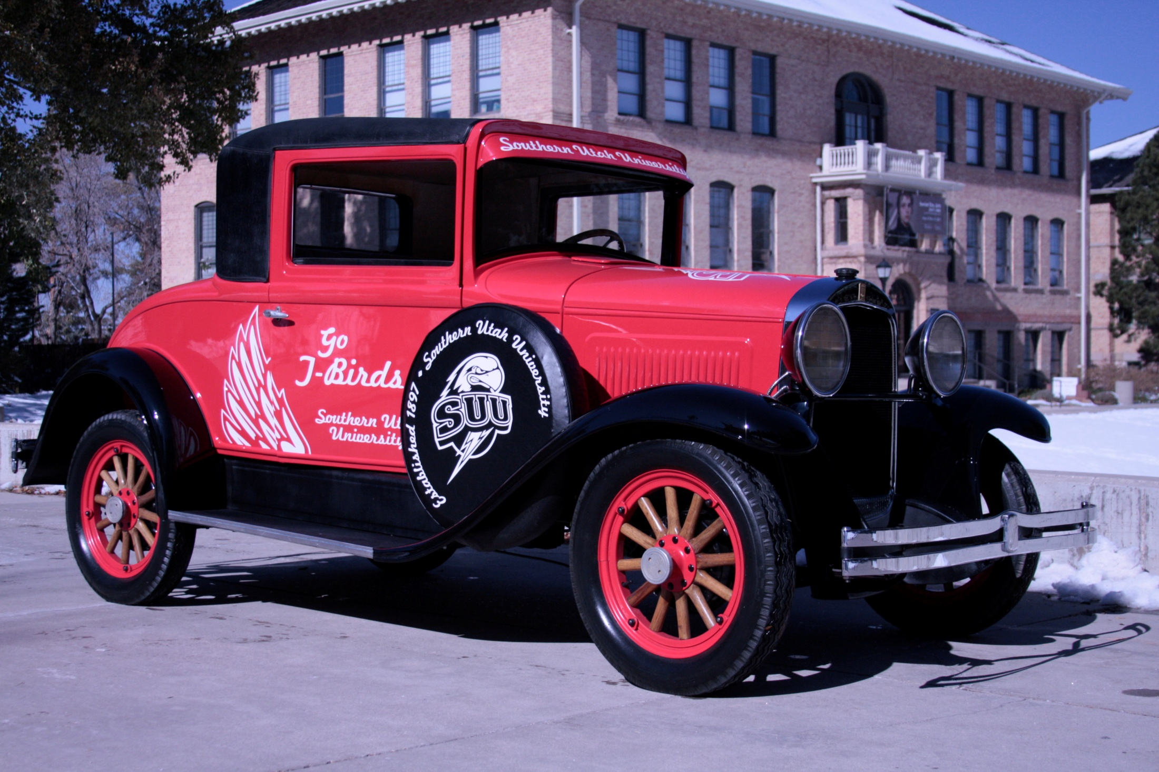
21

Slide 43
22

Slide 44
23
Pete Heilgeist 10/14/2011 1:33 PM > Stuart - > Any chance some one from your shop can contact Roice Nelson, the > "Donator" of the Whippet. We'd like to see if we can get him to come > to campus and see what we've done with his car. > Thanks, > Pete
Lori Blackner 10/31/2011 12:21 PM > Roice was in the class of 1915. He is deceased. I was not able to get > any other information from our banner records. I wish someone knew > his family so we could contact them. > > Lori
Pete Heilgeist 10/31/2011 1:32 PM > Hi Lori - I've attached the "gift" letter from Roice to Jack Jenks > that was done back in 2003. He signed his name H. Roice Nelson so > maybe we're dealing with a relative (or he just aged extremely well). > Thanks for your help - > pete
Lori Blackner 10/31/2011 1:42 PM > Pete, > > That does make a difference. I know H. Roice and Andrea Nelson. > Andrea and I went to school together. She is a Shirts. They live in > Texas, but they do come out to Utah usually once a year. I called and > left word for them to get us an e-mail address so we could send some > pictures of the restored car. I will follow through and find out when > they will be in town. Could you send me some photos of the car > electronically? > > Lori
Roots
From: "Pete Heilgeist" <heilgeist@suu.edu> Date: Fri, 11 Nov 2011 10:16:58 -0700 To: "Lori Blackner" Blackner@suu.edu
Subject: Re: The Willys Whippet
>
> Hi Lori - the guys had to wait for a nicer day to get some good pics > - here's three that I believe came out pretty well. Hope the Donors > are as impressed as I am. Certainly we'd love to get them in the > vehicle when they come to town. > > I'm going to get a couple of prints, probably 11 x 14's, of the Pic > #394 and have them framed professionally. We're going to hang > one up in our office, maybe give one to the president; should I get
> one done for the donors as well? > > Thanks again, > pete

Slide 45
24
Roice Nelson <rnelson@walden3d.com> 5/21/2012 5:25 PM > Dear Lori, > > Our plans for this summer are pretty much set now and I have some > requests: > > June 27th-29th is The 3rd Annual Nelson Grandkids Summer Science > Camp, and, based on previous correspondence, I was wondering > whether we could take the 5 grandkids who are over 8 and will be with > us in Cedar or a brief ride in the Willys Whippet on Friday the 29th?
>
> Best Regards, > > Roice
> Dear Roice and Andrea, > > I checked on the Willey's Whippet car and the person that is in charge > of it is Casey Bowns. He said they will be pulling it out of storage > in about three weeks and it will be ready when you are visiting. You > may want to work directly with him to set up the times and dates for > the reunion rides. He will make sure there is a driver and the car > available. He can be reached at 435-586-7792. It all sounds like lots > of fun. Let me know if there is more I can do. > > Thanks, > Lori
> Lori Ann Blackner > Director of Development Institutional Advancement > Southern Utah University, 351 W University Blvd > Cedar City, UT 84720 Office 435-865-8436 > Fax 435-865-8391 Cell 435-590-0794 blackner@suu.edu
Request

Slide 46
Notes

Slide 47
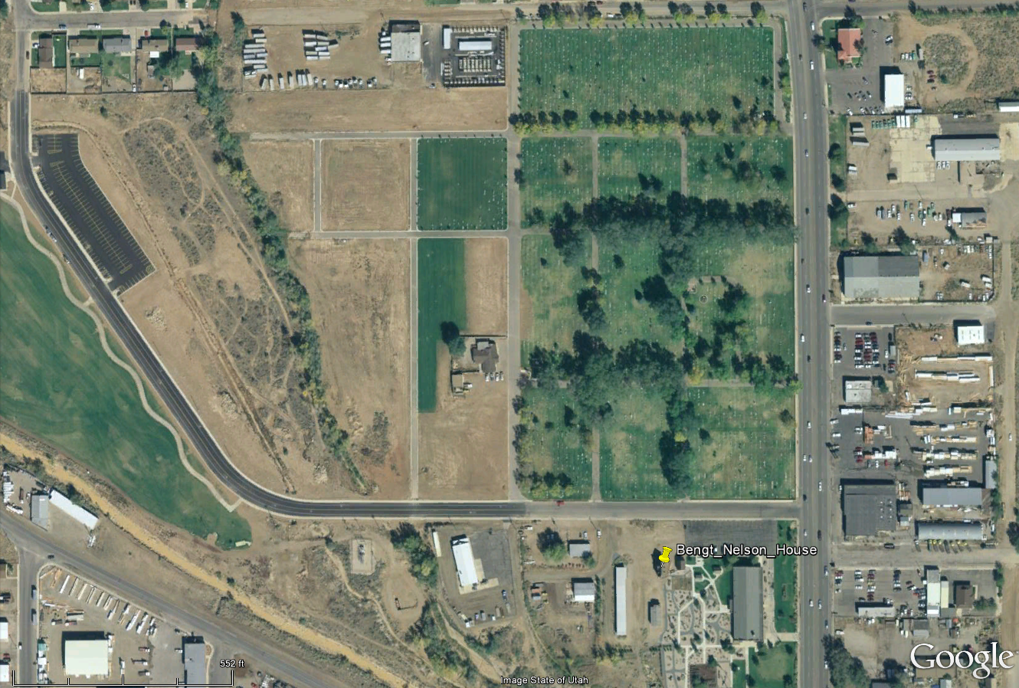
Cedar Cemetery & Bengt Nelson House

Slide 48
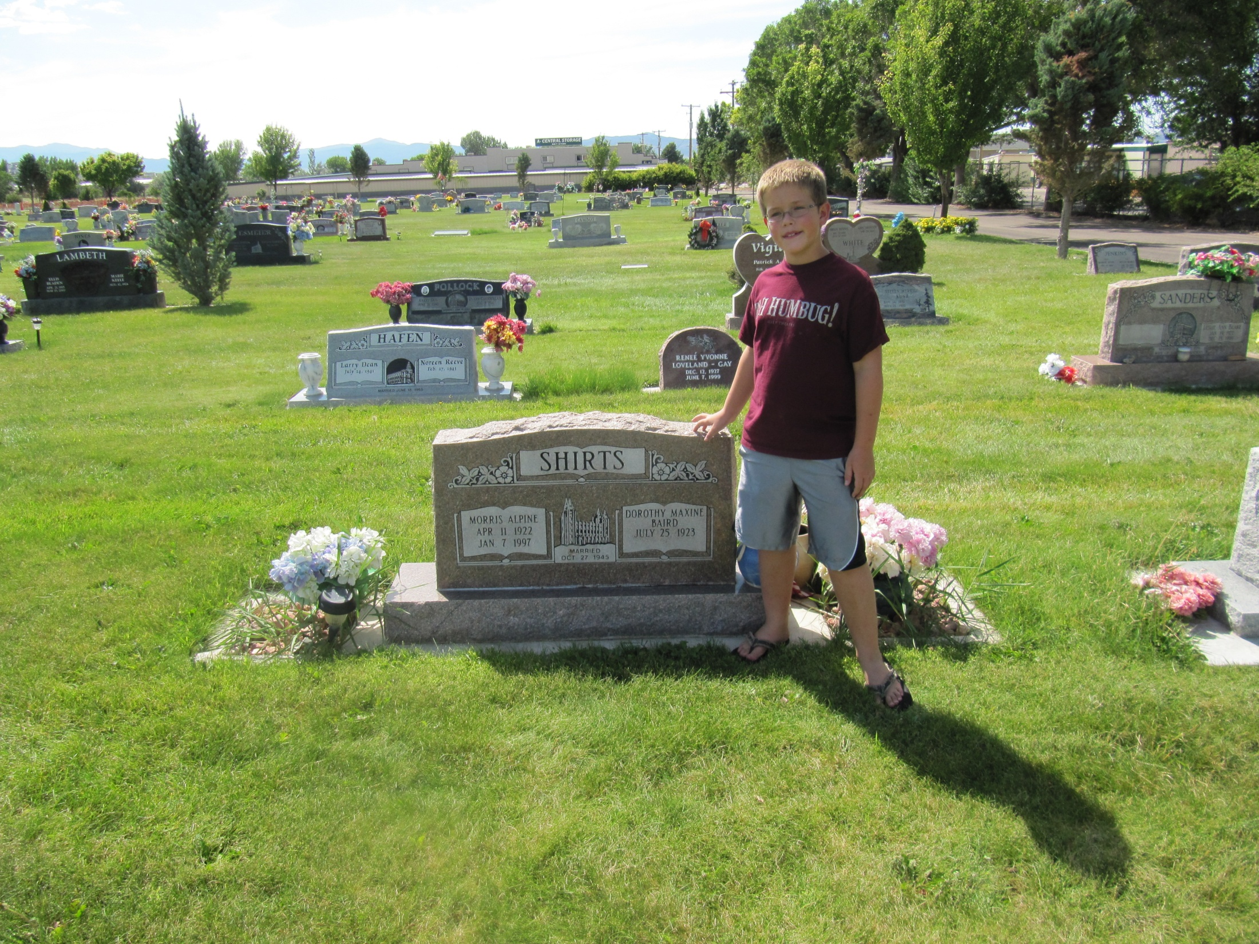
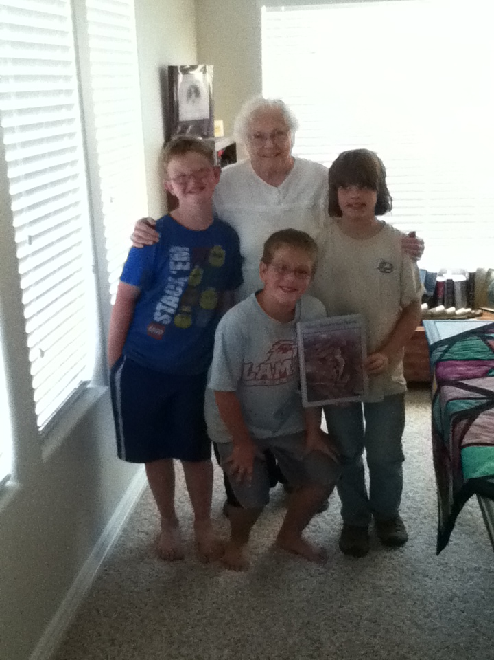
Grandma’s Dad & Mom

Slide 49
Notes

Slide 50
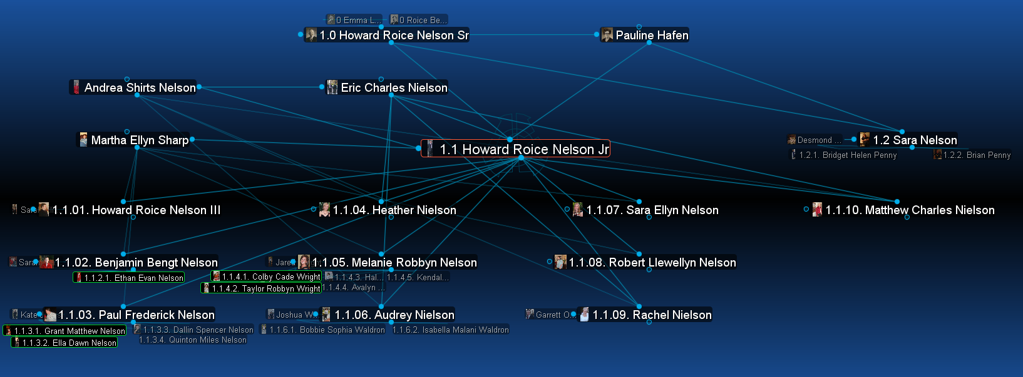
Grandpa Nelson’s Family

Slide 51
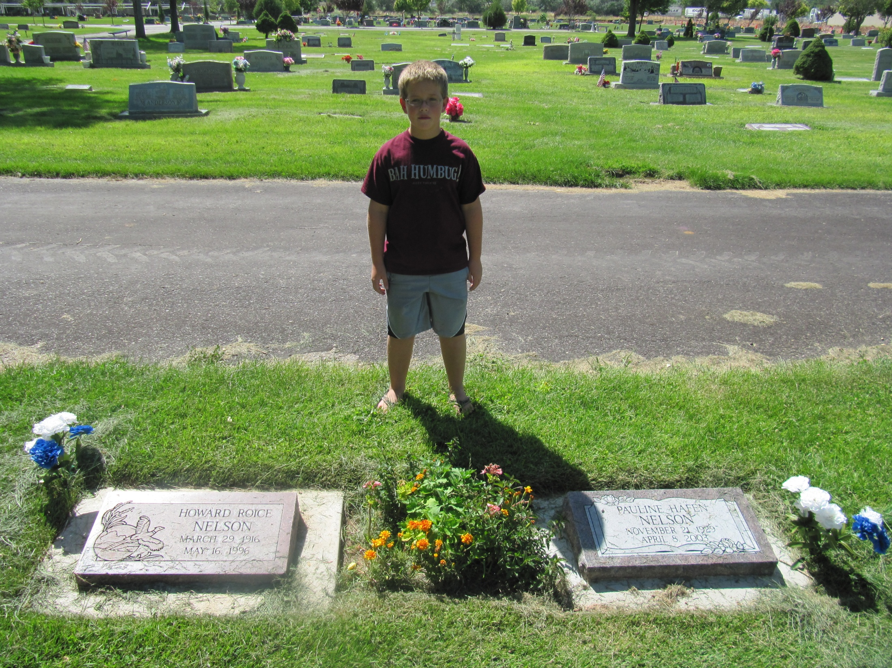
Grandpa’s Dad & Mom

Slide 52
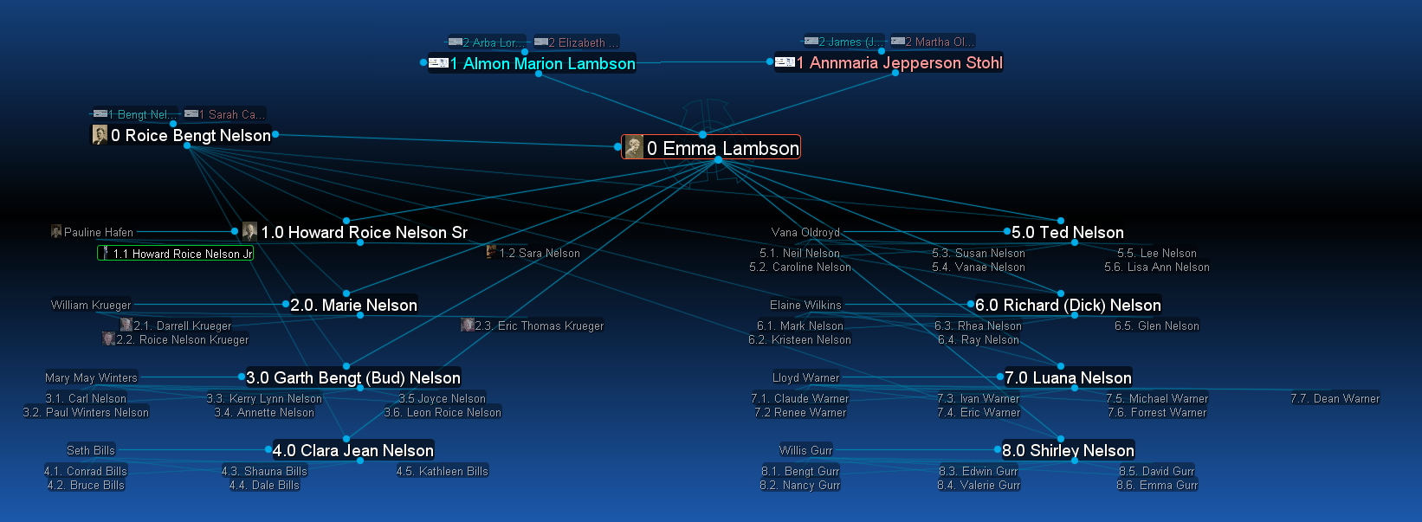
Emma Lambson’s Family

Slide 53
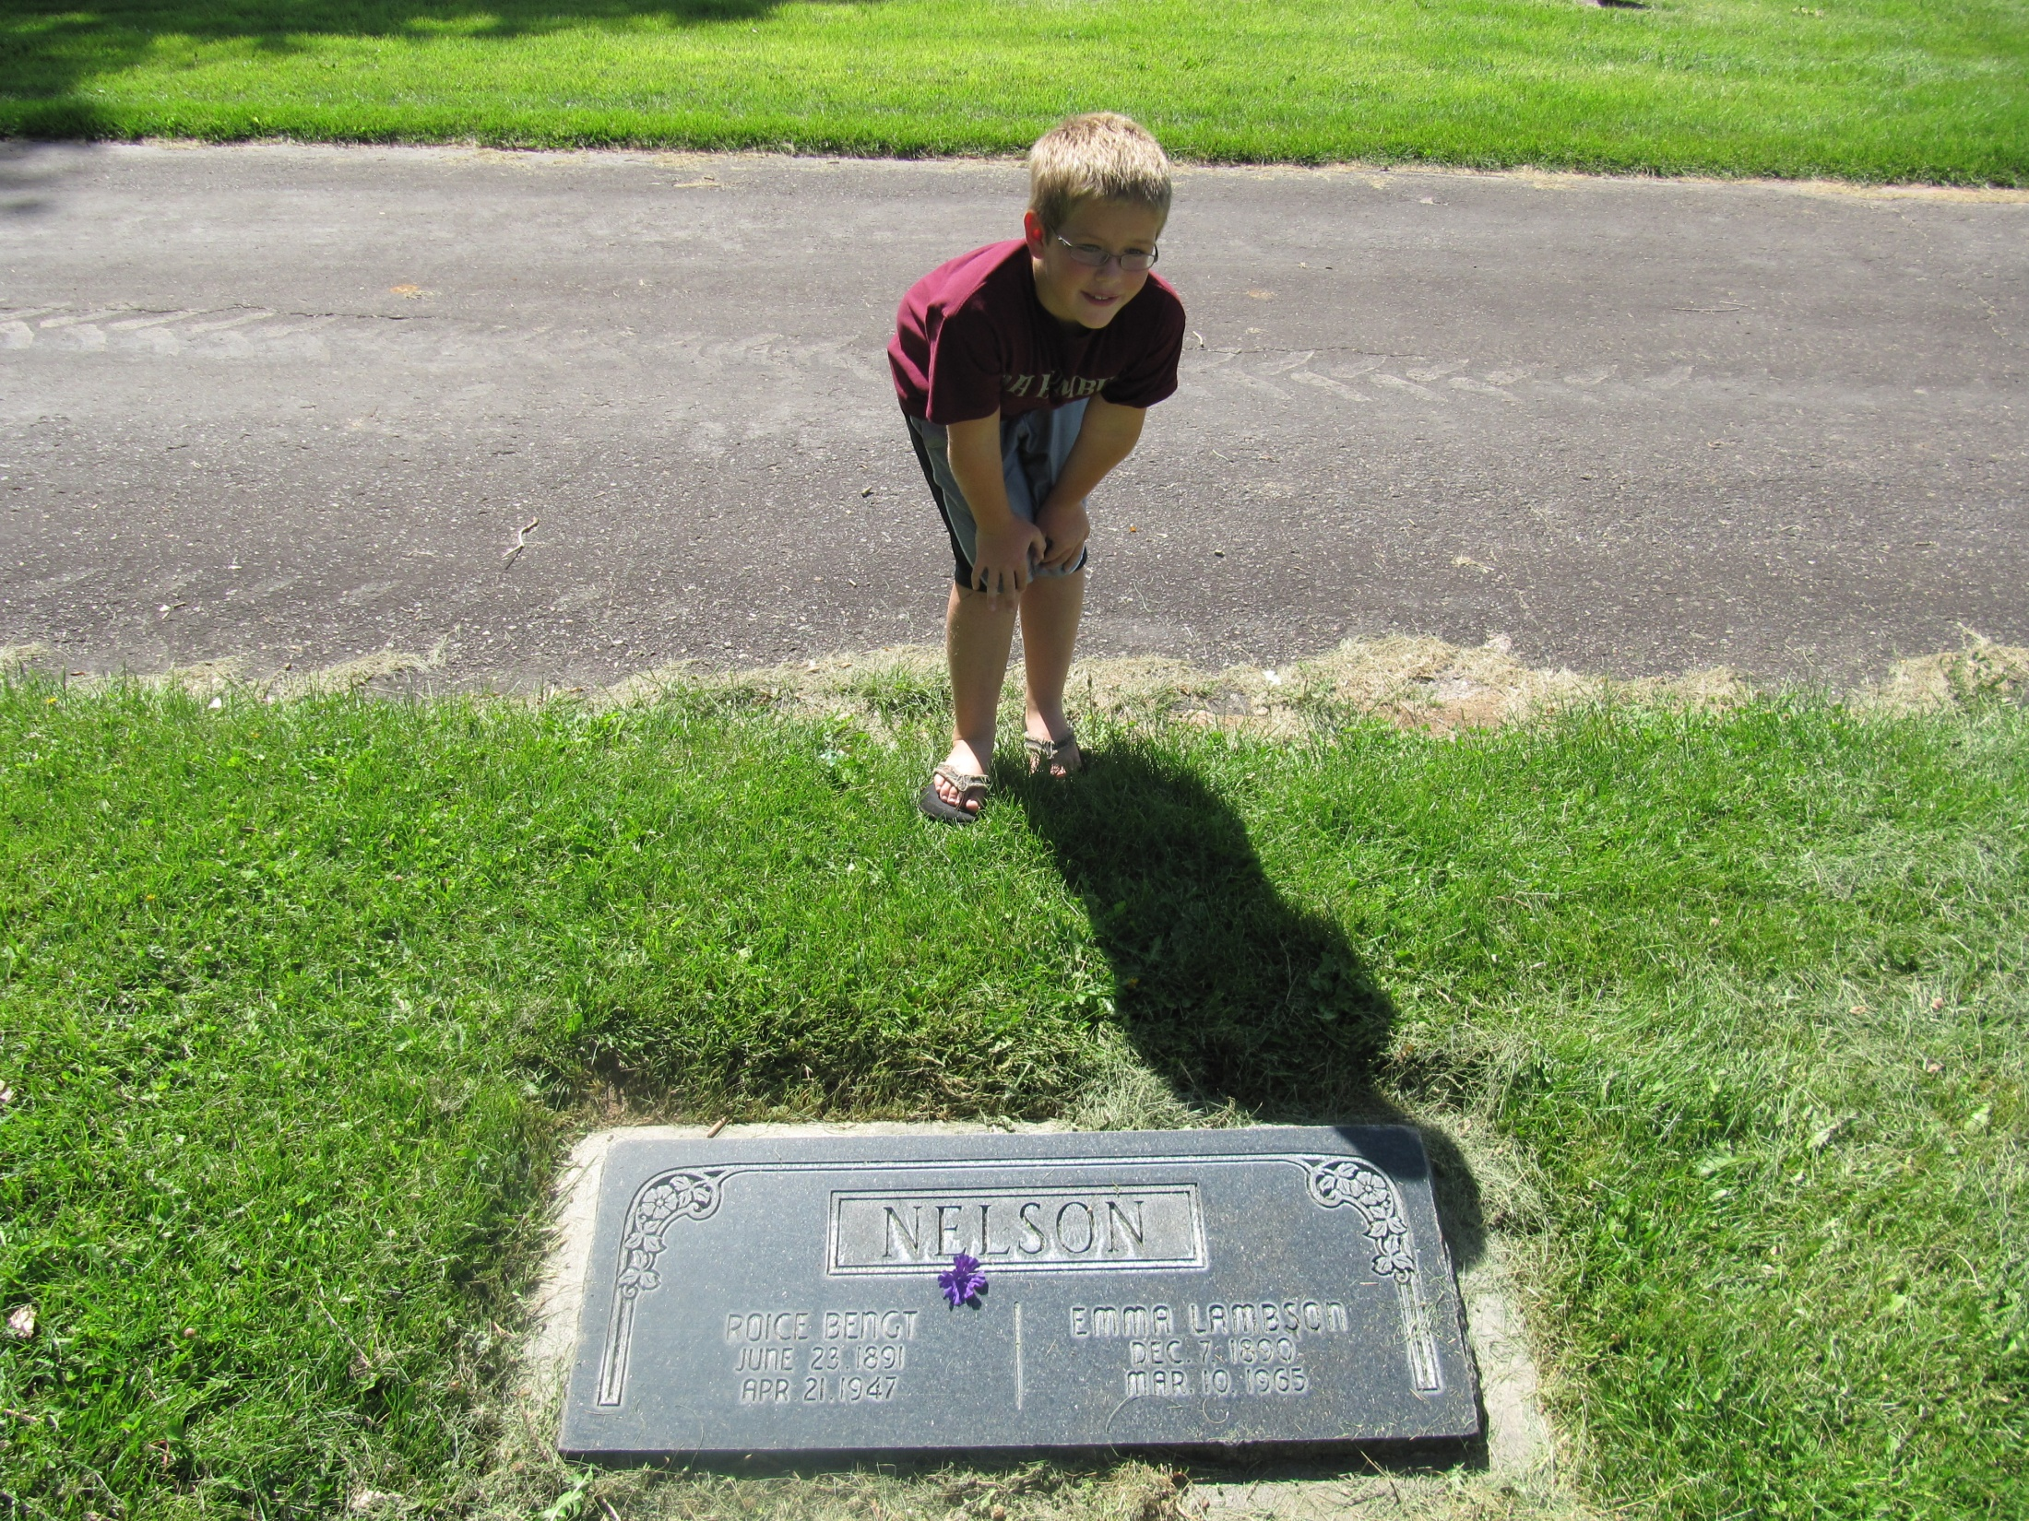
Grandpa’s Grandpa & Grandma Nelson

Slide 54
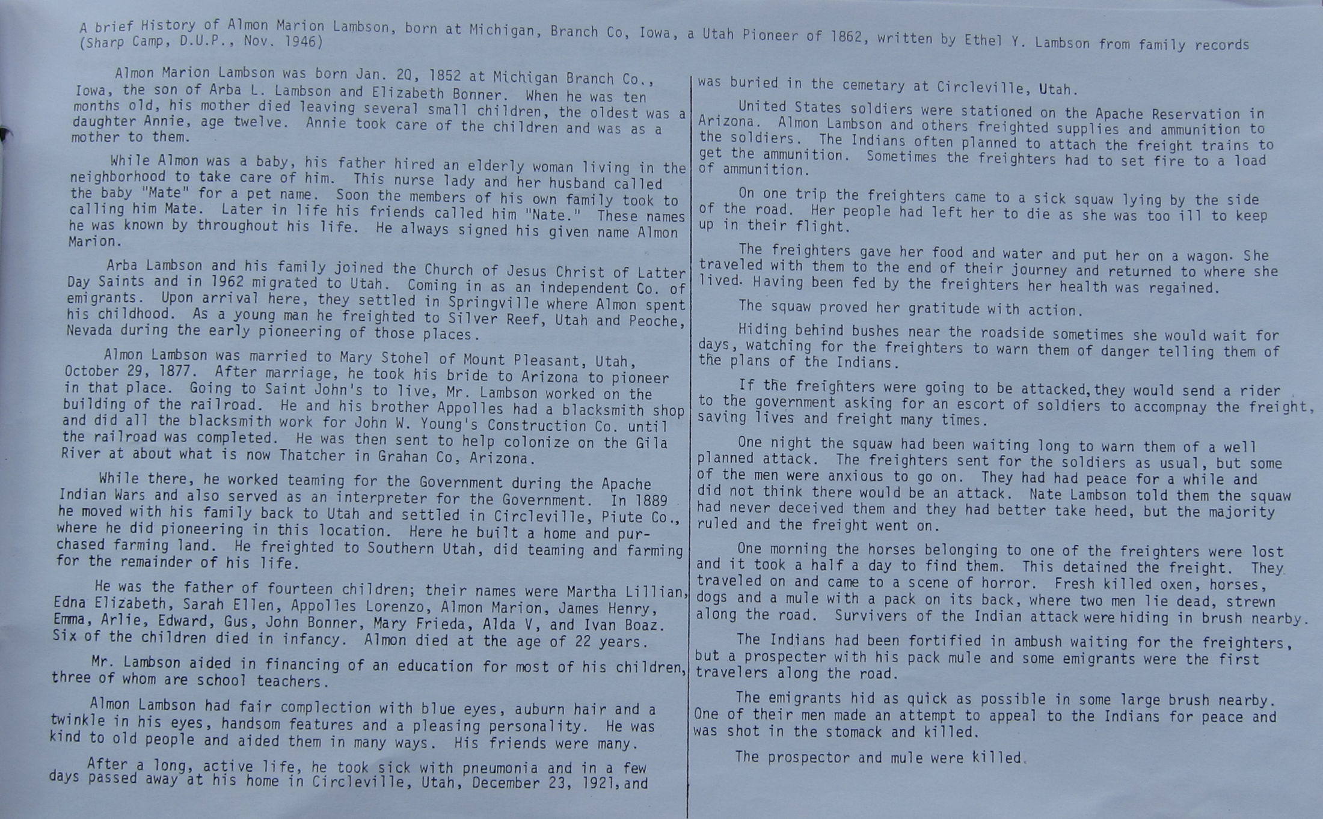
Emma Lambson’s Dad

Slide 55
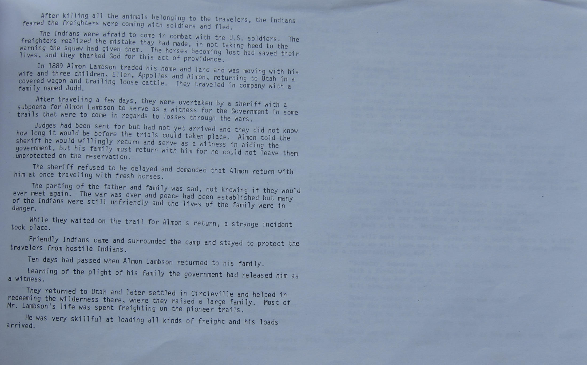
Emma Lambson’s Dad page 2

Slide 56
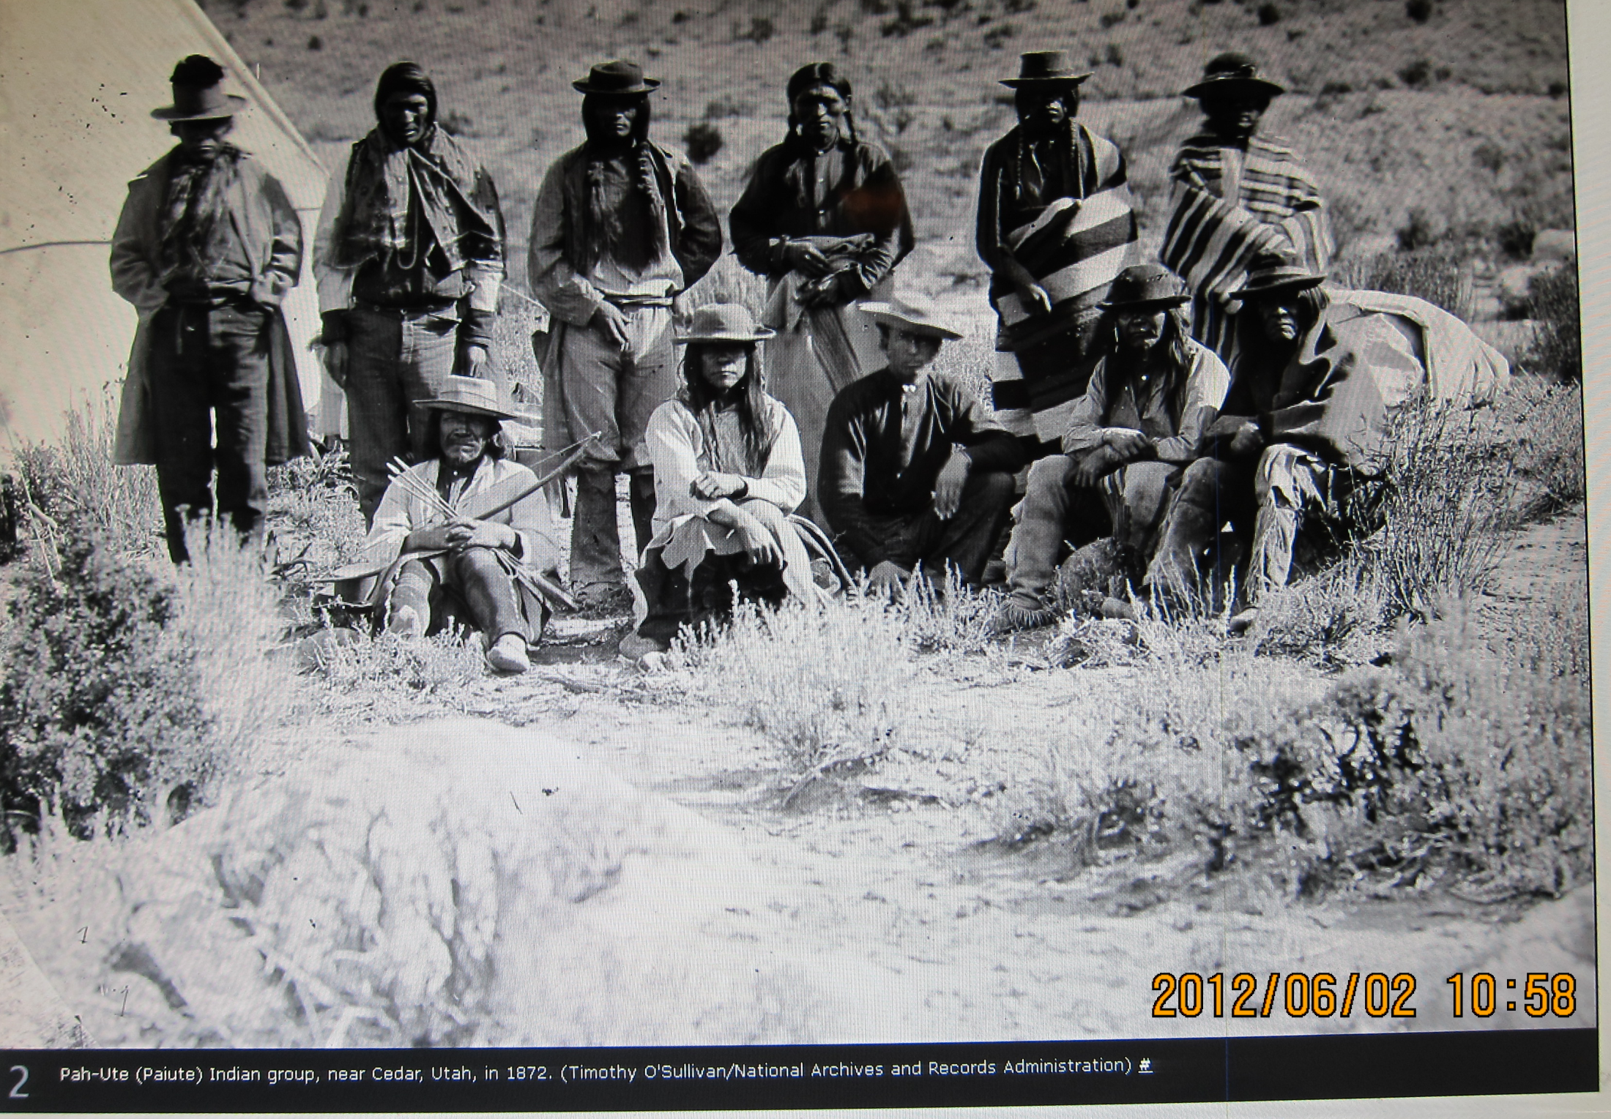
Paiute Indians Cedar City 1872

Slide 57
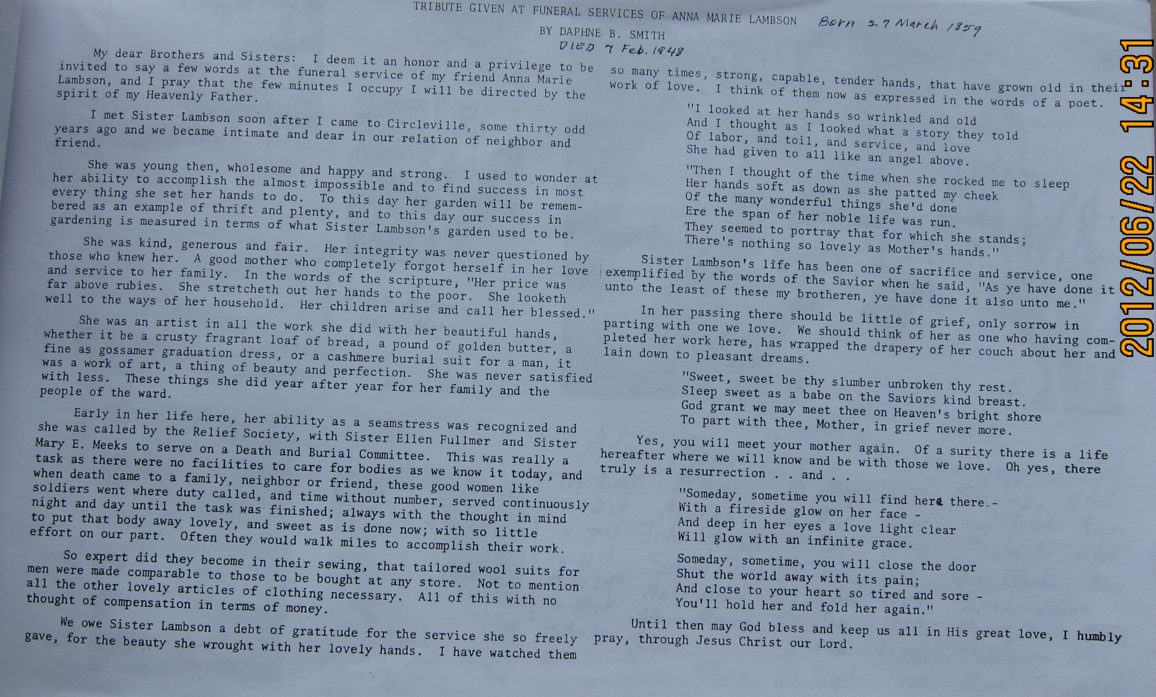
Emma Lambson’s Mom

Slide 58
Emma Lambson Nelson Ancestors

Slide 59
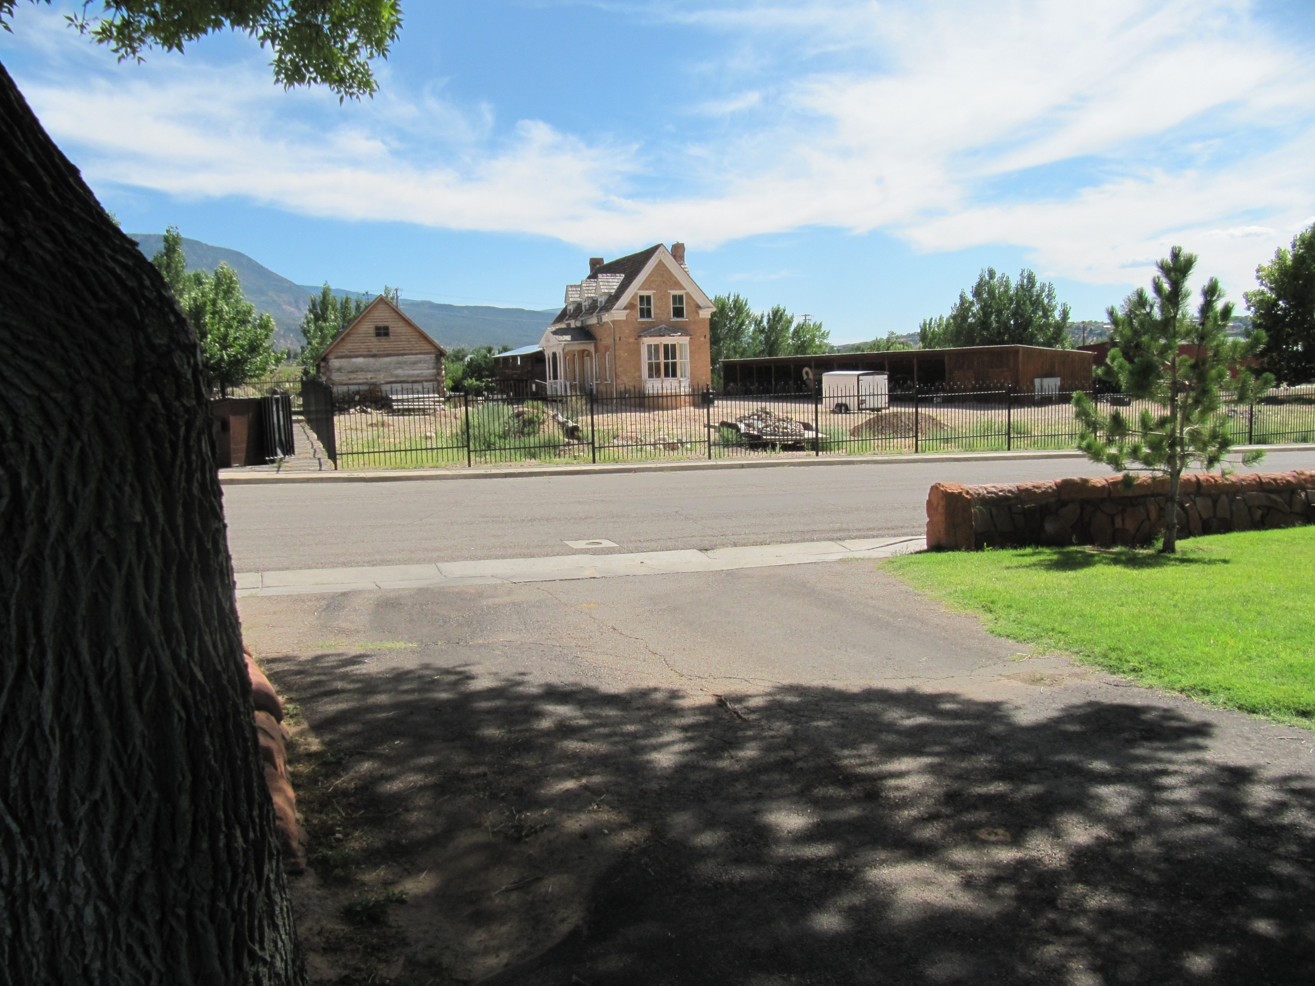
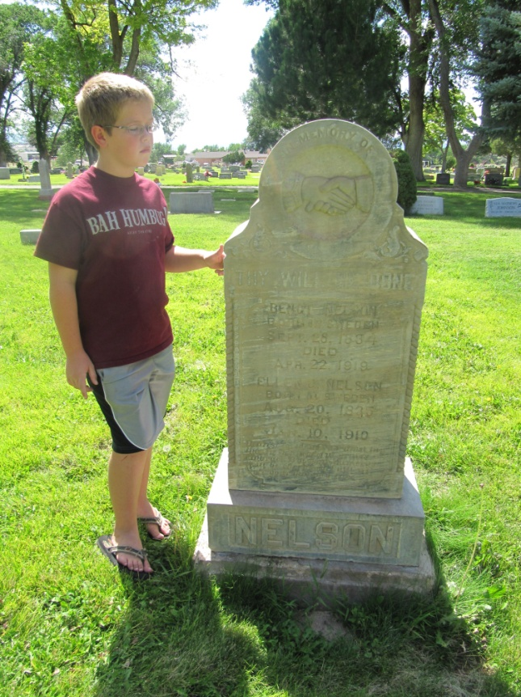
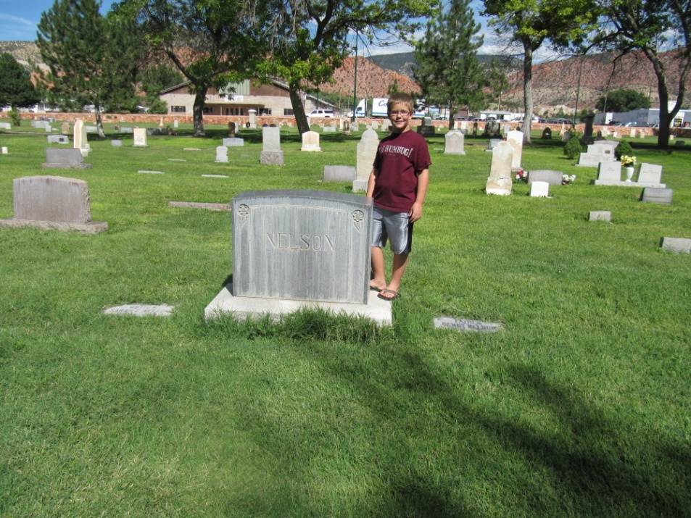
Bengt Nelson & Hunter House he built for his son Bengt, Jr. & Sarah Catherine Hunter

Slide 60
Notes

Slide 61
2012 Science Camp
What was best about 2012 Science Camp?
__________________________________
__________________________________
__________________________________
What would be your ideal 2013 Science Camp?
__________________________________
__________________________________
__________________________________

